Slide 1
Supporting sustainability in the tertiary education sector

Slide 2
The Environmental Association for Universities and Colleges (EAUC) is a not-for-profit charity with a membership of over 200 universities and colleges, supporting sustainability within the UK tertiary education sector.

Slide 3
How we can support you
A network of over 6,000 peers
One cohesive voice – stronger presence
Representation via consultations, policy and lobbying
Regular and relevant sector news brought directly to you
Networking - Communities of Practice, regional/branch groups and online networks
CPD - Annual Conference, face to face and online events (webinars)
Resources! Sustainability Exchange

Slide 4
Tools from the EAUC
The EAUC provides the training and knowledge your staff require to embed sustainability within your institution. The EAUC is the only organisation that provides specific support, tools and training that is aimed at staff within tertiary education related to sustainability:
We work closely with accreditation bodies such as CIWM and IEMA to provide sector-specific accredited courses for professionals.
We provide a sustainability elearning module which is free to EAUC members. The free elearning module is a 20 minute 'introduction to sustainability' and is only available to EAUC members. It is generic to cover all universities and colleges within the UK.

Slide 5
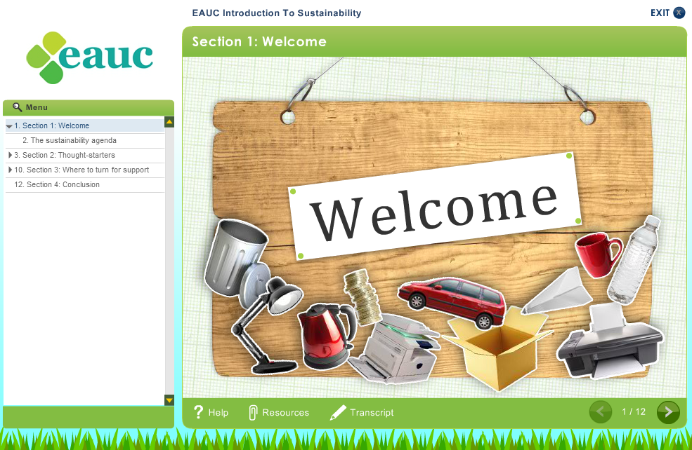
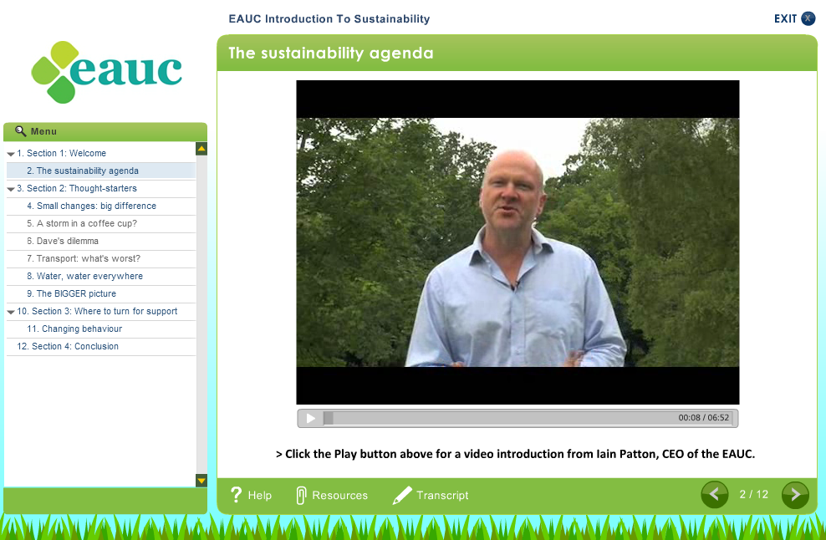
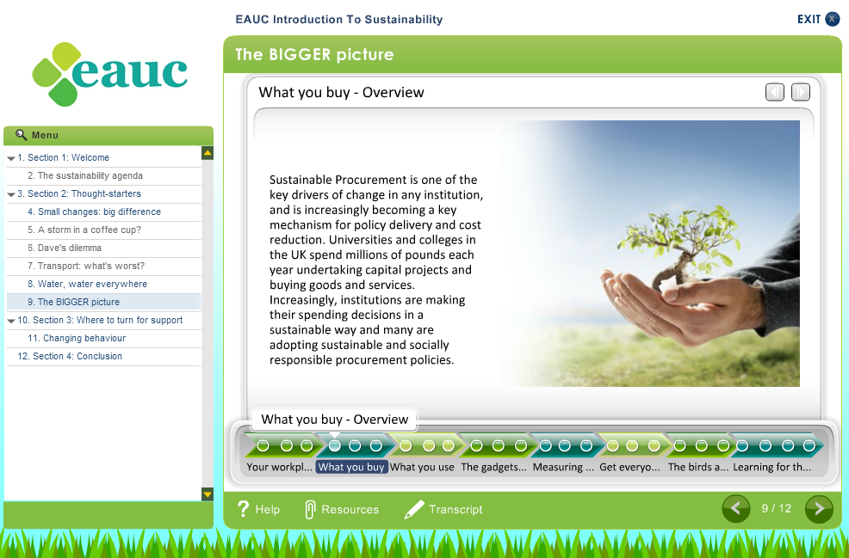
Sustainability e-learning module
Free to EAUC Members – worth up to £7,500

Slide 6
How our Tools Help You
By ensuring your staff and students have the skills, knowledge and tools they need to engage with sustainability issues, your institution will:
Reduce costs
Save
Engage staff and students

Slide 7
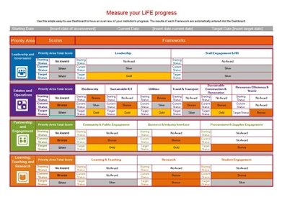
What is LiFE?
Let’s talk about LiFE
      LiFE is a planning and self-assessment tool specifically for colleges and universities to improve social responsibility and environmental performance through a whole institution approach.

Slide 8


Self-Assessment
At the centre of LiFE is
the planning and
self-assessment tool
This guides you through the Priority Areas, Frameworks and Activity Areas to measure your progress in every aspect of your environmental and social responsibility activities.
Notes:
The tool is challenging but we’ve worked hard to ensure it’s intuitive, easy to access and user-friendly with automatically generated tables and dashboards. Based entirely in excel, download the tool, read the guidance and you’re ready to go.

Slide 9
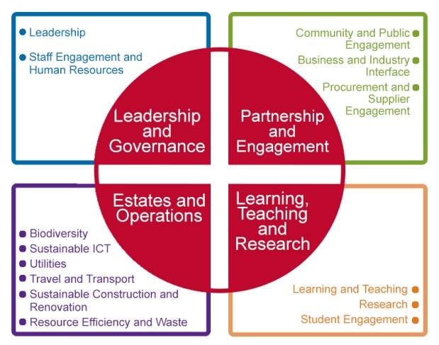
Priority Areas and Frameworks
Notes:
If you use the LiFE Self-Assessment tool in its entirety, it stimulates performance improvement across 4 Priority Areas. These have been developed to accurately reflect specific challenges that face the tertiary education sector.
Within each of these Priority Areas are 14 Frameworks that help you to review your current social responsibility and environmental activities, whilst helping to guide your future strategic planning in a simple, systematic and proactive way.

Slide 10
Activity Areas
Policy and Strategy | Action Planning | Stakeholder Engagement | Measurement
Commitments are in place to sustainability in this area of activity | Action plans are in place (SMART) and commitments made | Relevant stakeholders are involved in the activity. | Institutions are looking at measuring the impact and benefit of the activity not just the activity itself
Communication | Training and Support | Implementation | Links to the Curriculum
Activity is being communicated and there is clear support | People are being trained and supported | Embedded into the way things are done, systems and processes. Good practice examples | Links between campus, curriculum and community
Notes:
Simply work your way through the Framework(s) in the tool by adding evidence of existing activity in the 8 Activity Areas and then give yourself a score. We have provided helpful scoring guidance to ensure you are consistent and realistic.

Slide 11

Learning in Future Environments (LiFE)
Holistic tool that can be contributed to by different staff and departments across your institution.
One tool to collate all the already implemented projects and achievements and to make obvious the areas that need prioritising or improving.
Not a league table, no information or results are shared.
Accreditation will be available shortly.
Guides, videos and more help can be
      found at www.eauc.org.uk/life.

Slide 12


How we support sustainability knowledge exchange

Slide 13
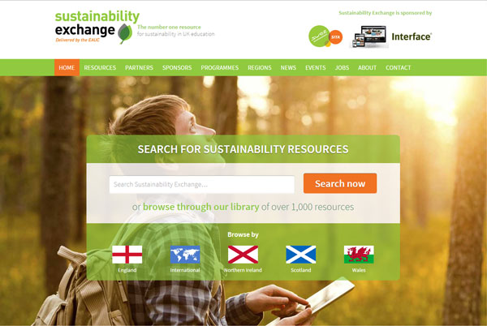
Sustainability Exchange
The UK’s first centralised information portal for the sector, sharing a wealth of information, experience and resources that are available to everyone.
www.sustainabilityexchange.ac.uk

Slide 14
Sustainability Exchange
Over 1000 active and useful resources
Resources are searchable and tagged by region, provider, resource type and LiFE Framework
320+ innovative Green Gown Award projects from 2011-2015
Free for everyone

Slide 15
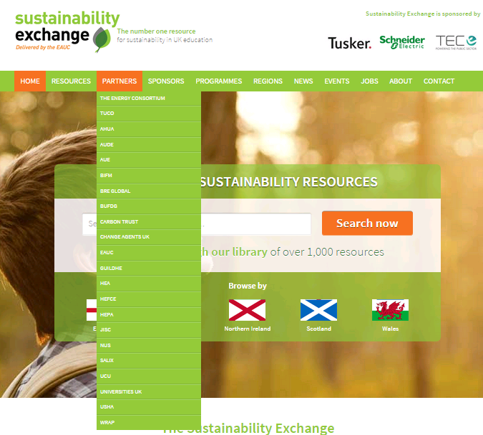
Sustainability Exchange
Partners have a key role on the Sustainability Exchange by providing specific insight and resources and disseminating good practice to the sector.

Slide 16
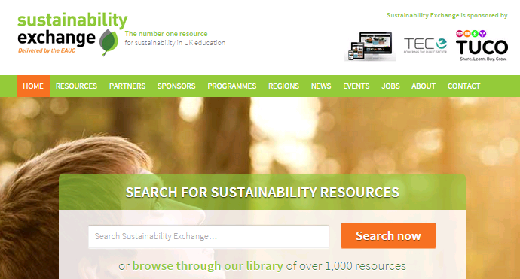
Sustainability Exchange
Notes:
Any relevant in and out of sector news, including current events being offered by the EAUC and current jobs available in the sector. EAUC Members can advertise their jobs for free both here and on the EAUC website.

Slide 17

How we support the sector’s achievements

Slide 18
Green Gown Awards
The Green Gown Awards ceremony brings together the leaders, drivers and thinkers of sustainability initiatives within the tertiary education sector.
Read about the Finalists’ in this year’s events on the Sustainability Exchange.
All dissemination of the winning and highly commended projects will be made available shortly.
Think you have what it takes? Apply for next year!

Slide 19
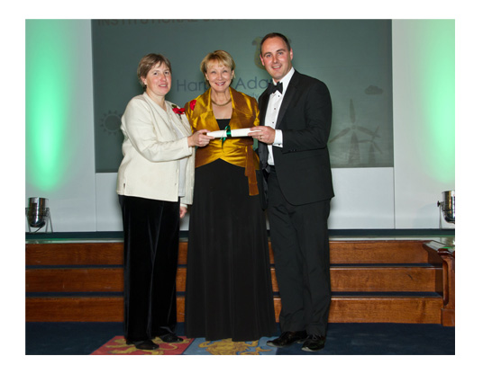
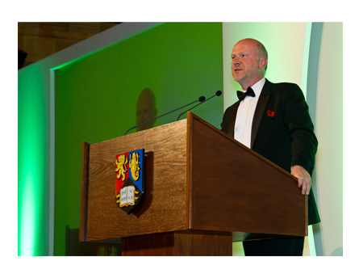


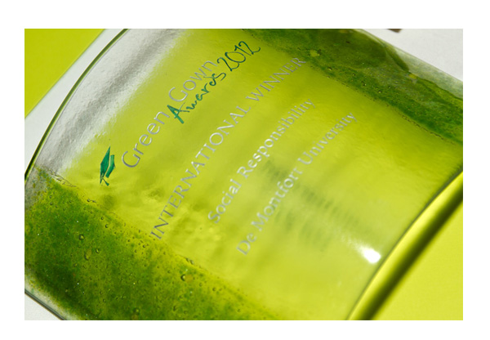
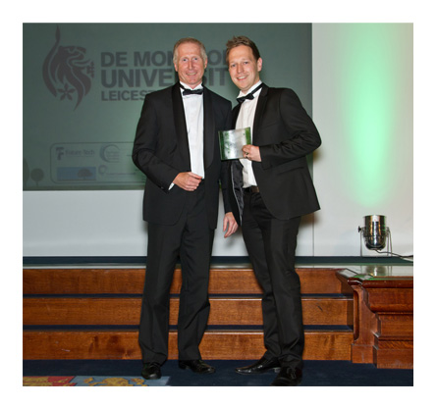




www.greengownawards.org.uk

Slide 20
Further Information
If you have any questions please contact us at:
info@eauc.org.uk
01242 71 4321

