Slide 1
Don’t forget to follow and tweet us @TheEAUC
Join in the conversation using #Influence2019

Slide 2
Nudgeathon: Influencing Behaviours Positively
Notes:
2 min

Slide 3


Nudgeathon
What is behaviour change using nudging?
What is Nudgeathon?
Nudgeathon exercise!

Slide 4
Nudgeathon
What is behaviour change using nudging?
Notes:
3 min
Many people partake in unhealthy behaviour which can be difficult to change.
Our environments have a very strong influence on us and we can end up doing things we don’t want to without knowing why
Our actions are a mix on conscious and non-conscious processes. Many behaviour change projects focus on conscious processes.
Non-Conscious processes are activated by ques in the environment. So if we change environment rather than trying to change someones mind it may change behaviour. This is called Nudging.
e.g. glass shape and size might affect how quickly and how much people drink.

Slide 5
Nudgeathon
What is behaviour change and by nudging?
What is Nudgeathon?
Notes:
4 min (slide and video)

Slide 6
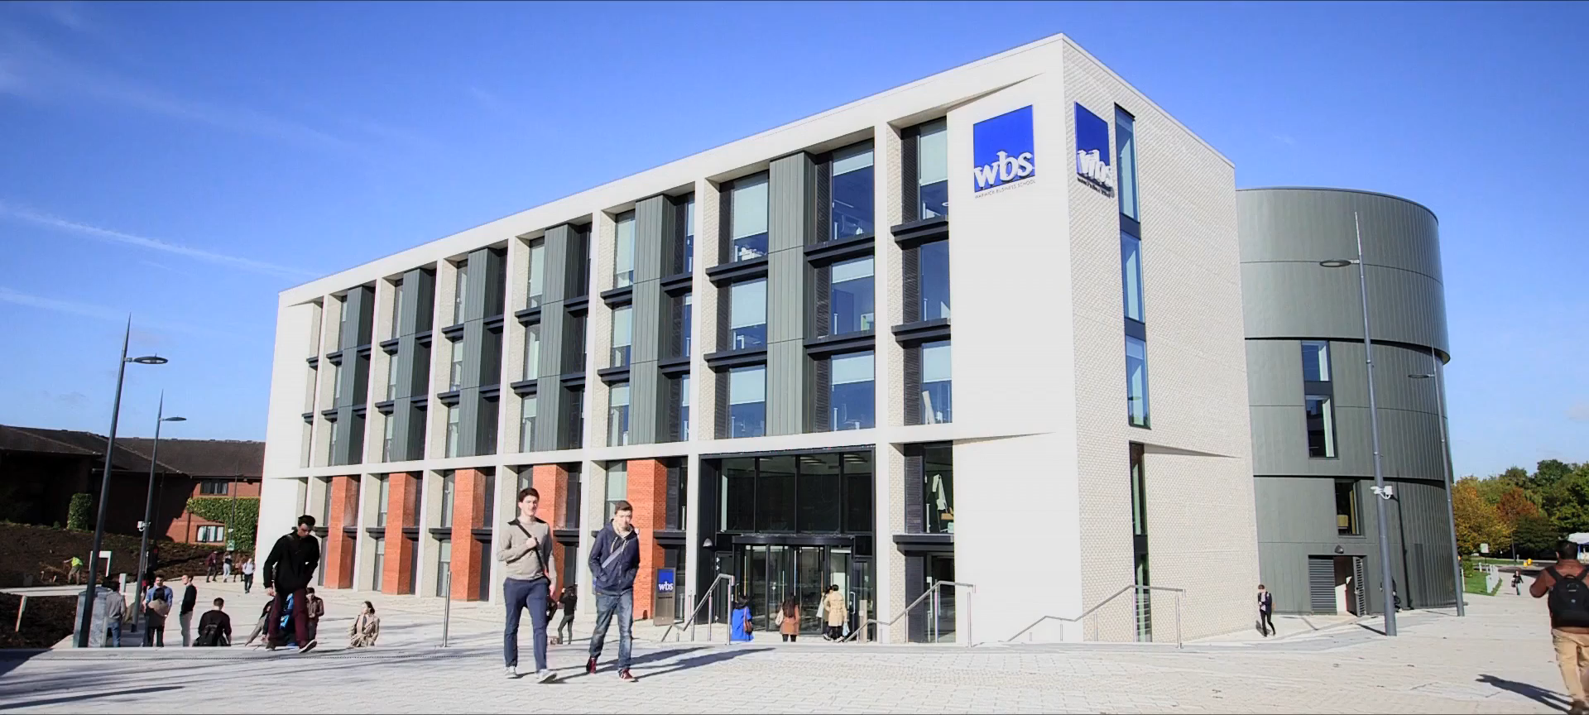

Slide 7
Nudgeathon
What is behaviour change using nudging?
What is Nudgeathon?
Nudgeathon exercise!
Notes:
2 mins (this slide and next one)

Slide 8








Seven Step Process (SSP)
Udall et al. (2019)
Define¹
Empathy²
Refine⁵
3
Pilot⁶
Ideas³
Test⁷
Show⁴
10
Days
3-365
Day 1-2
Notes:
Why I am here?
I will present an idea, founded in psychological research, which fosters citizen-led action: An innovative seven-step process (SSP). SSP can encourage sufficient action (e.g., sufficiency energy use in any sector: Homes, businesses, travel). SSP, a completely new idea, works on a small scale (Udall et al., 2019). In 1-month – 1-year, we can see sufficient action.
During SSP: (a) Company stakeholders identify and establish consensus on key challenges around reducing carbon emissions while maintaining competitive advantage; (b) Companies have the potential to solve these challenges while saving costs, and making money; (c) Companies gain understanding of how to effectively optimise energy decision making and change behaviour to be energy sufficient.
We believe SSP is an important tool to advance energy transition for companies because of its small-scale success. We work closely with stakeholders making the journey acceptable to citizens, and support energy sufficiency on individual and company levels, which can be informative/attractive for policy makers and design. SSP is in the early phases of use and we are writing a research application to do this on a larger scale. With your help, and by using SSP, we believe we will start this journey towards energy sufficiency.
Reference
Udall, A. M., Read, D., & Taj, U. (2019). Nudgeathon for Encouraging Energy Behaviour. Proceedings of the European Council for an Energy Efficient Economy Summer Study, 3-8 June 2019, Toulon/Hyeres, France, 1-12. Retrieved March 16, 2019, from: https://www.researchgate.net/publication/331653677_Nudgeathon_for_Encouraging_Energy_Behaviour

Slide 9
How can we get people to bring their own reusable mug?
Specific…
Where?
When?
What?
Write down the specific challenge
Define¹
Day 1-2
Notes:
1 minute provided to decide challenge (and share)
Keep tract of what we do and find so we can summarise what we did with key examples of the day
Needs to be SMART target

Slide 10
How can we get people to bring their own reusable mug?
Empathy²
Identify stakeholders
e.g. consumer/citizen, user, waiter.
Day 1-2
Notes:
1 minute to identify stakeholders

Slide 11



How can we get people to bring their own reusable mug?
Day 1-2
Notes:
1 min
Get each table to share the number of different roles

Slide 12
How can we get people to bring their own reusable mug?
Ideas³
Look at the card provided.
Develop a solution based on the tips on the card.
Day 1-2
Notes:
5 min

Slide 13
How can we get people to bring their own reusable mug?
Show⁴
Discuss and Share solution
(1 min elevator speech)
1 – Like
2 – Dislike
3 – Suggestion
VOTE
10
Day 1-2
Notes:
5 mins – need to alter this to make it shorter
1 – 1 member of each group share for 1 min
1.1 – each person in the room decides what they like and dislike
2 – 1 min to discuss idea
2.1 – 1 min to share feedback on like, dislike and suggest
3 – with all the knowledge personal decision = vote
Benefit of the process is that they get feedback straight away.
Record which group was 1st 2nd and 3rd

Slide 14
How can we get people to bring their own reusable mug?
Define¹
Empathy²
Refine⁵
3
Pilot⁶
Ideas³
Test⁷
Show⁴
10
Days
3-365
Day 1-2
Notes:
5 mins wrap up and Qs

Slide 15
Nudgeathon
What is behaviour change using nudging?
What is Nudgeathon?
Nudgeathon exercise!

Slide 16
Questions?
Contact
Alina: Alina.Udall@wbs.ac.uk
David: D.M.Chapman@warwick.ac.uk

Slide 17





The SDG Accord
Headline Sponsor
Don’t forget to follow and tweet us @TheEAUC
Join in the conversation using #Influence2019
End extreme poverty, inequality and climate change
www.sdgaccord.org

