Slide 1
ESD in FE Topic Support Network
Introduction to Responsible Futures
10/05/2016
Quinn Runkle
Senior Project Officer - Communities and Curriculum
Department for Sustainability, NUS
Notes:
3:15-3:45pm

Slide 2
How do we define ESD?
Education for sustainable development is the process of equipping students with the knowledge and understanding, skills and attributes needed to work and live in a way that safeguards environmental, social and economic wellbeing, both in the present and for future generations.
QAA ESD guidance 2014
Notes:
Hands-on and participatory learning
Preparing students for life beyond graduation
Looking at theory in a real-world context

Slide 3
Three spheres of work
Community
Institutions
Students’
Unions
Students leave tertiary education as part of the solution, rather than part of the problem
Notes:
Curriculum, campus, community – theme of today

Slide 4
In each of these spheres we aim to include…
Curriculum
Staff
Students
Formal
Informal
Subliminal

Slide 5
What does that mean for students?
Consider what the concept of global citizenship means in the context of their own discipline and in their future professional and personal lives
Democratic and participatory learning approaches are modelled. Teaching, learning and assessment activities are linked to real-life concerns.
Think about issues of social justice, ethics and wellbeing, and how these relate to ecological and economic factors
Develop a future-facing outlook, learning to think about the consequences of actions, and how systems and societies can be adapted to ensure sustainable futures.

Slide 6
The impact of our students
ESD allows colleges and universities to multiply the positive effect that they have on society, rather than simply limiting their negative effect

Slide 7
Skills for sustainable development
Global citizenship perspectives
Understand people’s relationship to nature
Analyse using many subjects
Plan for the long term as well as the short term
Use resources efficiently
Consider the ethical issues of your subject
Systems
thinking
Critical thinking

Slide 8
The impact of ESD in FE
5 million students across the UK
Informal and formal learning about sustainability makes for a better learner experience
FE is already well-suited to take this on:
Hands on, experiential learning
Real-life examples from instructors
Equipping students with life skills
Incredible knock-on effect in different sectors
Community connections
Notes:
Positive outcomes for learners
Quality teaching, learning and assessment
Effective leadership and management

Slide 9
To what extent to you agree/disagree?
My course helps students to develop ESD skills (critical thinking, systems thinking, communications, interdisciplinarity, etc.)
My course promotes students’ understanding of social justice, ethics and wellbeing, and how these relate to ecological and economic factors
Students have a say in what and how they learn on their course
I have a say in how my course run and if I wanted to change it (e.g. to include more sustainability content/skills), I would be able to do so easily

Slide 10
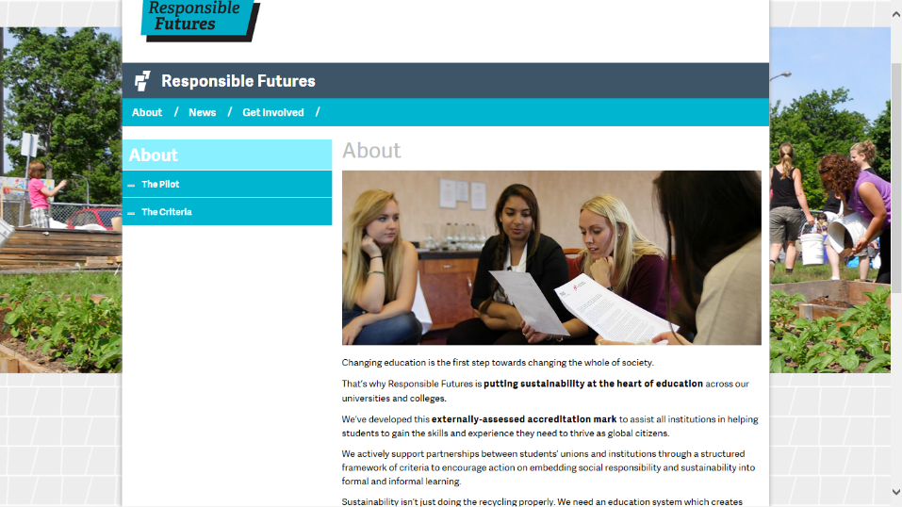

Slide 11
Responsible Futures…
Is an accreditation mark and supported change programme for a whole-institution approach to environmental sustainability and social responsibility. It spans the formal and informal curriculum and is applicable to both further and higher education.
Developed and piloted in 2014-15 by 13 institutions, 8 HE and 5 FE across England and Scotland (incl. Dumfries and Galloway College, South Lanarkshire College, and SRUC).

Slide 12
Process
Workbook of criteria outlining best practice, must reach score threshold
Supported cohort approach, regular contact, online resource bank
Student-led audit and programme review
Continuous improvement, student-driven change

Slide 13
Criteria themes
Baselining and benchmarking understanding
Working in partnership with the students’ union/association
Engaging senior management and developing organisational strategy
Creating meaningful policy and embedding ESD within existing academic and sustainability policies
Implementing specific interventions within the formal and informal curriculum
Measuring and articulating impacts and outcomes
Celebrating success

Slide 14
Accreditation
To achieve the accreditation mark, the Partnership must meet or exceed the score threshold of 200 points, out of the maximum 300 points, not including the four self-defined criteria.
Partnerships must complete the mandatory criteria to gain accreditation.
45 criteria in total: 10 are mandatory, 35 are optional, and of which 3 you can write yourself (self-defining criteria).

Slide 15
Impacts
Over 400 actions taken by the 2014/15 cohort, including:
Conducting student surveys;
Completing a curriculum audit/review;
Including ESD in the institution’s learning and teaching strategy;
Developing professional development opportunities for staff;
Gaining support of senior management, trustees, and/or governors;
Offering interdisciplinary experiences related to sustainability.
Currently, 6 institutions working through the programme, incl. Dundee and Angus College.
Notes:
400 actions completed by the 13 partnerships:
Conducted a survey of students;
Created a coordinating group;
Developed a SMART action plan with senior-level support;
Gained the support of high-level champions within both the students’ union and the university/college;
Included education for sustainable development within the institution’s learning and teaching strategy;
Developed professional development opportunities for relevant personnel on the issues covered by Responsible Futures;
Held an internal event bringing together staff and students;
Made use of student coursework;
Developed informal curriculum activities.
Other impacts delivered by the pilot cohort include:
10 completed a curriculum audit/review;
11 engaged with their trustees and/or governors to gain high-level support;
8 embedded sustainability within their institutions’ learner attributes;
9 students’ unions passed formal policy;
8 institutions created ‘living laboratories’;
9 institutions offer interdisciplinary experiences relating to sustainability through the formal curriculum.

Slide 16
Taking part in Responsible Futures
If you’re interested in joining the 2016 cohort of Responsible Futures, we have two sponsored places for your first year remaining for colleges in Scotland provided by EAUC Scotland.

Slide 17
What do you need?
What are the greatest successes you’ve had related to ESD? How did these occur?
What are your greatest challenges relating to ESD? What barriers are in place?

Slide 18
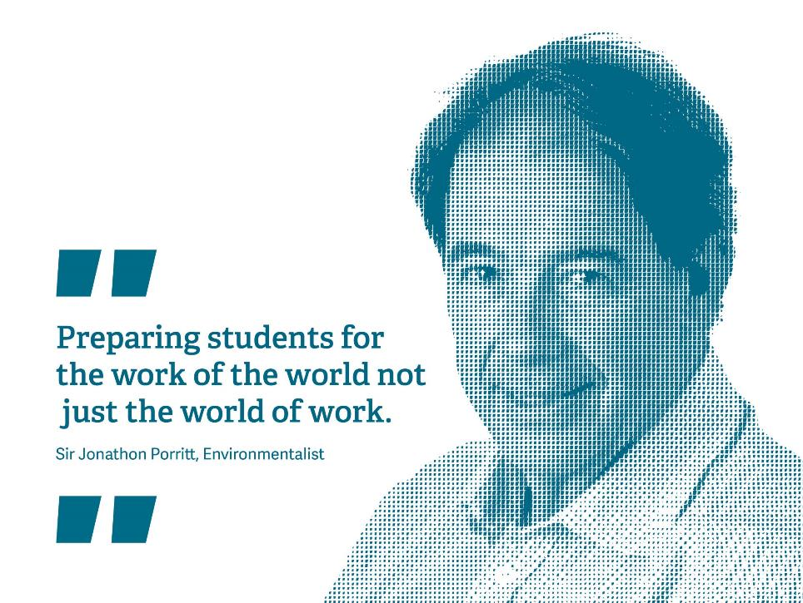

Slide 19
Thank you!
Quinn Runkle
quinn.runkle@nus.org.uk

