Slide 1


ACHIEVING HIGH PERFORMANCE BUILDINGS IN FURTHER AND HIGHER EDUCATION
- AND HOW BREEAM CAN HELP
Peter James
Higher Education Environmental
Performance Improvement ( HEEPI)
www.heepi.org.uk

Slide 2

THE HEEPI PROJECT
Founded 2000 – primarily HEFCE funded
Steered by key sectoral organisations
Founded Green Gown Awards
Now more specialised:
High performance buildings
Sustainable ICT – www.susteit.org.uk
Sustainable Labs – www.labs21.org.uk
Benchmarking
- buildings, transport surveys

Slide 3
HIGH PERFORMANCE BUILDINGS
Deliver highly productive work conditions
Safeguard health and well being
High levels of space utilisation
Very low energy use and carbon emissions
Low water consumption systems
Effective use of scarce resources
Avoid ‘low performance’

Slide 4
LAB PERFORMANCE
- 2006 prices, hypothetical 7000m²
Type | Medical/ Bio | Chemical | Physical/ Engineering
Best | £163,802 | £151,159 | £58,229
Good | £234,671 | Na | £97,626
Typical | £326,766 | £292,062 | £140,729

Slide 5









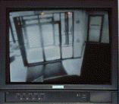


AVE MARIA UNIVERSITY
Fire Alarm
System
Campus
Security
Power System
Elevator
Mgmt.
Intrusion
Detection
Lighting
Controls
Access Control
(security system)
Building
Maintenance Users
Security
Users
HVAC
Control
Evacuation
Management

Slide 6
HIGH PERFORMANCE BUILDINGS
“minimal increases in upfront costs of about 2% to support green design would, on average, result in life cycle savings of 20% of total construction costs - more than ten times the initial investment”
- The Costs and Financial Benefits of Green Buildings, A Report to California’s Sustainable Building Task Force

Slide 7
LINK TO THE MAINSTREAM
Efficiency and effectiveness
- capital £1; operating £20
- salaries £100-200
Cost transparency
Space management
Well being
Student experience

Slide 8
THE CARBON TRUST’S VIEW
Environmental Criterion
Thermal mass
Daylighting
Building orientation
Facade performance
Area type grouping
Solar HWS
Ground Source Heat pump
Controls
CHP/Biomass
Rainwater harvesting
CHP/Fuel cell
Biomass
Wind
Photovoltaics
Wow Factor
Integrated Design
Bolt On
Cost

Slide 9
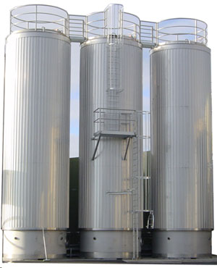
PROBLEM – THE SILOS

Slide 10

PROBLEM – DISCONNECTED BUDGETS

Slide 11

PROBLEM – RULE OF THUMB

Slide 12

PROBLEM – I WANT IT NOW

Slide 13
DESIGN INTEGRATION
Most lifetime cost - and energy consumption – is determined by design
‘Win win’ is highest in early days
A well managed ‘charette’ process creating intense dialogue and challenge between key stakeholders
Empowering ngineers and facilities staff
Understand the real costs of decisions
Commissioning and evaluation
-

Slide 14
A G(REEN)-LEAN PHILOSOPHY
Understanding the system
Right sizing
Smooth load following
Effective control and feedback
Flexibility
Review - commissioning & evaluation
Empowering ‘shopfloor staff’
Understand the real costs of decisions

Slide 15
RIGHT SIZING
Provisioning as required
Avoiding design to unlikely/avoidable peak conditions
Taking full account of diversity
Grouping of high energy loads
Sharing facilities or services

Slide 16
BREEAM FOR HE
BRE Environmental Assessment Method
- Credits for environmental positives
- Outstanding, Excellent, Very Good, Good, Pass
- Bespoke versus ‘Standard Schemes’
Weaknesses
- trade-offs within and between categories
- unchallenging
- not attuned to HE
Relaunched in 2008
- A 2007 ‘Excellent’ = 2009 ‘Good’

Slide 17
INTERNATIONAL STANDARD
DNGB
BREEAM
LEED
Europe (retail)
UK
Netherlands

Slide 18
BREEAM FOR HE - CHANGES
Reflect HE peculiarities
- Campus geography & integration
- Multi-use buildings
- Planning constraints
- Refurbishment
- Specialised buildings
Filtered credits (20%)
- especially for laboratories

Slide 19
BREEAM FOR HE - TIMETABLE
April – AUDE conference workshops
May – Steering group sign off
June – Assessor training
June/July – Launch
Dec 2010 (approx) – Review
??? – Mandatory, as in Scotland and Wales

Slide 20
BREEAM FOR HE - ADVANTAGES
Reflects HE circumstances
Lower costs – no more bespoke
Greater certainty from the start
Easier comparability and sharing
But … less tailoring
And it remains proprietary

Slide 21
CONTINUOUS IMPROVEMENT
SHARING EXPERIENCE
-User group
-User evaluation
BUILDING CAPACITY
-HE specific training
-Sector assessors
-Referral service?
BREEAM
HIGHER
EDUCATION
DRIVING IMPROVEMENT
-Innovation credits
-Benchmarking
-Linking with DECS
EFFECTIVE IMPLEMENTATION
-Post occupancy evaluation
-BREEAM in Use

Slide 22
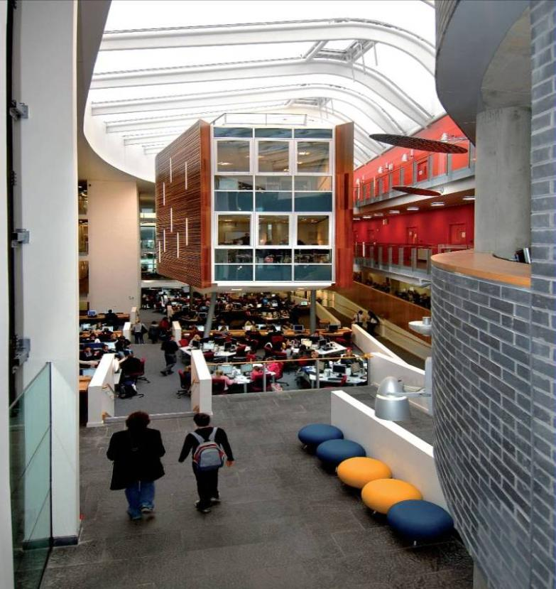
QUEEN MARGARET UNIVERSITY
Wanted greenest building in UK
PCs main barrier
98% thin client
25-30% space savings

