Slide 1
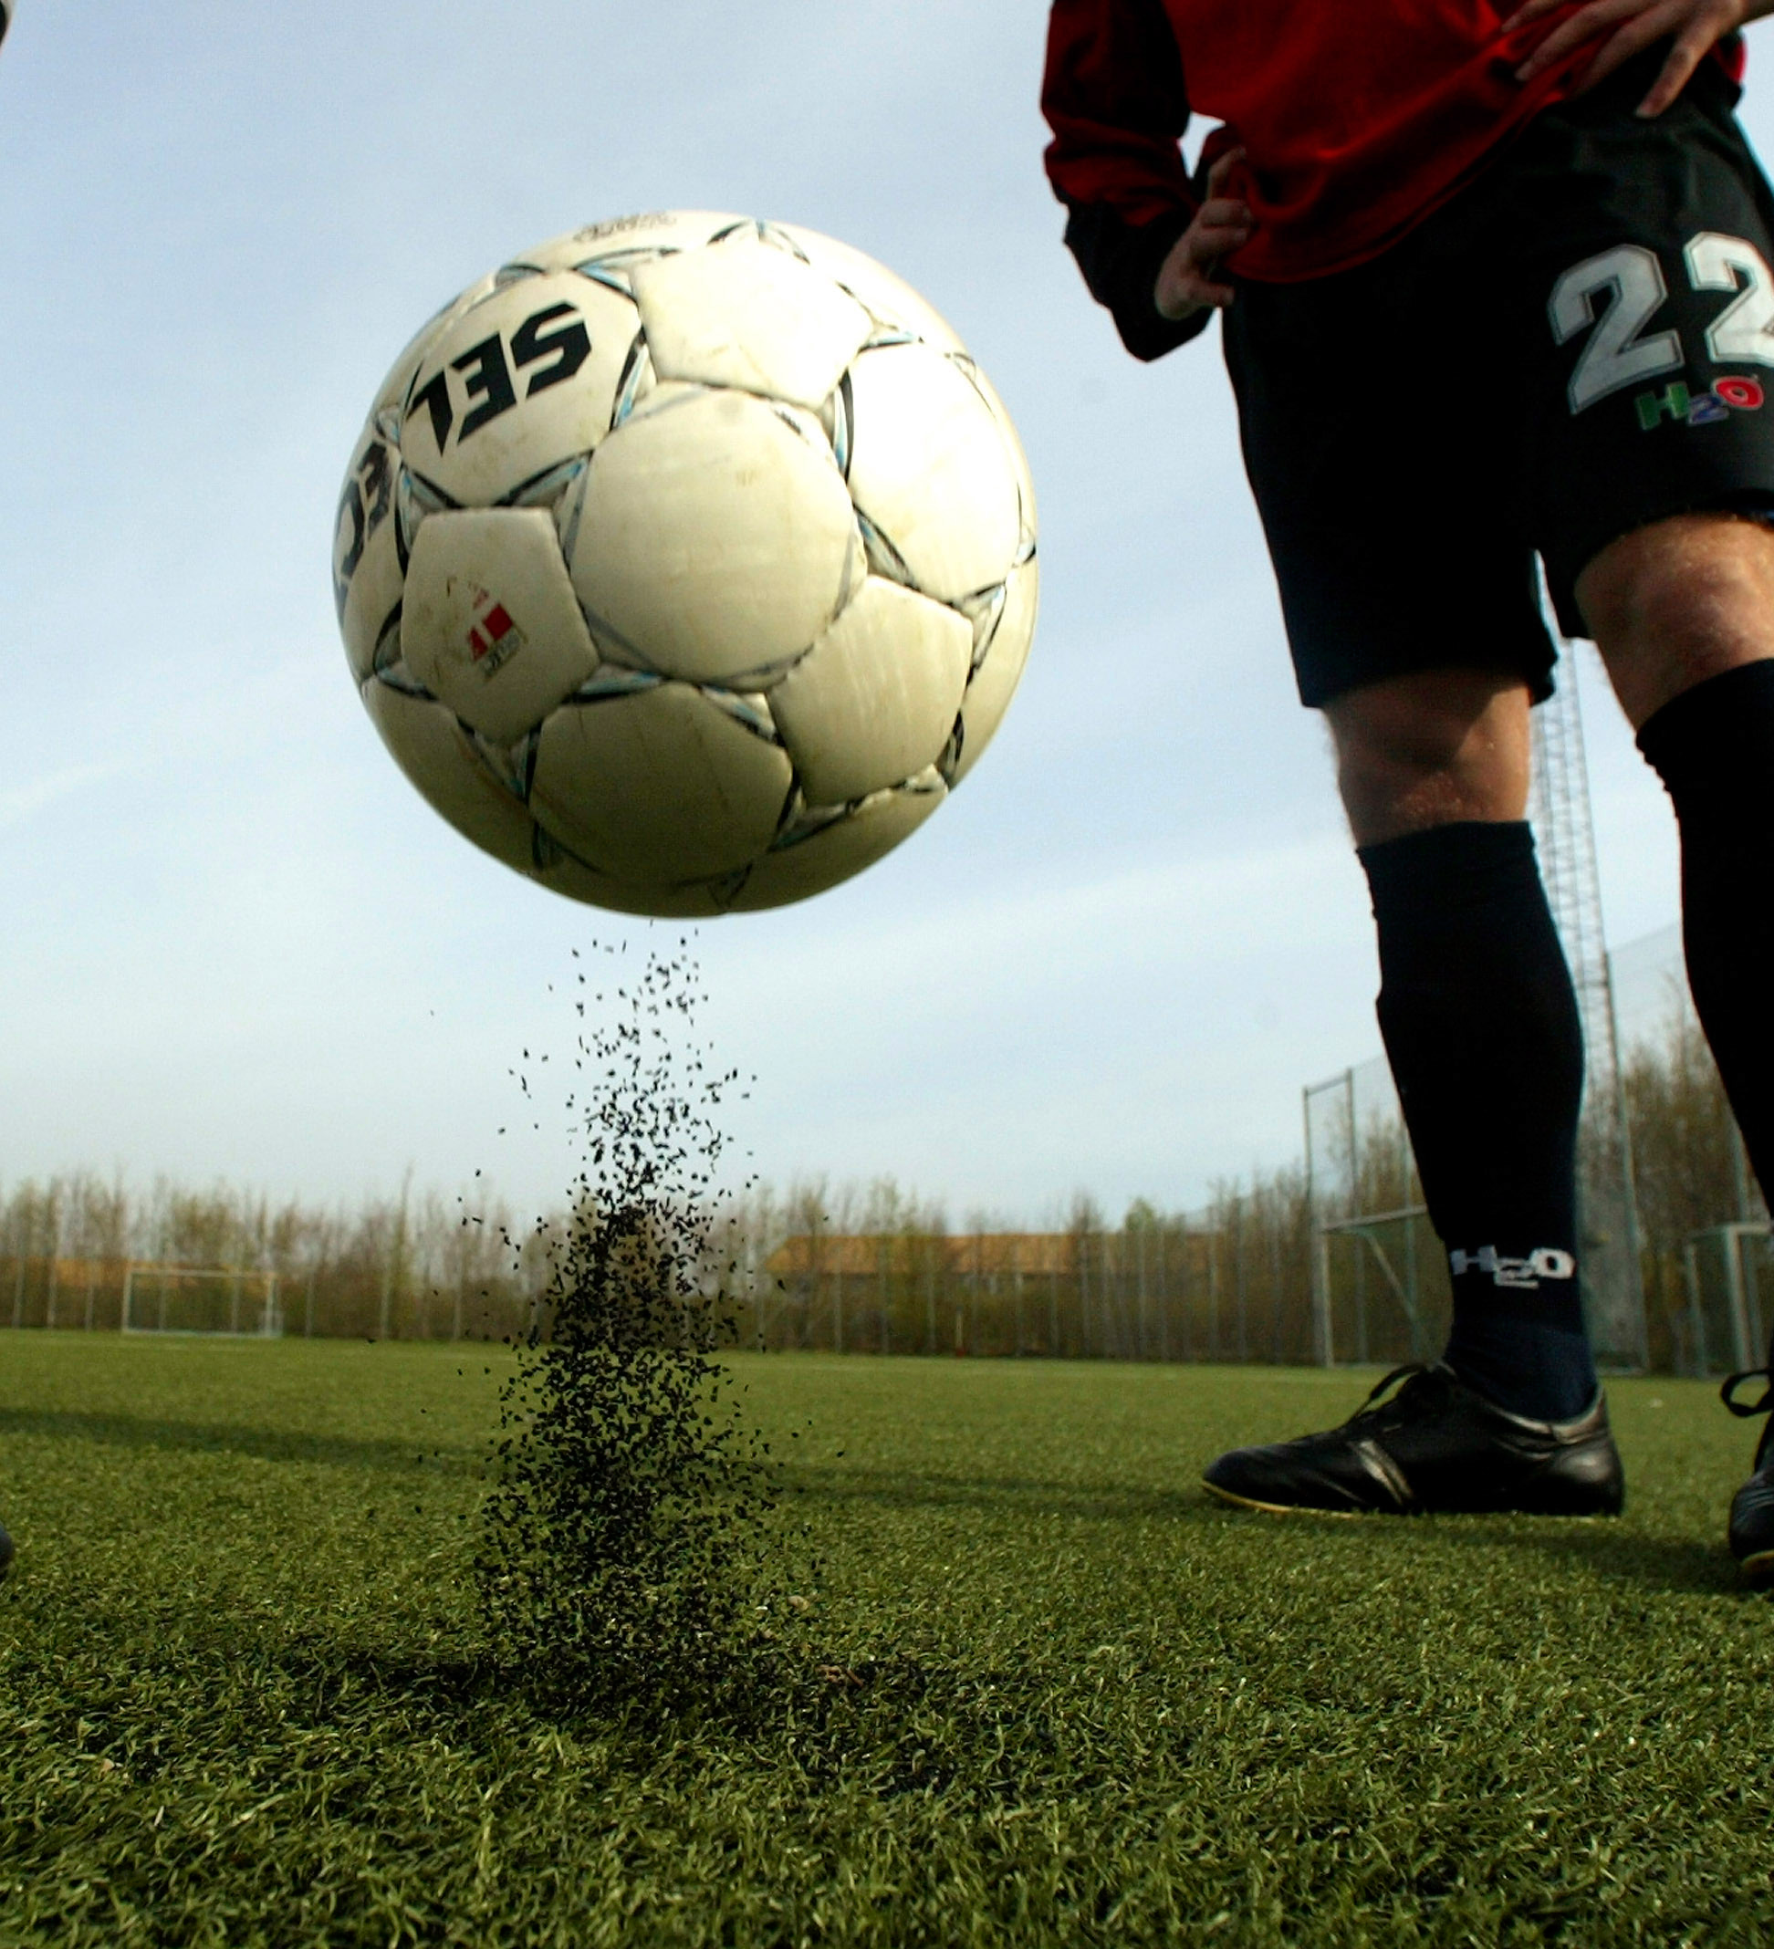


Pitch In: Microplastics and solutions for 3G pitches
Dr Madeleine Berg – Fidra
Notes:
Hi I’m Maddy Berg

Slide 2



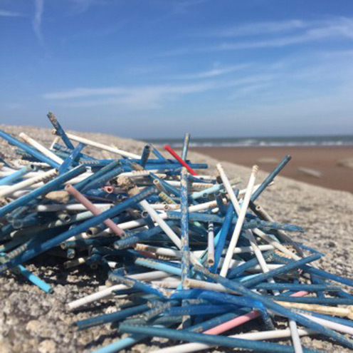
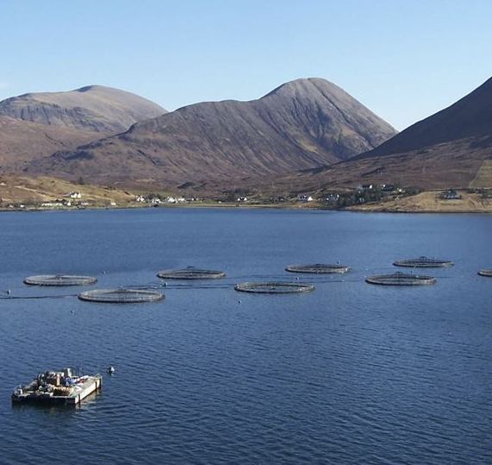
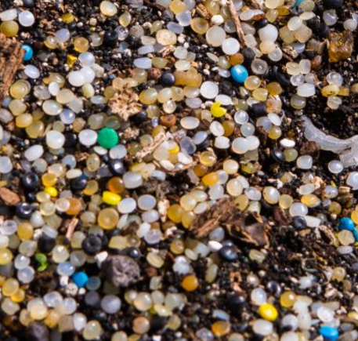


© Scott Currie
How do we work?
  Scientific
  Collaborative
  Targeted
www.Fidra.org.uk
Notes:
To tell you a bit more about Fidra, we are an environmental organisation based in North Berwick, in Scotland.
We work on specific projects focused around using collaborative dialogue and a strong scientific evidence base to find practical solutions to specific environmental problems – we often work on quite niche issues. Some examples shown on the right e.g. salmon farming, specific types of marine litter including cotton bud sticks and nurdles, or industrial plastic pellets. The projects I’ve worked on at Fidra have mostly focused on plastic pollution. Find out more on our website
We’ve been working on our Pitch In project for 2 years now, which is all about microplastic infill from sports pitches.

Slide 3
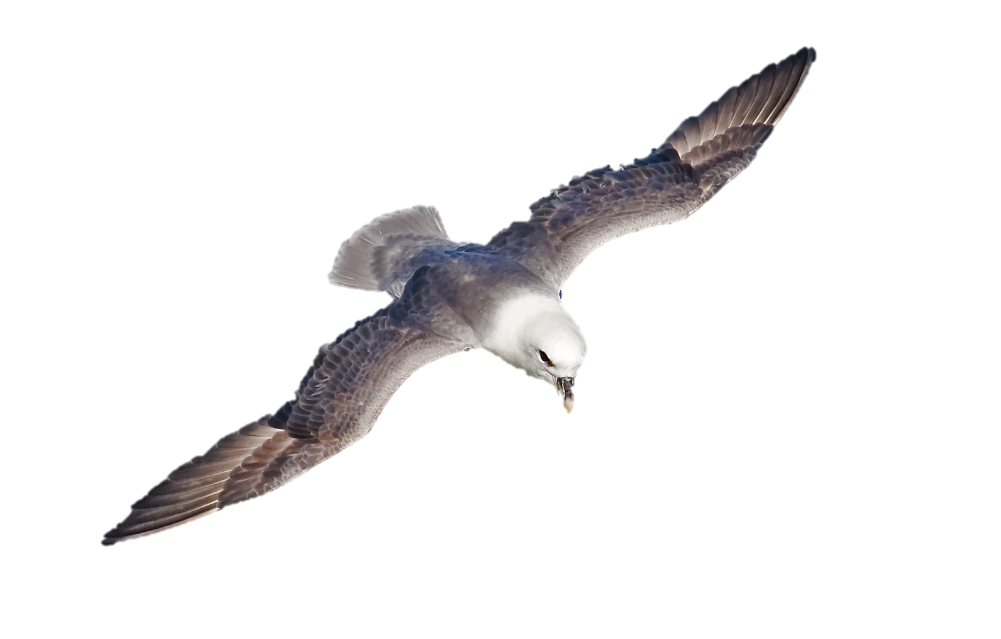
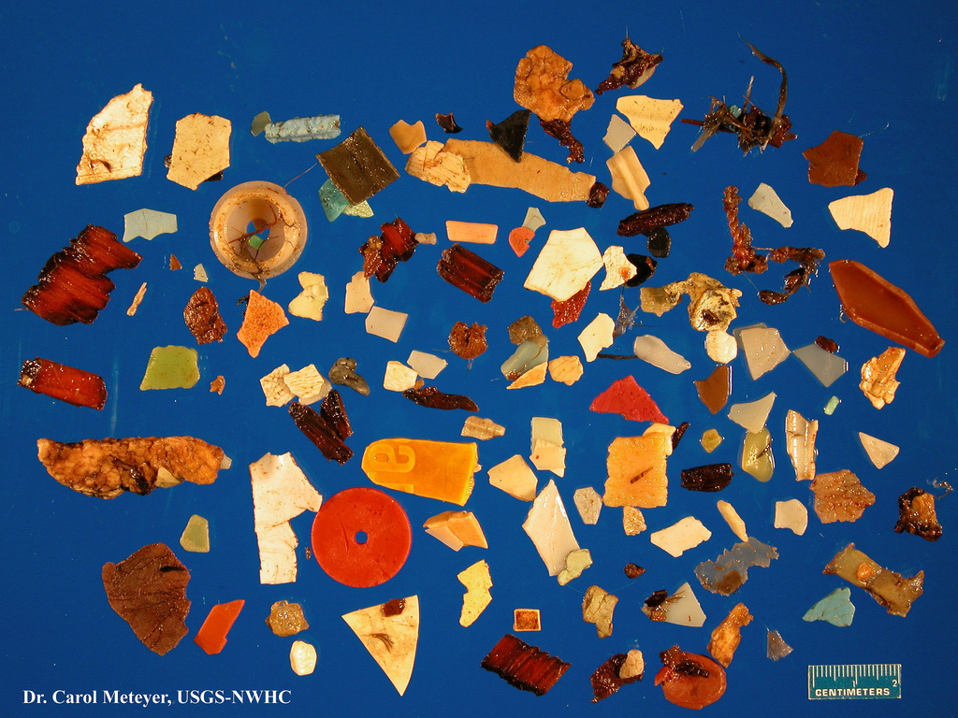


Why are microplastics a problem?
Pollutants in the environment (POPs)
Definition:
Synthetic Polymer (plastic or rubber)
<5mm in diameter
ADDITIVES
Break up, not down
Ingestion by animals
Associated chemicals
→ Human Health
REMNANT
MONOMERS
© Surfrider Foundation
Notes:
Just a quick note to explain what we mean by microplastic pollution and why we’re particularly concerned about it.
Microplastics are essentially plastics, (synthetic polymers) less than 5mm in diameter.
Plastic doesn’t go away in the environment so all plastic, however large, will just keep breaking up into smaller and smaller pieces. At the same time we’re adding primary microplastics to the environment, i.e. particles that are already that small. This means that the amount of microplastic in the environment is building up rapidly and isn’t going away any time soon.
These small particles have particular impacts – we know for example that animals of all sizes in the food chain including tiny plankton are eating microplastics. This picture shows what one fulmar has picked up in the North Sea for example. We know that ingesting this stuff can be harmful, physically, blocking stomach etc.
Although plastic itself is seen as harmless and inert there are associated chemicals that can have additional impacts on our bodies, e.g. additives that can leach out of the plastic, or existing chemical pollutants that attach themselves to the surface of microplastic particles once in the environment, which can make these tiny ‘pills’ even more harmful once ingested.

Slide 4
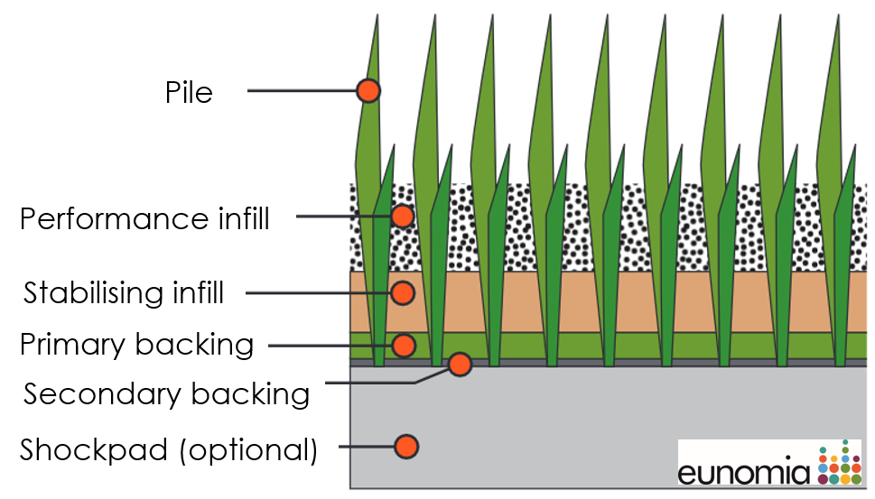
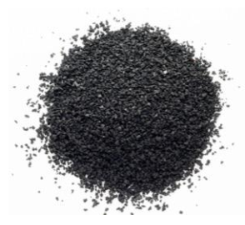
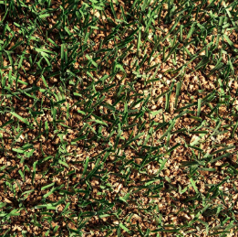
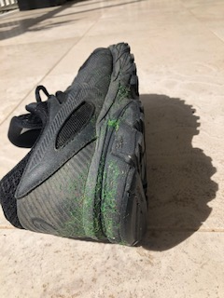
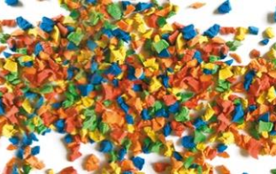
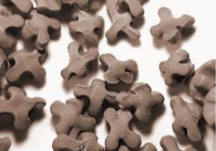
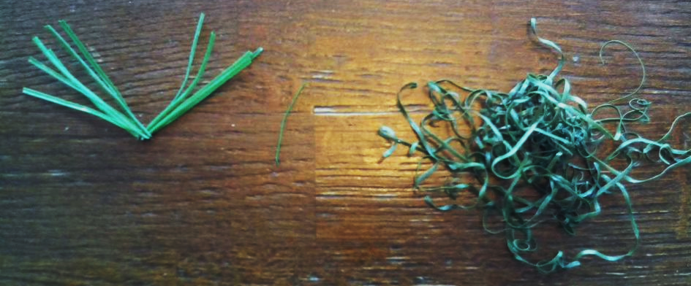
3G Pitches and microplastic
SBR Rubber – (90 -95%)
Cork
EPDM
TPE
Notes:
So what’s the problem with 3G pitches and microplastic?
If you’ve ever played on the pitch you will probably be aware of them – those little bits of rubber that stick to your kit and end up in your shoes. The rubber is called ‘performance infill’ and it is added to the top of a pitch to give the ‘bouncy’ feel of real grass. On the vast majority of pitches this is actually made of ground up old car and truck tyres – so-called SBR rubber, though there are also other kinds of rubber like EPDM and TPE which can be different shapes and colours. These are all microplastics. Only a small proportion of pitches at the moment use alternative non-microplastic infill like cork (will go into more detail later)
Worth mentioning also is of course the plastic ‘grass’ yarn – which can also come off and stick to your shoes etc. our project has been focused mainly on infill because the total losses are relatively much higher than from the grass

Slide 5
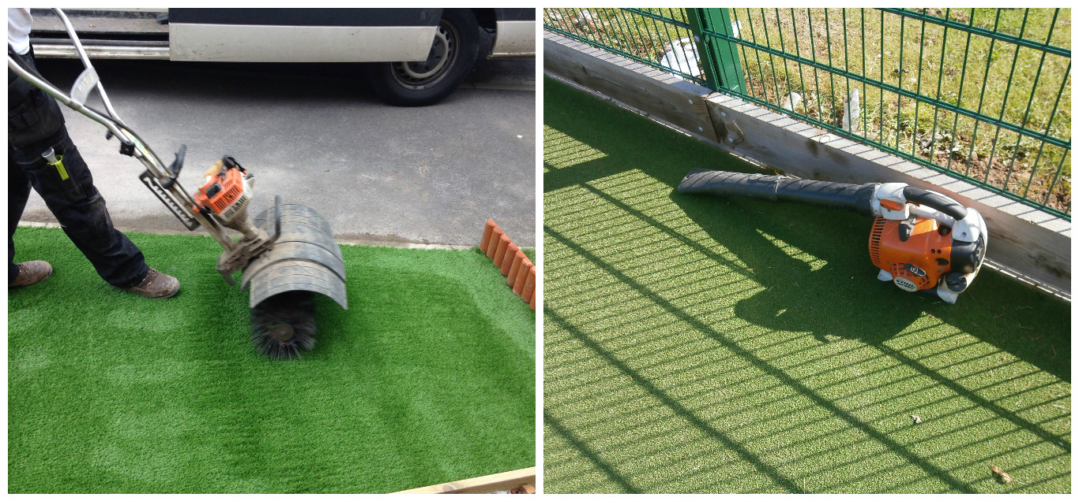
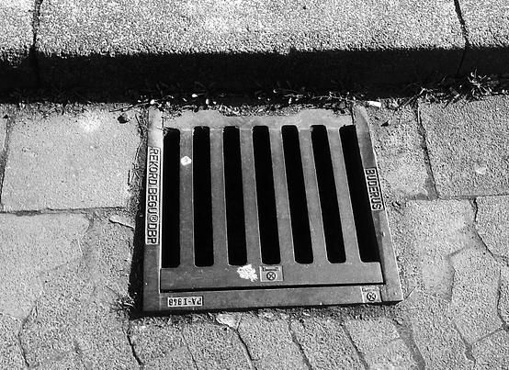
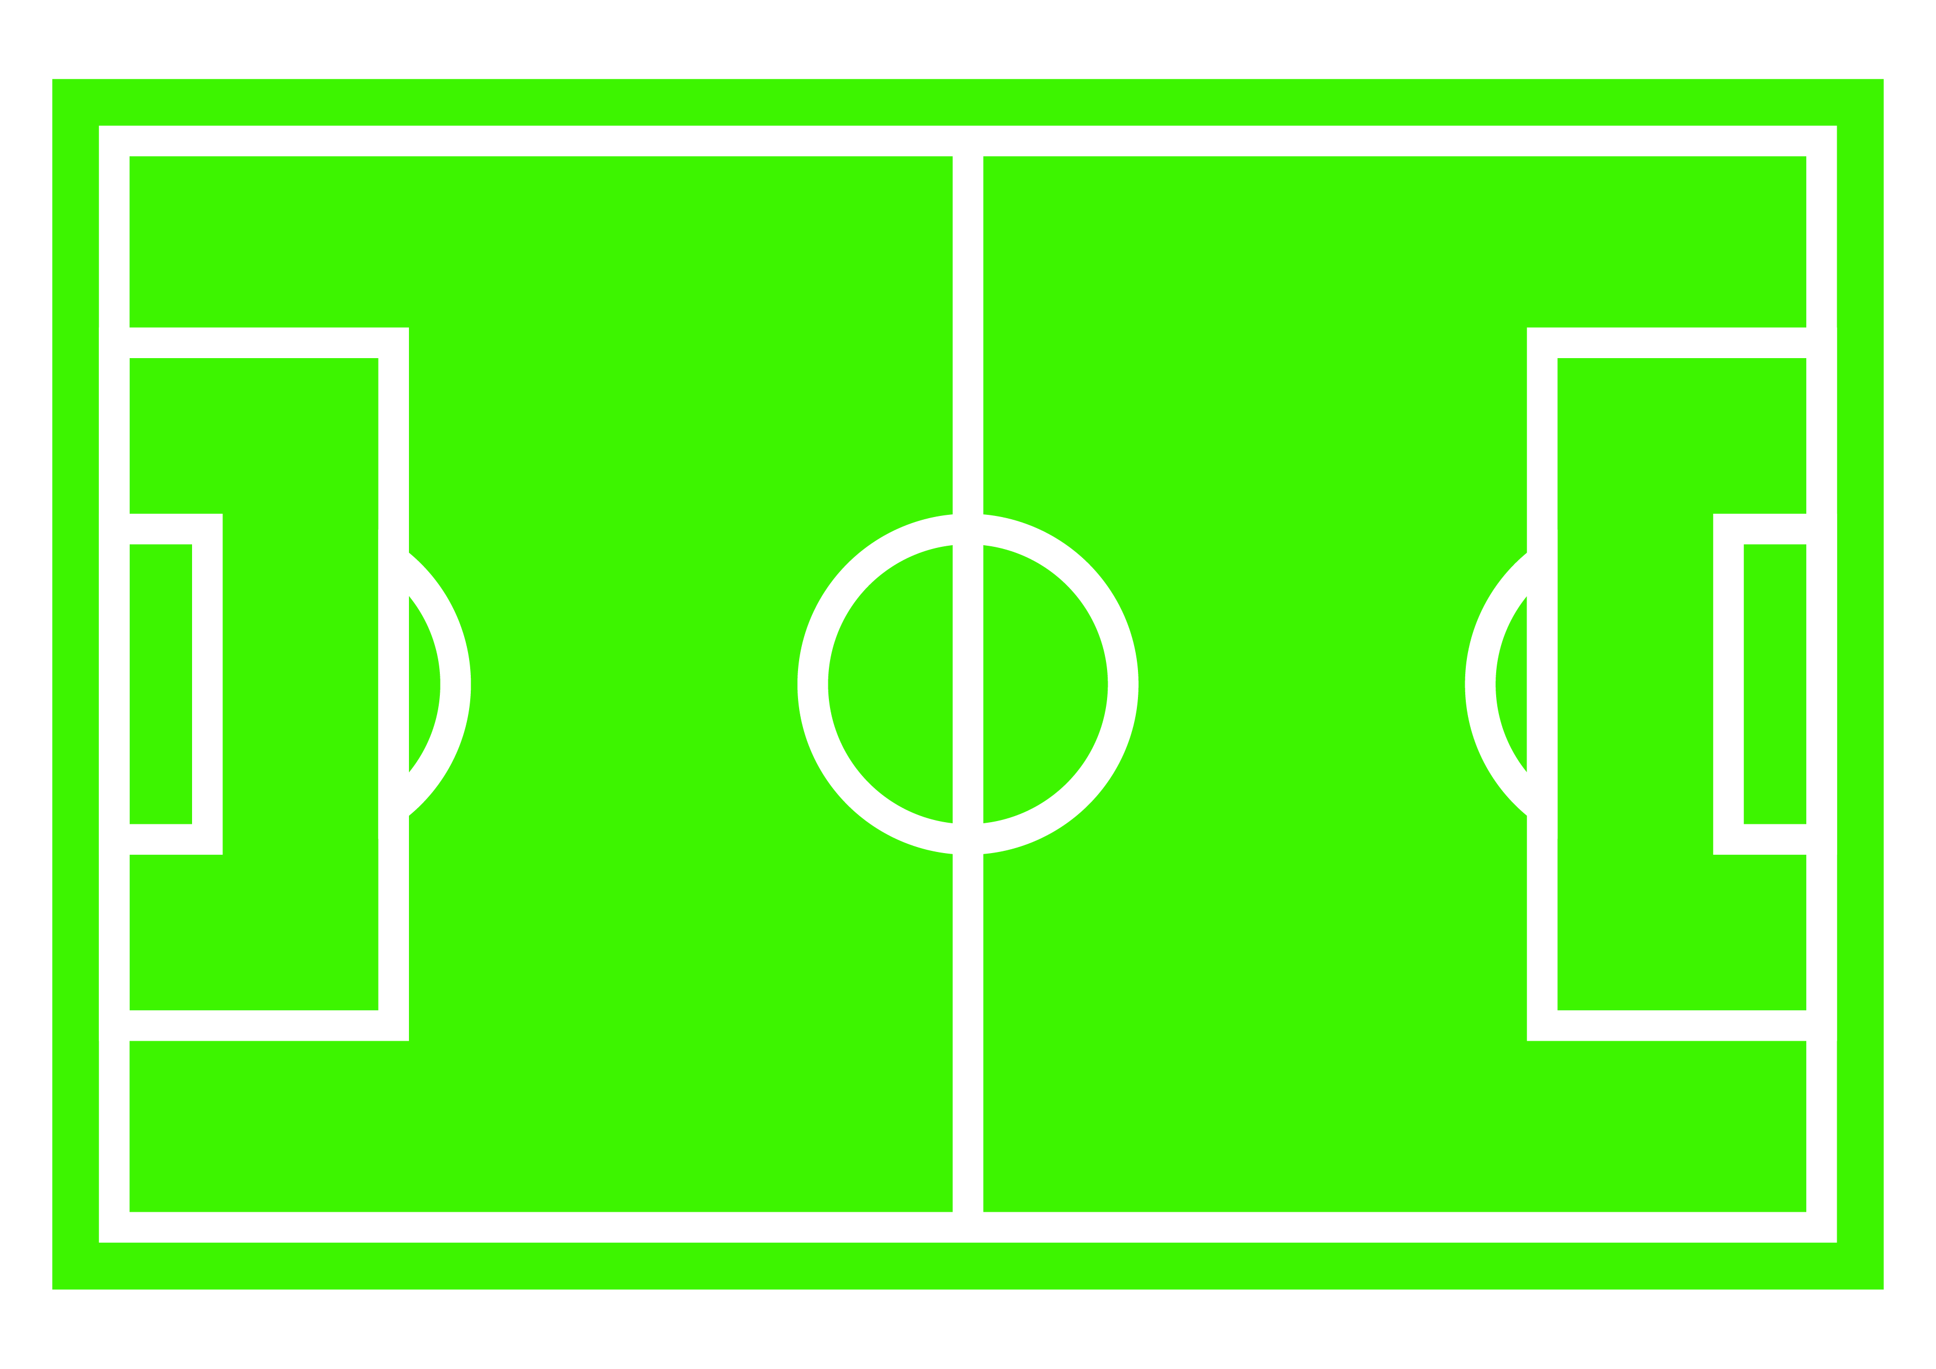
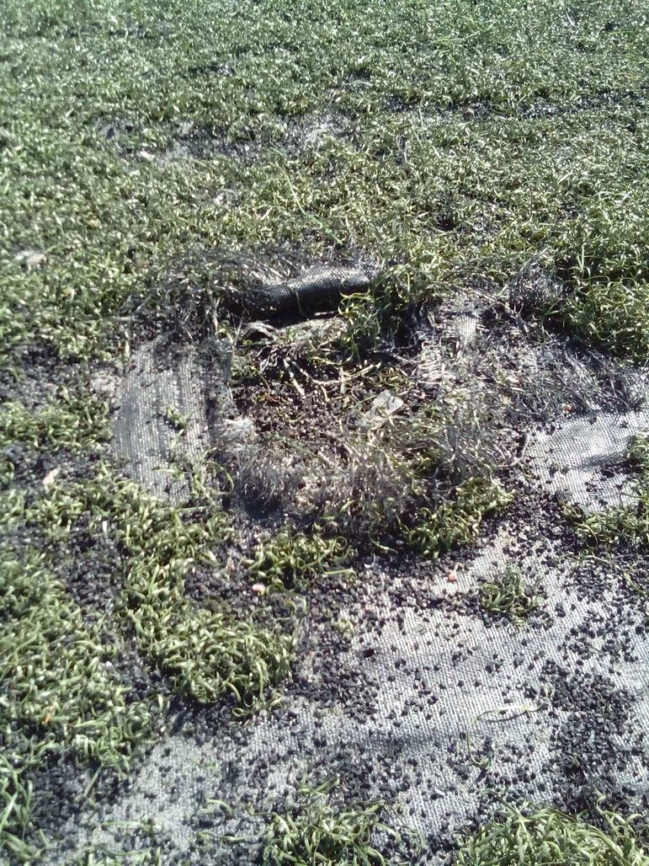
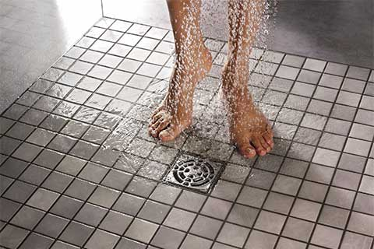
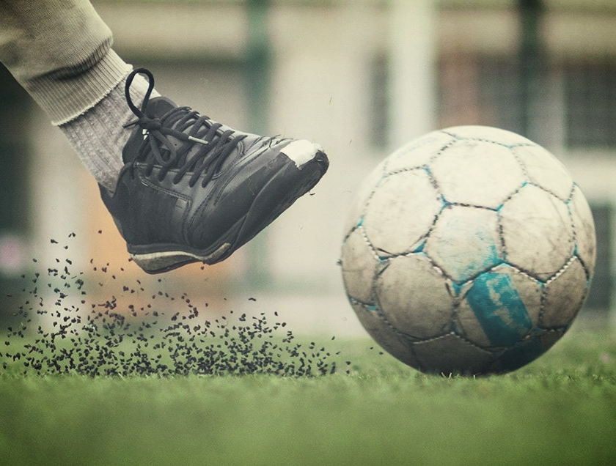
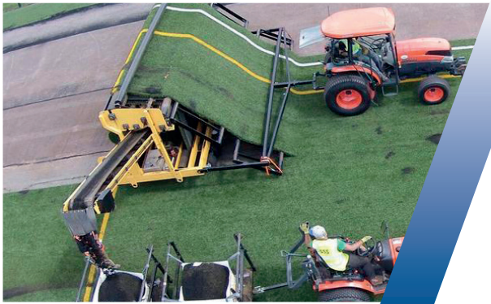
How does microplastic leave the pitch?
1- 5 tonnes of microplastic granules are added to each field per year
How do the granules escape?
Exit the pitch during maintenance activities
Washed away with rain water
Cling to socks and shoes
Installation/ disposal
Compaction(?)
Notes:
So how do granules actually escape the pitch?
We know that every year, pitch owners need to add infill to their pitches to keep up performance of the surface – at a rate of around 1-5tonnes a year, which is about 4% of the total infill - but where is that missing infill going? Lots of potential pathways…

Slide 6
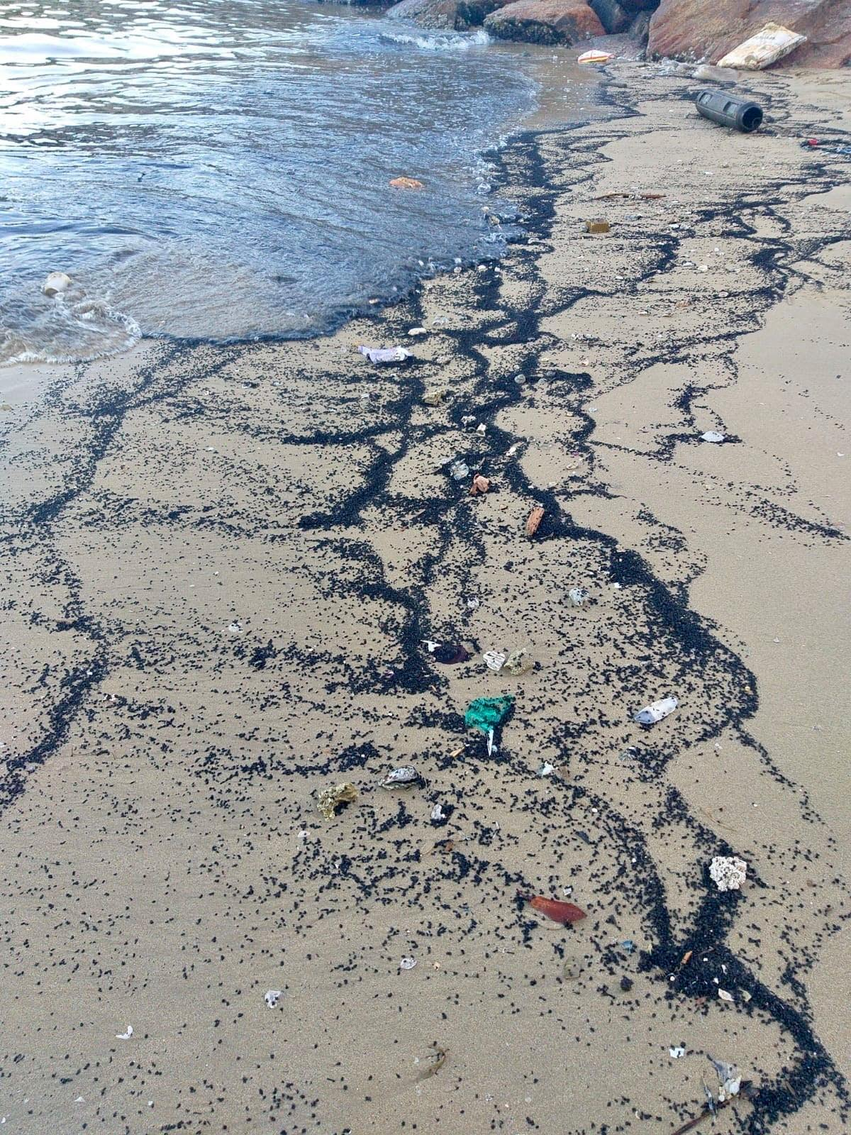
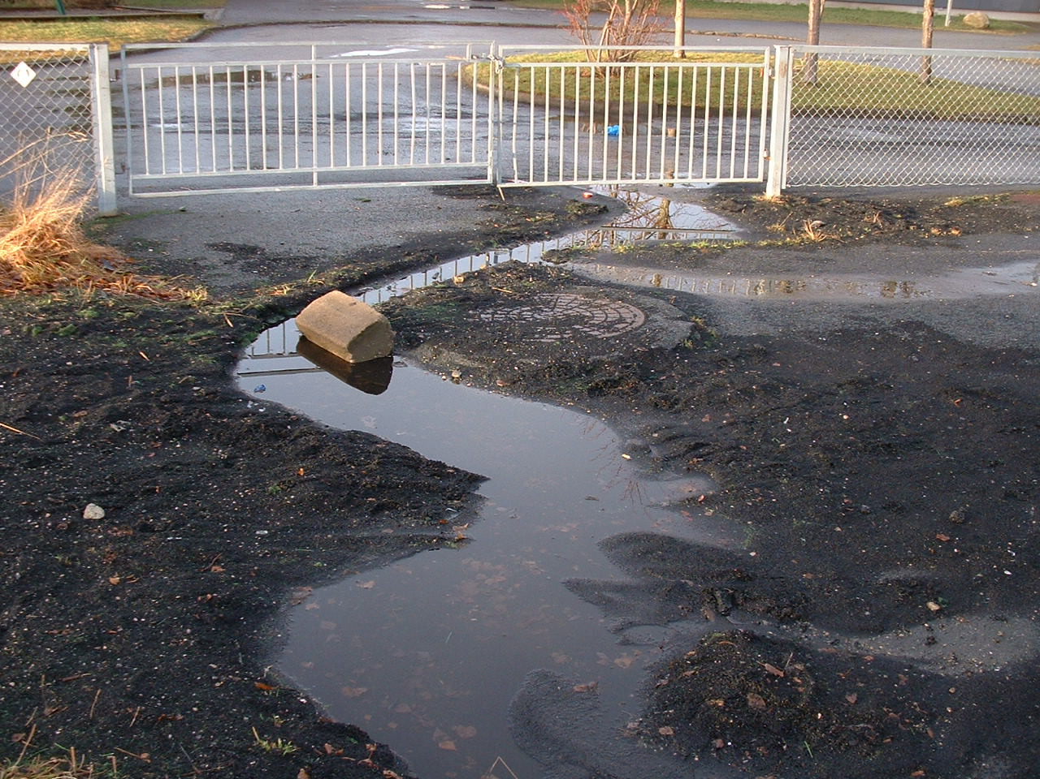
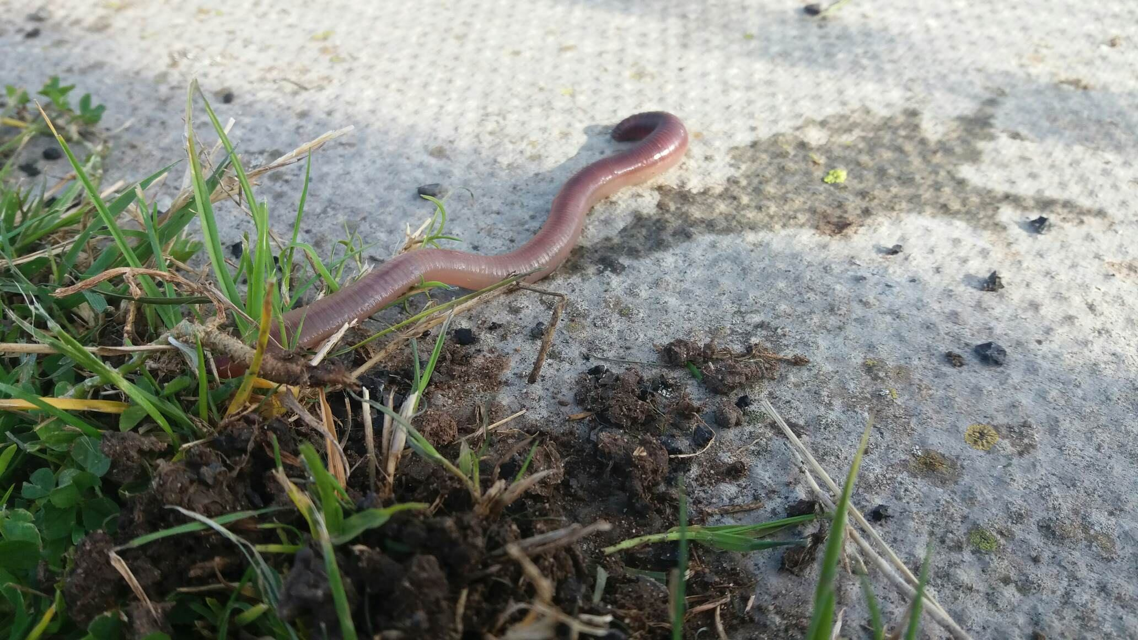
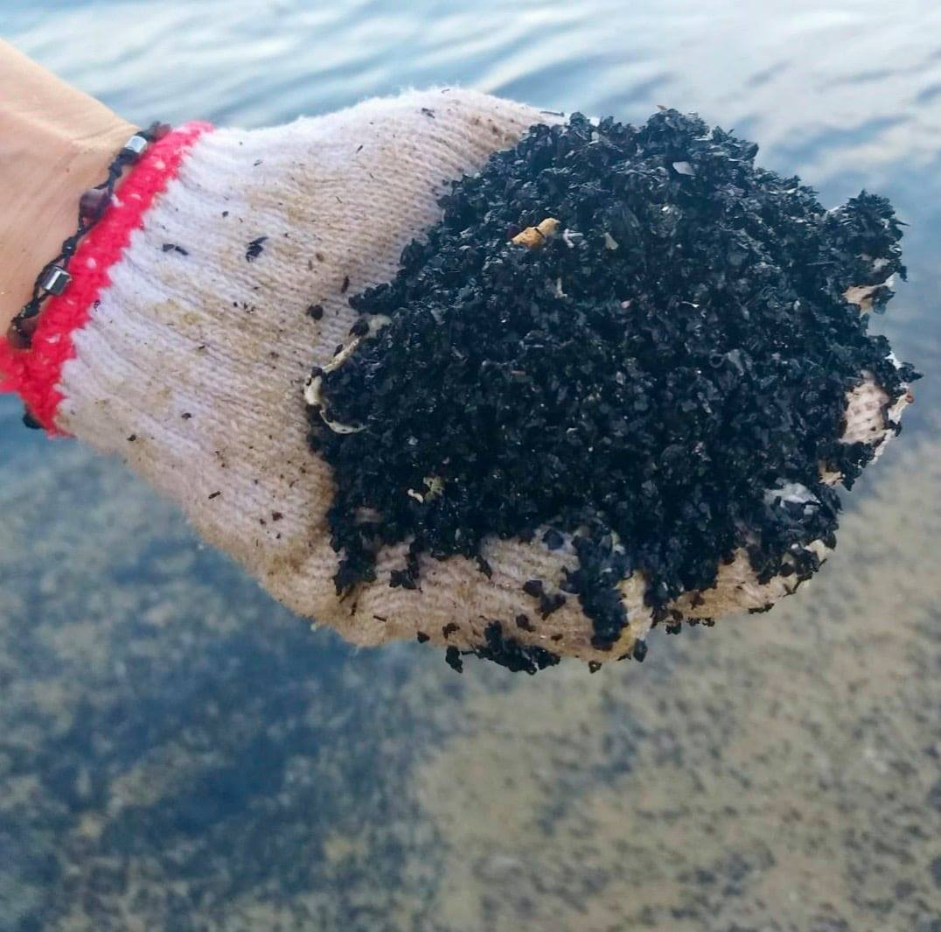
Impacts of 3G pitch pollution
Photo: Trondheim Kommune
Photo: Fidra
~400-1800 tonnes per year across Scotland
Photos: Plastic Free Seas HK
https://www.sepa.org.uk/media/495696/scottish_microplastics_report.pdf
Notes:
Microplastic – once in the environment, it doesn’t go away – builds up. Plenty of evidence that this has impacts on local environment of pitches as seen in these photos.
Recent estimates from a government-commissioned study in Scotland suggests that overall, there may be around 400-1800 tonnes per year of microplastic escaping pitches, going into the wider environment. The majority of that goes into local soils and surrounding grass.

Slide 7
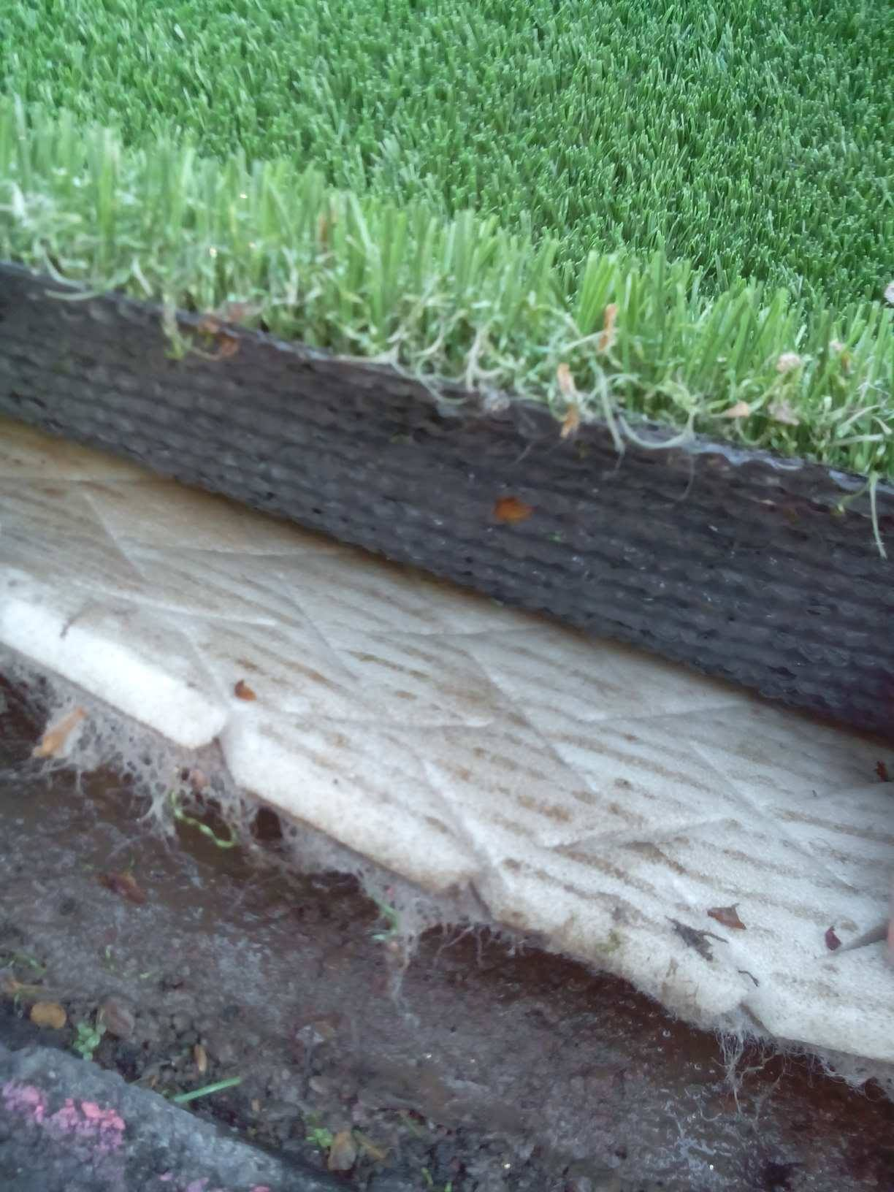
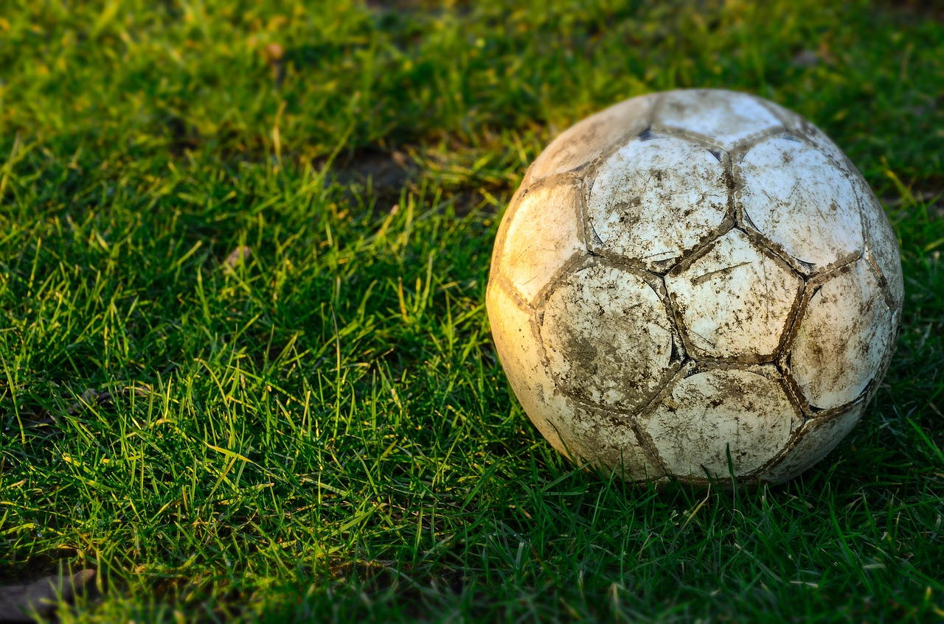
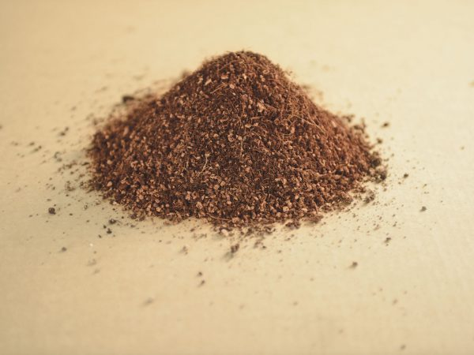
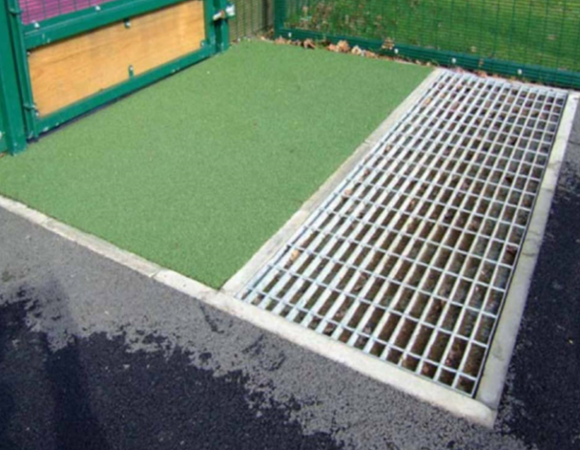
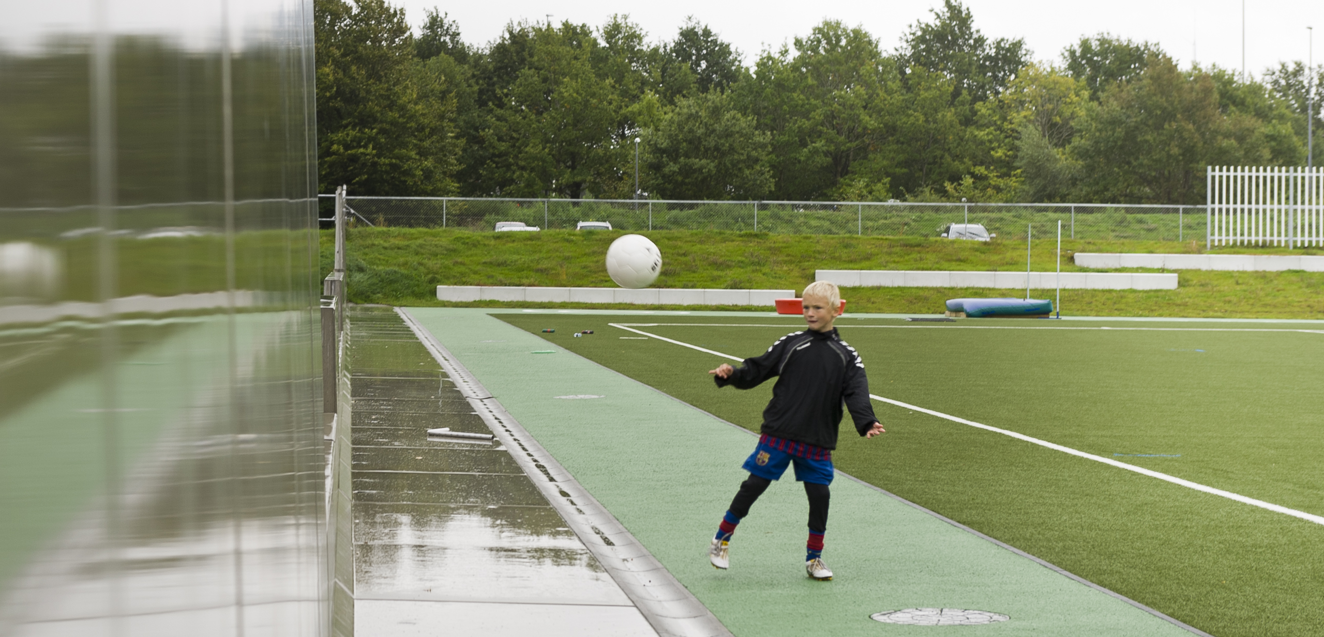
How do we stop microplastic loss from pitches?
GO MICROPLASTIC FREE
USE BARRIERS TO MINIMISE LOSS
CHANGE HOW YOU USE THE PITCH
Notes:
How can we stop microplastic loss from pitches?
At Fidra we’ve been keen to show that there are lots of ways that everyone in the pitch community and across the industry can take action to stop or reduce microplastic pollution. Our logical order of preference is as follows:
Microplastic free: natural grass, infill-free pitches, growing range of alternative non-plastic infills on the market. Obviously these are only things that can be considered right at the start of a project, or when the pitch is up for refurbishment.
Physical barriers: Options for pitches to reduce the amount of infill you need, and using kick-boards, filters in drains, even concrete walls or landscaping features to stop microplastic loss. Also retrofitting options.
Change how you maintain the pitch and how users behave when leaving the pitch -provide equipment like brushes to help, and educate maintenance teams.

Slide 8
End of Life and pitch disposal
End of life can have a major environmental impact
End of life is also a source of microplastic
Re-use does not solve problem of final disposal
Neither does stockpiling
Recycling is most environmentally friendly option (FIFA/Eunomia).
Image: FIFA / Eunomia 2018: Environmental impact study on Artificial Football Turf
Notes:
Wanted to also mention the end of life of pitches as this is a meeting on waste management.
Pitches last about 8-10 years before they need to be replaced
End of life can have a major impact.
Seems to go against any concept of waste hierarchy but want to explain thinking here:
NB some reuse services are described as ‘recycling’ but actually involve chopping up pitches into smaller pieces to be used for landscaping. Limited demand for these reused patches of grass mean there are currently major stockpiling issues of old pitches, and these will grow as many pitches are coming up to their end of life.
There are a growing number of options available now for fully recycling pitches and making sure there is increased demand for these services will make more industry options open up for this.

Slide 9
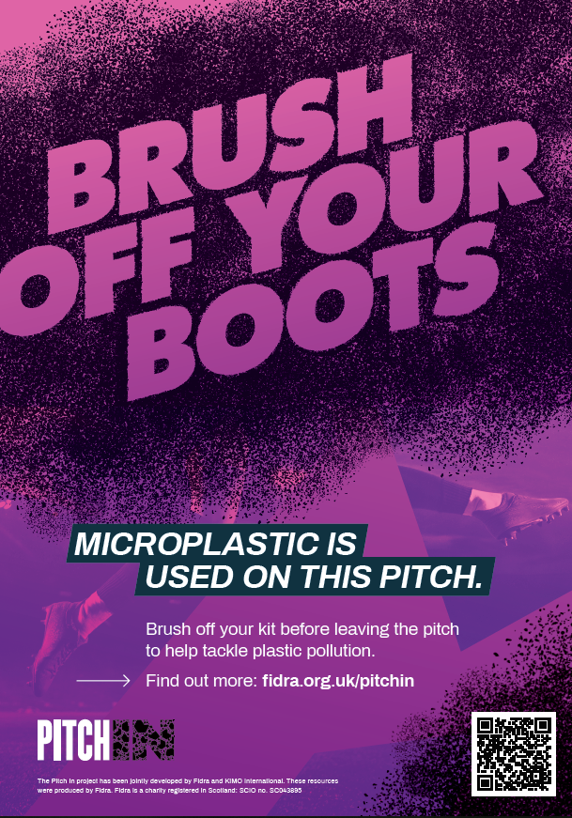
TAKE ACTION! Pitch Owners & Managers
New project / refurb?
Include specific requests in procurement
Check procedures for end of life
Existing pitches
Use physical barriers like kick-boards
Install stamp-off / brush-off trays for users
Include filters in drains
Work to raise awareness with users
Tell us you’re taking part
Sign our Code of Conduct
Add your pitch to our Pitch In map
CEN Technical Report 17519: Guidance on how to minimise infill dispersion into the environment
Notes:
Lots of different ways to take action if you’re involved with managing pitches…

Slide 10

TAKE ACTION! Pitch In for communities
Sign our pitch in pledge
Add your voice to our call to action
Add your pitch to our map to show you’re taking action
Take action on your pitch!
Raise awareness with users and owners
Share our guidelines with owners
Tell us what you’ve been doing!
  #teampitchin
www.team-pitch.in
Notes:
Maybe you’re watching this, thinking I don’t manage a pitch, but I do play on one, or maybe your kids do… still plenty of opportunities to take part in our project and help spread the word about this little-known problem.
The first thing to do is to check out our website, team-pitch.in and sign our pledge there. This is an individual pledge to say you’re willing to take action on your own pitch but also that you want to see broader change. We’ve also got an option to add your local pitch to our map where we’re collecting information on our pitch in community. If you’re doing something to tackle microplastic, however small an action, you can let us know and we’ll add a pin to our map.

Slide 11
CHANGE HOW YOU USE THE PITCH
For pitch users
Maintenance
Owners
Use brushes and stamp off trays
Dispose of any granules you find in the bin
Shake out your kit before you do your laundry
Don’t blow infill off the pitch
Clean off brushes etc. before leaving the pitch
Don’t remove snow from the pitch
Make sure you share information with users and maintenance teams
Retrofit barriers
Make changes during next refurbishment
Make equipment available to users
Dispose of the pitch correctly
Notes:
Pilot projects in Scandinavia
Low cost, precautionary measures

Slide 12

Resources
For owners / local authorities
Cleaner pitch guidelines
  For users, owners, designers
Code of conduct
Briefing for pitch owners
Case studies (coming soon!)
Information about alternatives and solutions
www.team-pitch.in

Slide 13
Resources
For communities
Print off or order our poster (coming very soon!)
Try out our activities
Template letters to pitch owners
Our Pitch In map tracks progress
www.team-pitch.in

Slide 14




Thank you!
Madeleine Berg, Fidra
Madeleine.Berg@fidra.org.uk
#teampitchin @fidraTweets
www.team-pitch.in

