Slide 1




Living Wage Employer Accreditation
Lynn Anderson
Living Wage Accreditation Officer (Scotland)

Slide 2

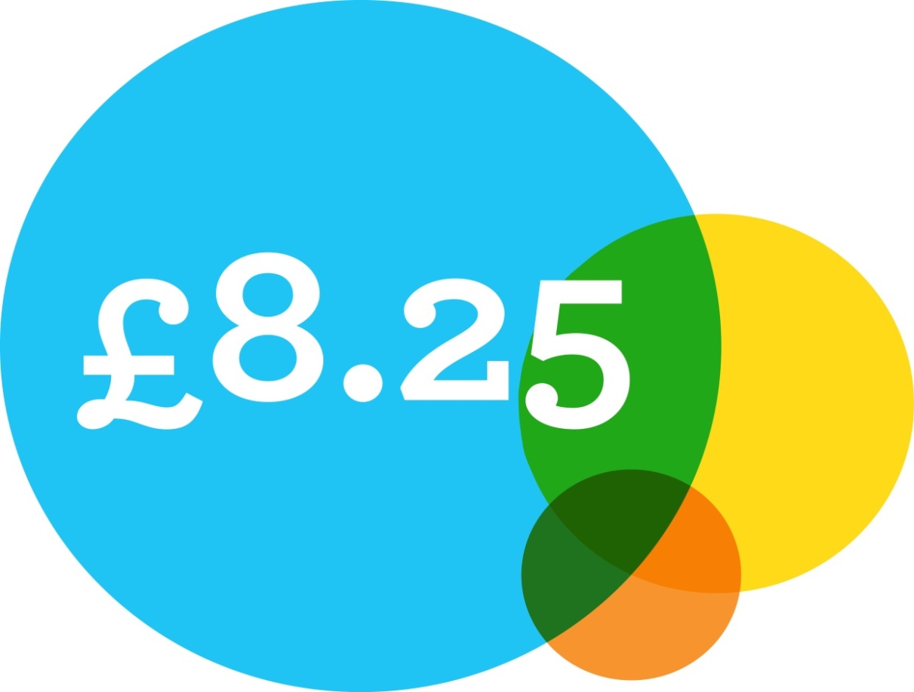
What is the Living Wage?
"The Living Wage is an hourly rate set independently and up-rated annually. It is calculated according to the basic standard of living in the UK."
UK Living Wage Foundation
18+
Voluntary
Uses Minimum Income Standard
Notes:
- The LW is set by the LWF.
The LW is defined as the amount of money needed to enjoy a basic, but socially acceptable standard of living. This is calculated through independent research using the ‘Minimum Income Standard’ for the UK. Decisions about what to include in this standard are set by the public; so it is a social consensus about what people need to make ends meet.
It applies to all workers age 18+
It is a voluntary standard that employers can choose to pay.
It is currently £8.25 per hour for the whole of the UK, outside of London.
Like the NMW, it is reviewed each year. The LW is a higher standard than the NMW. The NMW is the legal floor- the minimum that employers can pay without breaking the law. The NMW is set by UK Government, based on recommendations from the Low Pay Commission- an independent body made up of employers, unions and labour market experts.
Comparing the national living wage with the Living Wage, the gap is £2000 for a full time worker in Scotland - that's a difference of nearly £40 a week

Slide 3
Why do we need a Living Wage?
1 in 5 children in Scotland live in poverty- that’s around 210,000 children
Over half of children living in poverty in Scotland are living in a household where someone works, meaning that for many, work is no longer a route out of poverty.
18% of employees in Scotland (around 418,000 individuals) are paid less than the Living Wage.
£2k difference per year compared to NMW

Slide 4
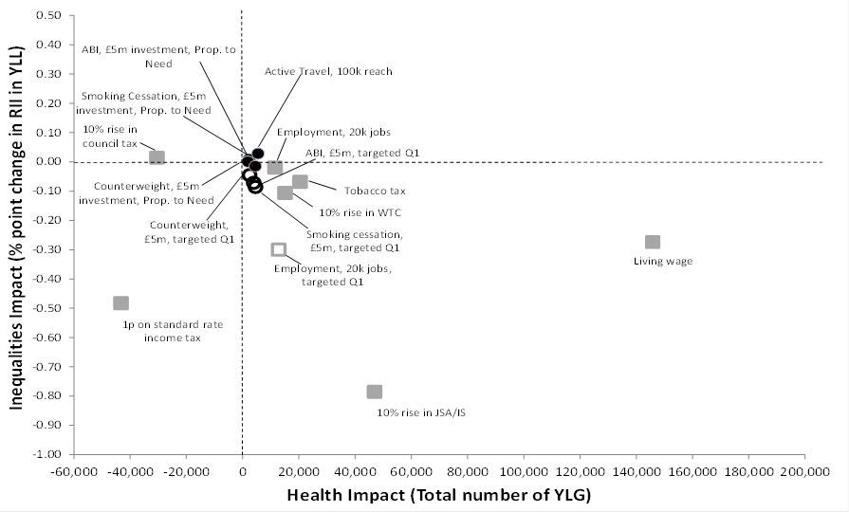
Living Wage & Health
Notes:
We know from speaking to low paid workers that working and living in poverty impacts negatively on their health. Worries about money and making ends meet can create or exacerbate stress and other mental health problems; it can also mean an inability to afford to have or maintain a good diet and nutrition; it can mean having no choice other than to live in poor quality housing; it can mean not being to afford to turn the heating on at home; replace or repair essential items when they break; save for the future; or enjoy a social life. Many low paid workers talk about feeling ‘trapped’ and feel very negative about their future, or future prospects.
Research undertaken by NHS HS looked at the available evidence on the relative impact of specific interventions on health and health inequalities. The research looked at the impact over the short, medium and long term for local areas and for Scotland overall.
As can be seen from this graph taken from this research, of the 11 interventions modelled, the introduction of a LW generated the largest beneficial impact on health and also reduced inequalities in health. YLG=years of life gained

Slide 5

What evidence do we have that the
Living Wage is effective?
Business
Social
Public Policy
Notes:
In addition to evidence that the LW good for the individual- something we might call the social case for the LW- I’d also like to highlight that there is a business and a public policy case for the LW too.
The public policy case for the LW essentially falls under two categories – Government revenue and economic stimulus. To put this as simply as possible; if more employers pay the LW, the state will get
more tax in, and it will pay less benefits out. We’ll also be putting more money in people’s pockets to spend which will increase demand and drive economic growth.
In terms of the business case, employers have reported that introducing the LW has had a positive impact on recruitment and retention (both of which we know can costs businesses a lot), as well as increased productivity and staff morale, and reduced absence from work.

Slide 6

Business Benefits
A 25% fall in absenteeism
Improved morale and motivation of workers
Enhanced quality of work from staff
Improvement on staff recruitment & retention
A resilient workforce
Reputational benefit as an ethical employer
For KPMG paying the Living Wage is simply good sense. You don't always need to start from the economic case in order to understand why it should be part of any forward looking sustainability strategy. Consider the social case and the changes in societal expectations over the last ten years and think about what the future might hold. I look forward to the day when the Living Wage brand is as widely known as the Fairtrade brand - and just as widely respected. It is going to come a lot sooner than you might think.
Mike Kelly, Former Head of Living Wage
Notes:
There are impressive business benefits to be seen when paying the Living Wage. There is a wealth of research that links higher wages generally with improved health, better retention of staff (therefore reduced recruitment costs), but even when recruitment is required, paying the Living Wage is an attraction for good applicants. Higher calibre of applicants are therefore available. In addition to bringing in better staff, paying the Living Wage can result in a more motivation from staff and better quality of work.
In an independent survey of accredited Living Wage employers, a 25% fall in absenteeism was reported. This could be liked to the improvements in health the Living Wage can be linked to, but could also be linked to the higher motivation of the workforce more generally. The resilience of staff was reported in the survey – with employees reporting that they were open to positive to organisational or operational changes. You want a loyal, motivated and positive workforce that are resilient to change – the Living Wage can help with that.
The quote on the slide mentions the social case, but the business case alone means that adopting Living Wage is something that you simply must consider. Employers that have joined the Living Wage movement often mention that they feel part of a progressive club. Living Wage is not a new concept, but it does show that an employer is forward thinking.

Slide 7

Do you qualify?
All directly employed staff must receive the Living Wage.
All contract workers who work regularly on your premises must also receive the Living Wage (or have a plan in place).
Remember the rate changes each year – statement of intent to pay Living Wage in future.
Notes:
Point 1,
Nationally agreed pay-scales
Pay differentials
Affordability
Top-up at the bottom? You can choose to apply a % increase on top of that if you wish– internal HR decision. Employers have done it differently.
If pay differentials are eroded as a result of paying Living Wage, you can decide how you want to handle that. Personally, I would aim to put you in touch with a similar employer who has went through the process. They will speak your language.
Dependant on the choices you make on how to pay the Living Wage, we are all working with tighter budgets.
We advocate that if an employer can afford to pay Living Wage, they should absolutely do so – savings seen in numerous areas (business benefits)
For point 2, this requirement applies to contracts that are in the scope of accreditation. In scope is defined as working on site for 2 hours in a given day for 8 consecutive weeks or more out the yeart.
In relation to procurement - The Scottish Government has examined how payment, by contractors, of the Living Wage can be taken into account as part of a public procurement process. The European Commission has confirmed that public bodies are unable to make payment of the Living Wage a mandatory requirement as part of a competitive procurement process where the Living Wage is greater than any minimum wage set by or in accordance with law. However, If Living Wage is built into a procurement policy that recognises the link between Living Wage and workforce matters, and is given an adequate weighting – this is a solution.
Our licence requires that the second condition noted here is met “to the extent permitted by law” and using your best endeavours of course.
For point 3,
The rate is announced during Living Wage Week (first week of November).
Employers have a maximum of 6 months to implement the new rate.
Communications with staff.

Slide 8
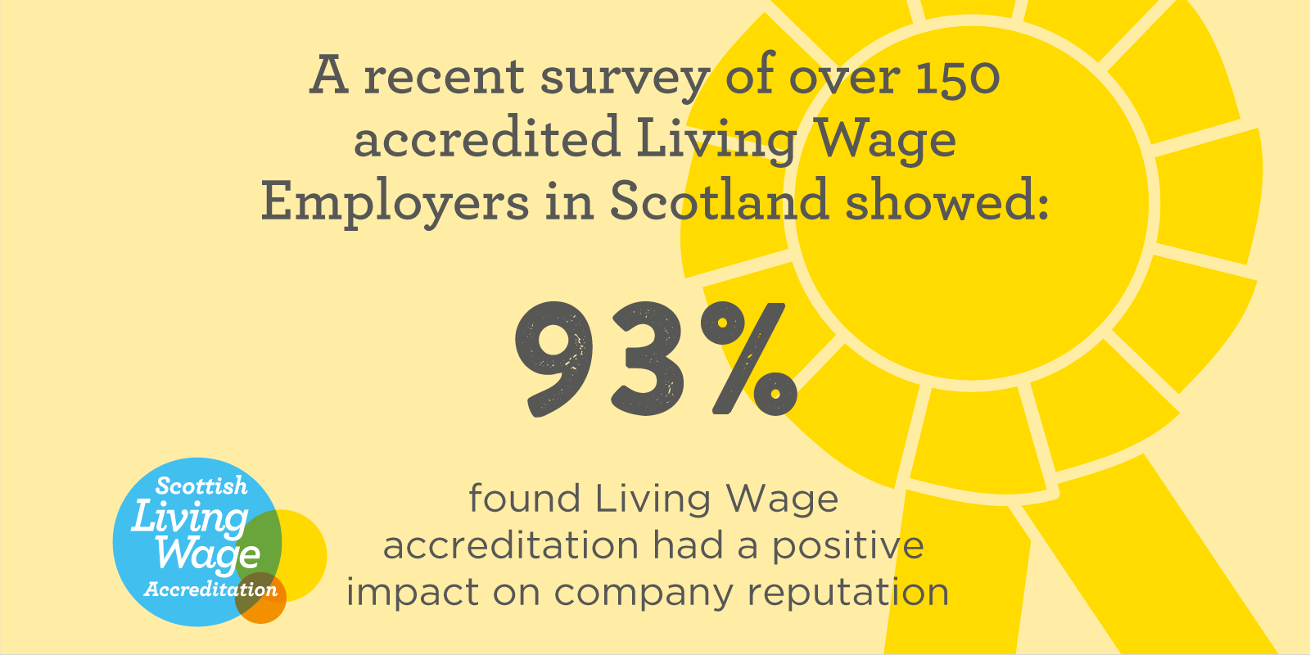
Notes:
Principal and Vice Chancellor Anton Muscatelli said at the their Living Wage celebration event, The Living Wage forms an important part of our ongoing actions to improve the working lives of our staff, who play such a vital role in making the University the inspiring place it is”.
We have a world class education system here in Scotland. The Living Wage movement includes the most innovative and progressive employers. Your institution can celebrate leading the way on fair pay.

Slide 9


Slide 10
Contact
email: lynn.anderson@povertyalliance.org
telephone: 0141 353 0440
Website: www.scottishlivingwage.org
You can also follow us on twitter: @ScottishLWAI

