Slide 1


Title Slide
GCU’s Strategy for Learning: working towards embedding the SDGs within our curricula”
Professor Alastair Robertson, Acting PVC L&T
Notes:
Acknowledge all contributors.

Slide 2
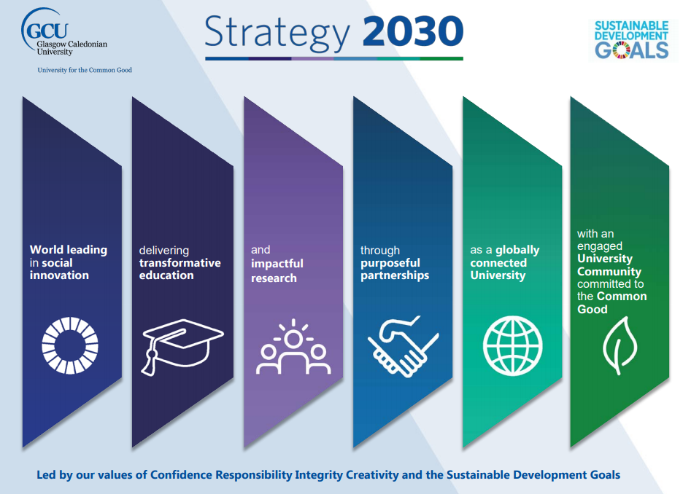
Notes:
GCU University mission- Uni for the Common Good
Aim- recognised world leader in social innovation
Commitment to use the SDGs to provide the guiding framework for our new L&T, Res strategies and the enabling plans (Infrastructure, People and Finance).

Slide 3
Embedding SDGs in the Curriculum working group
Established autumn 2020, one of several focussed working groups as part of overall SDG steering group, led by PVC Research.
Chaired by myself, representatives from each of the Academic Schools, Academic Quality, Strategy & Planning, Student Association
Agreed action plan:
  Completed- influence development of the University’s new Strategy for Learning 2030
  Early stages of implementation- Mapping existing activity i.e. curriculum, identifying champions etc; embedding in academic quality processes; staff and student CPD
  Ongoing- external engagement e.g. discipline networks, QAA, AdvanceHE, EAUC, Ellen MacArthur Foundation, PRME etc; student-led activities (societies, student representatives, wider student body)

Slide 4


Strategy for Learning 2030
Delivered across Campuses, Schools, Partnerships and Professional Services
Common Good Attributes
Learner Agency is at the centre of: Active global citizenship; Entrepreneurial Mindset; Systems Thinking; Responsible Leadership; Resilience, Compassion and Empathy; Confidence
Pedagogic Principles
Our pedagogic principles drive the design of our curricula, its delivery and assessment
Underpinned by our values: Confidence, Responsibility, Integrity, Creativity
1. Equality of participation and attainment
2. Excellence in learning, teaching and the student experience
3. Enhance employability, knowledge and skills
4. Research-led, globally-aware curriculum
5. Flexible, accessible provision
Priority areas for action
We will champion equality of participation and attainment for all students.
We will deliver excellence in teaching and the student experience, underpinned by our holistic approach to student support.
We will enhance the employability, knowledge, skills and attributes of our students through collaborative and active learning.
We will embed a commitment to the Sustainable Development Goals to deliver positive impact for societal challenges.
We will facilitate innovative learning which supports flexible provision and a blend of on and off campus experiences.
Key intentions
Notes:
Highlight
Common Good Attributes
Pedagogic Principles
Key intention 4 (in more detail next slide)

Slide 5

edFl
Co-created
Communities & Socialisation
Wellbeing & Safety
Evolving infrastructure & Estate
Excellence in Learning and Teaching
Core transferable skills embedded
Delivering our new L&T strategy:
priority intentions and actions
4. We will embed a commitment to the Sustainable Development Goals (SDGs) within our research-led, globally aware curriculum to deliver positive impact for the societal challenges of inclusive societies, healthy lives and a sustainable environment.
Embedding our enhanced Common Good Attributes across our provision.
Mapping our provision and learning outcomes explicitly to the SDGs.
Providing our students with opportunities to deliver positive impact on societal challenges throughout their studies and the co-curriculum.
Ensuring all of our programmes assess students’ relevant sustainability competencies.
Supporting our students to succeed as active global citizens and responsible leaders committed to furthering the Common Good.
Strengthening our research-teaching nexus, ensuring our curricula are informed by leading developments in research and professional practice.
Developing an inclusive, enquiry-based and research-led learning approach to curriculum design and student engagement.

Slide 6
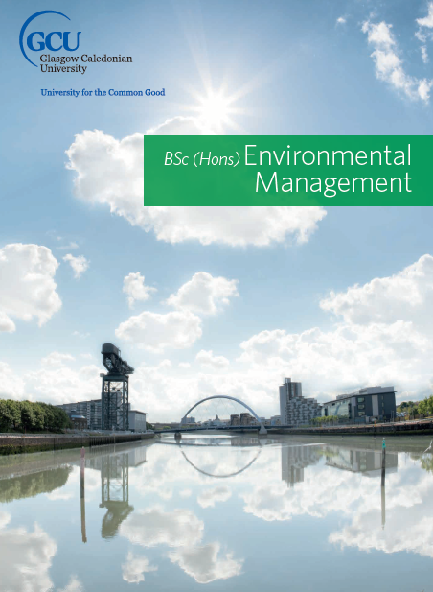
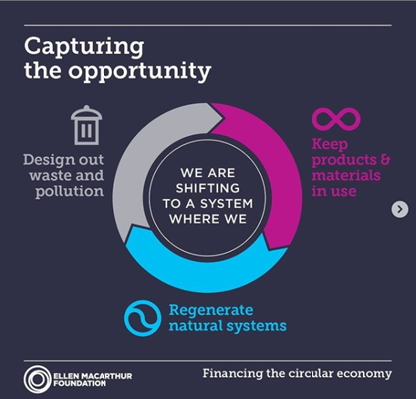

Current provision
Provision explicitly focused on SDGs already e.g.
  BSc (Hons) and MSc Environmental Management
  MSc Climate Justice
  BSc Environmental Civil Engineering
  MSc in International Economic and Social Justice
  A range of modules e.g. Poverty, Inequality and wealth; Luxury Branding and Sustainable Marketing; International Marketing Concepts for Ethical and Sustainable Practice; International Management Governance and Sustainability; Resource Management and Circular Economy
Need for systematic mapping:
  SDGs are explicit in the module (clear from words and narrative used)
  SDGs are implicit in the module (unclear from words and narrative used)
  SDGs are not covered in the module (neither explicit not implicit)
Notes:
There are others, these are just select examples.

Slide 7




How to measure ‘sustainability literacy’ of students ?
Use The Sustainability Literacy Test (Sulitest) www.Sulitest.org
Endorsed by UN Higher Education Sustainability Initiative
1. Use for formative or summative assessment.
2. Use randomly
(e.g. at induction sessions or on a relevant module)
3. Use systematically: for degree programmes
(Administer and assess progress through the years)
Free of charge; easy to use; plenty of online support and tools
Instant results; confidential; standard and tailored packages…
Notes:
More general test

Slide 8
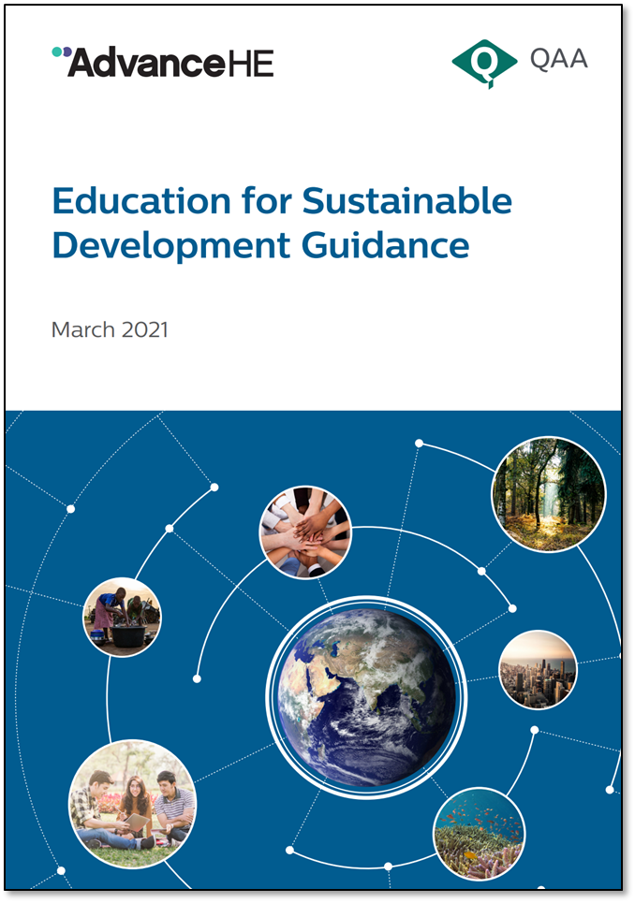
Quality systems and processes
Our core framework at the School level covers Enhancement-led Internal Subject Review (discipline level), Programme Approval, Programme Review and Annual Monitoring.
Strategy for Learning 2030 requires ‘Mapping our provision and learning outcomes explicitly to the SDGs’. Alignment with UNESCO competencies- fairly straightforward.
This will include narrative evaluating and reflecting where alignment is in the subject discipline supplemented through our processes of internal and external peer review.
Enhancement-led Internal Subject Review will be the predominant vehicle for integration and unit of review for SDG mapping positively creating a baseline of SDG alignment against current curriculum and act as an enabler for future development and enhancement.

Slide 9

Student-led activities
Students as change agents and co-creators of their curricula
Involving students in mapping our curricula against SDGs
Student groups/societies (especially academic societies) complementing SDG in the course with speakers and events
Equality and Diversity reps activities/campaigns to spread awareness and/or campaign for action on an SDG-related issue.
Student-led training on SDGs, carbon literacy training etc
NUS SOS SDG Teach-in: pledges from staff and students to embed SDGs in the curriculum (https://www.sos-uk.org/project/global-goals-teach-in)
Notes:
Last year’s NUS Students Organising for Sustainability:
48 institutions from 10 countries took part. GCU was placed 2nd for student reach and 3rd place for the number of educators

Slide 10


Conclusions
Until now, emphasis has been on research aligned to SDGs but new opportunities with Strategy for Learning 2030, new Common Good Attributes to fully embed across all aspects of the student learning experience.
Strong engagement at the more local level (individuals, various disciplines)
SDG engagement aligns with institutional mission and aims (vital)
Need to empower the student body as well as academic staff
Academic quality systems and processes provide an important enabler to embed SDGs within curricula
Explicit and implicit alignment with SDGs- important differentiation- complexities of mapping

