Slide 1
Professional Standards
Why sustainability matters

Slide 2
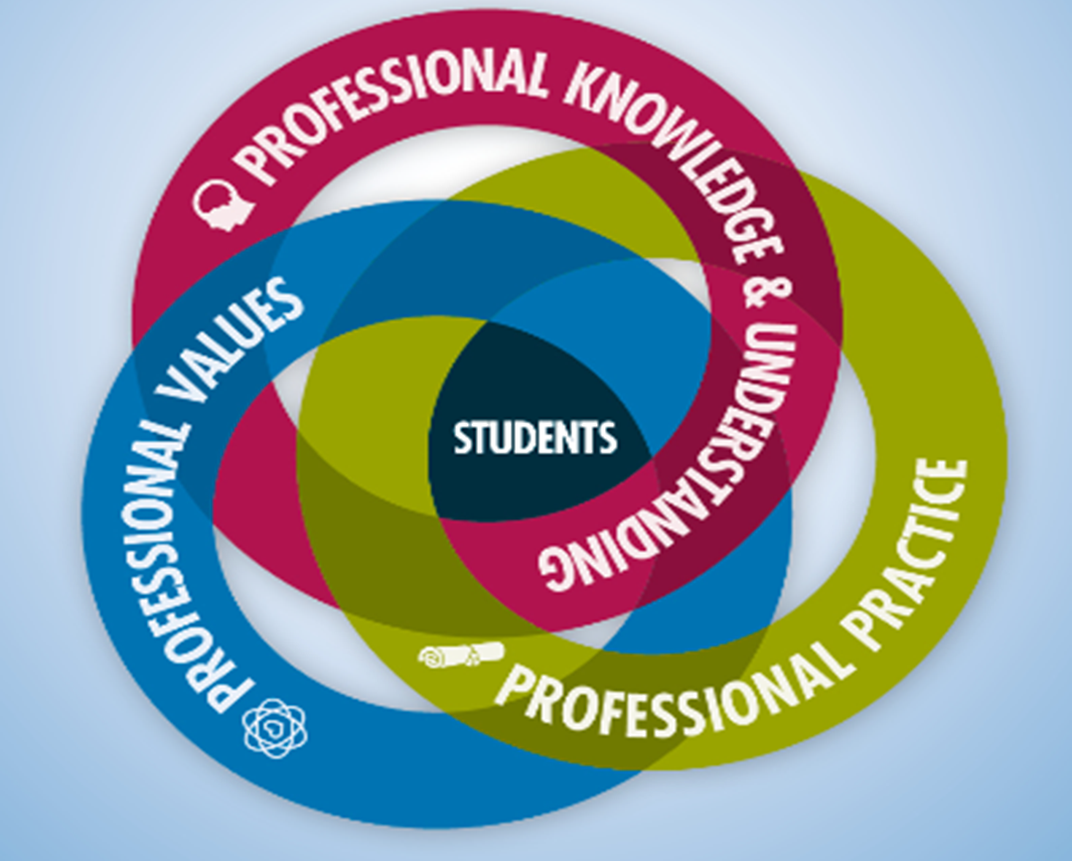

Slide 3
What role do Professional Standards have in Professional Learning?
Professional Update
On an ongoing basis:
  engage in the college staff review scheme
  engage in ongoing career long professional learning
  keep a reflective record of your professional learning and evidence of impact of learning on your thinking and actions
  reflect and plan using the Professional Standards

Slide 4
Professional Standards
Standards as provocation and catalyst for learning
Professional values
Frame & support your thinking and practice
As a way to signpost and plan your learning
Standards as provocation and catalyst for learning
Develop teacher agency
Self evaluate & engage in critically reflective dialogue about practice as part of ongoing PRD process
Challenge and consider your beliefs, values and professional actions
Reflect on your professional practice

Slide 5
New Professional Values

Slide 6
Professional Knowledge and Understanding
Political, social and economic drivers
Learning, teaching and assessment theory and approaches
Technologies and resources for learning, teaching and work
Student pathways and transitions within the wider education community
The principles, processes and purposes of quality assurance and improvement

Slide 7
Professional practice
Ongoing professional learning
Effective and inclusive practice and engagement woth students as partners
Creates innovative curriculum design and learning and teaching
Effective application of digital technologies to learning, life and work
Critical reflective and collaborative practice in learning and teaching

Slide 8

Sustainability in learning and teaching
Themes of sustainability and the impacts of course-relevant decisions on people and the environment should permeate teaching practice, inform it, and be made explicit to learners.
Design
Content
Delivery

Slide 9
Professional Learning is…..
Engagement with Employers on curriculum design and delivery
Self-evaluation and critical reflection processes
Experiential, action or enquiry-based learning
Professional dialogue with colleagues, community partners, other professionals, and learners
Focussed professional reading and research
Leading or engaging in practitioner enquiry/action research
Critical analysis of reading, learning and impact on professional practice
Peer support e.g. coaching or mentoring
Classroom visits/peer assessment/classroom observation
online learning/blogs
Work shadowing
Co-operative or team teaching
Participation in collaborative activity
Leading or participating in a working or task group
Planning learning which is inter-disciplinary or cross-sector
Participation in activities relating to assessment and moderation
Secondments, acting posts and employer placements
Professional/Academic conferences

Slide 10
Contact Details
Tel: 01786 272418
Suzanne.Marshall@cdn.ac.uk
www.cdn.ac.uk
Follow @ColDevNet on Twitter
facebook.com/collegedevelopmentnetwork

