Slide 1

ESD in the Veterinary Curriculum
EAUC Education for SD in HE TSN
Evaluating ESD in the curriculum
November 2019
Sharon Boyd
sharon.boyd@ed.ac.uk

Slide 2

Where to start?

Slide 3
RCVS Day One Competencies
2 Understand the ethical and legal responsibilities of the veterinary surgeon in relation to patients, clients, society and the environment.
To abide by the principles in the Code of Professional Conduct, veterinary surgeons…must be able to think through the dilemmas they face when presented with conflicting priorities and be prepared to justify the decisions they make.
As well as decisions relating to individual patients, animal groups, populations of animals and clients, veterinary surgeons must take account of the possible impact of their actions beyond the immediate workplace, e.g., on public health, the environment and society more generally.

Slide 4
Campus
Campus (e.g. green buildings, planting for biodiversity, recycling, transport)
Veg garden
Biodiversity surveys and hedgehog friendly
Wellbeing events (e.g. plant-a-plant)
Climate awareness
Plastic challenge
Workshops with the UoE SRS Department

Slide 5
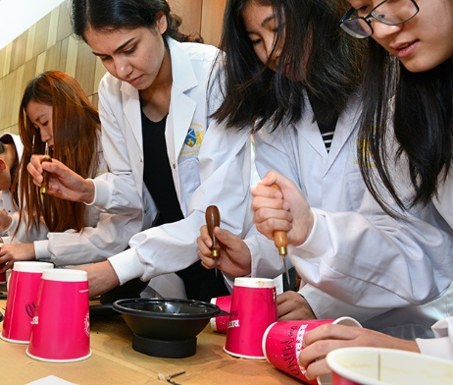
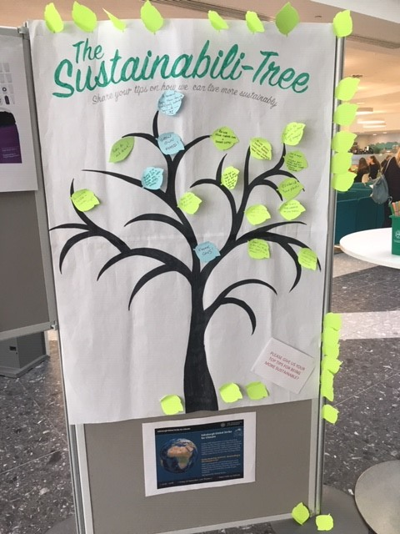

Slide 6
Social Responsibility and Sustainability (SRS) in Veterinary Medical Education
Secondment to the Institute for Academic Development 2015-2017
Curriculum mapping exercise to determine those areas of the veterinary curriculum where SRS/ESD themes were present but not explicit, or where it could be included (HEA and QAA, 2014)
Packed curriculum

Slide 7
Criteria (Bloemen 2013)
cover one or more themes related to SRS/ESD (content)
approach the themes from a discipline-specific, interdisciplinary or holistic perspective (approach)
are taught using mostly student-centred and praxis oriented teaching and assessment methods (delivery and assessment)
allow students to engage with local community projects or businesses (community engagement).
Notes:
Would argue that we train students to consider problems from a multi-disciplinary perspective, but as we have no direct examples, other than ECA, this is hard to demonstrate

Slide 8
Themes
Environment (includes ecosystem health, food and farming)
Economy (including employment rights)
Society (includes medicine, health and wellbeing)
Crosscutting themes
  Sustainability
  Ethics
  Environmental ethics (relationship between humans, animals and the environment)
  Scholarly ethics (specific to the discipline)
  Futures scenarios
  Uncertainty and risk
Notes:
BVMS clearly covers a range of themes, in many cases, multiple themes are covered in the same course

Slide 9
Pedagogies
Student-led learning
Real-world case studies
Problem-based learning
Group work
Debates
Site and field visits
Role-plays and simulations
Stimulus activities (e.g. work with the ECA)
Reflective accounts
Personal development planning
Futures visioning
Worldview and values research
Outdoor learning
Work-based learning
Guest speakers
Self-assessment
Peer-assessment
Action research (possibly EMS)
Multi-dimensional assessment (incl. social impact + academic)
Notes:
Reminder of Ross Galloway’s cargo-cult presentation – while we can say these types of pedagogical practices are being used, we can only draw conclusions that they’ve been successfully and effectively implemented from student feedback and results.

Slide 10
ESD courses
Explicit link
Student Research Component (Foundation)
Veterinary Public Health
Animal Welfare
Global Academy
Student-selected projects and activities

Slide 11
ESD developments
Curriculum review
Student and staff sustainability think-tank
Embedded cases – sustainability core theme
Sustainability Champions
… and Vet Sustain https://www.vetsustain.org/

Slide 12


Celebration!
UoE Sustainability Awards Gold
Green Gown (UK & Ireland) finalists 2017 and 2019

Slide 13
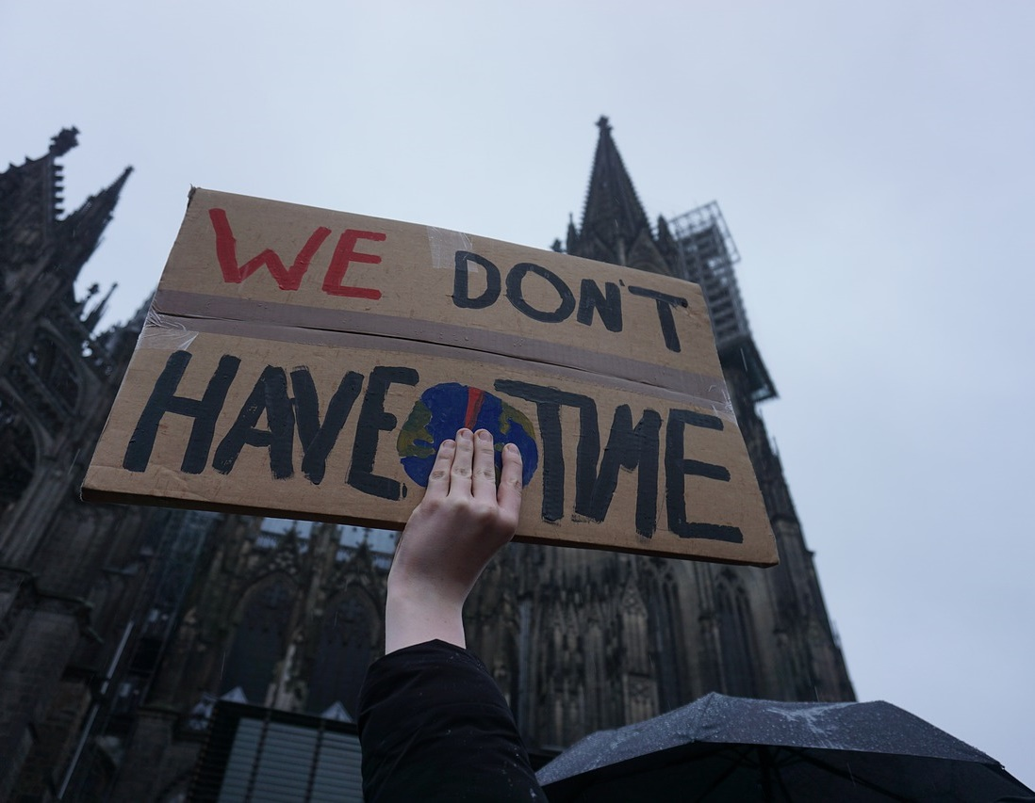

Slide 14
References
Bloemen, O. 2013. Learning for change: Social Responsibility & Sustainability in Undergraduate Courses at the University of Edinburgh 2012-13. http://www.docs.hss.ed.ac.uk/iad/Learning_teaching/Academic_teaching/Resources/Sustainability/SRS_in_UG_Courses_Full_Report.pdf
HEA and QAA 2014. Education for sustainable development: guidance for UK higher education providers. http://www.qaa.ac.uk/en/Publications/Documents/Education-sustainable-development-Guidance-June-14.pdf

