Slide 1
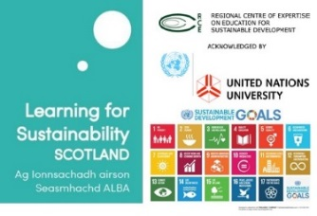
Measuring sustainability in
the curriculum
January 10th 2018

Slide 2
Welcome!
Rehema White,
Chair LfS Scotland, University of St Andrews

Slide 3
Learning for Sustainability Scotland
Learning for Sustainability (LfS) Scotland is an open network where members and partners come together to undertake collaborative projects, research and advocacy that push forward Learning for Sustainability practice
and policy in Scotland.

Slide 4
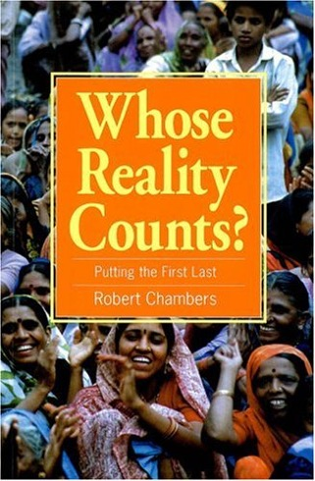
Historical development
Environmental movement catalysed by Silent Spring (1962); environmental education
Changes in notions of development post-colonialism; famine
Interdependence of social justice and ecological integrity
Education for sustainable development; learning for sustainability
Pedagogy and curriculum: critical reflection, transformative learning, outdoor learning, global citizenship, holistic view, future thinking, values based, systems thinking, interdisciplinary, real world problems, problem solving, experiential, practice linked….....

Slide 5
Learning for sustainability
Harnessing the full potential of learning to create a flourishing, sustainable world within formal institutions (e.g. schools, FE and HE) and in non-formal (e.g. community, business) and informal (e.g. through media and cultural norms) contexts
See Learning for Sustainability Scotland website

Slide 6
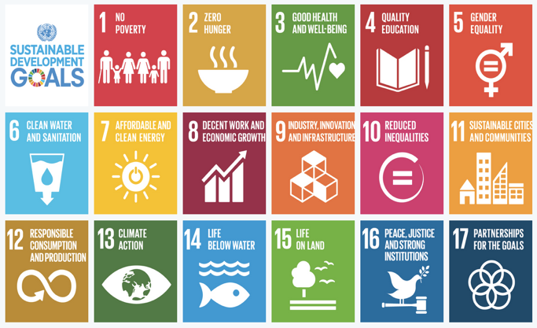
UK sustainability context
UN DESD 2005-2015 and UN RCEs in ESD
UK UN national commission note on ESD
QAA ESD guidance 2014
HEA report on embedding sustainability in the curriculum
SDGs: UKSSD action plan; Young people, education & SDGs St Georges house consultations

Slide 7
Linking to Institutional Sustainability Intentions
Rehema White
University of St Andrews

Slide 8
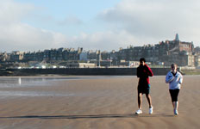
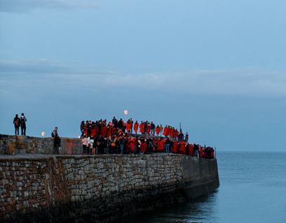
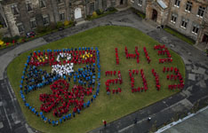
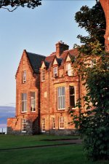
University of St Andrews
A small and ancient institution (600 yrs); 8000 students in small coastal town
Research intensive
52% students in residences
SD module then undergraduate Programme then postgraduate
St Andrews Sustainability Institute (SASI)
Estates enthusiasm
Student and staff grassroots movement including Transition
Integrated action and revitalised SD Working Group

Slide 9
Aim of SD Programme
Enable students to critically interrogate the principles, practice and plurality of sustainable development and contribute to the evolution of innovative, interdisciplinary thinking and action necessary to move towards more sustainable futures

Slide 10
Principles of SD degree at St Andrews
Why? Critical interrogation of SD
With whom? Interdisciplinarity and practice
How? Pedagogy
What? Curriculum
Where? Local focus and global perspective

Slide 11
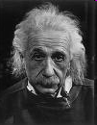
Why? Critical thinking
“We can’t solve problems by using the same kind of thinking we used when we created them”
“Education is not the learning of facts, but training the mind to think”
Albert Einstein

Slide 12
With whom?
Interdisciplinarity
Sustainable development
Biology
Geography
Economics
Management
Divinity
Estates
Social Anthropology
Medicine
International Relations
Chemistry
History
Maths/Stats

Slide 13
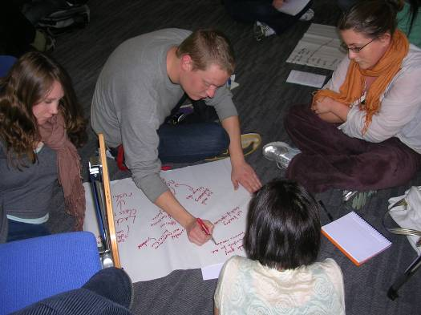
How? Pedagogy: Transformative learning & skills
Educational display
Group work
Careers support
Design
Essays
Dissertation
Debate
Marketing
Independent research
Exams
Reports
Presentations
External linkages
Popular articles
Time management
Reflective assignments
Fieldtrips

Slide 14
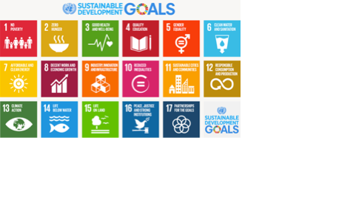
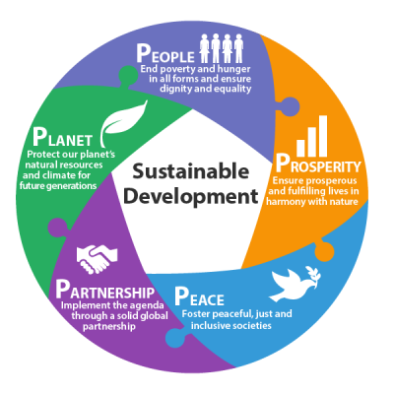
What?
Curriculum: Academia as if the world matters
Topics:
Poverty
Health and wellbeing
Water and sanitation
Climate change and energy
Prosperity and responsible consumption and production
Sustainable communities and cities
Biodiversity and ecosystems
Cross cutting themes:
Knowledge for research, learning and practice
Policy, decision making and governance
Partnership and diversity
Sustainable behaviours
Values, philosophies and ethics
Equity and Gender
Contemporary sustainability issues matrix 2016

Slide 15
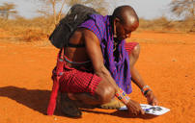
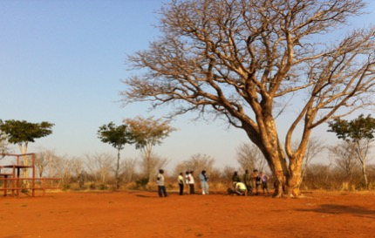
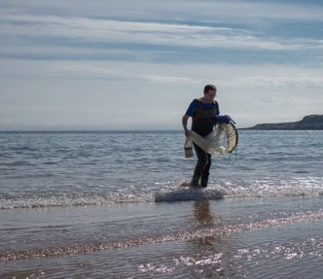
Where? Local focus and global perspective

Slide 16
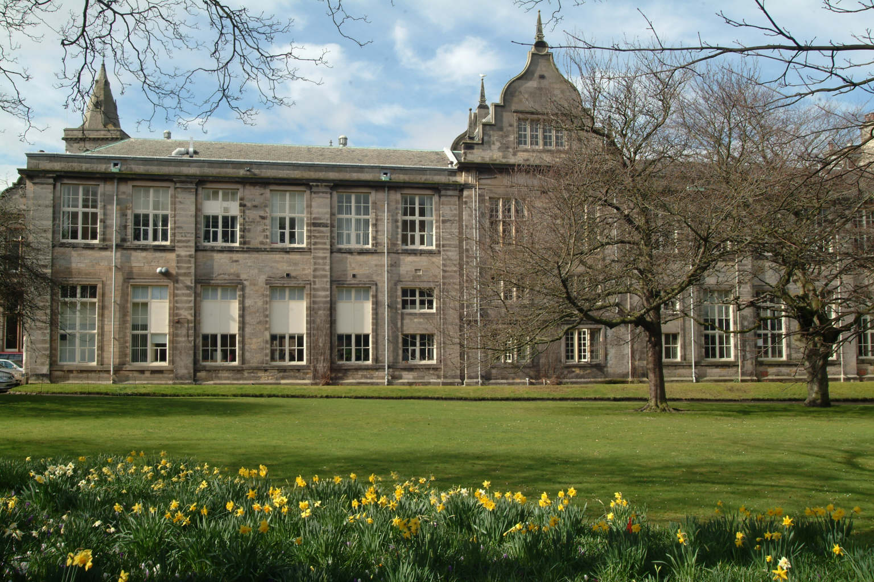
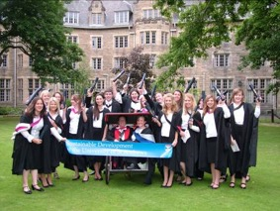
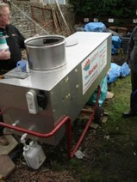
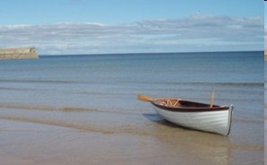
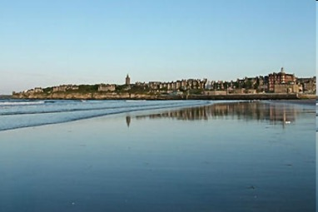
Towards a sustainable university? University of St Andrews
Teaching
Estates
Linking to Institutional Sustainability Intentions
Research
Governance
Students
White 2013; White and Harder 2013; White 2014
Community

Slide 17
Towards a sustainable university? University of St Andrews
Teaching
Estates
Research
Transition UStA
Governance
Students
White 2013; White and Harder 2013; White 2014
Wider Community

Slide 18
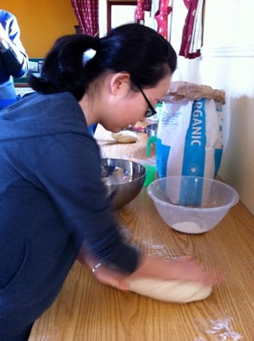
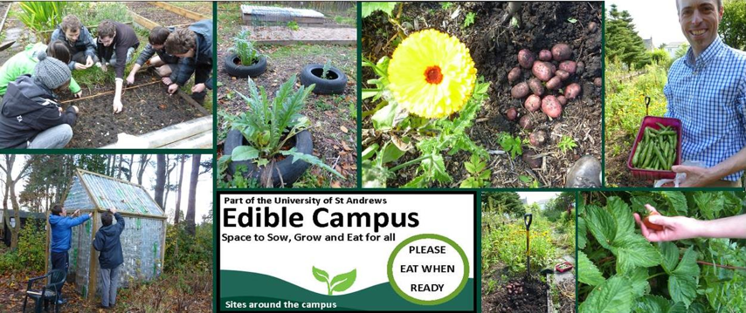
Transition University of St Andrews
Notes:
Growing
Cooking and sharing food – llnks to vegan soc, fine dining
Veg bag scheme
Food policy and food waste

Slide 19
Approaches to measuring / encouraging sustainability in the curriculum
MODULE SURVEY SDWG initial survey of module names and engagement with HoSs – uni wide survey C 2014
WORKING GROUP - LTC WG on LfS – attempt to gain cross institutional support from LTC but not resourced
SCOPING AND INTERVIEWS Transition links with research and teaching
LEARNING FROM OTHERS–beginning of a strategy with smart targets. At this stage wanted to know more of hat others had done
DRAFT AIM AND INDICATORS Preliminary research on other institutional experiences and draft aims to our SDWG
ENCOURAGING MORE! Symposium plan to pursue sustainability in curriculum discussions and present draft outline for comment

Slide 20
Examples of scoping sustainability in the curriculum: Shona Russell and Katherine Ellsworth-Krebs
Pro Deans (Curriculum) identified relevant modules codes /descriptions
Directors of Teaching from 13 out of 20 Schools and Units responded
194 modules identified across most schools and departments
Sustainability spans topics of localism, human-nature relations, technological development, behaviour change, ethics and CSR.
Examples:
The arts of Islam; the age of Klimt; experimental art of the 1960s
Ecosystems and conservation; Evolution; Animal cognition
The impact of chemistry; Surface Chemistry and Heterogeneous Catalysis
Green information technology; data intensive systems
Theology in Latin America
Victorian literature and science; literature and ecology
Planet earth; welcome to the Anthropocene
Notes:
Some provided detailed narratives explaining how sustainability is conceptualised in teaching activities as well as module descriptors, while most provided a list of modules. Additional information on staff with an interest in sustainability and research centres that relate to sustainability.

Slide 21
Overall aim: to equip our University community with the knowledge and skills to understand and address sustainability
All students are aware of and understand what sustainability is
All students have an understanding of different facets of sustainability
All students have the opportunity to study sustainability
All students have the opportunity to be involved in sustainability activities outside of the curriculum
Students will understand the links between their knowledge and experience.
All students will have the opportunity to develop critical thinking in relation to sustainability, as widely defined
All academic staff are aware of the drive to consider and support learning for sustainability
All support and operations staff understand how their activities could support learning for sustainability
(adapted from Leeds University Sustainability Action Plan document)
http://2ej3yy3dhmmm499wwc3l4n36.wpengine.netdna-cdn.com/wp-content/uploads/2015/03/4381-Leeds-Action-Plan-A4-Landscape-V5.pdf

Slide 22
Towards a ‘sustainable university’
“It is essentially a transformative space; where transformational practices are theorized, modelled and imagined. An open space which is not known by its 'ivory towers'; its rigid traditions, or its allegiance to power, but rather by its creativity, and energy for change; a 'hub' of social transformation and social learning for a more sustainable, just and equitable future. At the heart of such a university lies independence of thought, critical debate and social critique, but perhaps more importantly, such critical debate and social critique should feed imagination and re-imagination that is creative, productive, and intellectually rich and stimulating” (Lotz-Sisitka in Sterling et al 2013)
Notes:
Transformation, reflection, environmental nature, significant change, social change, leadership

Slide 23
Conclusions
Widely scoping sustainability is useful
Support for ESD grown – timing?
Focus on pedagogy? - critical thinking
Strategy and SMART indicators being developed alongside theoretical discussions
How much is enough?

Slide 24
Measuring sustainability in the curriculum
Group Discussion

Slide 25
Measuring sustainability in the curriculum
Summary and Next Steps
Rehema White, Chair LfS Scotland

