Slide 1

Tools for teaching ESD
Rehema White
University of St Andrews and
Learning for Sustainability Scotland

Slide 2
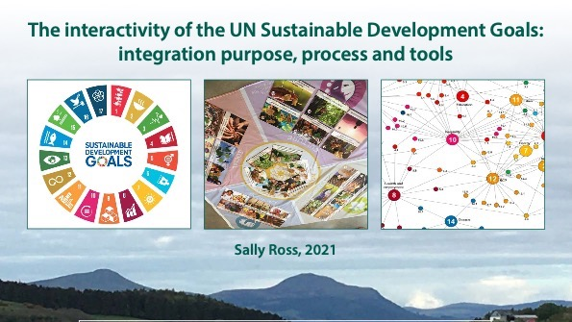
https://www.scottishinsight.ac.uk/Portals/80/SUIIProgrammes/Falkland%20Estate/Folk%20Place%20Work%20-%20Interactivity%20of%20SDGs%20Brief.pdf

Slide 3
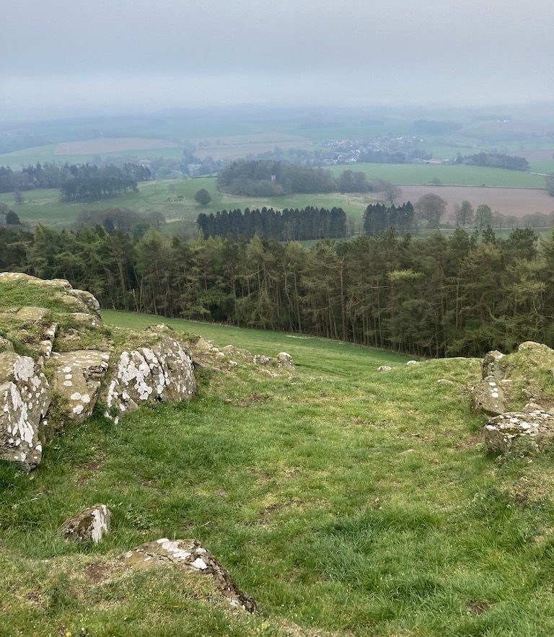
Aims of our brief
1. Explore theoretical frameworks to interpret the holistic vision of the SDGs
2. Describe existing practical tools that can be used to map and monitor progress against the SDGs by sectors, communities, businesses or enterprises
3. Inform the choice of a practical mapping tool for our project.
4. Provide a resource for further programmes
Ross 2021

Slide 4
 | Function Tool | UTILITY | STAKEHOLDERS | IDENTIFY ORGANISATIONAL VALUES AND PURPOSE | UNDERSTAND SDGs | MAPPING | INTERACTIONS | TARGETS , INDICATOR& MILESTONES | INTEGRATION | REVIEW PROGRESS
T1 | Stakeholder analysis matrix | All | ●
T2 | Stakeholder engagement matrix | All | ●
T3 | Theory-U | Any organisation or group with sufficient time | ●
T4 | UN SDG Knowledge Hub | All |  |  | ●
T5 | EcoliseWiki | Communities |  |  | ● | ●
T6 | Land Portal | Primarily Government, but also others for the land |  |  | ●
T7 | Gaia Education SDG Flashcards etc | Communities and Government primarily | ● |  | ● | ● | ● | ● | ●
T8 | Global Ecovillage Map of Regeneration | Communities, but also applicable to groups, projects, organisations, and even countries |  | ● |  | ●
T9 | Scottish National Performance Framework | Government primarily, Scottish communities and businesses secondarily |  | ● |  | ●
T10 | SDG Impact Assessment Tool | Research and educational institutions, companies, entrepreneurs, civic organisations, and public agencies |  |  | ● | ● | ●
T11 | Global Goals Mapping Tool | Funding agencies |  |  |  | ●
T12 | SDG Interactions Framework | Government, researchers, communities |  |  | ● |  | ●
T13 | SDG Synergies Approach | Government, researchers, to some extent communities |  |  |  |  | ●
T14 | Scotland Can B Impact Culture Events & Economy Advisors Training | Business people and business advisors |  |  |  |  |  |  | ●
T15 | Global Ecovillage Network Impact Assessment | Communities, but also applicable to groups, projects, organisations, and even countries |  |  |  | ● |  |  |  | ●
T16 | SDG Action Manager | Businesses, but it can be used by not-for-profit organisations, with sections that are not relevant being ignored |  |  | ● | ● |  | ● |  | ●
T17 | SDG Compass | Companies of all sizes but the process the tool outlines can be useful for all |  | ● | ● | ● | ● | ● | ● | ●
Table 1: Matrix of tools by SDG integration function

Slide 5

Global Ecovillage Network
Map of Regeneration
https://ecovillage.org/projects/map-of-regeneration/

Slide 6
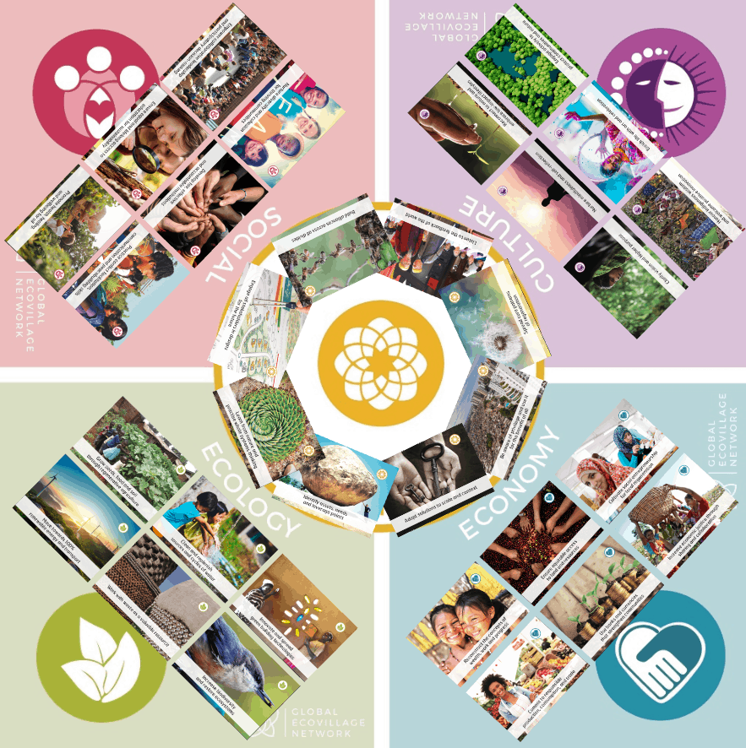
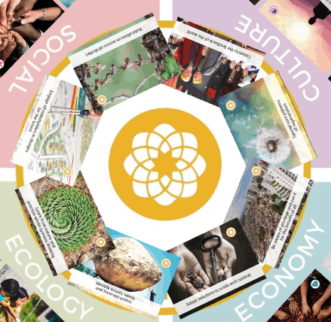
https://prezi.com/view/bOjFnQaBH20H8Ysdp8LS/

Slide 7
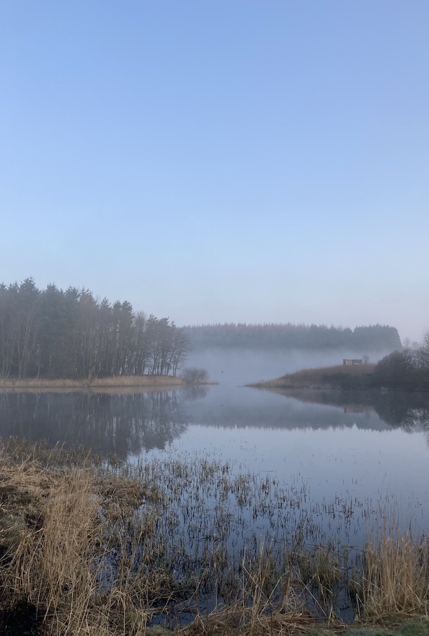
Activity with Map of Regeneration
Define context, scale and scope of the exercise
Each person highlights 3-6 areas of strength and of weakness or neglect in the community
Use as basis for mapping, discussion of scope and interconnectivity of SD issues, visioning what a regenerative deign might look like, reflection on diversity of perspectives
Links to SDGs via impact assessment and the GEN cards
Could use to identify areas of focus for class projects, to encourage diverse dissertations etc

Slide 8
Example –University of St Andrews community mapping by students in one class
area | topic | +ve | -ve
Social | Diversity |  | 14
 | ESD | 17
 | Health | 9 | 7
Cultural | Reconnecting with nature | 13
 | Indigenous knowledge |  | 16
Ecological | Renewable energy | 16 | 2
 | Waste | 2 | 14
Economic | Equitable land
 | Responsible consumption
Design | Address privilege | 2 | 17
 | Systems thinking | 2
Notes:
Discussion on

