Slide 1
Introduction to ESD and the QAA / Advance HE Education for Sustainable Development Guidance
Rehema White
Learning for Sustainability Scotland
GOSSIP, School of Geography and Sustainable Development.
University of St Andrews

Slide 2
contents
What is ESD?
Guidance Process
QAA guidance summary
What does this mean for us?

Slide 3
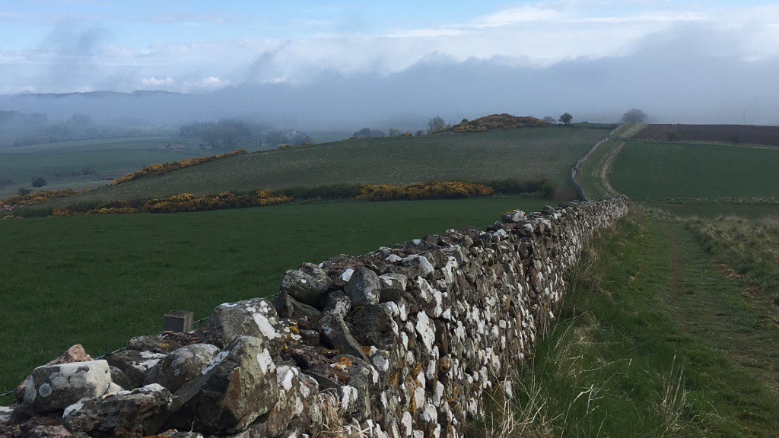
Context
“Interconnected environmental and social issues such as global climate change, local and global biodiversity loss, depletion of natural resources, deforestation, air quality, access to water, hunger, gender equality, and widening inequalities of wealth, health and wellbeing. ”
Increased urgency to tackle interlinked crises
Policy context UNFCCC and UN SDGs
Green recovery for a better world
Aligns with some education directions eg quality education, entrepreneurship
Employer needs
Student expectations for ESD

Slide 4
What is Higher Education for Sustainable Development?
What is the role of universities?
How can we develop ‘sustainable universities’?
How do we provide education for transformation and self fulfilment as well as for society and vocation?
How do we prepare students for our uncertain, complex world?
How do we strengthen the capacity for critical interrogation of information?
ESD!

Slide 5
Process for the QAA/ Advance HE guidance 2021
Last guidance 2014
Quality Assurance Agency for HE and Advance HE
Expert group, debate and drafting
Consultation
Revision
Critical reflection eg Price et al 2020; Price et al 2021
Practice guides

Slide 6
Section 1 - Introducing ESD
ESD empowers learners to take informed decisions and responsible actions for environmental integrity, economic viability and a just society, for present and future generations, while respecting cultural diversity. It is about lifelong learning, and is an integral part of quality education. ESD is holistic and transformational education which addresses learning content and outcomes, pedagogy and the learning environment. It achieves its purpose by transforming society. UNESCO, 2019
Not merely about and not merely environmental issues!
ESD is an educational change agenda grounded in transformative learning and critical pedagogy.
ESD develops competencies - skills, attributes and values - for a better world

Slide 7
Support staff, students, managers and whole institutions
Not merely tweaking curricula!
Links to bigger agendas

Slide 8
Section 2 – Getting started with ESD
“ESD is best achieved when:
ESD objectives, targets and KPIs are part of the institution’s strategic priorities and subsequent strategies and policies.
The framing of ESD within the curriculum is included in the validation of new courses and ongoing review of existing courses.
ESD is central to the staff and student induction process, as well as staff appraisal and/or promotion criteria.
ESD is articulated within quality assurance and enhancement processes.
Staff development to enable ESD is fully supported at an institutional level.”

Slide 9
Section 3 – teaching, learning and assessment for ESD
Specific subject knowledge and knowledge of SDGs |  | A student who displays this competency can
 | Systems thinking competency | recognise and understand relationships, analyse complex systems, consider how systems are embedded within different domains and scales, deal with uncertainty | Ways of thinking
 | Anticipatory competency (Future thinking) | understand and evaluate multiple outcomes, create their own visions for the future, apply the precautionary principle, assess the consequences of actions, deal with risks and changes
 | Critical thinking competency | question norms, practices and opinions, reflect on one’s own values, perceptions and actions, sustainable development discourse
 | Strategic competency | develop and implement innovative plans and actions that further sustainable development at the local level and further afield | Ways of practising
 | Collaboration competency | learn from others, understand and respect the needs, perspectives and actions of others, deal with group conflicts, collaborative & participatory problem solving
 | Integrated problem-solving competency | apply different problem-solving frameworks to complex sustainable development problems, develop viable, inclusive and equitable solutions, utilise appropriate competencies to solve problems
 | Self awareness | reflect on own values and actions; monitor feelings and needs | Ways of being
 | Normative | understand and reflect on norms and values underpinning actions, appreciate other worldviews, negotiate goals and trade offs

Slide 10
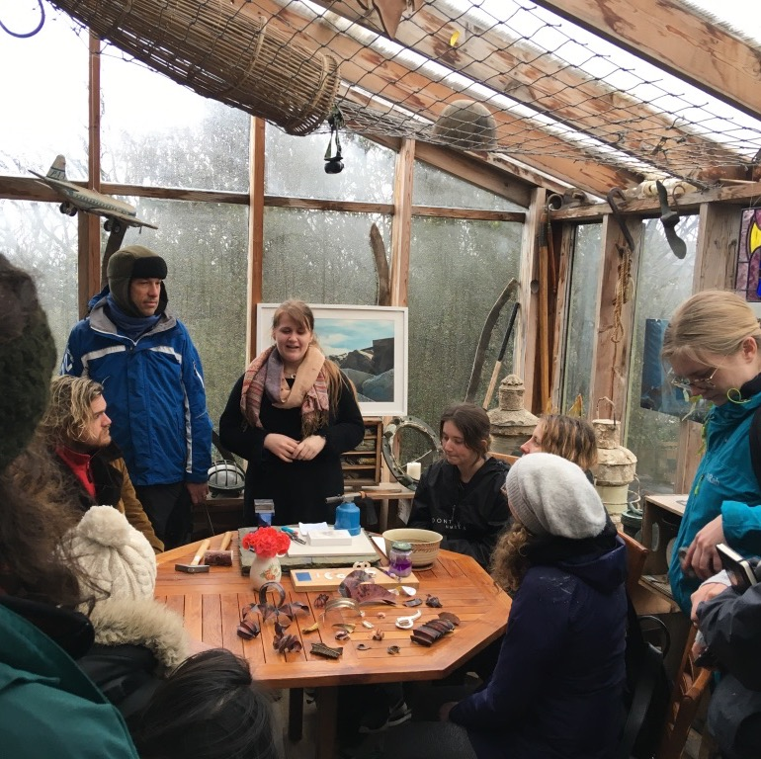
Teaching practices
Collaborative learning
Enquiry based learning
Playful learning
Storytelling
Problem based learning ….

Slide 11
Section 4 – annotated references and resources
Policies and strategies, UN and other
Non UNESCO resources
UK frameworks

Slide 12
QAA Resources and practice guides from Nov 2021
Examples
UNIVERSITY OF SHEFFIELD A five-step framework for a whole-institution approach to embedding ESD
UNIVERSITY OF GLOUCESTERSHIRE The stories we live by: A free online course about sustainability and the role of language in shaping society
UNIVERSITY OF MANCHESTER Living Lab: Applied research to affect change for sustainable development
Storiesweliveby.org.uk

Slide 13
How to get started with ESD?
Be inspired, read the guidance, learn from other places and gather enthusiasts in your institution
Join the community of practice in Scotland – TSN, EAUC, LfS Scotland
Consider own context!
The QAA/Advance HE guidance can be used for information, resources, advocacy

