Slide 1
THE NEW AGENDA Closing the Performance Gap May. 16. 2017

Slide 2
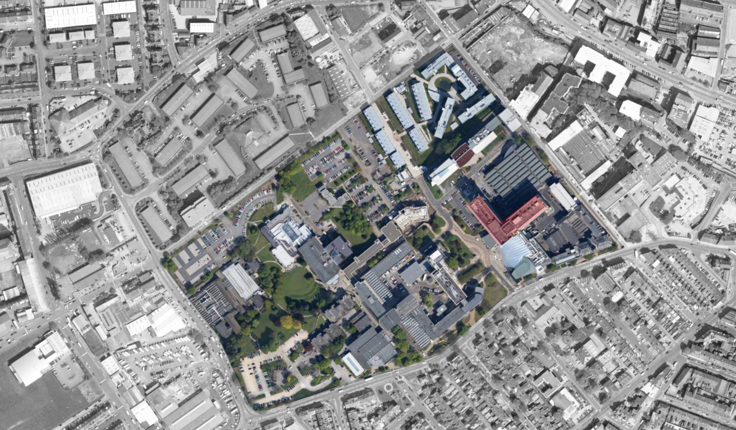

Slide 3
Size: 124,600m² Gross Internal Area
Covers: 36.7 hectares over 3 sites
12,000 Students 2,500 staff
Emit 8,400 tonnes Co2
72,000m³ water consumed
460 Tonnes of waste produced (100% diversion from landfill)

Slide 4
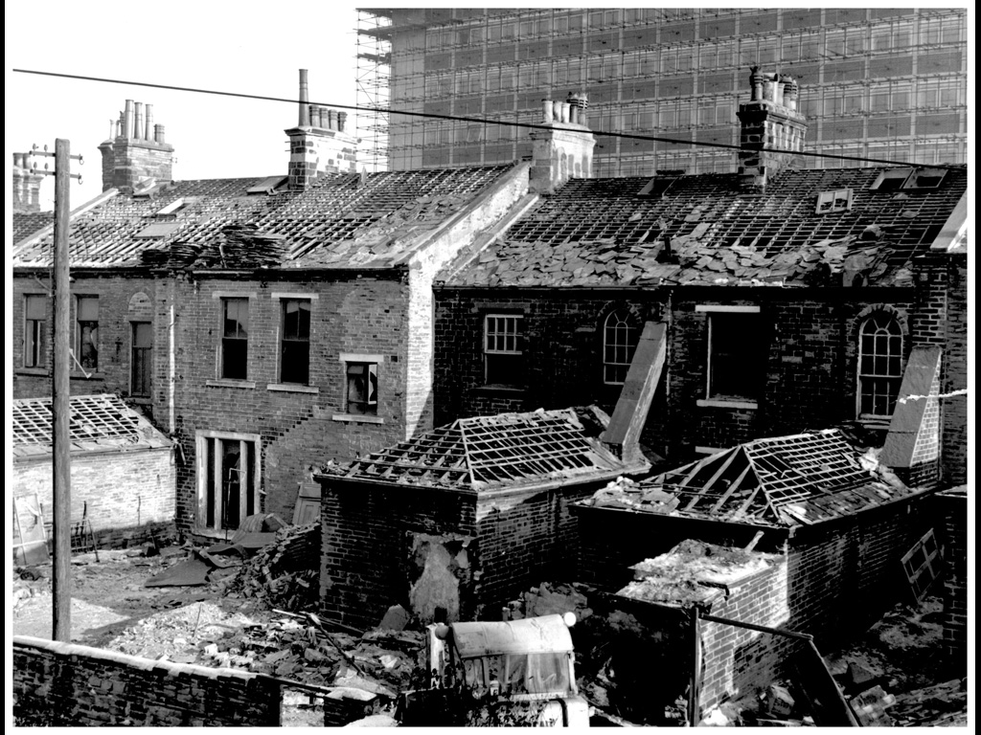
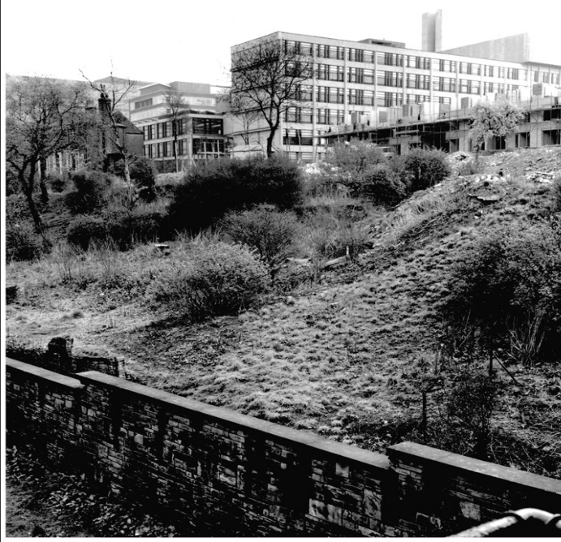
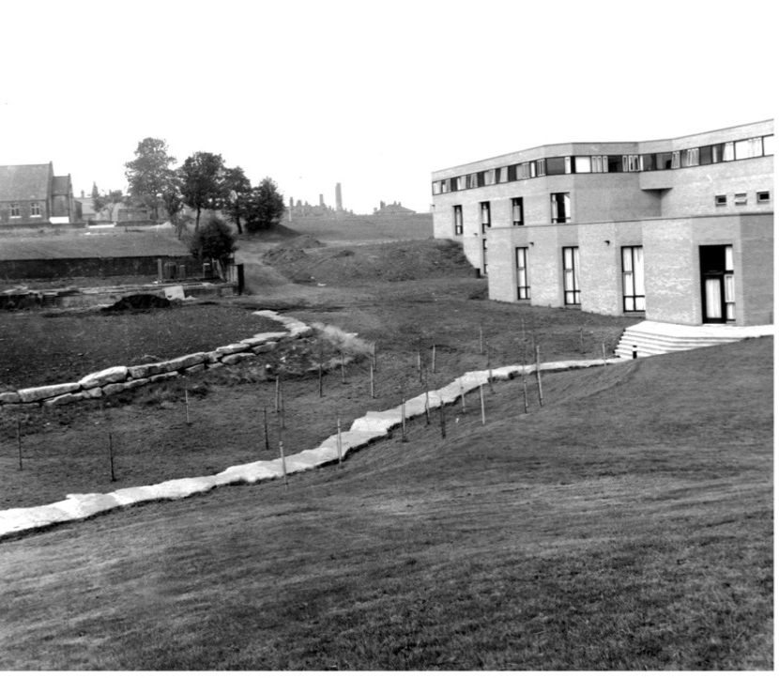
The Legacy Estate
THE NEW AGENDA RUSSELL SMITH: HEAD OF ESTATES

Slide 5
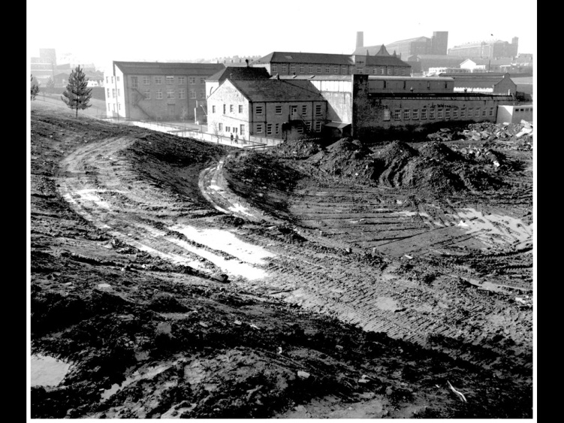
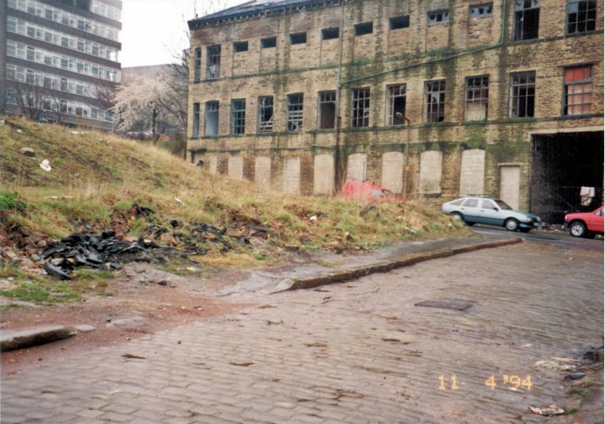
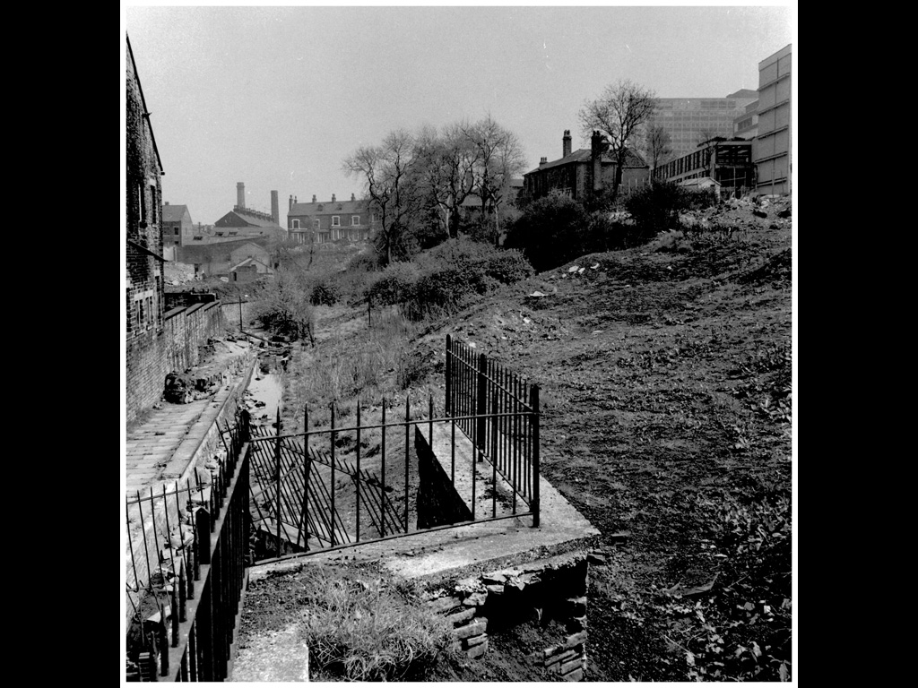
The Legacy Estate
THE NEW AGENDA RUSSELL SMITH: HEAD OF ESTATES

Slide 6
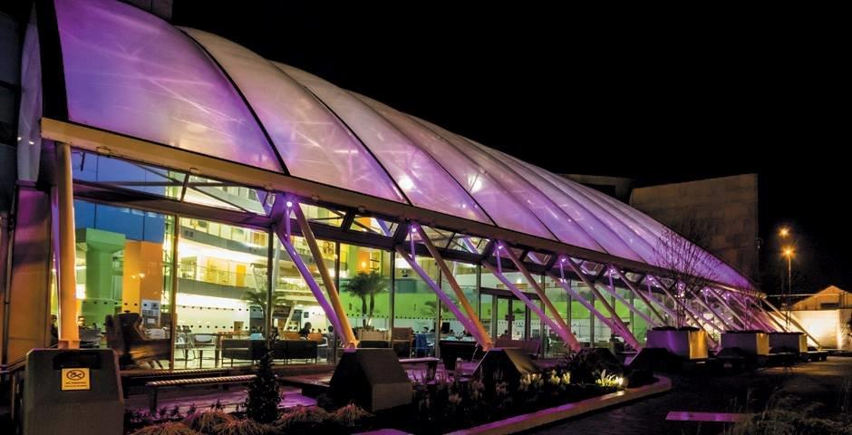
IN 2005 WE UNDERTOOK AN AMBITIOUS SUSTAINABLE REGENERATION OF THE ESTATE

Slide 7
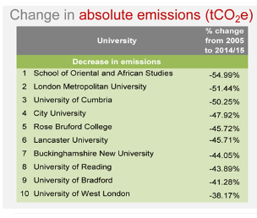
7 BREAM Bldgs - 3 outstanding
1 Passivhaus Bldg
World’s largest monolithic hemp building
41.26% carbon reduction
On target for 50% @ 2018
IS0 14001
6th in the World UI Metric

Slide 8
Does anybody remember 1973?

Slide 9
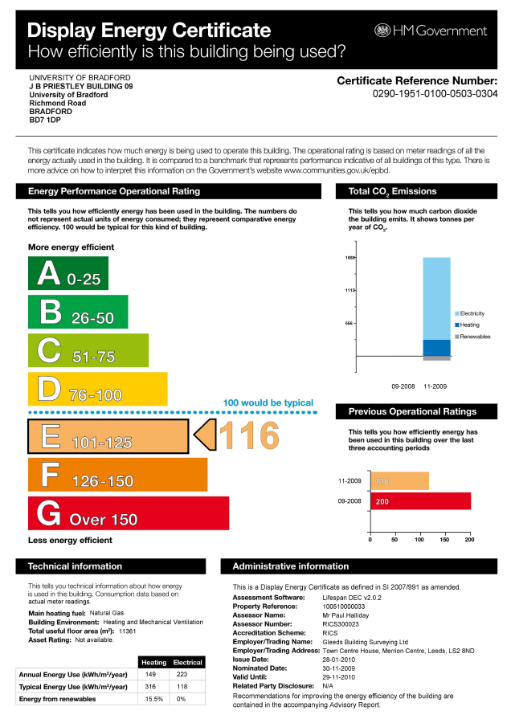
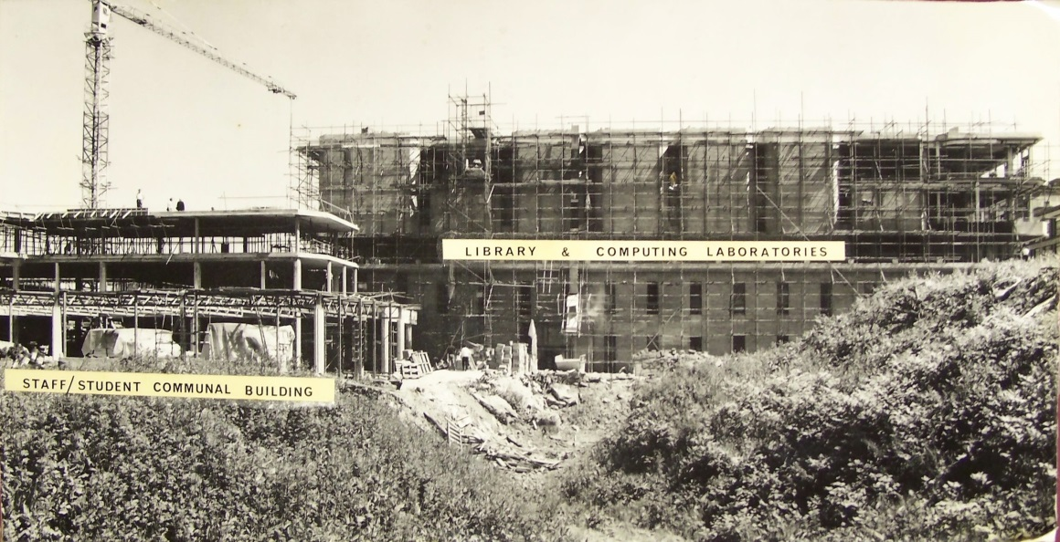

Slide 10
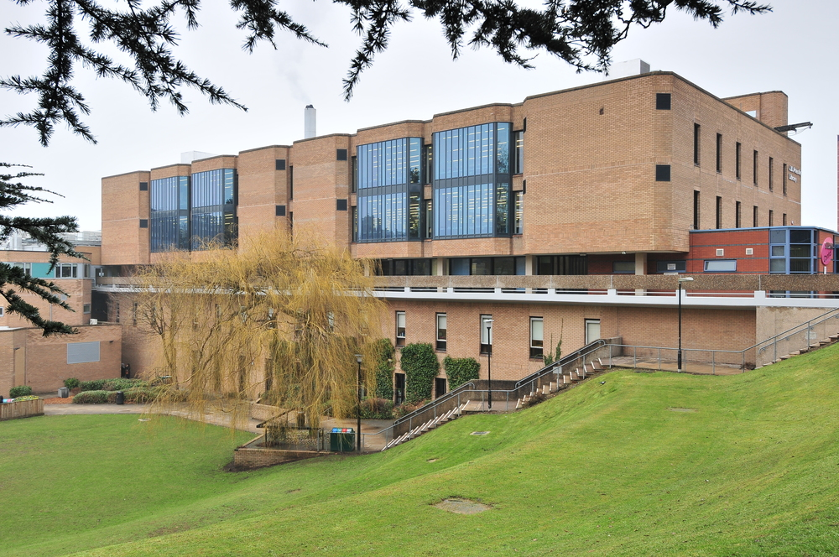
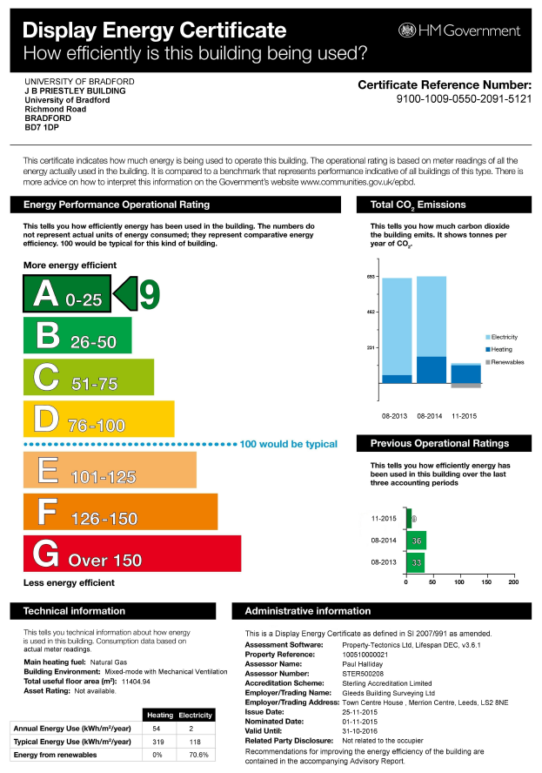

Slide 11
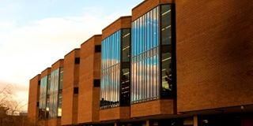
JBPL 2014/15 - A9
JBPL 2013/14- B33
JBPL 2009/10 - E116
JBPL 2008/09 - G200
Primary Energy Demand down from 372kw/m2 to 111kw/m2

Slide 12
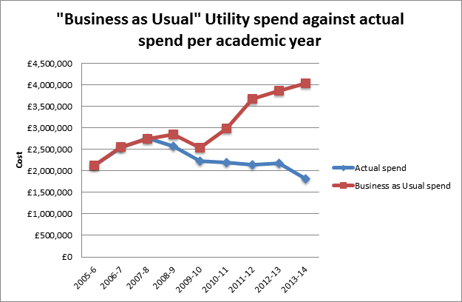

Slide 15
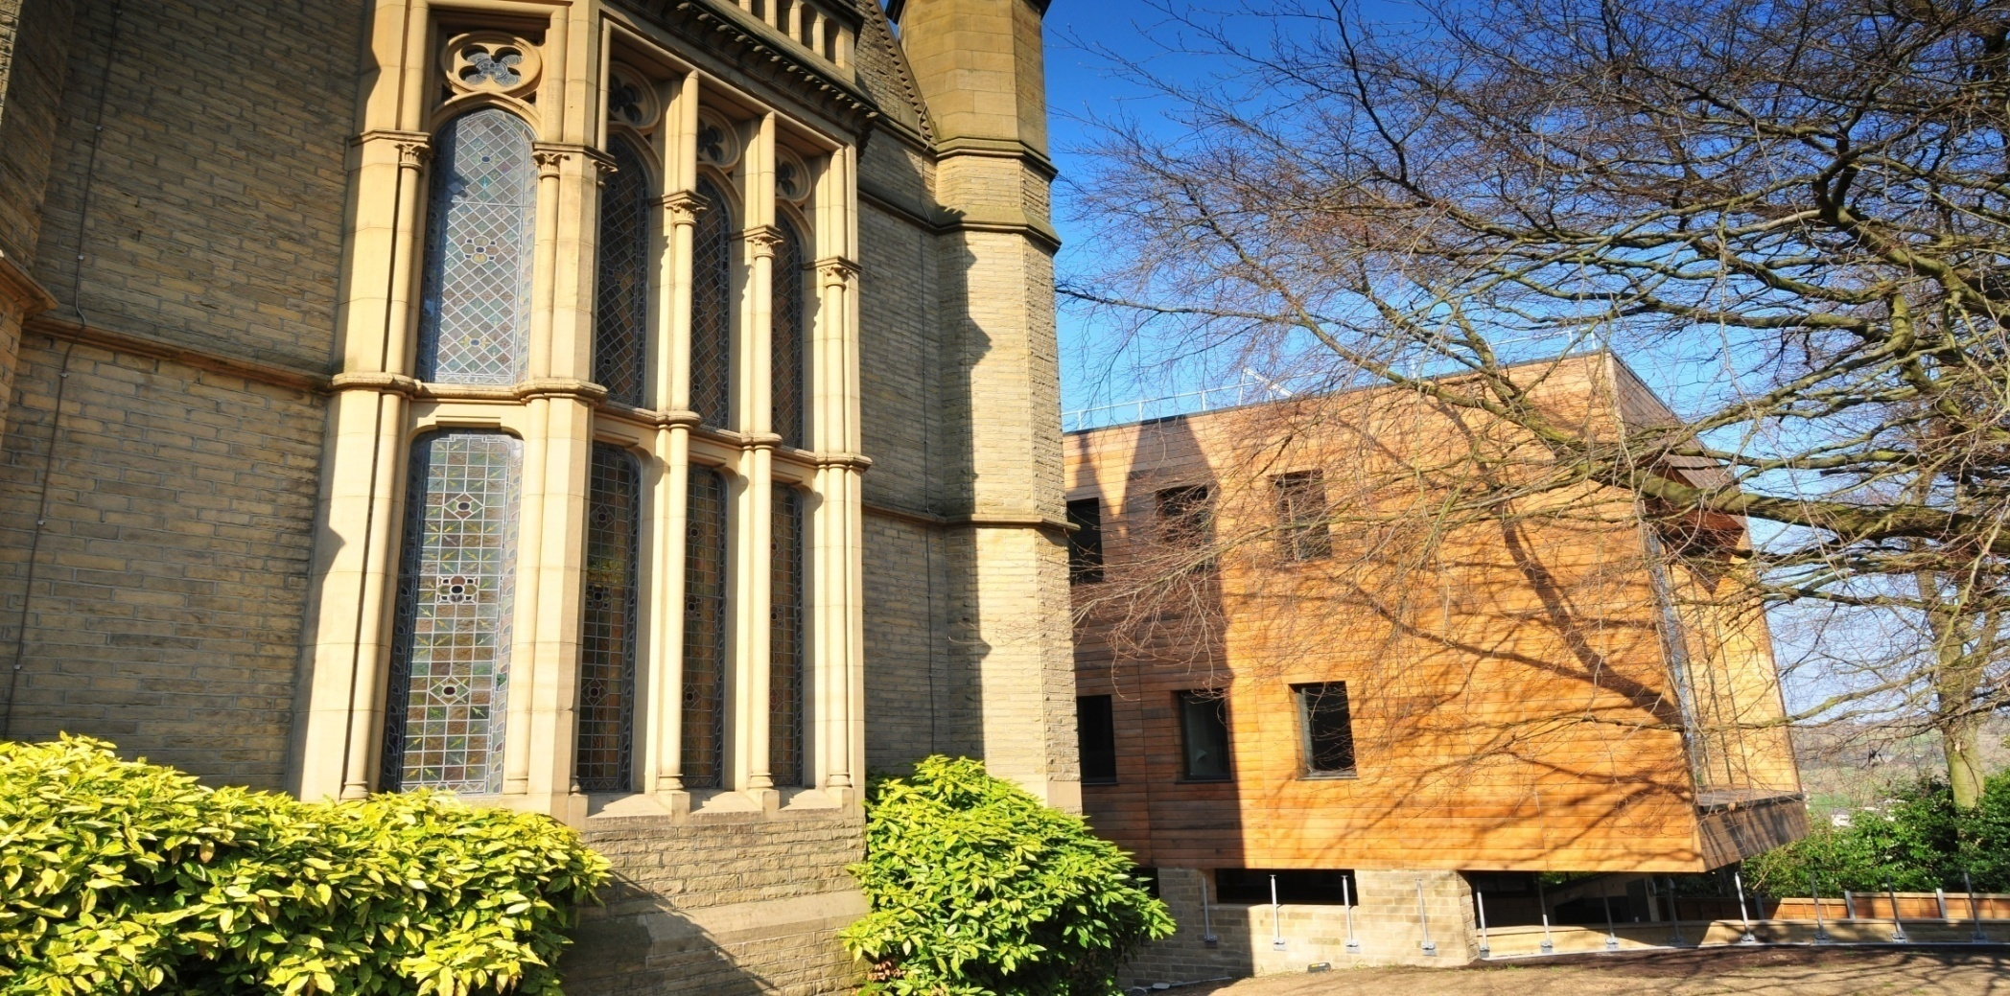
HOW?

Slide 16
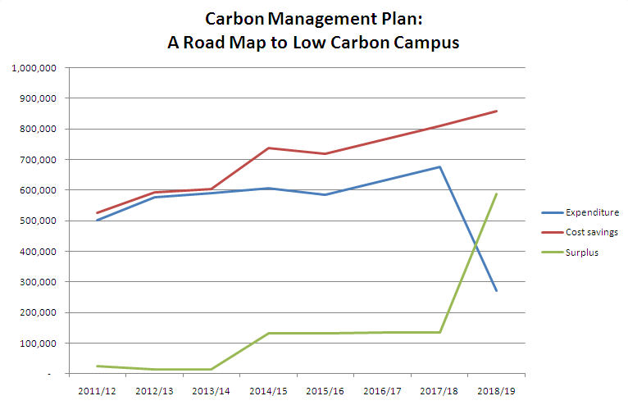

Slide 17
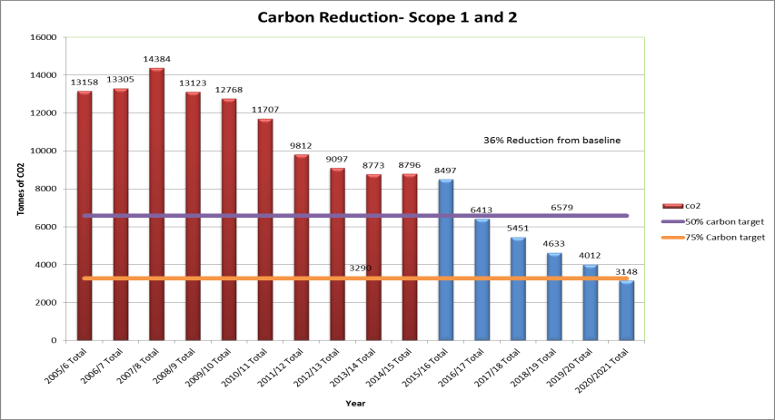
Energy Performance

Slide 18
MANY GOALS: ONE TEAM
Institutional buy in
Simple target driven CMP
Recycle utility savings
Sustainable construction specification
Maintenance and Capital works teams working to one goal

Slide 19
The last decade
Climate change?
The green agenda?
Leaving something for our children?
Government/HEFCE targets?
Driving change?

Slide 20
THE NEW AGENDA?
NATIONAL GRID: UK FUTURE ENERGY SENERIOS (JULY 2014)
“No one can be certain how the energy future will evolve and this uncertainty may continue for decades.”

Slide 21
Alistair Buchanan (CEO Ofgem):
“Britain will be very tight on power station capacity in three to five years' time”.
CIBSE Annual lecture, Nov. 7. 2012.
Notes:
ADDRESSING AN UNCERTAIN ENERGY FUTURE

Slide 22
Damien Speight, Chief Trader Drax Power Station:
“It only takes the confluence of three things to cause a squeeze. A power Station coming off line, cold weather and conflict in a gas producing region and two of those happened in the winter of 2012/13.”
Major Energy Users Council, October. 22. 2013.

Slide 23
Sources of Natural Gas in 1999
Norwegen
Großbritannien
Russland
3.000 km
Niederlande
1.000 km
2.000 km
Kasachstan
Deutschland
Ukraine
Usbekistan
Frankreich
Rumänien
Aserbaidschan
Turkmenistan
Algerien
Libyen
Ägypten
Sources of natural Gas in 2025 – political issues ?

Slide 24
This is what it means for the University

Slide 25
The New Agenda
Good business sense
Business Continuity

Slide 26
OUR RESPONSE

Slide 27
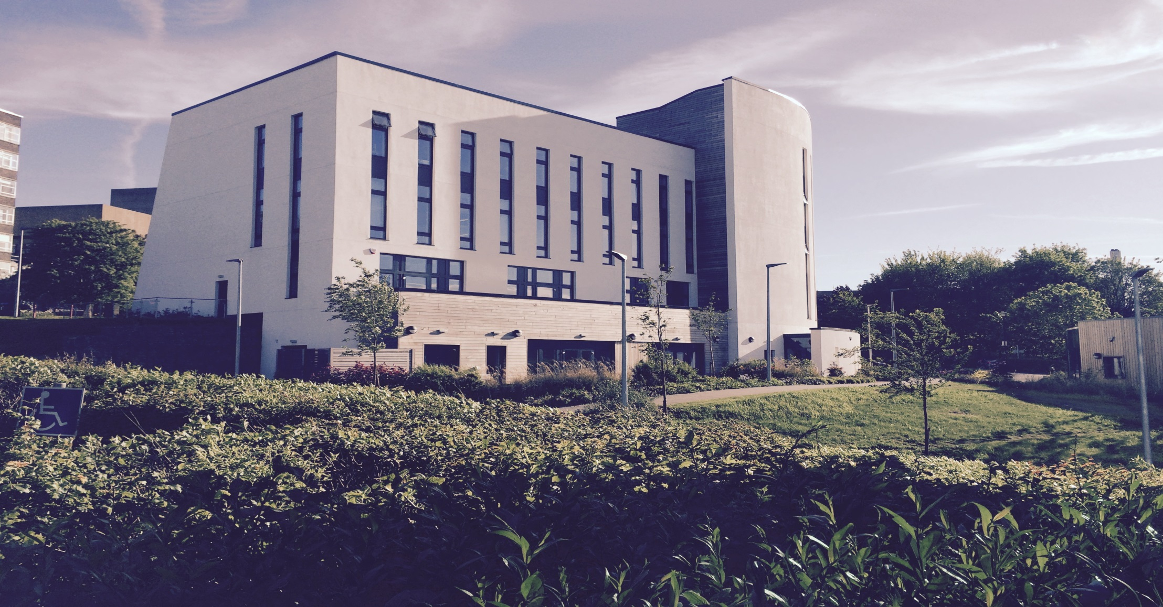
BRADFORD: 50@50
Bradford 50@50

Slide 28
Four strands to a financially secure future
1: Creating a micro smart grid (completes Jan. 16)
2: Preparing the infrastructure and teams to maximise external opportunities (ongoing)
3: Carry on reducing the base load/building fabric improvements (ongoing) linked to a University wide behaviour change programme
4: Increased investment to modernise the infrastructure

Slide 29
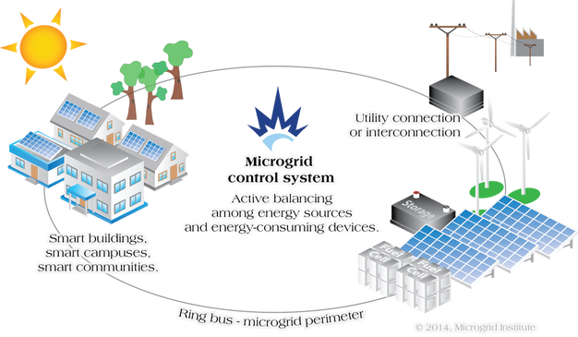
Micro Smart Grid
£1.9m Project
SALIX/HEFCE funded
Operational Dec. 2016
£250k savings pa
Enable the ambitious 2020 carbon target to reached early
Assist the University’s off grid/business resilience aspirations
Project linked to using the Estate as a teaching tool

Slide 30
Bradford 50 @ 50 progress:
Maximising TRIAD period monitoring and planned shift loading through winter periods
Ongoing optimisation of plant and controls including energy audits of particular energy-intensive areas
White Goods rationale and policy to include portable heaters/fans
New Carbon Management Plan – 75% by 2020
Micro Smart Grid operational Feb. 17

