Slide 1
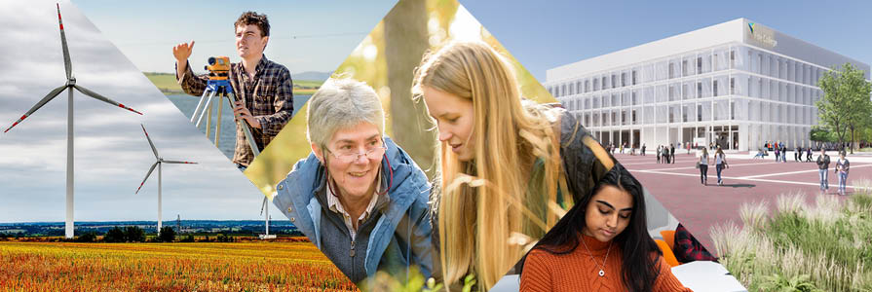
SFC Net Zero and Sustainability Framework for Action
March 2023

Slide 2
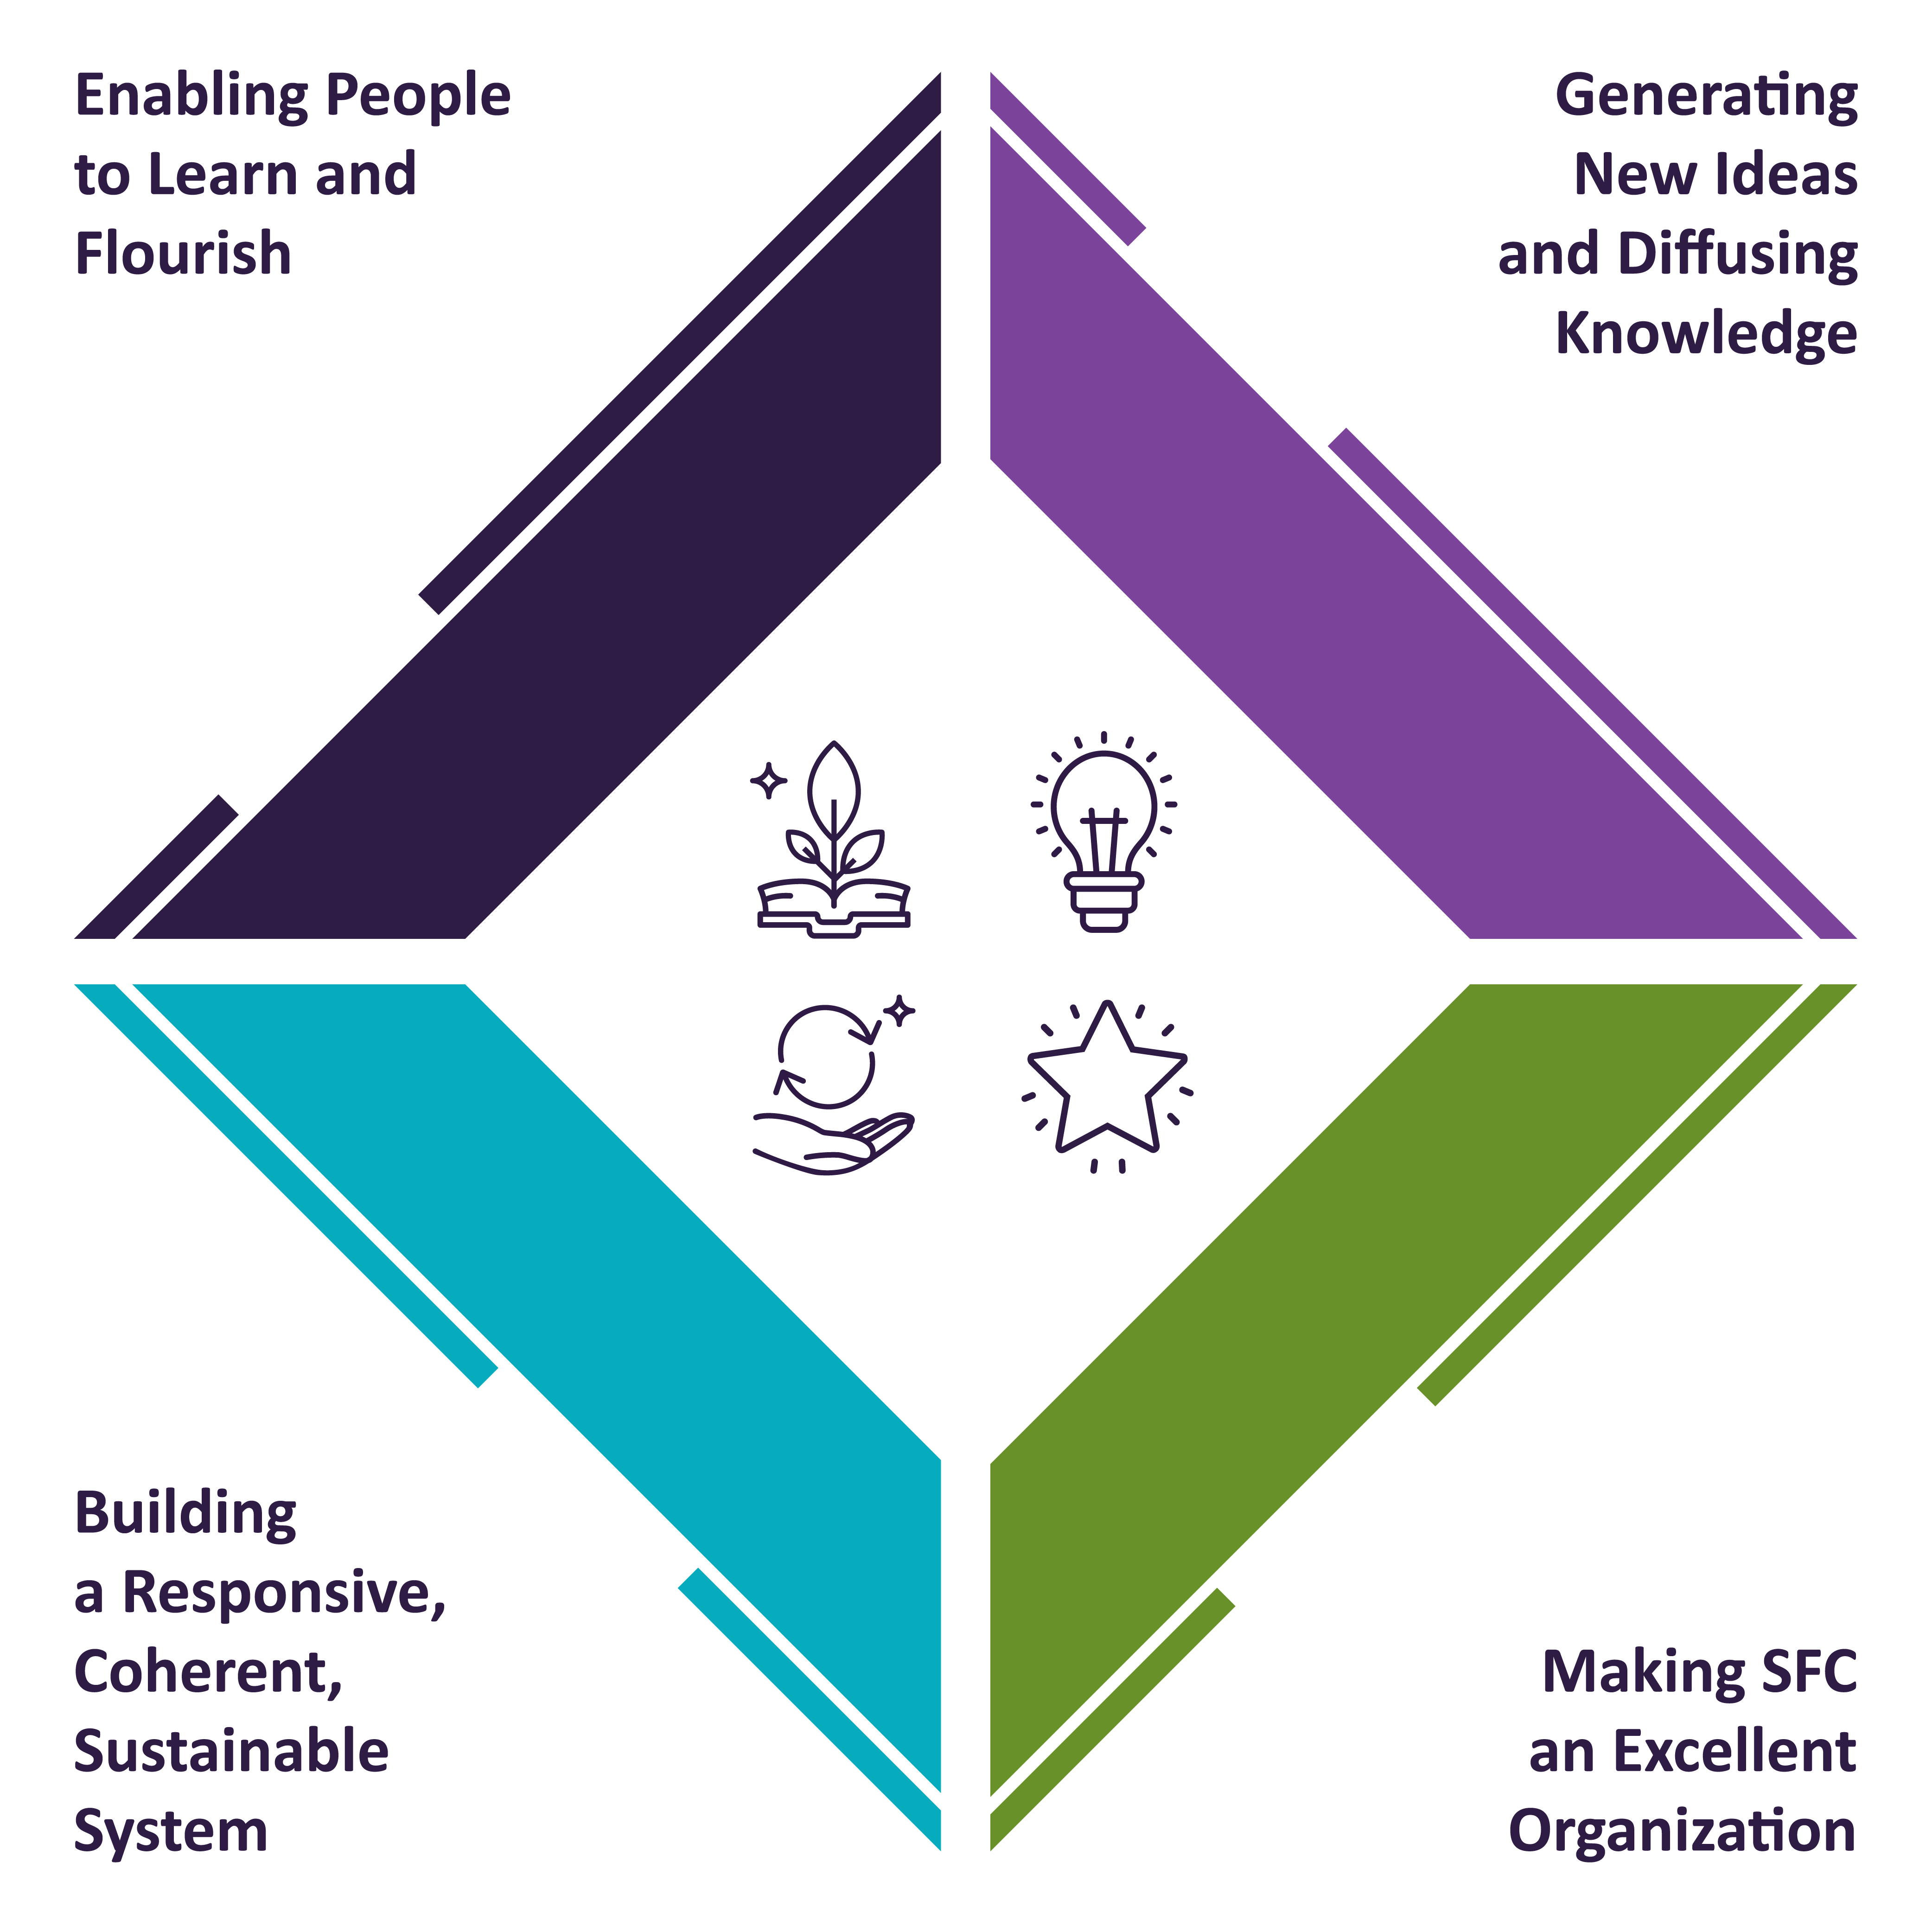
Our Strategic Objectives

Slide 3

“We will support Scotland’s colleges and universities as global leaders in accelerating the climate emergency response and Scotland’s just transition. This should lead to reduced emissions, system change, and long-term climate resilience.”
Strategic Plan 2022-2027 connects through the Net Zero & Sustainability Framework for Action strategic outcomes.

Slide 4

Strategic outcomes: Net Zero & Sustainability Framework for Action
Just transition (community health, wealth, opportunity part of net zero benefits realisation)
Green growth (inc. upskilling, reskilling and education, value creation including R&I: new opportunities.)
Place-based net zero transformation (including sense of place, access and infrastructure.)

Slide 5
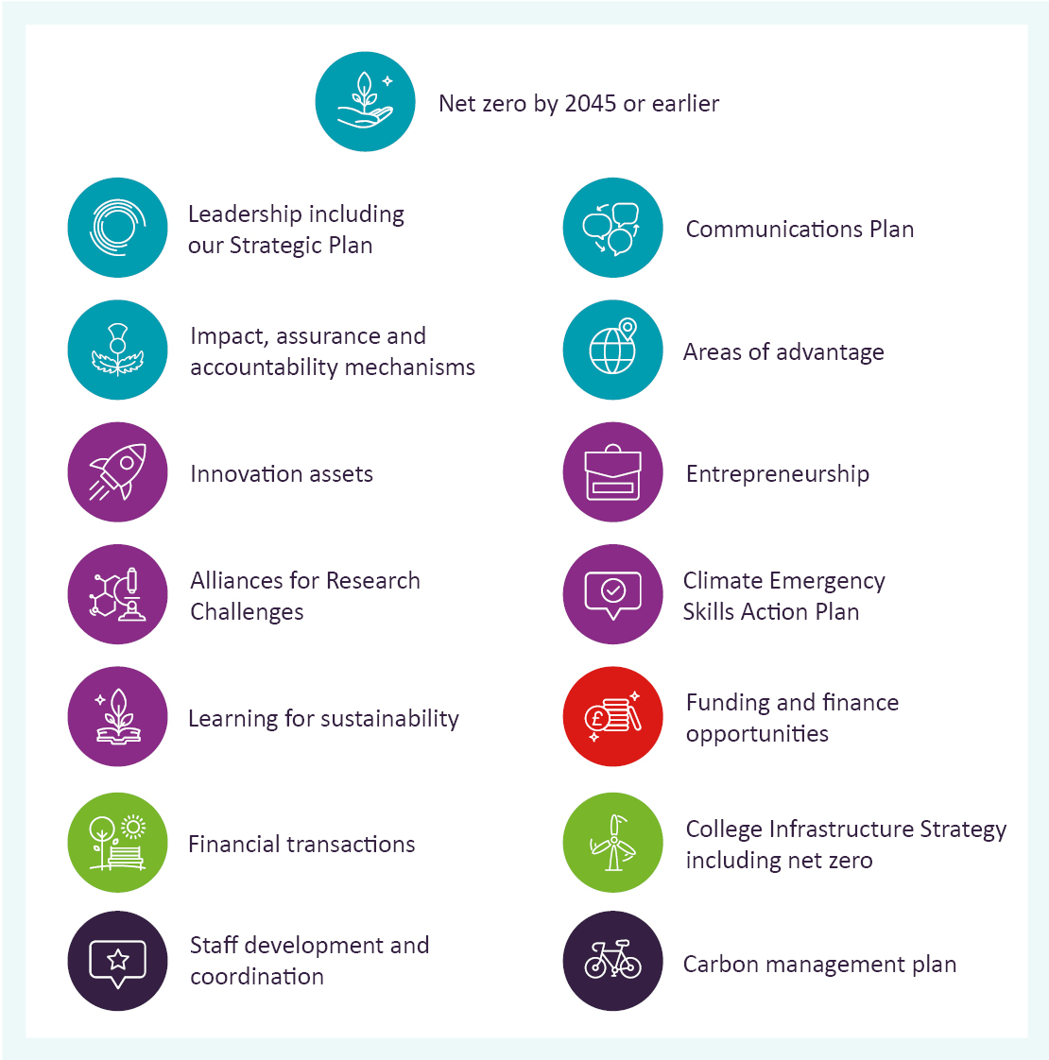
SFC Net Zero & Sustainability Framework for Action: Themes & Action Points
Theme 1 | Driving corporate accountability
Theme 2 | Innovation, education, research and entrepreneurship
Theme 3 | Funding & finance
Theme 4 | Green Estates
Theme 5 | SFC carbon reduction

Slide 6

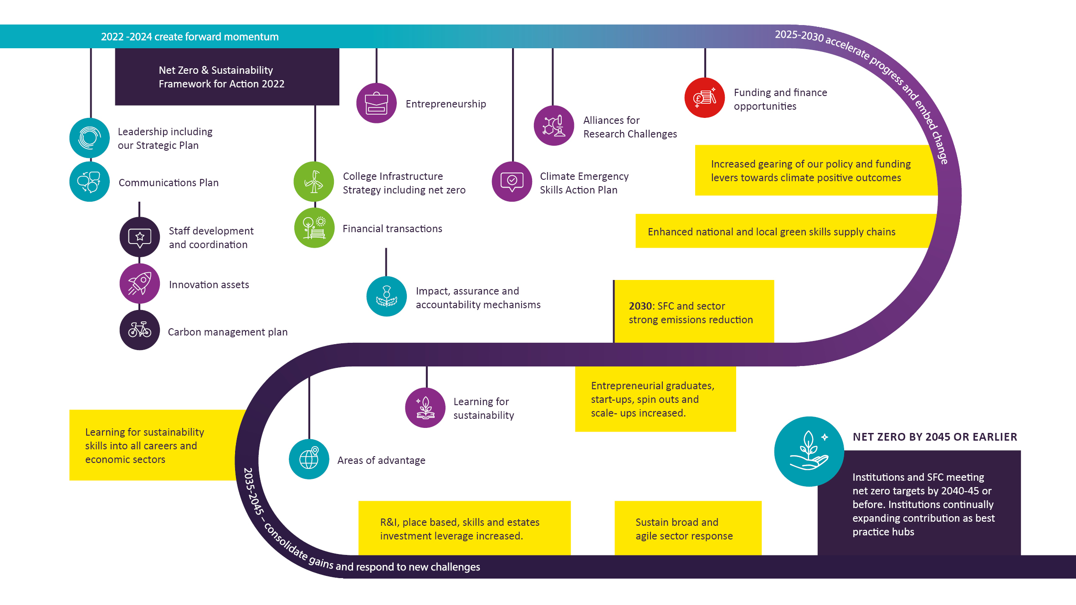
Action points and milestones: the route to delivering the Framework

Slide 7
Themes and Action Points
Assurance and Accountability Framework
Net zero by 2045 or earlier
Strategic Framework, leadership, governance, staff engagement and mainstreaming net zero
Supporting areas of net zero advantage
Communications Plan
Driving Corporate Accountability
Increase coordination & delivery including staff development
ARCs foreground environmental sustainability.
Knowledge exchange & innovation assets for green growth & just transition
SFC carbon reduction
Maximising the contribution of the college and university estate
Carbon Management Plan
Innovation, education, research & entrepreneurship
Sustainable funding and accelerating change
Green estates: College Infrastructure Strategy & net zero capital funding
Net zero entrepreneurship
Climate Emergency Skills Action Plan, upskilling &
re-skilling and pathfinders.
Embed net zero approaches in our funding & investigate new funding models for investment in institutions
Net Zero place making
& collaboration including Financial Transactions
Learning for Sustainability

