Slide 3
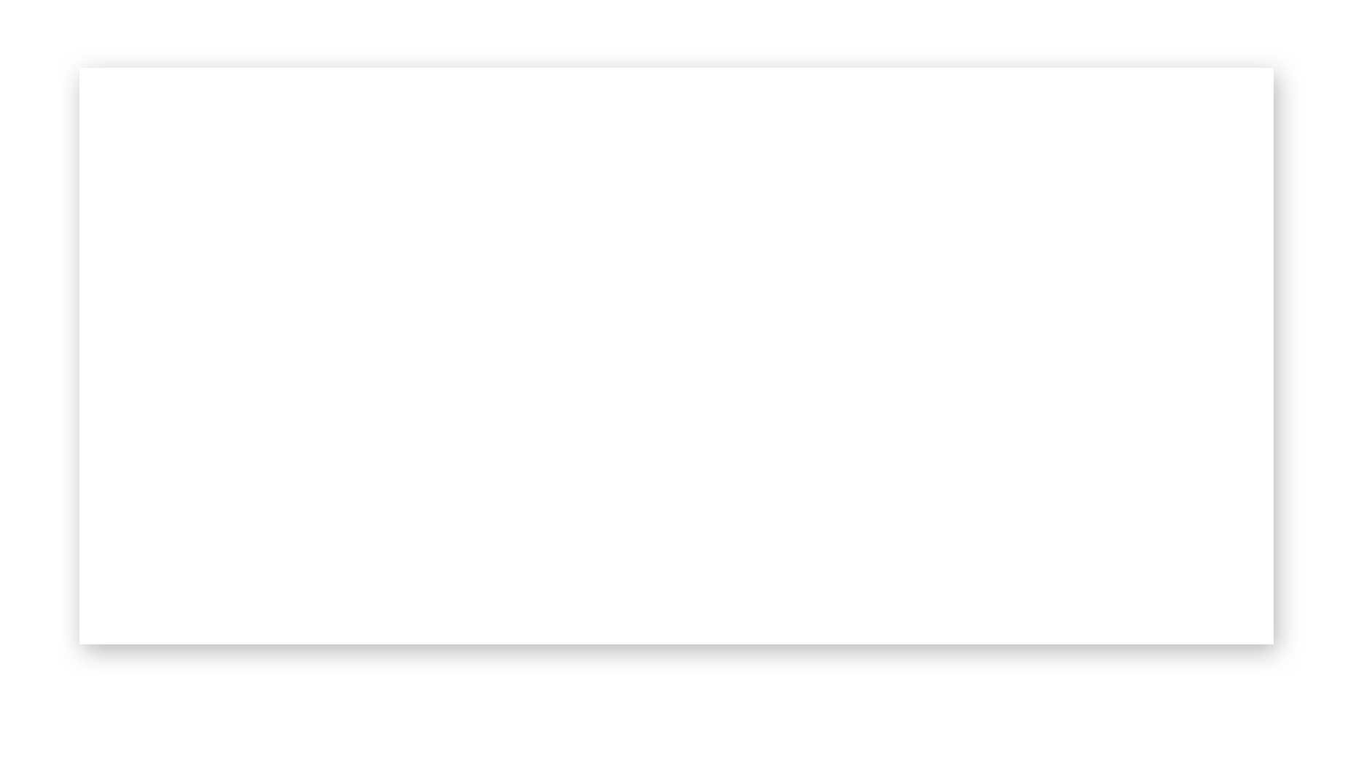
>600 million people use social networks at least daily

Slide 4
Awareness of Facebook is close to 100%
More than 1 billion people (>70% of internet population) use social networks.

Slide 5
37 minutes is the average time members spend each time they log in to Facebook

Slide 7
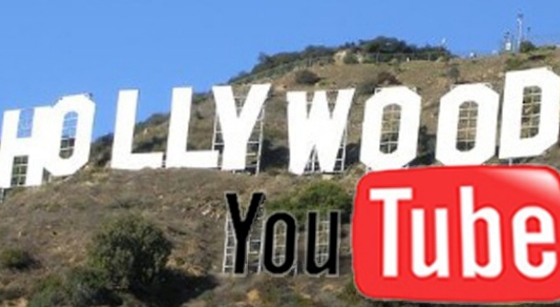

Slide 8
25% of Americans have watched video on the phone
Youtube is the world’s 2nd largest Search Engine
700 billion Video views in 2010
8

Slide 9
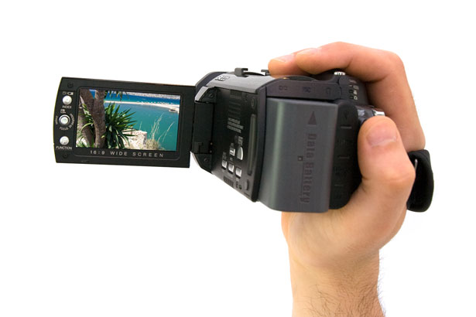
Visual Media
48 Hours of video uploaded to Youtube per minute
Other Video sites – specialized content
Vimeo is best quality and allows longer than 10 mins
Producing your own Films is easy
9

Slide 10
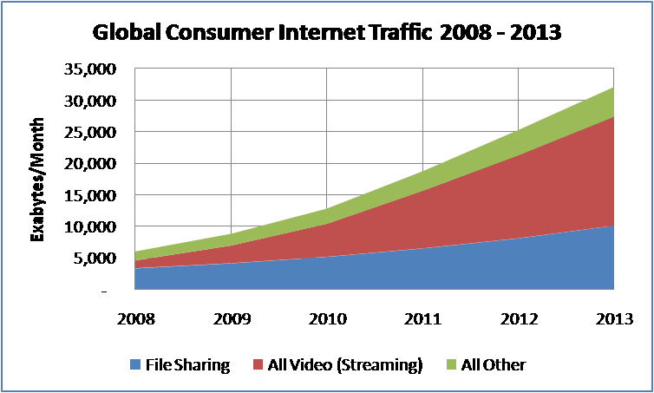
video predicted to account for 90% of all online traffic by 2013

Slide 11
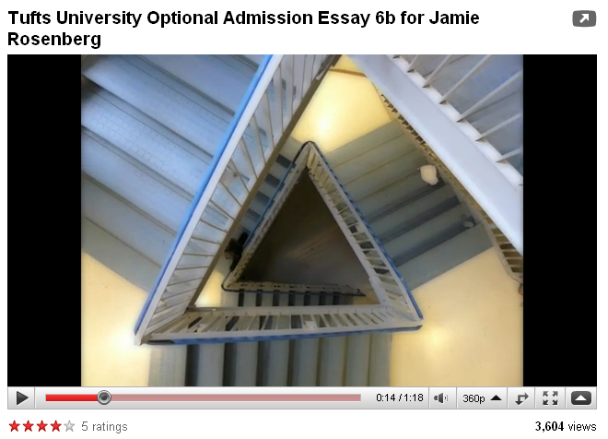
http://www.youtube.com/watch?v=3IUX5ksZfPA
11
Notes:
Universities now using Youtube as part of applications

Slide 12
Setting up a Youtube Channel allows users to follow your content and to build an audience.
http://www.youtube.com/user/ecotubeview
12
Notes:
HOW MANY OF YOU HAVE A YOUTUBE CHANNEL?

Slide 13
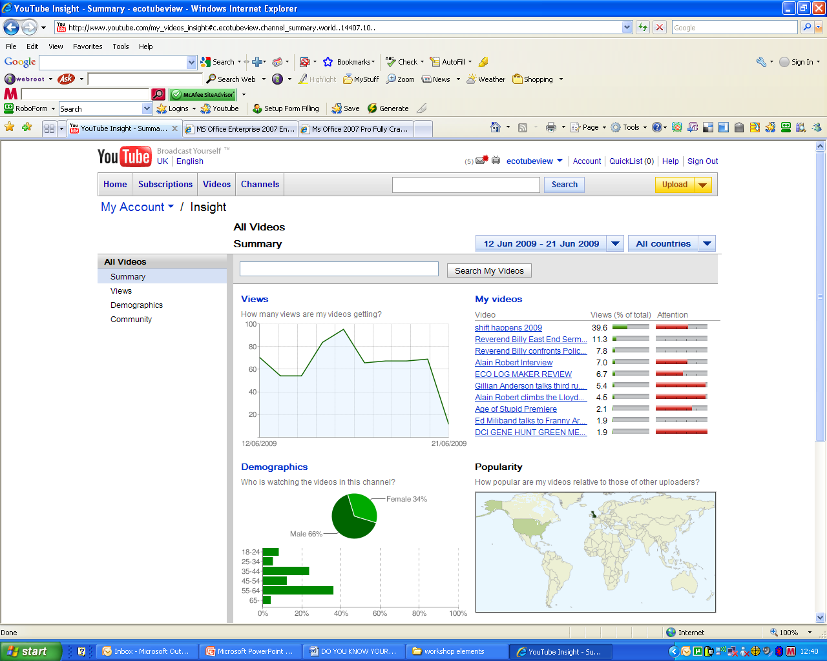
13
Notes:
Powerful tools – if you look for them

Slide 14
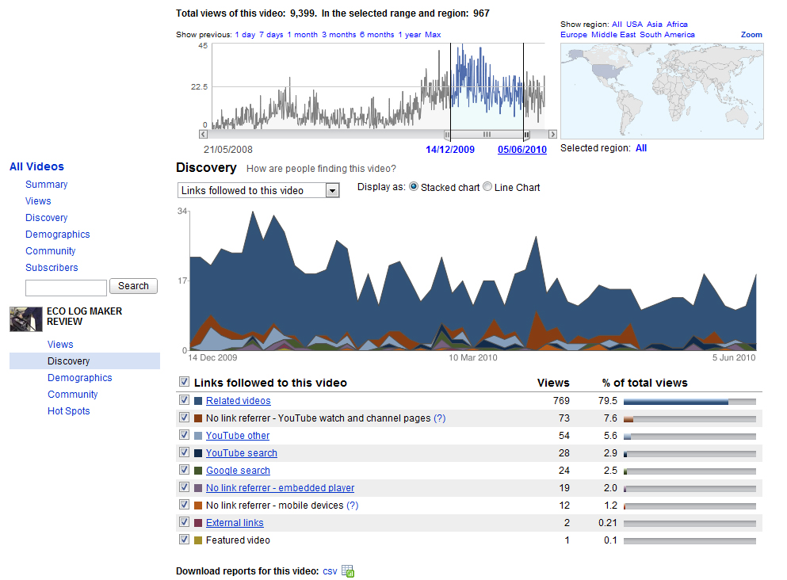
Notes:
Log Maker – viewings over time – Note Christmas – can you see a pattern

Slide 15
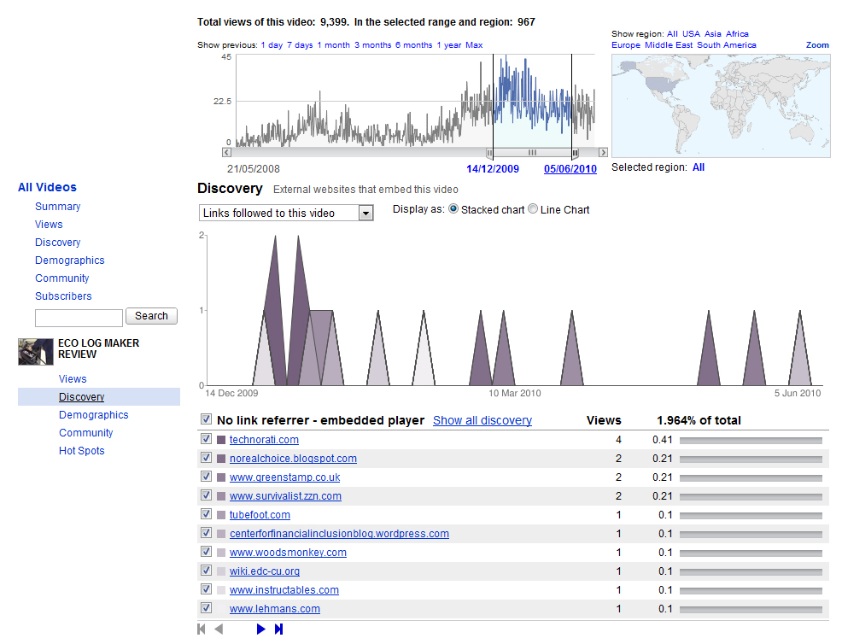
Notes:
Where did the video get embedded?

Slide 16
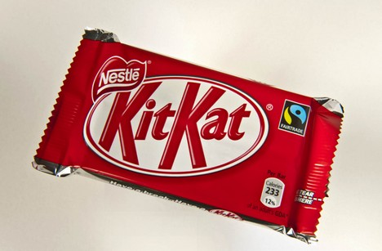
http://www.eco-tube.com/v/GAIA/Dying_for_a_Kit_Kat.aspx
Notes:
Viral Video can take off and bring about change very quickly

Slide 18
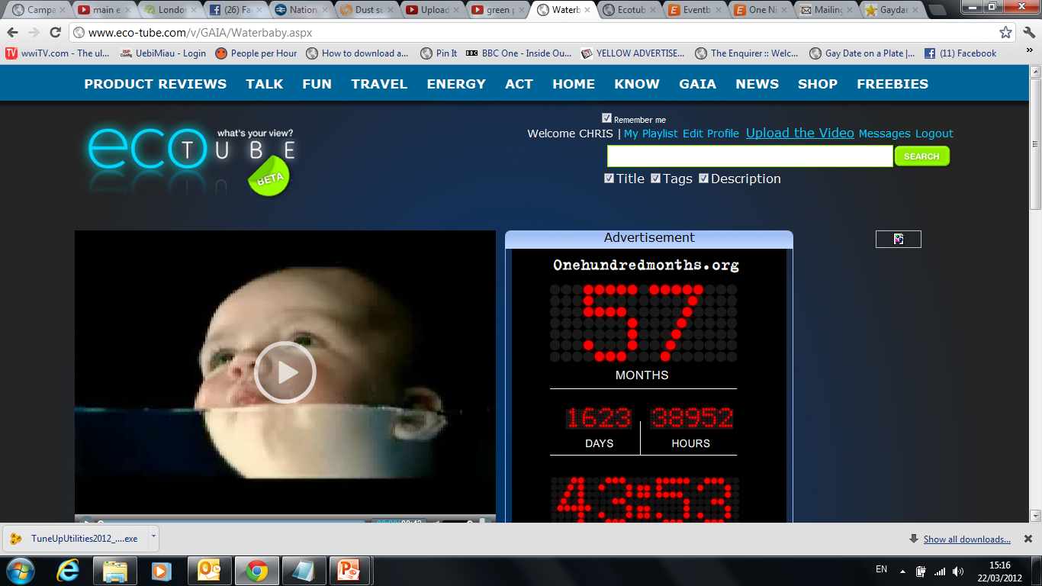

Slide 21
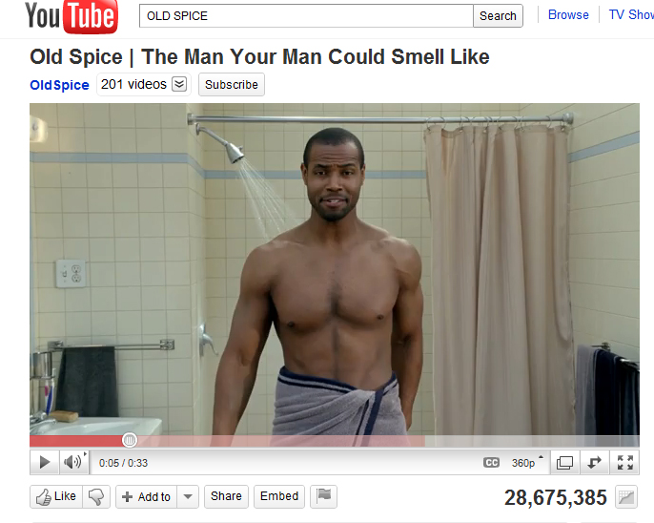
Number of videos made: 180+
Number of comments: 22,500
http://www.youtube.com/watch?v=owGykVbfgUE
Notes:
VIRAL CAMPAIGN – OLD SPICE Number of videos made: 180+
Number of video views: 28 million for the first one
Number of comments: 22,500

Slide 22
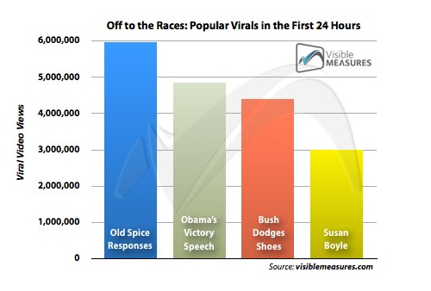
Notes:
FOLLOW UP PEOPLE ASKED QUESTIONS AND HE ANSWERS ON SCREEN

Slide 23
The future of web video advertising
http://www.youtube.com/watch?v=4ba1BqJ4S2M Bear

Slide 24
SOCIAL MEDIA REVOLUTION
24
Notes:
WHOSE ON FACEBOOK?

Slide 25
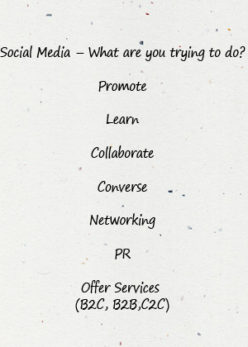
25

Slide 26
What do we need to achieve?
Notes:
KEY QUESTIONS

Slide 27
What do we need to achieve?
Which audiences are important to
achieve this?

Slide 28
What do we need to achieve?
Which audiences are important to
achieve this?
Where are those audiences online and
what platforms are they using?

Slide 29
What do we need to achieve?
Which audiences are important to
achieve this?
Where are those audiences online and
what platforms are they using?
Do the platforms fit with content we have
or can create?

Slide 30
What do we need to achieve?
Which audiences are important to
achieve this?
Where are those audiences online and
what platforms are they using?
Do the platforms fit with content we have
or can create?
Can we sustain what we start?

Slide 32
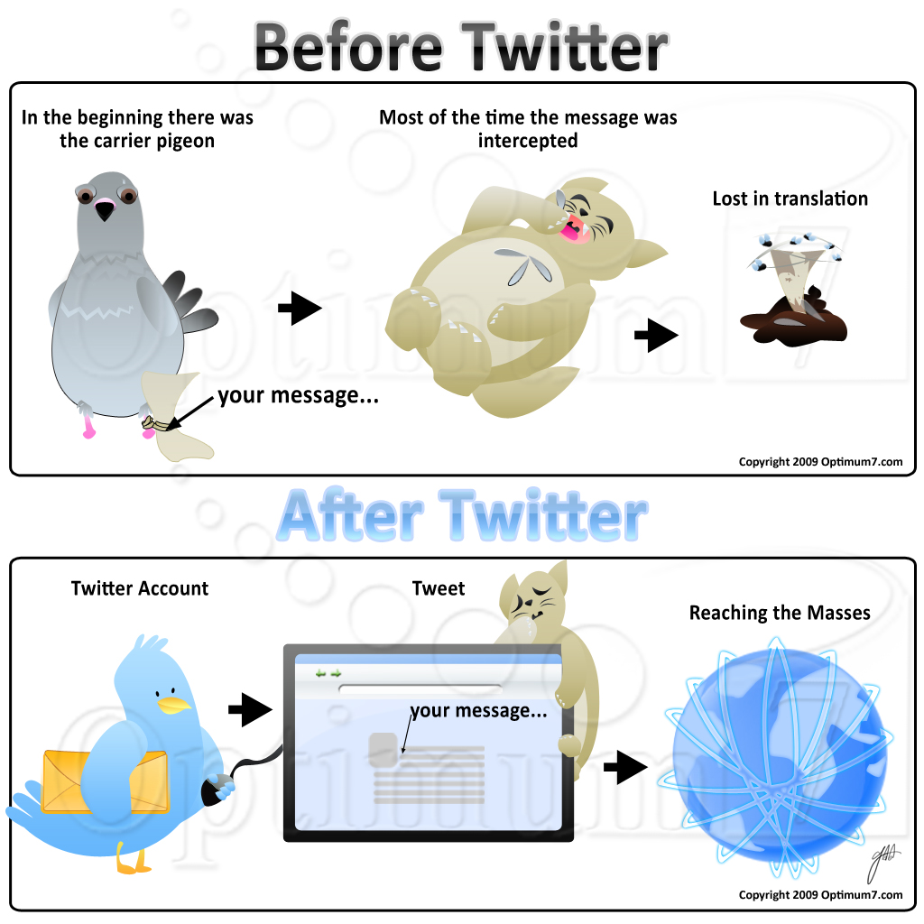

Slide 33
What's all this about Twitter?
Twitter is micro blogging
User Generated news & links
Twitter could be the biggest search engine in 5 years
Follow your Favourite Celebs
Ashton Kushner 4.8 million
Demi Moore 2.5 million
Eddie Izzard 1.5 million
Send messages direct to celebs
(no guarantee they will answer!)
33
Notes:
How many of you use twitter?

Slide 34
Twitter announced that it is now seeing 250 million tweets per day from its users.
100 Million Active users per day
34

Slide 35
9 Million UK users
10 million new accounts per month
50% of users over 35
55% users using mobile to tweet
1 in 6 users sign up via mobile
35

Slide 36
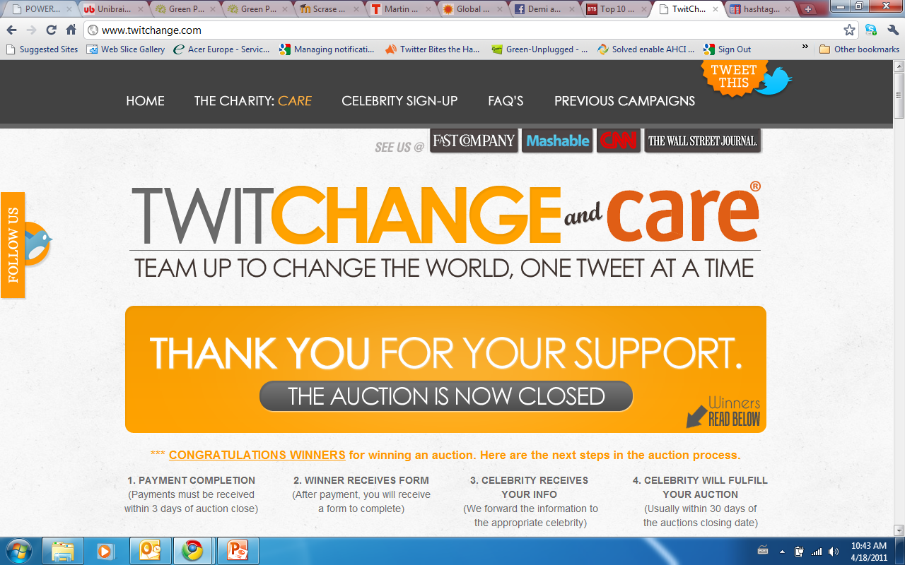
Notes:
TwitChange represents the only global celebrity auction, where you can bid to get retweeted, followed, or mentioned by a celebrity of your choice, or all those things at once. The money from this unique auction goes to a chosen charity.
Last year TwitChange managed to raise around $500,000 and together with AHOMEINHAITI.ORG help to provide a shelter to $1.5 million people in Haiti. Moreover, with its 178 celebrities and 750 auctions, TwitChange got over 35 million web hits in 4 weeks. Not too bad.

Slide 37
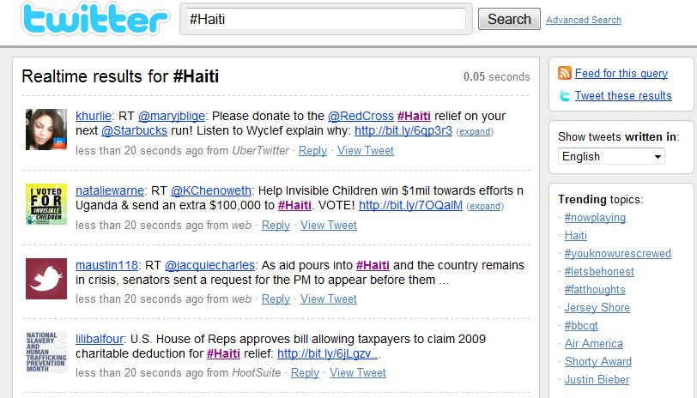
Notes:
BUT SERIOUSLY

Slide 38
#OCCUPYLSX
http://www.eco-tube.com/v/KNOW/Why_do_banks_make_so_much_money.aspx
Notes:
DEMO

Slide 39
Notes:
TOO MUCH INFORMATION? YOU NEED A FUNNEL!

Slide 40
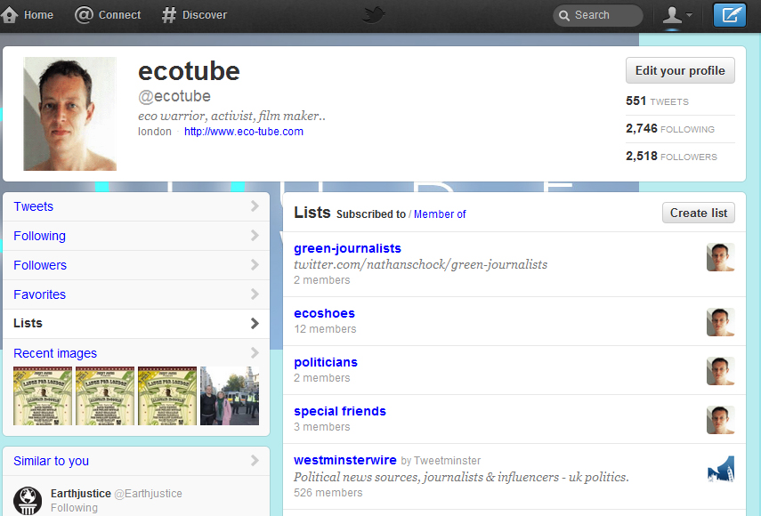
Notes:
LISTS – STILLS and demo live

Slide 41
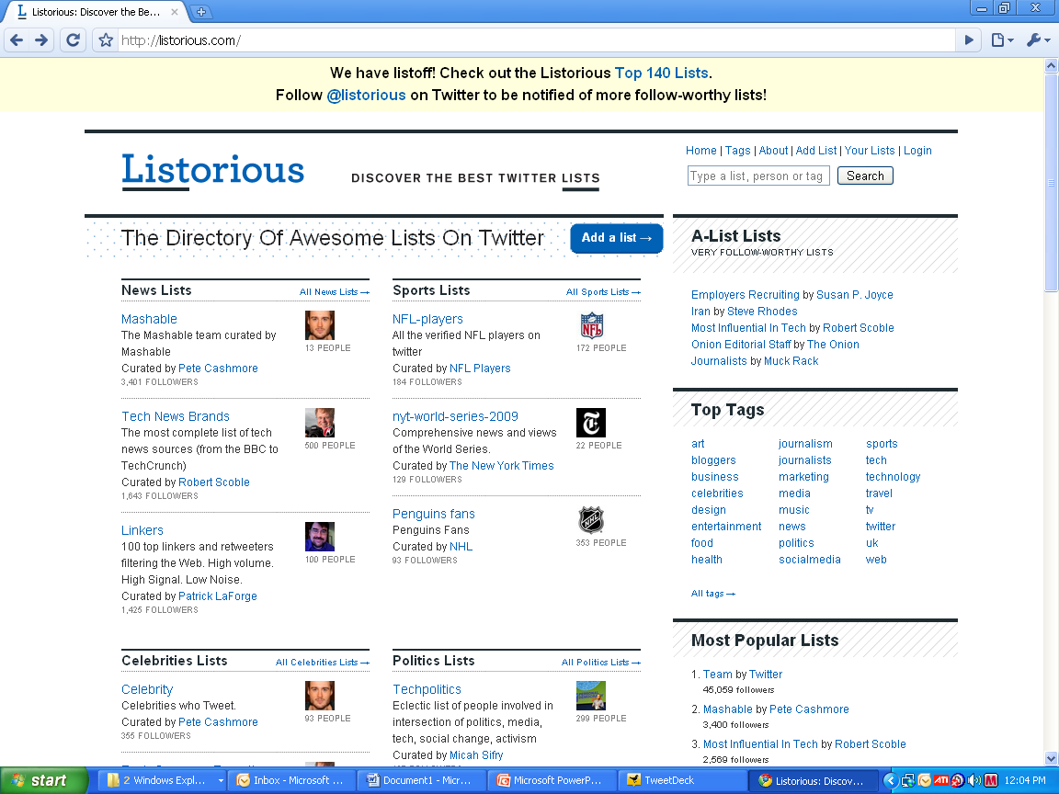
http://listorious.com/
41
Notes:
FIND EXPERTS – SET UP YOUR OWN LISTS

Slide 43
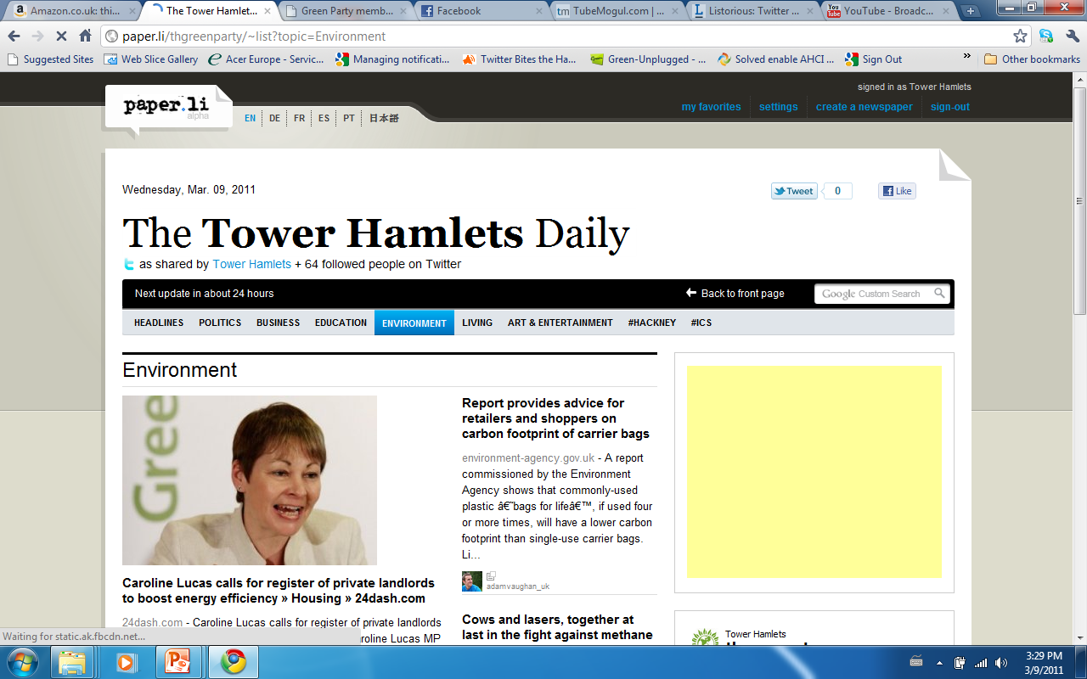

Slide 44
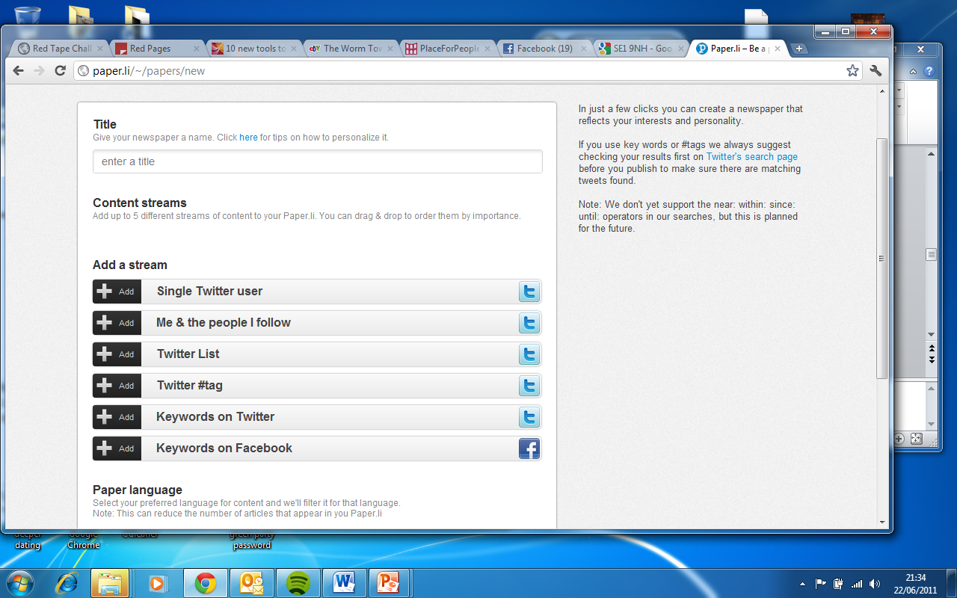

Slide 45
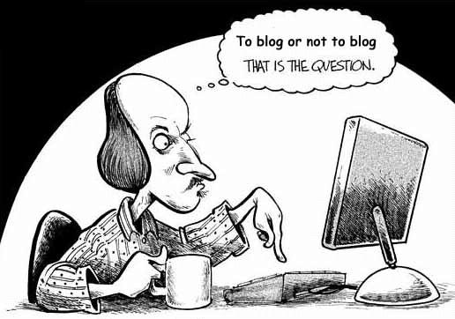
BLOGGING
WWW.BLOGGER.COM
www.gawker.com/
WWW.CHRIS4COUNCIL.WORDPRESS.COM
http://www.theginlady.com/
45
Notes:
Wordpress can use purchased domain names

Slide 46
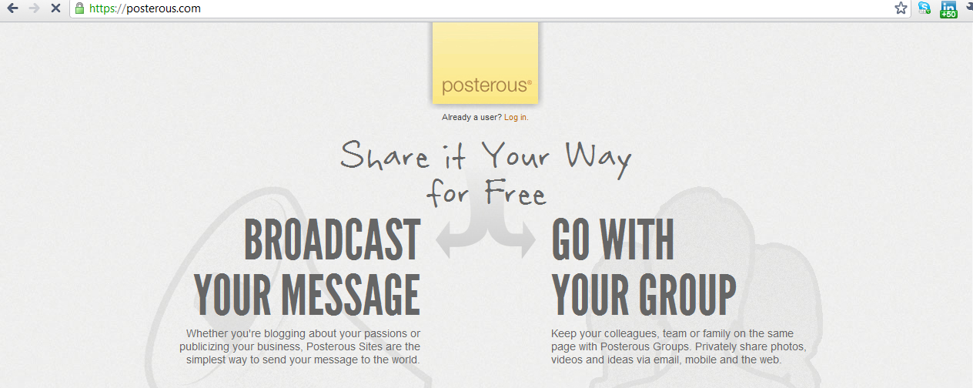

Slide 47
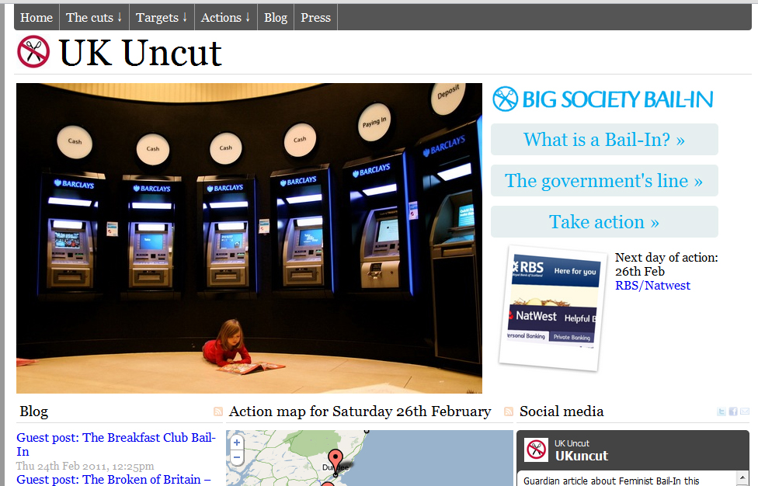
Notes:
WORDPRESS BLOG WEBSITE

Slide 48
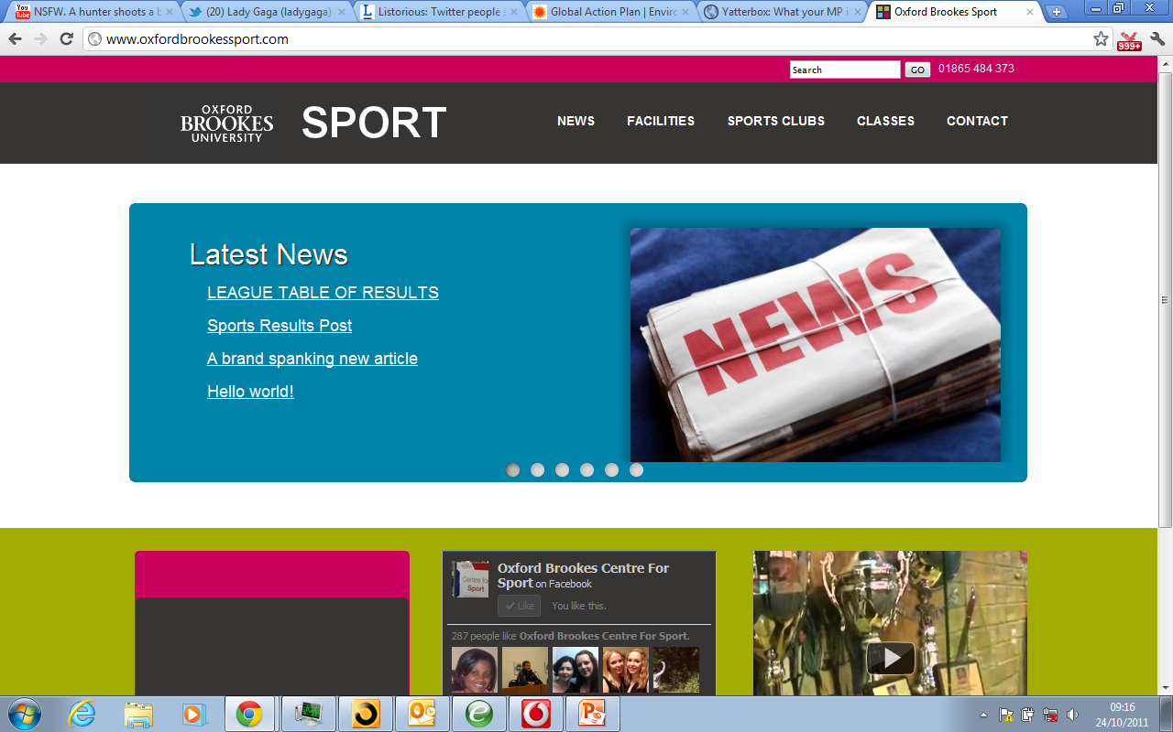
WEBSITE I BUILT FOR OXFORD BROOKES SPORT DEPARTMENT
GOOD RATES AVAILABLE!

Slide 49
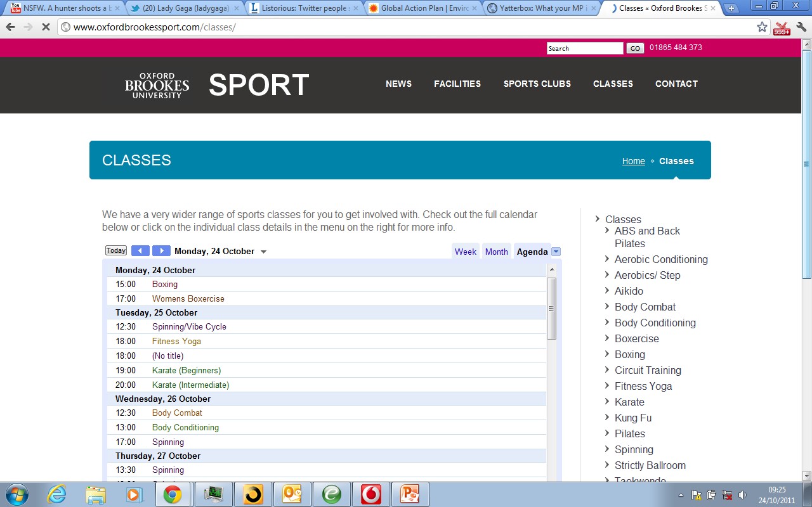

Slide 50
50
Notes:
TAKE A BREAK HERE How many of you are on Facebook

Slide 51
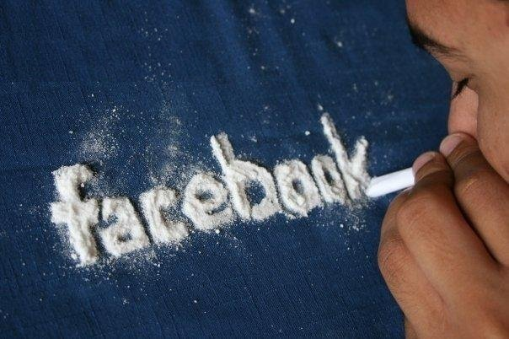
FACEBOOK ADDICTION
Notes:
How many of you on Facebook?

Slide 52
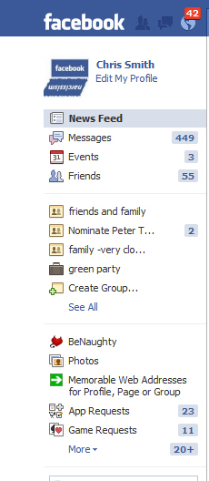
FACEBOOK : BUSINESS OR PLEASURE
OR BOTH

Slide 53
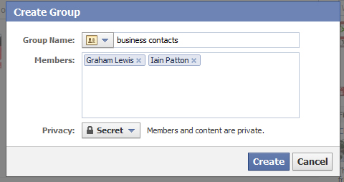

Slide 54
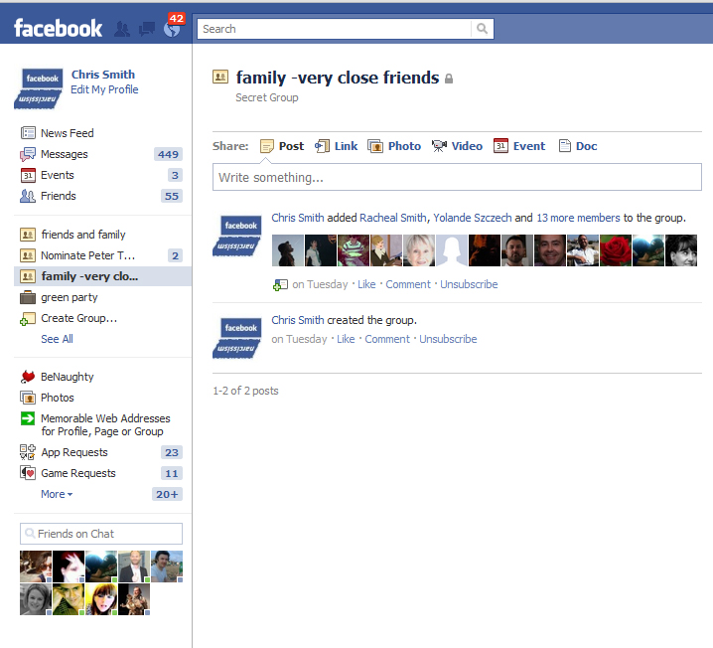
Notes:
END THIS SECTION WITH A LOOK AT A SUCCESSFUL VIRAL CAMPAIGN

Slide 55
Three Simple Rules
for successful social media
Authenticity
Consistency
Leadership
55

Slide 57
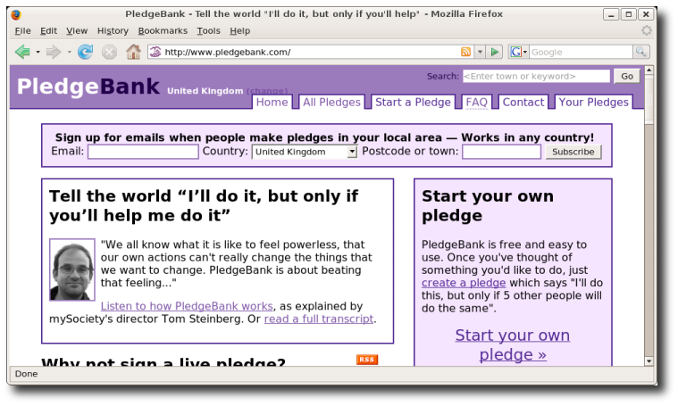

Slide 58
http://www.crowdfunder.co.uk/investment/green-london-2012-517
Notes:
Show Video & rewards

Slide 59
http://www.eco-tube.com/v/ENERGY/How_Green_is_your_Internet.aspx

Slide 61
Piloted by DECC – most advanced online digital behaviour change system available – can be fitted to any existing estate energy monitoring systems and collate, output information live.
http://www.carbonculture.net/
Please contact me for an introduction!
Notes:
Commissioned by DECC – most advanced online digital behaviour change system available in the UK today – can be fitted to any existing estate energy monitoring systems and collate, output information live.

Slide 64
Notes:
Advanced human behaviour change – most advanced system of it’s type – 40% of people at DECC signed up

Slide 65
http://youtu.be/5m8kTWXFKXQ?hd=1&t=2m22s
Notes:
Universities will need best practise – mention my work on this

Slide 67
67

Slide 68
20th April 2012
www.socialmediabootcampuk.com
30% OFF FOR EAUC MEMBERS

Slide 69
CHRIS SMITH
WWW.ECO-TUBE.COM
CHRIS@ECO-TUBE.COM
07881-823071
WWW.HOWTOMASTERSOCIALMEDIA.COM
WWW.SOCIALMEDIABOOTCAMPUK.COM
WWW.TOWERHAMLETS.GREENPARTY.ORG.UK

