Slide 1
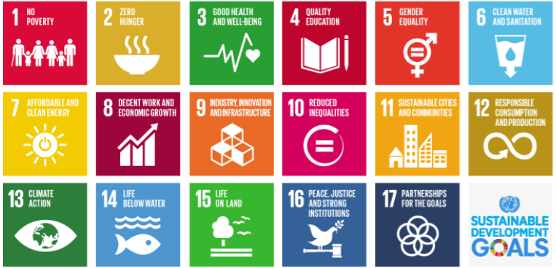
2022 SDG Teach In
Feb 21st – March 11th

Slide 2





INTRODUCTION TO SOS-UK
We are working to…
Move sustainability from being a niche subject that relatively few study to something all students learn about - all students should be “sustainability students”.
Create cohort after cohort of positive, solutions-driven students who go on to make the world a more sustainable place.
Shift society from an obsession with short-term profit to long-term benefit.
By…
Getting more students leading on, and learning about, sustainability.
Embedding sustainability in formal education, from early years to adult learning.
Making sustainability more inclusive, for everyone.
CONTACT: hello@sos-uk.org

Slide 3
SDG TEACH IN 2022:
Statistics and Achievements

Slide 4



OUR LARGEST REACH YET!
772 educators pledged to incorporate the SDG’s into their teaching and learning
141,369 students & learners reached through lessons, workshops and tutorials
134 educational institutions took part, including schools, colleges, universities and training providers

Slide 5
Year | # of:
2018 | Educators pledged: 257
 | Students reached: 16,220
 | Institutions involved: 31
2019 | 206
 | 17,521
 | 19
2020 | 307
 | 25,026
 | 24
2021 | 496
 | 47,292
 | 48
2022 | 772
 | 141,369
 | 136

Slide 6
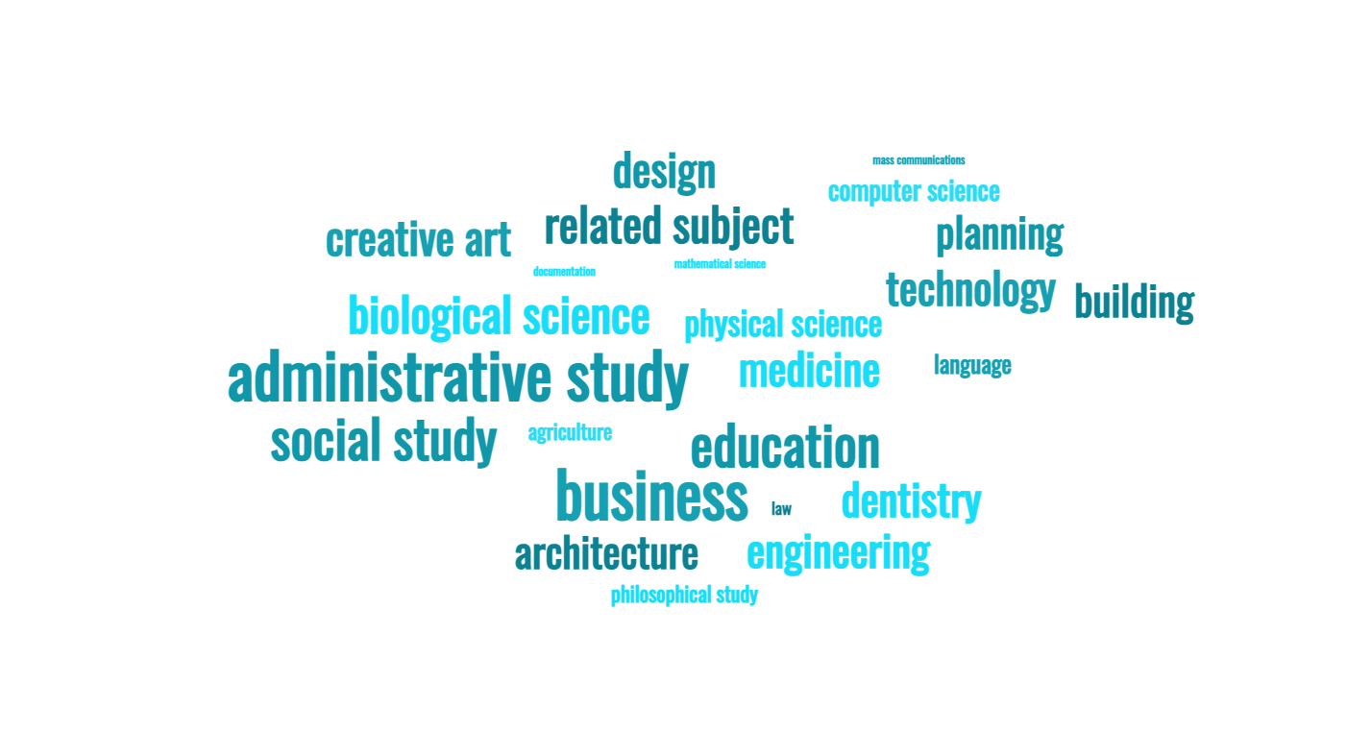
A RANGE OF SUBJECT AREAS
Notes:
More specific modules include:
MSc Medical Bioscience - MSkills: Digital literacies and practical skills
Creative and Ethical Leadership, BA(Hons) Sustainable Festival Management, Year 2
Creative Innovation in Experience Management BA (Hons) Sustainable Festival Management Year 1
BA Accountancy
Msc Business In Technology
TLevel and BTECs in IT and Computing, Level 3 to Level 5
BA in Language and Linguistics
L1 & L2 Introduction in Culinary Skills

Slide 7
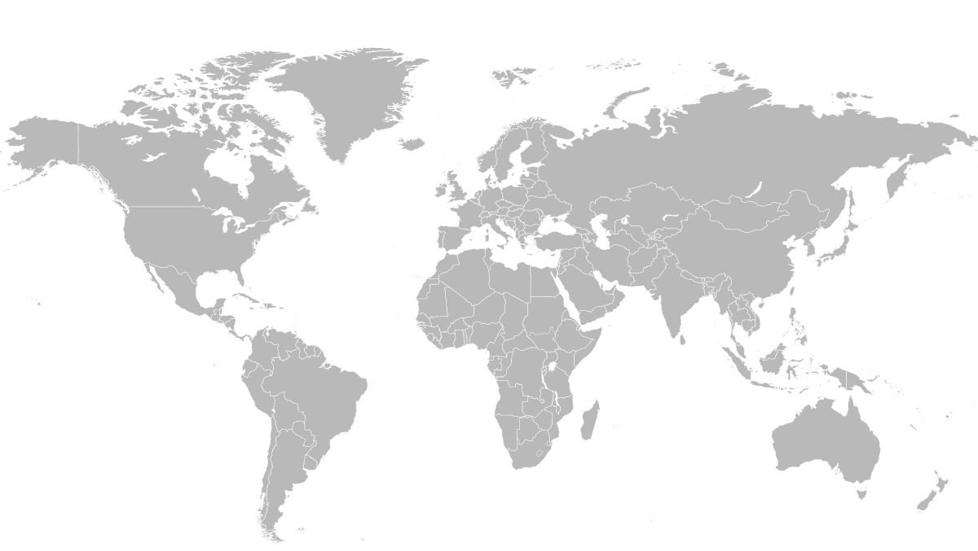

GLOBAL REACH
UK
Canada
Ireland
Italy
USA
Spain
Nepal
Japan
Malta
China
Egypt
UAE
Sierra Leone
India
Colombia
Nigeria
Ecuador

Slide 8
Sustainability Skills from the SDG Teach In - Educators
"Lateral thinking - Business students learnt that any part of the value chain can impact areas they hadn't thought about."
"Empathy, determination"
"Empathy and working with people, understanding the lived experiences"
"Courage to ask questions of those in positions of power/influence"
"Awareness of themselves as influencers for change"
"Listening, reflection on learning"
"Interpersonal relations and capacity building"

Slide 9
Sustainability Skills from the SDG Teach In - Students
"Wider awareness of sustainability in every topic."
"I have a much broader understanding of the pressing issues and have discovered many things I have not considered before eg geopolitics, and the complexity of fuel insecurity and its future."
"Self esteem"
"A wide range of inter-disciplinary skills including critical thinking and understanding how I can take control of my actions to make a difference"
"Social and cultural awareness, innovation"

Slide 10
THIS YEAR’S LEADERBOARDS

Slide 11
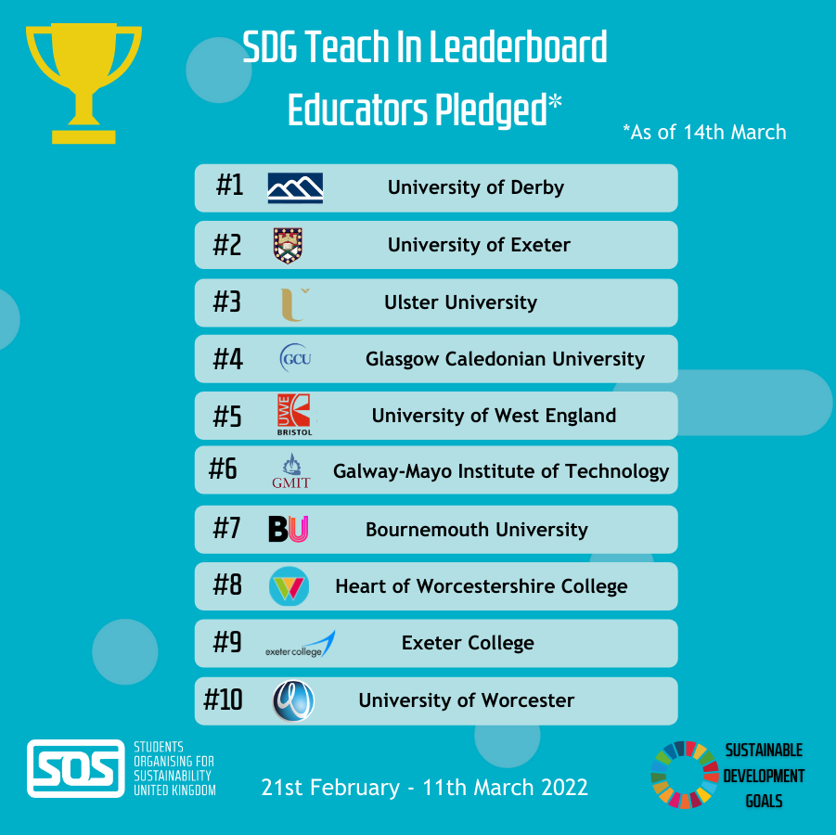
Notes:
In scotland – City of Glasgow College with 13 educators, Dundee and angus with 8 educators, university of edinburhg with 8 educators, Strathclyde, north east college, university of the highlands and islands, Glasgow kelvin college, Edinburgh college and west Lothian college also had pledges

Slide 12
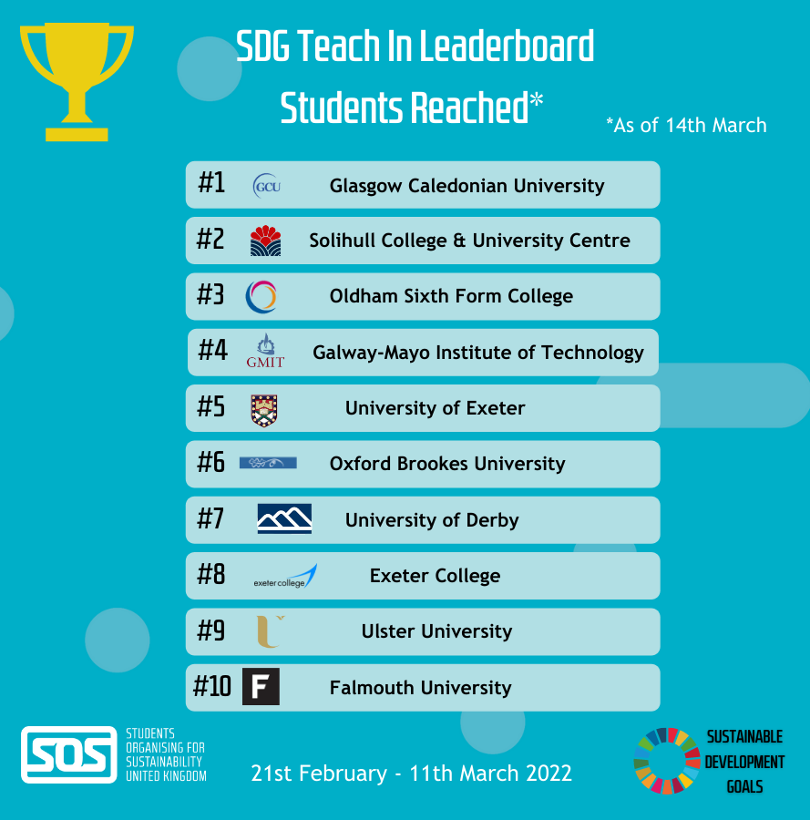

Slide 13
CASE STUDIES
Notes:
Now for the exciting part of the webinar! Here I will show you a range of case studies sent in to us from educators who took part in the Teach In. The case studies span the formal, informal and subliminal curriculum! They also range from primary schools, colleges, universities. Just as a reminder, if you haven’t sent us your case study yet - you still can. We’d love to see how you embedded the SDG’s during the Teach In. You will find my email address at the end of the slide deck which you will be sent after the webinar.

Slide 14
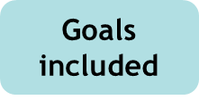




Case study: Glasgow Caledonian University – Occupational Therapy
“GCU Occupational Therapy uses the SDGs to inform the whole curriculum, including placement modules and individual placement opportunities, particularly those that run with our third sector partners and which are focused on group, community and population outcomes.
I like to check all my curriculum development (from whole module planning to individual sessions) against the 17 sustainable development goals and ensure that it addresses at least one of them (ideally more than one!).
However, one thing the Teach In has made me consider is speaking more about the goals in my work with colleagues and students, and making the goals more transparent. For example, one idea I had was to have a little logo on Powerpoint presentation slides with the relevant SDG on it so that others could clearly see what the content area linked to. This is a reflection I will take forward to next year’s Teach In.” – Anita Volkert (Lecturer in Occupational Therapy)
Source: https://gcuocc.wordpress.com/2022/03/09/sustainable-development-goals-2022-teach-in-theres-still-time-to-pledge/

Slide 15
Case study: Dunard Primary School, Glasgow
At Dunard Primary, all students, including nursery to primary 7 were challenged to complete global goals tasks with a member of their family or as part of their community. Students were given bronze, silver and gold awards depending on the number of tasks they completed.
"Each year was given an in individual goal to focus on, links to watch the world's biggest lesson and clips to watch explaining how this SDG aspiration affects them now and in the future, Each year was given eight challenges across curriculum areas including literacy, art and design, STEM and outdoor learning. Students were able to pick and choose which challenges they'd like to complete.
To ensure equity for all, some activities were completed with support within the school and I set up a Dunard community event on a Saturday morning. All parents were invited and saw families on a guided walk along our canal, litter picking and investing goals 14 and 15. Families were also taught about sustainable infrastructure and the history of the wonderful Glasgow canal. Challenges were ranked on completion and children received certificates based on how many were achieved. Overall the day was a huge access." - Claire McCeachran, teacher at Dunard Primary

Slide 16










Case study: West Lothian College, Early Learning and Childcare
The vision was to create an interactive, engaging and partnership-driven event that would highlight the SDG Teach In goals.
A range of outdoor, sustainable, active experiences led by lecturers, students and subject specialists was planned, for 70 visiting children and young people from Dedridge Primary School, Southdale Primary School and Linlithgow Academy in West Lothian. The Teach-In outdoor sustainable activities included:
planting, basket weaving
renewable energy workshops
making bog gardens
eco arts and crafts.
"Sustainability is embedded within teaching and learning experiences across all levels within our department. This is grounded in the ethos of outdoor learning principles, which our students learn to prepare them for the workplace after completion of their studies. Our Childhood Practice students have extended their learning in relation to the college sustainability goals by maintaining greenspaces on campus including making planters. These experiences will allow the students to achieve the John Muir Discovery Award."

Slide 17


Case study: Heart of Worcestershire College
During the Teach In, L3 Exended Diploma in Health and Social Care reviewed a report from the Kings Fund about the impact of the Health and Social Care sector on the environment.
Students discussed how as health and care workers, there is an increasing need to factor in the wider context (social and environmental – a public health perspective) of the patient's health, and by broadening this over time sustainability is embedded into health and social care.
Students brainstormed small changes that the healthcare sector can make that would have a big impact. Their ideas included:
How we deliver care (is it better to bring care to the service user, or bring groups of service users together to receive care?)
Integrating and planning so the sector can avoid duplication
Being prepared for environmental challenges
The importance of only doing things that work (nothing more wasteful than treatments that don’t work)

Slide 18

Case study: De Montfort University, School of Computer Science and Informatics
For module on IT Service Practice, a lecture and discussion were developed and delivered which looked at the importance of digital transformation in the delivery of SDGs, and which examined how each of the technology areas was impacting on SDGS
Students were shared technology reports and links including:
The role of artificial intelligence in achieving the Sustainable Development Goals | Nature Communications
Role of Internet of Things in Sustainable Development | EcoMENA
Blockchain can be the key that unlocks the SDGs. Here's how | World Economic Forum (weforum.org)
Accelerating Sustainable Development with Hyperautomation - UNICC

Slide 19
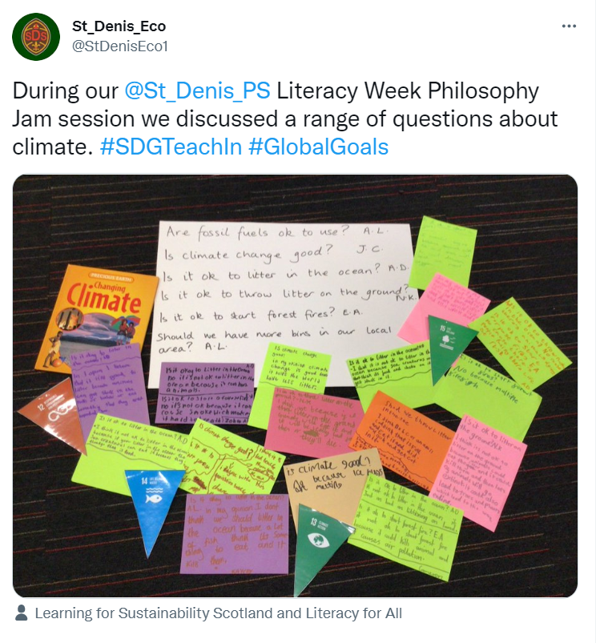

Slide 20
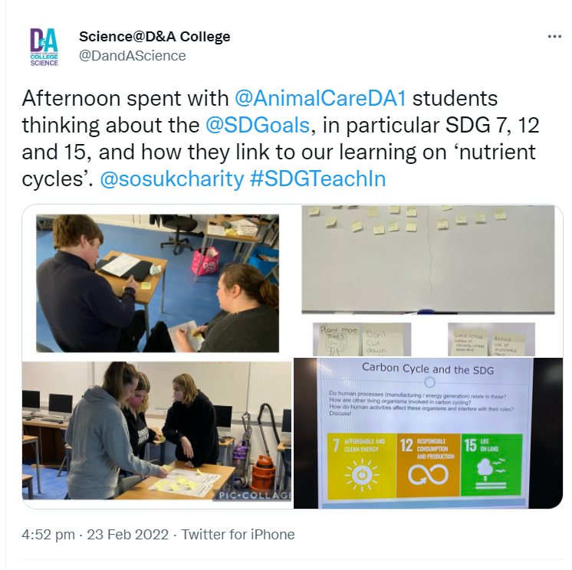

Slide 21
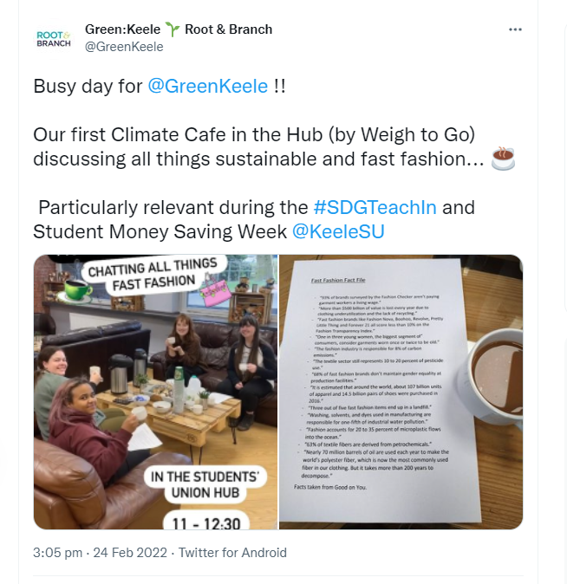

Slide 22
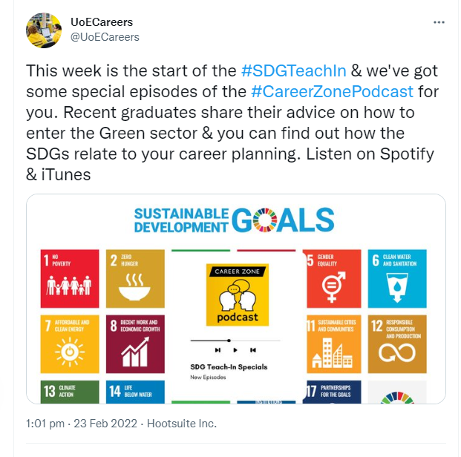

Slide 23
SOS-UK Programmes

Slide 24




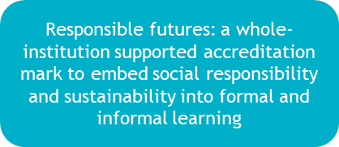
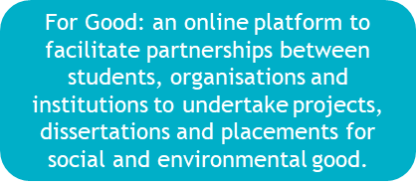
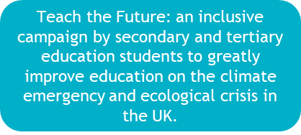
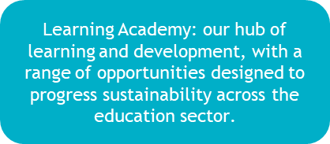
Education for Sustainable Development beyond the Teach In
We need to deliver Education for Sustainable Development all year round, not just three weeks each year. SOS-UK run a number of campaigns, programmes, workshops and consultancy to support staff and students to lead on and learn for sustainability within the education sector. Find out more by clicking on the icons below:
Please get in touch if you would like to discuss additional support from SOS-UK or find out about any of our programmes and campaigns: hello@sos-uk.org

Slide 25
SDG TEACH IN 2023:
Dates for your diary

Slide 26
SDG TEACH IN 2023 - Monday 27th February – 31st March
Next year, we plan to make the SDG Teach In even BIGGER and BETTER than before!
It will run for a whole month.
This will give you the chance to spread the word about the Teach In, plan on how you will embed the SDG’s into your course and give you much more wiggle room.
Press this link to pledge to take part in the 2023 SDG Teach In!

Slide 27


Slide 28
“Our biggest challenge in this new century is to take an idea that seems abstract – sustainable development – and turn it into a reality for all the world’s people”
Kofi Annan
Former Ghanaian Secretary General of the United Nations from 1997-2006

Slide 29
For anything else ESD related please contact:
Meg Baker, Director of Education
Meg.Baker@sos-uk.org
Sonya Peres, Senior Project Manager for Education
Sonya.Peres@sos-uk.org
Kedijah Eaves-O’Connor, Project Manager for Education
Kedijah.EavesOConnor@sos-uk.org

