Slide 1
Institutional Blackout: engaging staff and students in saving energy
Simon Kemp, Neil Smith, Julia Kendal, Joshua Davies
University of Southampton

Slide 2
Schedule
Southampton Blackout
Discussion: Engaging students and staff
Lessons learnt & moving forward
Discussion: Blackout at your institution
Final Q&A

Slide 3
Aims of the Session
To inform delegates of the methodology and execution of Blackout
To engage delegates in discussion around the key lessons learnt and barriers faced when running a Blackout
To enable delegates to apply Blackout at their host Institution

Slide 4
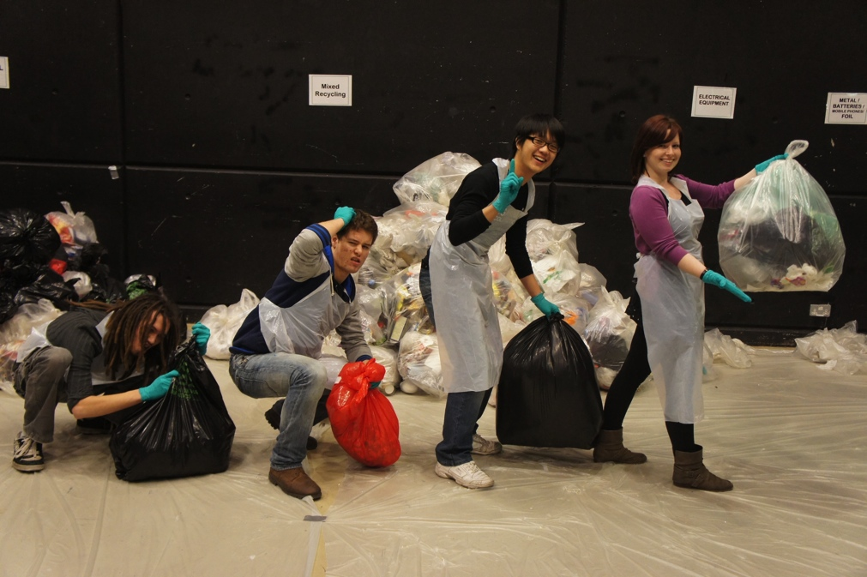
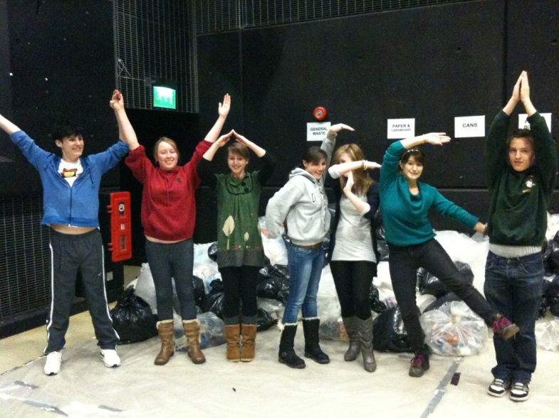
Background
University of Southampton Carbon reduction target of 20% by 2020 (based on 2005 levels)
Existing sustainability student – staff partnerships

Slide 5
Background
‘Energy Audit’!
Focus on main campus – 34 buildings over one night
Steering Committee – staff & students
Initial plan to run it within 6 months
Pilot after 3 months……….
New plan to run it within 8 months

Slide 6
Planning, planning, planning...
Campus quad system with a ‘Blackout HQ’
Staff information campaign with equipment opt-outs – run through operating officers two months in advance
Staff: Email, university portal, sustainability officers
Students: Joshua Davies

Slide 7
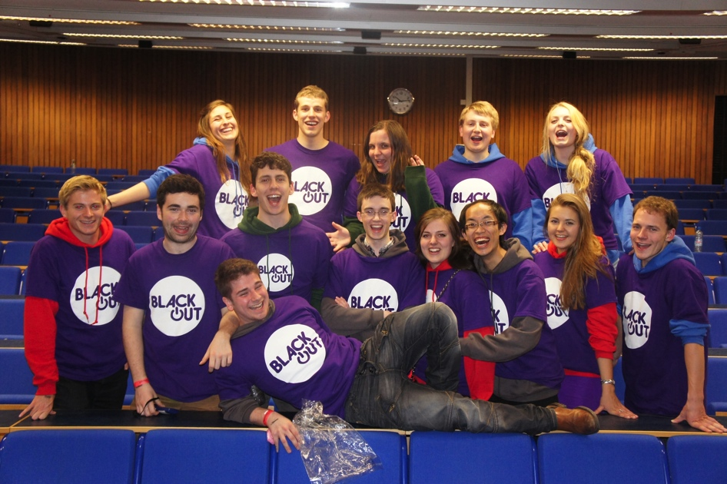
Recruiting Students
Run by senior figures of SUSU in November
Student committee selected in February
Weekly meetings to manage project
Aim: Make the event highly desirable

Slide 8

Recruiting Students
Marketing plan (Facebook, Twitter, Posters, Pull-up banner, promotional t-shirts, flyers)
Extra funding acquired

Slide 9
Recruiting Students
Large amount of ‘freebies’:
1. Energy auditing experience
2. Blackout Hoodie
3. Food Voucher
4. Ipad 2 prize draw
5. Graduate Passport Points
6. VIP Entrance to Club Night at the SU
7. Dominos Pizza (not advertised)

Slide 10
Preparation & Training
1 x staff training session
2 x student training sessions
Focused on responsibilities and risk management
Introduction to audit methods
KEYS ARE KEY!!!!

Slide 11
Training
Building No.:
Group No.:
Room No. | No. of PCs | No. of PCs on | No. of Monitors | No. of Monitors on | Lights on | Window open | Printers No | on | Charger No | on | Fridge in room | Other

Slide 12
Blackout Rules
You will be led by a member of Staff whose instructions you must follow
You are not permitted to leave your group at any time – this includes toilet breaks
You must not let anyone not in your group into the building
No consuming alcohol, smoking or drug-taking
You must not touch anything, especially any documents, in any office except for the off-switch on electrical equipment that has been left on
Notes:
Jodie

Slide 13
Blackout
The Day Of Destiny!!

Slide 14
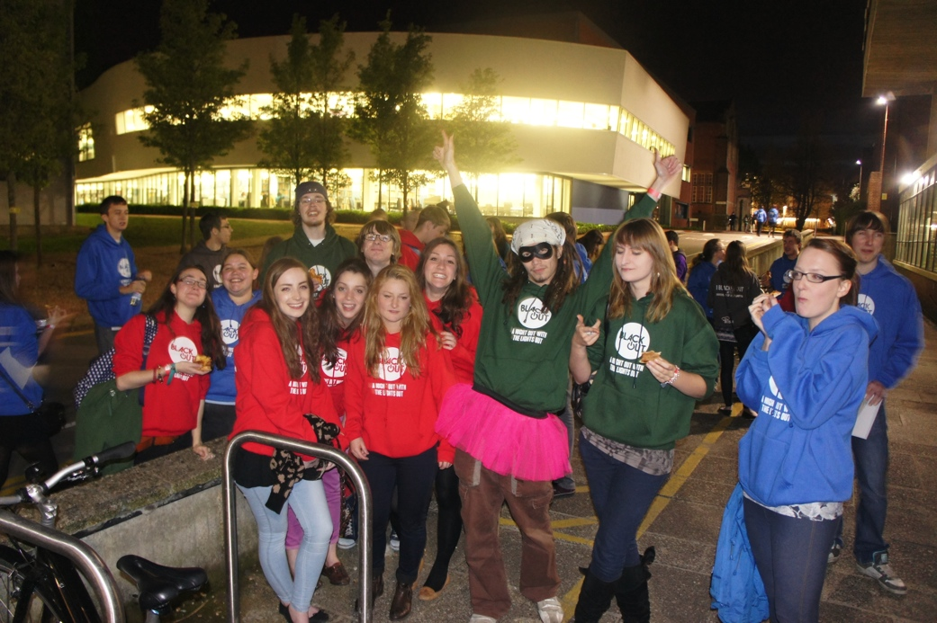
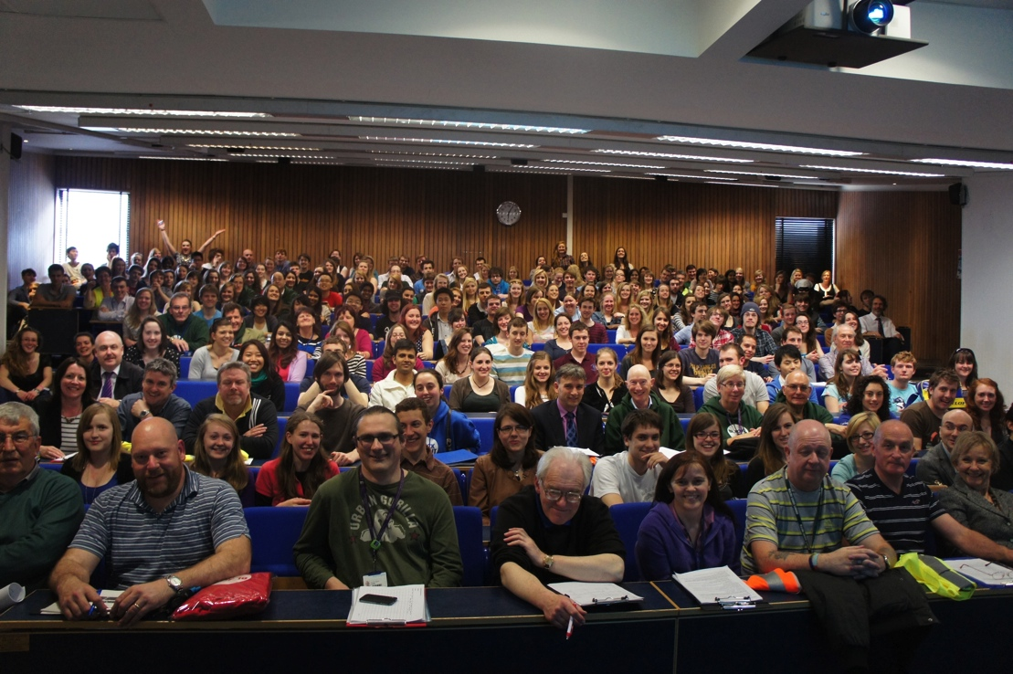
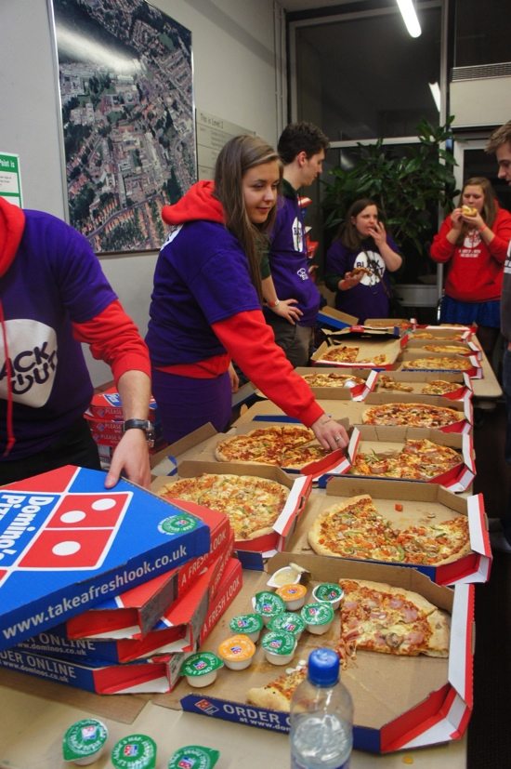
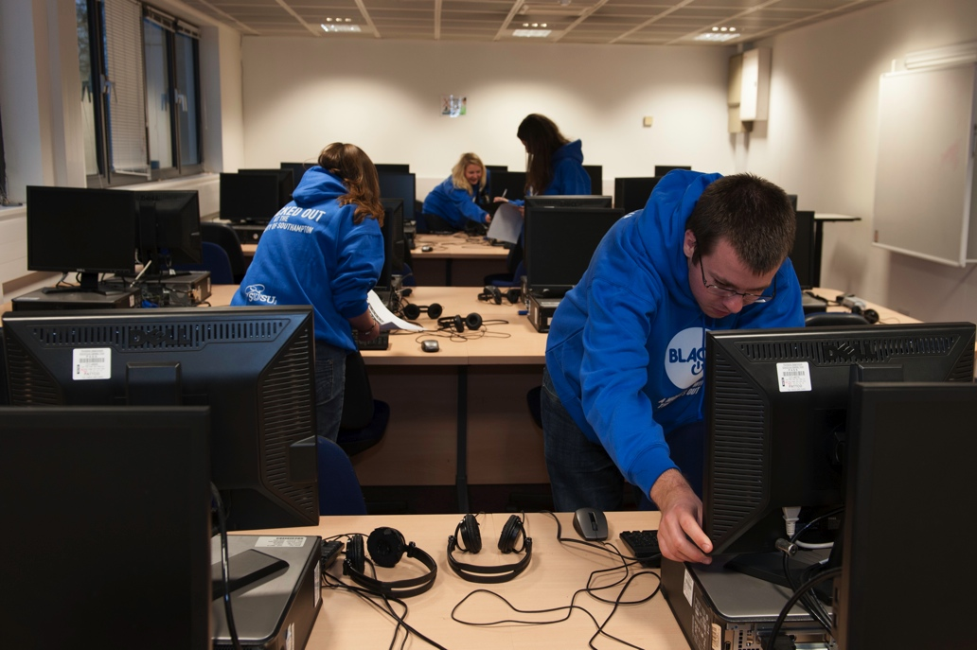
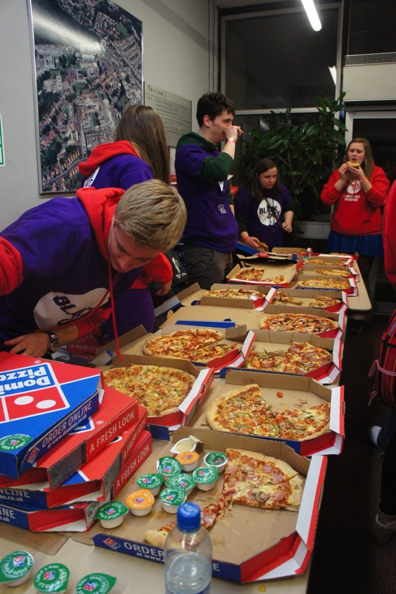
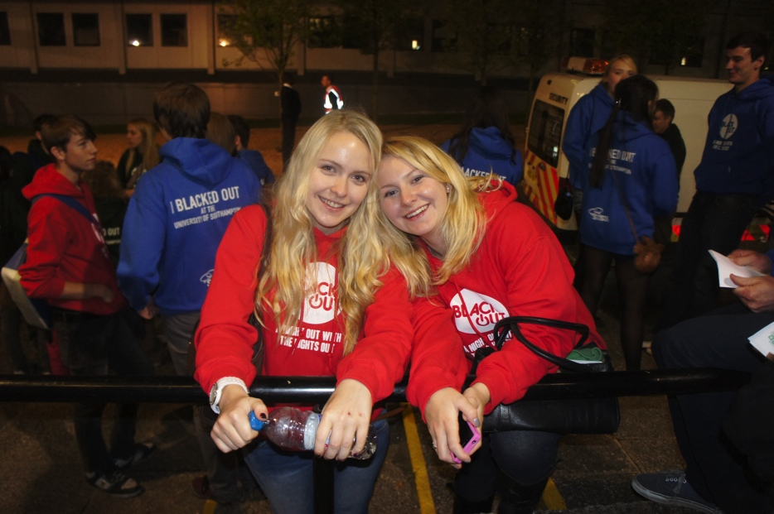
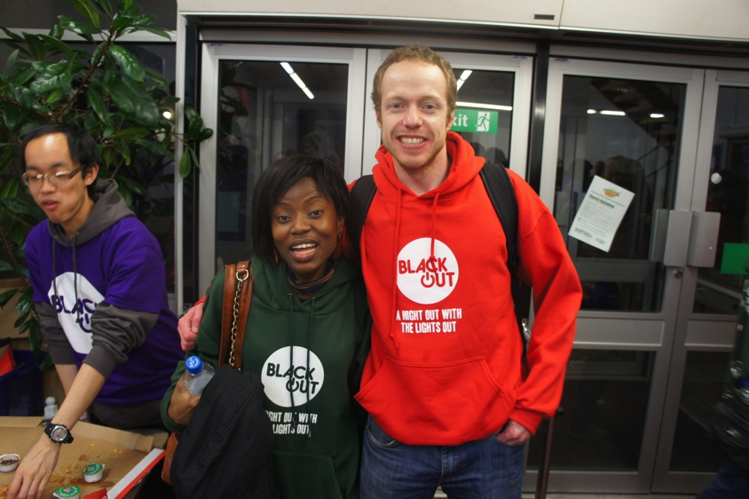

Slide 15
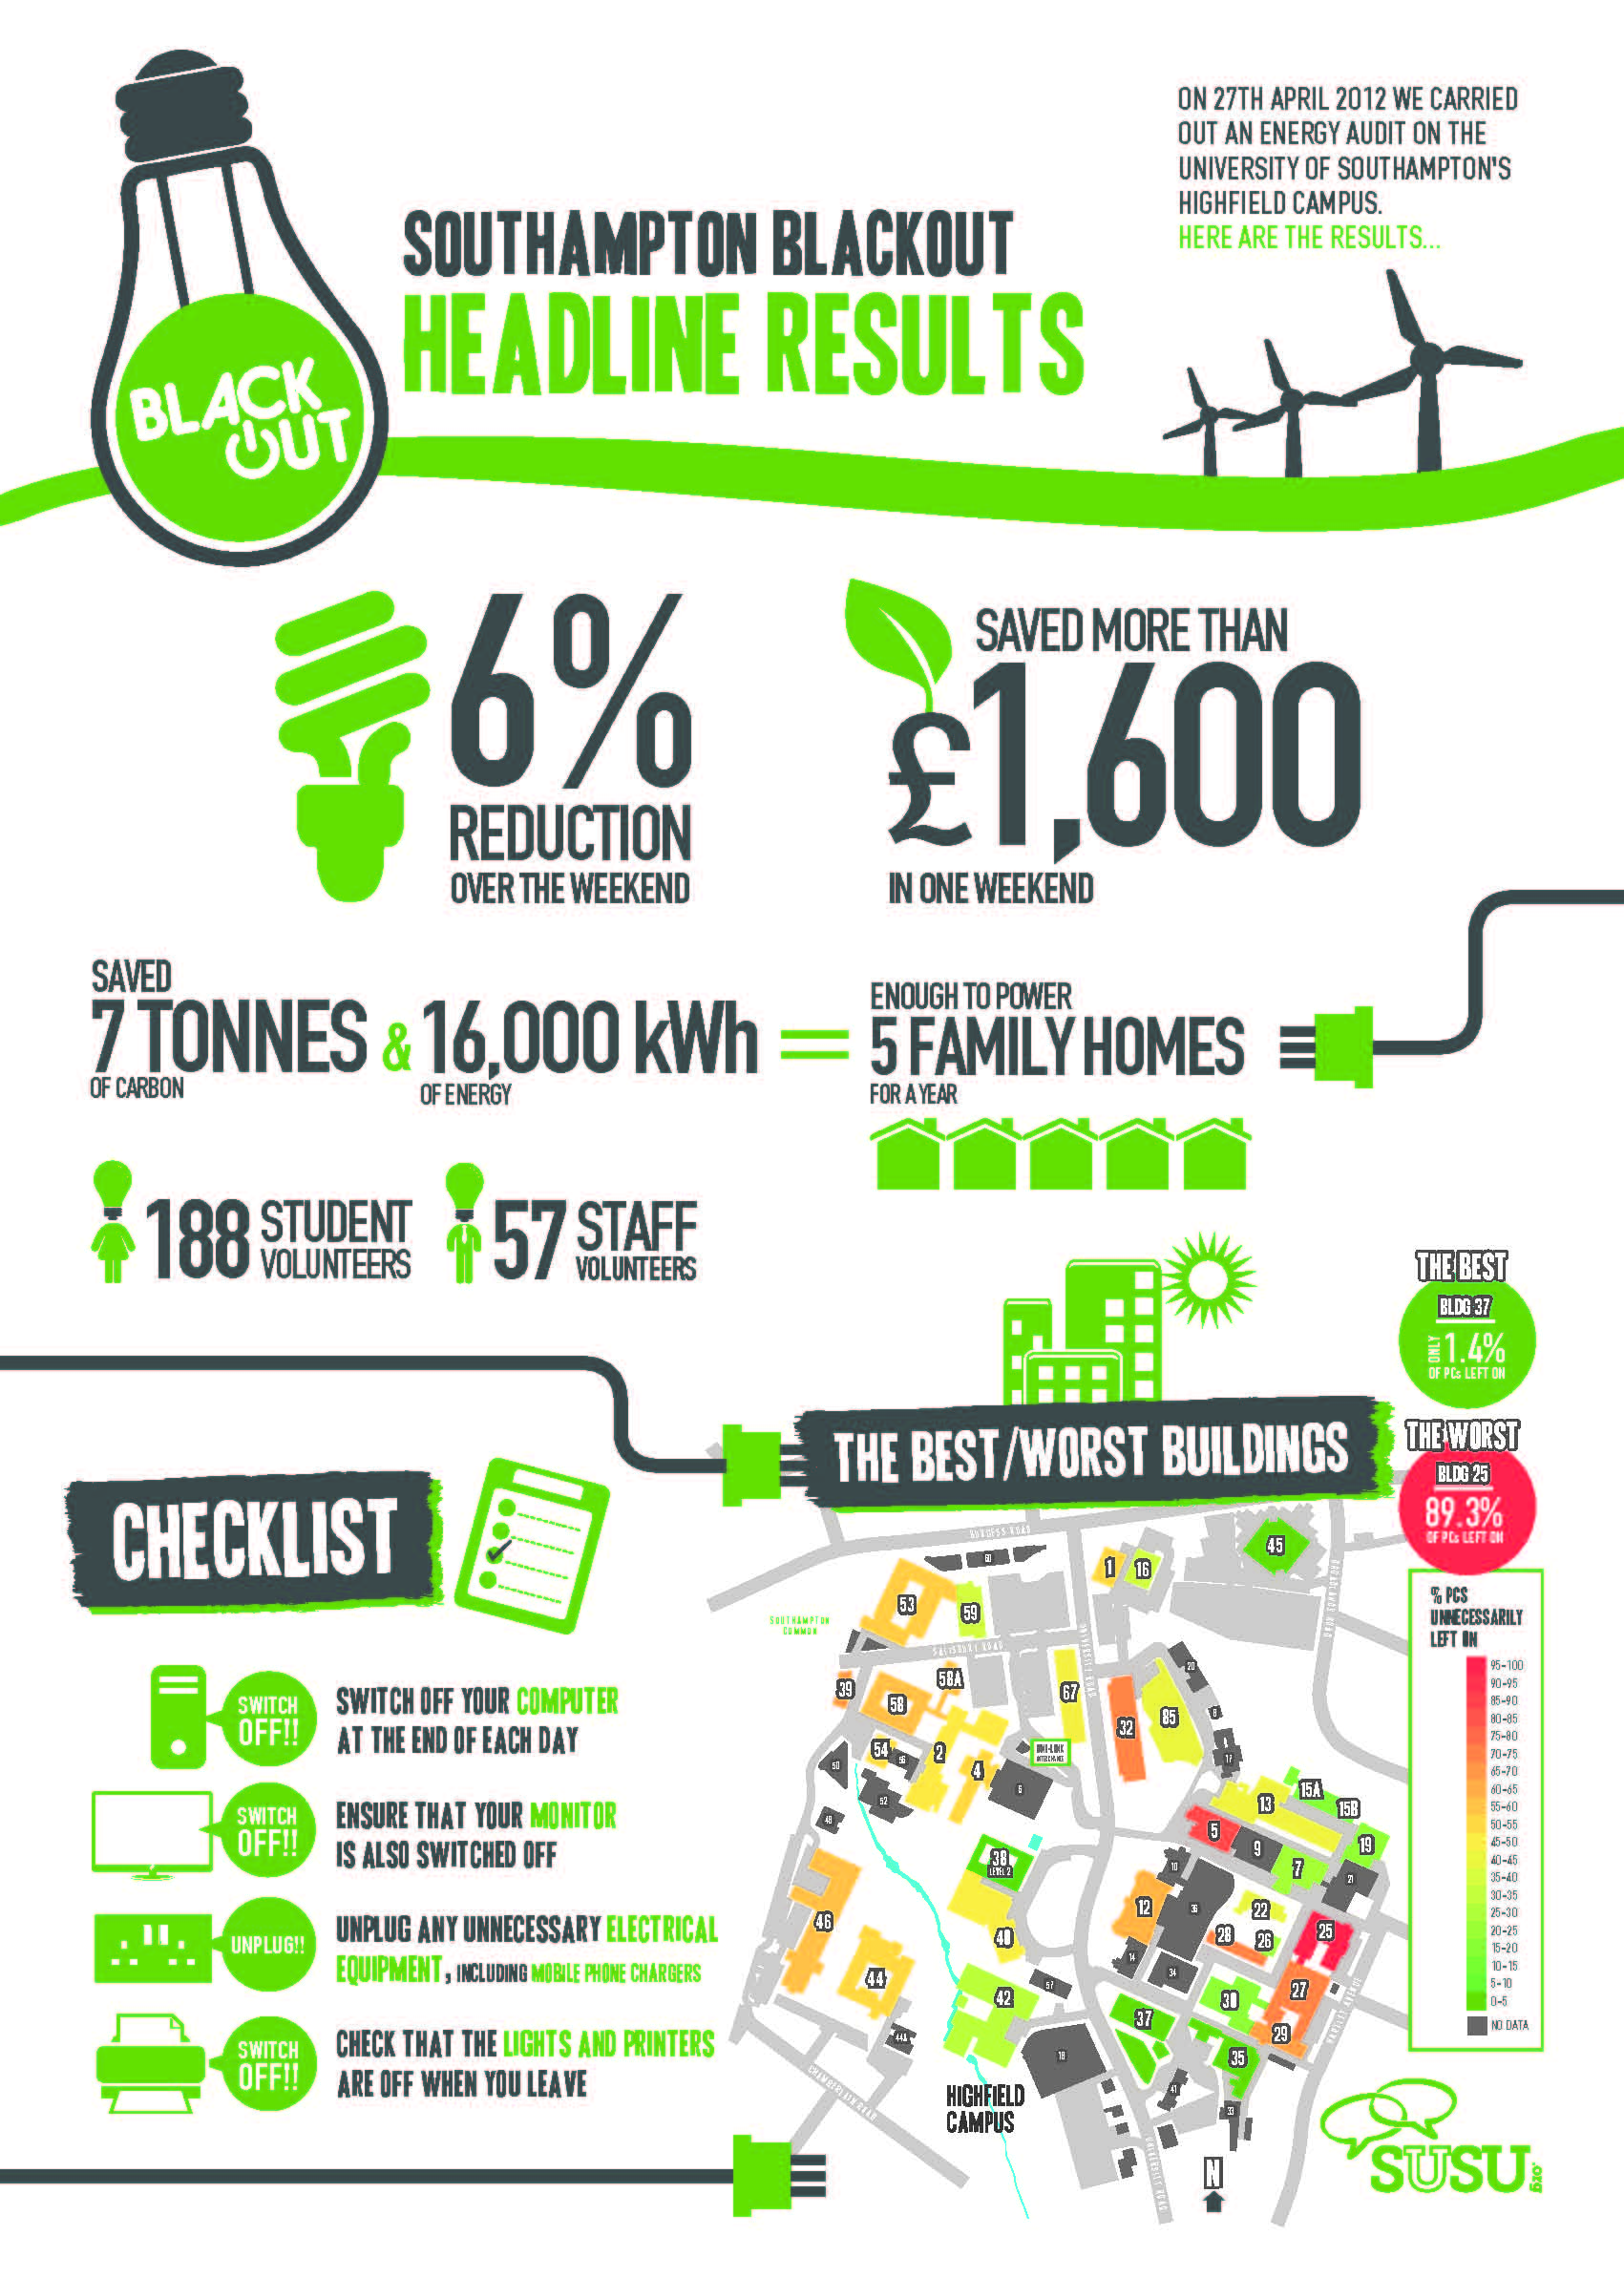


Slide 16
Ongoing Communication
When? | What?
Week following Blackout | Intranet post: Headline results Email: thank you to all volunteers
5 weeks on (Friday before Bank Holiday Weekend) | Intranet post: reminder of results; request to switch off
Prior to summer break | Intranet post: Reminder to switch off
Beginning of Autumn term | Intranet post: reminder of results; request to switch off
Autumn term | Intranet posts: Information about shortlisted for Green Gown Award and receiving Highly Commended

Slide 17
Questions?

Slide 18
Discussion
Working in groups, discuss how you would engage:
Students
Staff
To take part in a Blackout in your Institution
Report back in 15 minutes

Slide 19
Lessons Learnt
Are all the incentives necessary?
Importance of active student partnership & joint leadership
Need for consistency in the training for audit completion
Need for repeating and reinforcing the message
Very, very, very labour intensive & not a model for regular events

Slide 20
Moving Forward
Blackout 2013:
  2 more campuses, hence more students and staff
  City – City council, hospital, 5 local businesses approached
Blackout 2014:
  Q. Should we attempt a nationwide Blackout?

Slide 21
Open Discussion
Are you interested in running a Blackout at your Institution in 2014?
What do you feel your greatest barrier is likely to be? Students, Staff, Senior Management buy-in
What support do you feel you might need?
Is a nationwide Blackout feasible?

Slide 22
Ensure students & staff work together from the very start of all sustainability projects

Slide 23

Follow #sotonblackout on 26th April 2013 from 18:00

Slide 24

Switch off the lights on your way out

