Slide 1
CLIMATE CHANGE REQUIRED REPORTING
CORPORATE EMISSIONS, TARGETS AND PROJECT DATA
7 October 2015

Slide 2
Welcome!
Rebecca Vivers, Jennifer Kaczmarski & Jen Cassells from SSN reporting team
SSN – funded by the Scottish Government to support public sector climate change action and reporting. Team of 6 staff, majority are here to facilitate & assist event
RES support – Steven Turnbull for other carbon management support and information on RES tools
Carbon management expert - Clare Wharmby

Slide 3
Reporting Process
Reporting template, Guidance Notes and Frequently Asked Questions (FAQ’s) are all available on the SSN website
Completed reports for 2014-15 (a pilot year) are due on 30 November 2015 and should be submitted to ssn@keepscotlandbeautiful.org
After today, and if your query is NOT answered by the Guidance Notes or FAQ’s please email:
rebecca.vivers@keepscotlandbeautiful.org
jennifer.kaczmarski@keepscotlandbeautiful.org
jen.cassells@keepscotlandbeautiful.org

Slide 4
Do Not Panic!
This is a new template for all public sector bodies. We understand that you may not have all your data/resources/projects yet.
The report replaces other reporting requirements e.g. UCCCFs
Do not be afraid to submit an incomplete report, gaps can be good. An incomplete report is better than no report!
Remember to write a commentary: if you can’t get data or don’t have projects this year, then explain how you intend to do it next year.

Slide 5
Event Details
Focus on Section 3 of reporting template: Corporate Emissions, Targets & Project Data
Full run through and interactive workshops on each part of Section 3
Chance to ask questions, these will either be answered today or afterwards as FAQ
Opportunity to speak to similar organisations who have similar reporting procedures

Slide 6
Follow up
Analysis of submitted reports will be used to identify training needs and work programme for SSN next year to tailor support in advance of 2015-16 reports.
SSN are working with the Climate Leaders’ Officers’ Group (CLOG) to develop an analysis plan. This will include identifying areas of improvement within the template for 2015-16 and also sectoral analysis of climate change action and progress.

Slide 7
Agenda
Time | Activity | Presenter
9:30 – 9:40 | Introduction by SSN team – Don’t Panic! | Jennifer Kaczmarski & Rebecca Vivers
9:40 – 9:55 | Using the ISM approach in reporting | June Graham
9.55 – 10.20 | Part 1 – current and previous carbon footprints | Clare Wharmby
10.20 – 10.35 | Part 1 – group exercises | Table groups
10.35 – 10.45 | Part 2 - targets | Clare Wharmby
10.45 – 10.55 | Part 2 – group exercises | Table groups
10.55 – 11.30 | Part 3 - projects | Clare Wharmby
11.30 – 11.50 | Part 3 – group exercises | Table groups
11.50 – 12.10 | Part 4 – increases and decrease | Clare Wharmby
12.10 – 12.20 | Part 4 - group exercises | Table groups
12.20 – 12.25 | ISM revisit | June Graham
12.25 – 12.30 | Wrap-up | Rebecca Vivers & Jennifer Kaczmarski

Slide 8


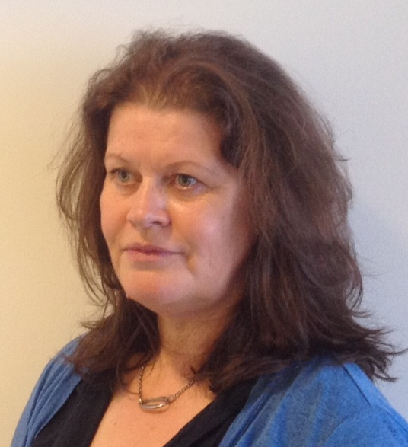
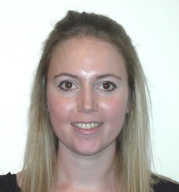
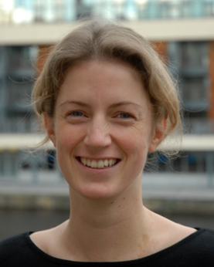
SSN reporting team
Rebecca Vivers
Kate Airlie
June Graham
Jennifer Kaczmarski
Clare Wharmby
Jen Cassells

Slide 9
Objectives of Section 3
Improve the quality and resolution of corporate emissions and project data from the public sector
Provide a consistent framework for reporting for all organisations – this will improve analysis
Help organisation focus on the key issues for reporting
It is not expected that:
  100% of organisations will have 100% of the data
  Organisations achieve absolute accuracy
  There will be no changes in the future

Slide 10
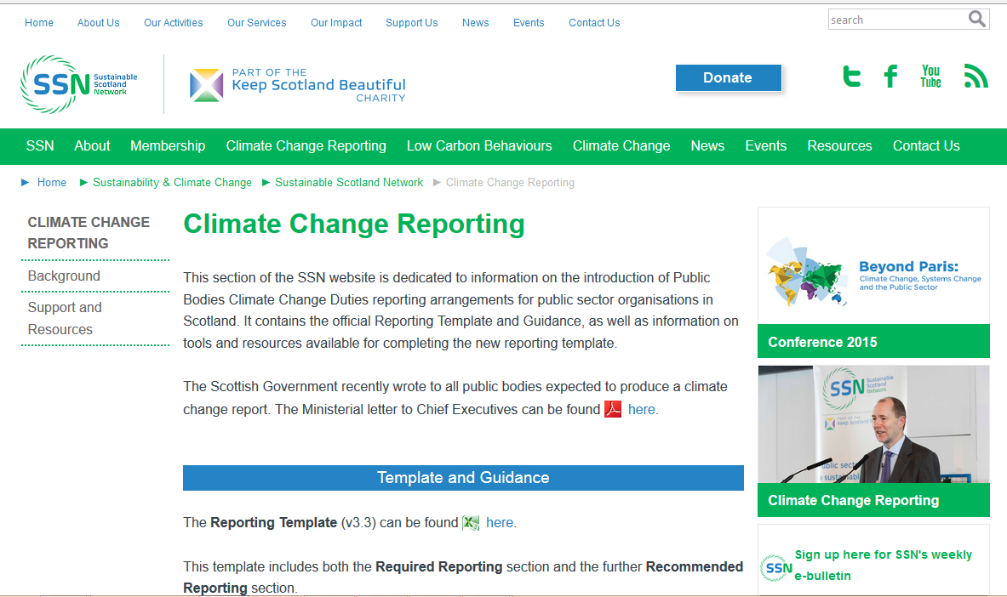
Source of information
BODY TEXT (Arial 24pt suggested size)

Slide 11
Carbon footprinting tools
Public Sector organisations are using a range of tools to calculate their carbon footprints and manage their project registers:
  The Resource Efficient Scotland Carbon Footprint & Project Register tool – now available for 2014/15
  CMPR (original Carbon Trust CMP tool)
  UKWIR carbon accounting workbook
  Own developed spreadsheets

Slide 12
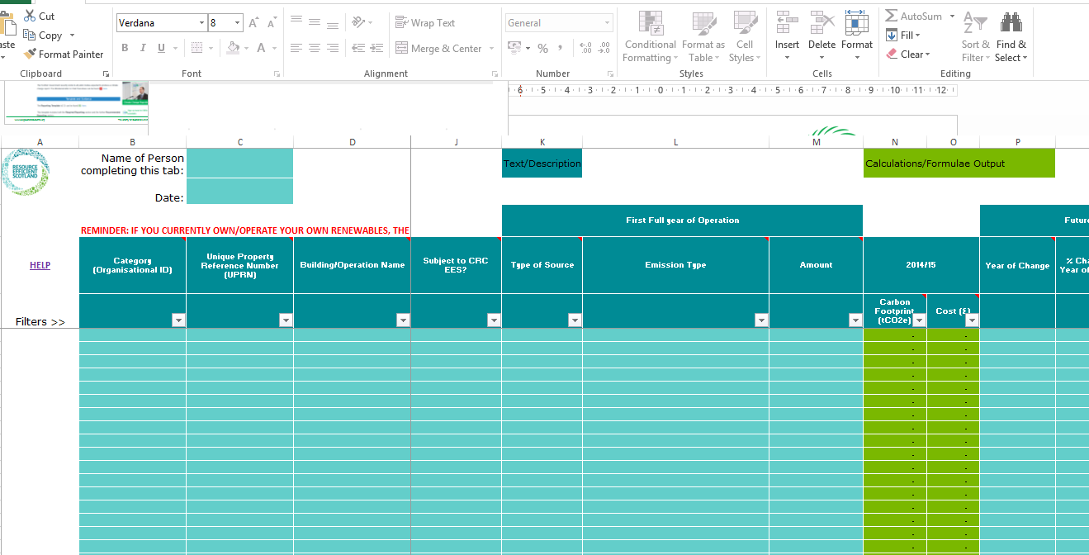
Carbon Footprint & Project Register tool

Slide 13
Recommendations
If you are running your own system, it works for you and you have confidence in the data, there is no need to change
If you have not yet started to calculate your carbon footprint, the CF&PR tool is a good option:
  Reliable emission factors
  Only data entry required
  All data requirements are in one place
The CF&PR Tool will be used in this workshop to explain how to enter your data

Slide 14
Alignment of emission factors and years
Calendar Year
All months fall within 2014
Use 2014 factors
Financial Year
Most months fall in 2014 (9 out of 12)
Use 2014 factors
Academic year
July to June
6 months in each year
Use 2015 factors
2014
2014/15
2014/15

Slide 15
Section 3 – 4 key parts
Part A - Current and previous carbon footprints:
Question 3a
Question 3b
Question 3c
Part B – Targets:
Question 3d
Part C - Carbon reductions from projects
Question 3e
Question 3f
Question 3h
Question 3j
Part D - Carbon increases/decreases from other sources:
Question 3g
Question 3i

Slide 16
 | Emissions
3a | Corporate emissions from start of baseline year to end of report year
Current and previous emissions
Key points:
Your baseline year is specific to your organisation
Year type is for reference
Scope 1 – 3 is approximate
The comments here are important e.g.
Scope 1 | Scope 2 | Scope 3 | Total | Comments
2,900 | 11,200 | 6,165 | 20,265 | Baseline year for current carbon management plan. Grid electricity using old DECC factors and not split into scope 2 and 3. Waste calculated with carbon metric. No water data available.

Slide 17


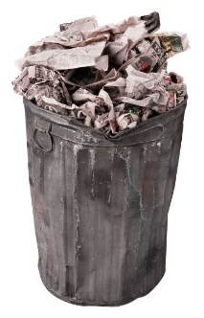
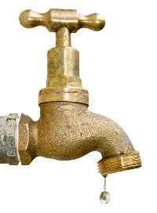

GHG Protocol - Scopes
Fuel use in buildings
Fuel use in fleet
Grid electricity:
Generation
Indirect emissions:
Direct emissions from estate/vehicles:
Water use
Waste/recycling
Business travel and commuting
Transmission & distribution losses
Fugitive emissions (refrigerants)
Scope 1
Scope 2
Scope 3

Slide 18
Exclusions
Carbon footprint boundary
Overseas recruitment office
Energy
Waste
Water
8 campus buildings + 1 accommodation
Shared hospital site (10%)
Direct fuel use (kWh)
Direct fuel use (kWh)
Natural gas
Natural gas
Gas oil (1 site)
Grid Electricity (kWh)
Grid Elec
Grid Electricity (kWh)
Grid Electricity
Consumption of goods, materials & services
transmission & distribution
generation
T&D
generation
Staff & student commuting
Waste (tonnes)
Water (m3)
recycle
supply
Refrigerants
landfill
compost
treatment
All staff business travel
Fleet fuel use (litres)
Staff business travel
Diesel
Petrol
Car(£)
Rail (£)
Air (£)
taxi
bus
Key
Scope 1
Scope 2
Scope 3
Notes:
This is one possible version of the organisational boundary

Slide 19
Things that can go wrong with historic data
Boundaries can creep because of data availability or improved data coverage
Lack of documentation of data sources, coverage, actual consumption data and methodology
Boundaries can leap because of mergers or divestments
DECC changed their methodology for EF for grid electricity, air travel and waste

Slide 20
How the CF&PR tool can help?
Key points:
It can store previous carbon footprint data (historic CFs tab)
However, it does not currently correct for historic grid factors (historic data is entered as tCO₂e)
It does not split emissions into scopes
 | 2011/12 |  | 2012/13 |  | 2013/14
Type of Source | Carbon Footprint (tCO₂e) | Cost (£) | Carbon Footprint (tCO₂e) | Cost (£) | Carbon Footprint (tCO₂e) | Cost (£)
Stationary | 14,408 | 8,987,500 | 14,354 | 8,950,000 | 14,074 | 8,943,000
Water | 153 | 144,750 | 147 | 139,925 | 149 | 140,890
Waste | 3,006 | 1,564,000 | 2,738 | 1,528,800 | 2,325 | 1,441,000
Transport | 3,080 | 4,585,000 | 3,063 | 4,550,000 | 2,972 | 4,427,500
TOTAL | 20,647 | 15,281,250 | 20,303 | 15,168,725 | 19,520 | 14,952,390

Slide 21
 | Emissions
3b | Breakdown of emission sources
Key points:
Provide the level of breakdown that makes sense to you
If you can’t find an appropriate factor, use one of the ‘Other’ options and detail in the comments
Any further information that you think would be useful, detail in the comments e.g.
Emission source | Scope | Emissions (tCO₂e) | Comments
Business travel – car | Scope 3 | 2,782 | Based on mileage for average diesel car – no information held about fuel types and sizes. Only data collected through expenses system.

Slide 22
 | Emissions
3c | Generation, consumption and export of renewable energy
Key points:
Estimated figures are acceptable; just document in comments
Make sure you check units (kWh not MWh)
Biomass fuel consumption should be recorded as emissions, while heat/power generation is in 3c
Generation of renewables | Total generated (kWh) | Total consumed (kWh) | Total exported (kWh) | Comments
Renewable electricity | 200,000 |  | 200,000 | 1 wind turbine
Renewable heat | 100,000 | 100,000 |  | Solar thermal array – estimated generation

Slide 23
Reconciling 3a and 3b
Key points:
The template only has EFs for 2014
If you use 2015 factors to calculate your footprint, put the correct value in question 3a
Then put in your consumption units in Q3b and explain in comments at the bottom
Scope 1 | Scope 2 | Scope 3 | Total | Comments
2,900 | 11,200 | 6,165 | 20,265 | Calculated using DECC 2015 EFs as college is using an academic year basis
Total | 20,265 | Total does not match with Q3a as using different year of EF for calculation

Slide 24
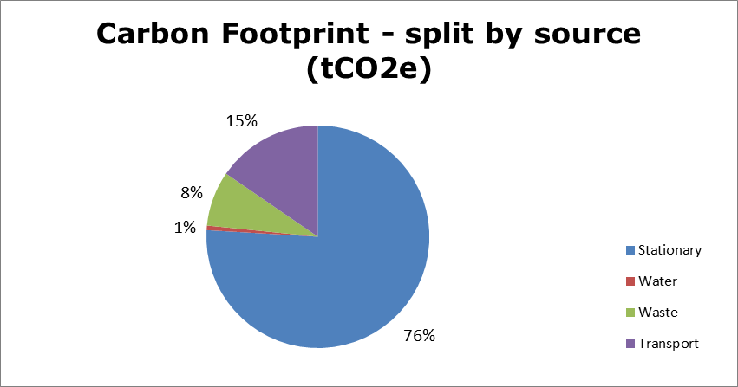
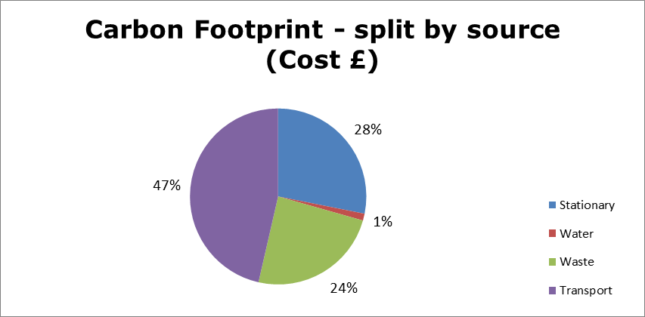
How the CF&PR tool can help?
Key points:
It can store current emission sources and calculate the associated carbon footprint using the same factors as the Required Reporting template
It can be used by very small to very large organisations
It is possible to use filters to get consumption totals for reporting
It creates tables and graphs for use in reports e.g.

Slide 25

Exercise A – table groups
Go round the table making introductions
State your name and role
Explain the size of your emissions footprint and baseline year (if known)
Problem 2
The organisation has merged with another organisation in the past year and all the footprinting data is in mess as they have not had time to sort out the combined footprint – what should they do?
Problem 1
The person completing the Climate Change duties report is new to the job and all they have is a spreadsheet with some annual carbon footprint totals (no breakdown into source or consumption data) going back to 2006/07 – what should they do?
Problem 3
An organisation pays a proportion of the electricity and gas bills at the main site of another organisation because of prior arrangements. Who should include this in their emissions data?
Lessons learnt/outstanding issues from Part A?

Slide 26
 | Targets
3d | Organisational targets
Key points:
The aim of this question is to get an overall picture of the targets that public sector organisations are setting around carbon emissions
Some organisations might just have an overall carbon reduction target
Some might have no overall target but instead reduction targets for different emission sources or parts of the organisation
Some might have no targets – the reasoning should be explained in the governance section

Slide 27
Targets and scope
All new build/refurbishment projects to meet BREEAM excellent standard
Carbon Management Plan reduction target
2% annual reduction up to 2020 based on 2011/12 baseline year
Reduce data centre energy use to SG target Power Usage Effectiveness
Business travel target; reduce costs by 10% based on previous year
Water use – reduce by 20% over next five years

Slide 28
Issues with targets
Carbon CO₂e
Understand variance
Set conditions
Regular updates
Cost £
Consumption e.g. kWh/litres

Slide 29
Exercise B – table groups
Lessons learnt/outstanding issues from Part B?

Slide 30
Part 3 – Projects
Part C - Carbon reductions from projects
Question 3e
Question 3f
Question 3h
Question 3j

Slide 31
 | Projects and changes
3e | Estimated total annual carbon savings from all projects implemented by the organisations in the report year
Key points:
Focus is on estimated annual savings that you will get from all projects implemented in the reporting year e.g. 2014/15
Savings are put against emission sources – one question is where the public sector is focusing effort
If the implementation phase of a project runs over more than one reporting period, count it in the year that it is complete e.g. a CHP project starts in June 2013 and finishes in June 2014; therefore the implementation year is 2014/15 and it is reported in Question 3e and 3f
Clarify uncertainties in the comments box e.g.

Slide 32
Overall project savings in reporting year
Project Description | Location | Capital Spend Year | Commissioning Year | First Full Year of CO2e savings
Replace existing T8 lamps with LED alternatives | Buildings 1,2,3,4,5,6 | 2014/15 | 2014/15 | 2015/16
Optimise AHU operating timings | Buildings 1,2, 3, 4 | 2014/15 | 2014/15 | 2015/16
Install VSDs on AHU motors | Buildings 1,2,3,4,5,6 | 2014/15 | 2014/15 | 2015/16
Install CHP (elec) | Buildings 3,4,5,7,8 | 2014/15 | 2014/15 | 2015/16
Install CHP (gas) | Buildings 3,4,5,7,9 | 2014/15 | 2014/15 | 2015/16
Emission source | Total est. annual carbon savings (tCO₂e) | Comments
Electricity | 2,295 | Estimated total based on 5 projects including one renewable (PV panels) and one CHP
Natural gas | -692 | Impact of the CHP project on gas consumption
Data management
This is an area where it will help to have a record of all projects in one place
The CF&PR tool can help with this

Slide 33
 | Projects and changes
3f | Detail the top 10 carbon reduction projects implemented by the organisation in the report year
Key points:
Focus is on estimated annual savings that you will get from individual projects implemented in the reporting year e.g. 2014/15
If your organisation has not completed 10 projects, include all that have been done
Top 10 can be a judgement call; it might be based on total saving or on best payback or include smaller pilot projects with innovative elements

Slide 34
 | Projects and changes
3f | Detail the top 10 carbon reduction projects implemented by the organisation in the reporting year
Specific data management
Funding source
First full year of saving
Capital cost
Operational cost
Project lifetime
Primary fuel source saved
Estimated carbon and cost saving
Behaviour change

Slide 35
 | Projects and changes
3h | Anticipated annual carbon savings from all projects implemented by the organisation in the year ahead
Key points:
Focus is on estimated annual savings that you will get from all projects implemented in the year ahead e.g. 2015/16
Most organisations should have a reasonably good idea of what these are because approx. 50% will have already happened
If you are uncertain about the annual savings or if the project/s will even go ahead, document this in the comments

Slide 36
 | Projects and changes
3j | Total carbon reduction savings from the baseline year
Key points:
This can only be answered if your organisation has excellent carbon reduction project records
A project implemented in year 1 should produce savings each year (until the end of the project lifetime)
Therefore this is cumulative savings of all projects
If you are unable to answer this question, explain in the comments box e.g.
Total savings | Total est. emissions savings (tCO2e) | Comments
Total project savings since the baseline year |  | Unknown because no collated carbon reduction project records prior to 2013/14

Slide 37
Example 1 of how to carbon cost projects
An LED lighting replacement for 50% of light fittings in Building 1
Building 1
Electricity 6,500,000 kWh
Natural gas 7,000,000 kWh
Water use 40,000 m³
Aim of project Reduce electricity from lighting (LED saving approximately 80% from average lights)
Data into CF&PR tool
Estimated project cost
Based on estimated payback of 3 years: multiply 780,000 x 3 x £0.1 = £234,000
Electricity on lighting
UK data for offices indicates 30% on lighting = 6,500,000 x 0.5 x 0.8 x 0.3 = 780,000 kWh
Type of Source Saving | Type of Emission Saving | Amount of Savings | Annual Savings for this project already captured in most recent CF?
Stationary | Grid electricity (kWh) | 780,000 | No
Simple Payback (Years) | Carbon Cost Effectiveness (£/tCO₂e) | 2015/16
 |  | Carbon savings (tCO₂e) | Cost Saving (£)
2.9 | 600 | 390 | 81,163

Slide 38
Example 2 of how to carbon cost projects
Replacement of oil-fired boiler at Building 5 with a biomass boiler
Building 5
Electricity 1,000,000 kWh
Fuel oil 1,200,000 kWh
Water use 6,000 m³
Data into CF&PR tool
Estimated project cost
CT guidance: average cost per kW installed is £700. Estimated size is 400kW
What is the project going to do?
Replace most of the fuel oil consumption with biomass (assume 90%)
Type of Source Saving | Type of Emission Saving | Amount of Savings | Annual Savings for this project already captured in most recent CF?
Stationary | Biomass Self Supply - Wood Chips or Pellets replacing Oil (kWh) | 1,080,000 | No
Simple Payback (Years) | Carbon Cost Effectiveness (£/tCO₂e) | 2015/16
 |  | Carbon savings (tCO₂e) | Cost Saving (£)
6.8 | 944 | 297 | 41,040

Slide 39
Example 3 of how to carbon cost projects
Organisation-wide printer review to change settings to a password print collect function + automatic double sided printing
What is the project going to do?
Reduce paper use & print consumables
Save electricity on printing
Reduce waste at source
Waste recycling
112 tonnes
Data into CF&PR tool
Estimated project cost
£1,000 for IT and staff awareness
Estimate proportion of paper in recycling = 50%
Estimate saving from reducing waste printing = 50%
Simple Payback (Years) | Carbon Cost Effectiveness (£/tCO₂e) | 2015/16
 |  | Carbon savings (tCO₂e) | Cost Saving (£)
0.5 | 1,701 | 0.6 | 1,960
Type of Source Saving | Type of Emission Saving | Amount of Savings | Annual Savings for this project already captured in most recent CF?
Waste | Paper & board (mixed) recycling | 28 | No

Slide 40
Exercise C – table groups
Problem 2
Our organisation has a project list but the projects are not carbon costed
Problem 1
I am trying to complete my Carbon Reduction Project List but I do not have the data – other individuals within the organisation run their own spreadsheets with the data etc…….we have lots of separate systems with different information criteria for energy, waste, transport etc.
Problem 3
Our project list has 4 large projects that run over 3 or 4 years each; none are complete yet and therefore we have nothing to report in this section
Lessons learnt/outstanding issues from Part C?

Slide 41
Part 4 – Increases and decreases
Part D - Carbon increases/decreases from other sources:
Question 3g
Question 3i

Slide 42
 | Projects and changes
3g | Estimated decrease or increase in emissions from other sources in the report year
Key points:
This question is about the other factors that are driving your carbon footprint e.g.
Student numbers
Your organisation’s carbon footprint
Research income
Estate changes
Emission factors
Weather e.g. degree days

Slide 43
Reframing the question
In the reporting year (2014/15):
If nothing else had changed from the previous year, what would you have expected your footprint to have been:
  CF 2013/14 minus projects implemented in 2013/14
However, this is an unlikely scenario. What might have changed:
  Consumption patterns – up or down
    Weather related?
    New buildings?
    Less staff?
  Emission factors for grid electricity

Slide 44
Influence of the grid factor
Year of emission factors | 2013 | 2014 | 2015
Grid factor | 0.4836 | 0.5375 | 0.5004
Percentage change from previous year |  | +11% | -7%
Carbon footprint from 1,000,000 kWh of electricity (tonnes CO2e) | 484 | 538 | 500
Key points:
Impact of the grid depends on alignment of factor year

Slide 45
 | Projects and changes
3h | Estimated decrease or increase in emissions from other sources in the year ahead
Key points:
Same question but asking about what is likely to affect your footprint in the year ahead (2015/16 compared with 2014/15)
How can the RES tool help you answer this question?
  Look at future changes – what buildings/emission sources are due to change in the next year?
  Look at emission factors – what emission factors are changing significantly in the next year?

Slide 46
Exercise D – table groups
Lessons learnt/outstanding issues from Part D?

