Slide 1
EAUC Sustainability in the Curriculum: Music Soundscapes in assessment
Image: Tree Music by Mikecogh Licensed under CC BY-SA 2.0
Dr Jane Pettegree, Lexie Dykes, Lucy Reynolds, Kirstin Spence
Laidlaw Music Centre University of St Andrews
January 2023
Notes:
Line spacing + Page numbers

Slide 2
ESD Competencies
Highlight:
Systems thinking across disciplinary boundaries
Self-awareness (reflective process)
Normative competency (communicating values / environmental awareness using music)
(against QAA https://www.qaa.ac.uk/the-quality-code/education-for-sustainable-development )
St Andrews pledges on Sustainability – see https://www.st-andrews.ac.uk/sustainability/

Slide 3
Contents
01 Teaching Context: ‘Words and Music’
02 Theory-lite: “listening to the world”
03 The assessment brief
04 Case Study 1: Lucy Reynolds, Climate Change Protest (The Sea)
05 Case Study 2: Kirstin Spence, ‘On the Verge of Extinction;’
06 Case Study 3: Lexie Dykes, Home

Slide 4
Module Context
01
“Words and Music” is a liberal arts elective module designed for first year students at the University of St Andrews, not specialist music students, some who will have (advanced) musical skills, others who won’t have much prior formal music education.
Key questions: how do words shape musical form, and how can music add affective and imaginative depth to words?
Syllabus looks at songs from different periods and genres of “Western Music” composition, ending with a focus on contemporary ‘soundscape’ composition – including songs which ‘sample’ sounds found in the world.
Image: Blackbird in apple tree, by Ewan Bellamy, Licensed CC BY0-NC-ND 2.0
A soundscape is a recording of the sounds heard in a specific area, which – when thoughtfully curated – can help direct a listener’s attention to a particular phenomenon.

Slide 5
Soundscape Theory-lite
02
1940s/50s: Pierre Schaeffer (aka ‘the Father of Sampling’) and ‘musique concrete’ - extraction of sound from the world (‘acousmatic listening’)
1960s-80s: R. Murray Schafer– using soundscapes to return us to the world e.g. The Tuning of the World (Toronto, 1977); and The World Soundscape Project at Simon Fraser University - https://www.sfu.ca/sonic-studio-webdav/WSP/ (‘acoustic ecology’)
Contemporary Impact: recent folk music in the UK has combined traditional methods of song composition with ‘samples’ of real-world sound, so that the message shaped by the words can be illustrated by sounds associated with these causes E.g. Northern Flyway (Jenny Sturgeon and Inge Thomson) and Jenny Sturgeon’s Living Mountain (label Hudson Records) Katrine Polwart et al. Spell Songs project (based on the Lost Words books by Robert Macfarlane and Jackie Morris) - https://www.thelostwords.org/

Slide 6
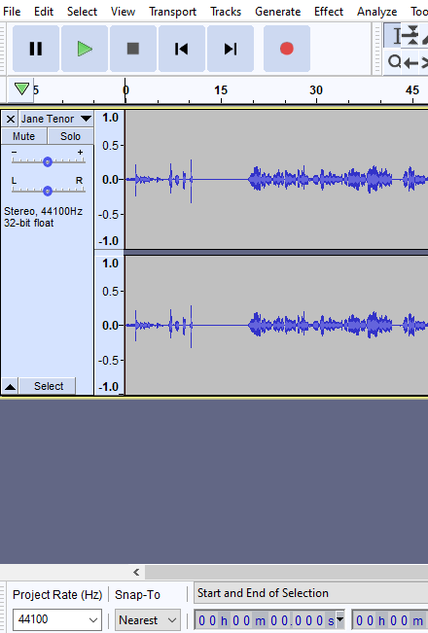
03 The Assessment Brief
Words-and-music final project: sound file (mp3) and commentary
Create a sound file that demonstrates how words and sounds can combine to make musical meaning. This may be a ‘soundscape’ interaction between words and various types of ‘found’ sound.
The commentary will position the song in a relevant listening context and explain the principles of design and meaning behind your piece.
Using e.g. mobile phones to record, and open access Audacity software to do basic editing.
Aim to give students creative control over how they respond to the module content – learning through creative play

Slide 7
Assessment Feedback Grid

Slide 8
Case Studies
Student Responses included:
Quite a few who used this task to meditate on a variety of psychological processes, neurodiversity issues, and mental health challenges (broadly, how songs connect emotions with framing words)
A few who wrote conventional pop songs reflecting on how these connected with material from earlier in the semester
Some who engaged strongly in the ‘eco-poetic’ agenda, including the three following examples

Slide 9
Case Study 1: Lucy Reynolds, Example provided with Lucy’s permission. Lucy
“This recording explores an unfolding story within a soundscape and is about the relationship between humans and nature …(the sea in particular).”
Lucy’s commentary explained she took part in the School Strike for Climate movement; her lyric was inspired by Toch’s Geographical Fugue and includes a list of cities and towns threatened by global sea level rise.
The soundscape also uses radio clips about climate change, protests and conversations about this, along with water sounds recorded locally around St Andrews.
A narrative of environmental disaster
Image: St Andrews out to sea, by Patrick Down, licensed CC BY-NC 2.0

Slide 10
Lucy: What did I learn / get from this assignment?
“Because the project for this module was completely different to any other university assessment I've done, the premise of it was a bit daunting at first. However, unlike other assessments, the format of this one gave me the opportunity to (and indeed made me) assess my own understanding of the environment and the relationship I have with it, applying and using lived experience and observations which, at least at this level of my degree, hasn't been the case in my other subjects. It meant I was engaging with the world around me when recording and shaping the individual sounds that would later make up the final project and using a part of my brain through creative analysis and observation that, despite being crucial, is sometimes overlooked in academia. ”
Image: Climate Change Camp Protest 2007 (near Heathrow) by Andrew* – licensed under Attribution-ShareAlike 2.0 Generic CC BY-SA 2.0

Slide 11
Case Study 2: Kirstin Spence, ‘On the verge of extinction’
Student studying geography and sustainable development
Kirstin says: “This soundscape highlights the fragility of nature and the effect that humans are having on the natural environment, ultimately leading to species extinction.” The ecosystem she focusses on is the forest.
Her project draws on contemporary compositions by e.g. Emily Doolittle (seals), Jenny Sturgeon (birdsong), and Robin Haigh’s ‘Hydrogen, Helium, etc’ about rare elements.
She combines Waqas Hayat’s poem “Endangered animals” with a sample of the song ‘Blackbird’, birdsong, climate change speeches, forest sounds and tree felling, to create a soundscape about endangered habitats.
The sample here is from the beginning and end of the track
Image: Madagascar deforestation, by Cunningchris2 licensed CC-BY-SA-4.0

Slide 12
Kirstin: What did I learn / get from this assignment?
““The process of making this soundscape forced me to, first, appreciate the natural environment and think about the different sounds that are found in a forest ecosystem but then also to consider the effect that humans are having on the planet and how this will change the sounds which have become so ingrained into our idea of the natural world. …. I wanted to use this piece to showcase the gradual silencing of the planet as different species and habitats are destroyed and create a source of reflection. The last few seconds of the soundscape are in complete silence which paints a bleak view of the planet’s future.”
Image: The Chase Wood, Newbury – Licensed CC BY-SA 2.5, near the Newbury Bypass – taken by Joolz-common-swiki 2005

Slide 13
Case Study 3: Lexie Dykes, ‘Home’
Used Edward Thomas’s poem ‘Home’ – about a soldier returning home from WW1 – to think about what journeying ‘home’ sounds like
“I have combined clippings of myself reciting the poem, supported by natural recorded and pre-recorded sound effects … this allowed me to explore the relationship between sound, text and subjectivity, i.e., how do I hear comfort? What sounds denote home for me?”
Used own recordings (e.g. herself whistling and walking, flatmates laughing) alongside the BBC Soundscape site for samples of British birdsong and other ambient noises: https://sound-effects-bbcrewind.co.uk/
She was also interested in the evocation of nature found in Benjamin Britten’s Peter Grimes (studied on the module) – a piece written by a composer who was home-sick – words alternate with sound ‘interludes’.
The clip takes material from the start and towards the end of Lexie’s composition – connecting human sounds with birdsongs.
Lexie – what did you learn / /take away from this assignment?
Song Thrust singing in a tree in the Netherlands – by Taco Meeuwsen – Licensed Creative Commons 2.0 Generic https://commons.wikimedia.org/w/index.php?curid=5343495

