Slide 1










Designing
For
Compliance
Stephen Hill, Arup
Notes:
Bring in audience – you, us in this room

Slide 2
VALUE
Notes:
Property market all about value. For UK Commitment scheme to succeed, link to value has to be clear

Slide 3
200
5
1
Energy Costs
Rental Costs
People Costs
Wellbeing Performance Gap
Energy Performance Gap
Notes:
Energy costs are minimal in the context of overall business costs
Building performance for tenants becoming more focused on occupant well-being, seen as contributor to lower absenteeism, lower turnover and higher productivity
Recognise that most businesses will prioritise wellbeing over energy efficiency

Slide 4
DESIGN
Notes:
Property market all about value. For UK Commitment scheme to succeed, link to value has to be clear

Slide 5



Notes:
Focus on compliance - rapid rise in standards has made compliance main focus rather than real performance

Slide 6
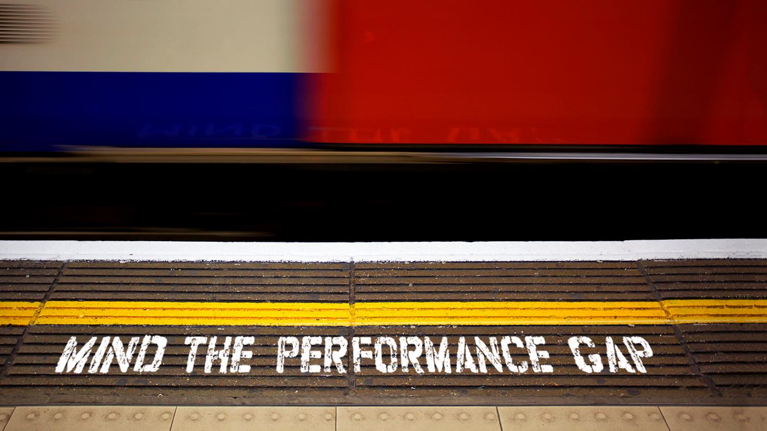
Notes:
Leads to performance gap

Slide 7
REASONS WHY BUILDINGS DON’T WORK AS THEY SHOULD
Notes:
Property market all about value. For UK Commitment scheme to succeed, link to value has to be clear

Slide 8
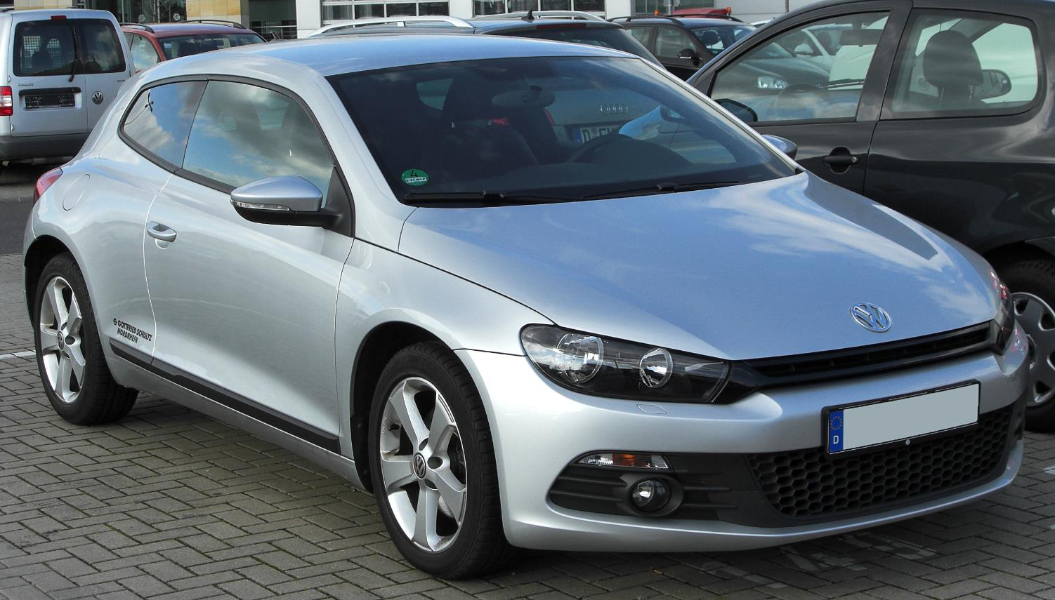
Carbon Calculations
Notes:
Carbon calculations are theoretical and compliance focused. Don’t generally relate to real outcomes

Slide 9

Complexity
Notes:
Leads to over-complexity

Slide 10

Notes:
Implementation of controls of complex integrations poorly delivered. Systems functional but not capable of operating at design efficiency
PwC – with highly skilled and motivated FM team, fully involved in construction, still took 3 years and significant investment to get trigen to work efficiently.

Slide 11
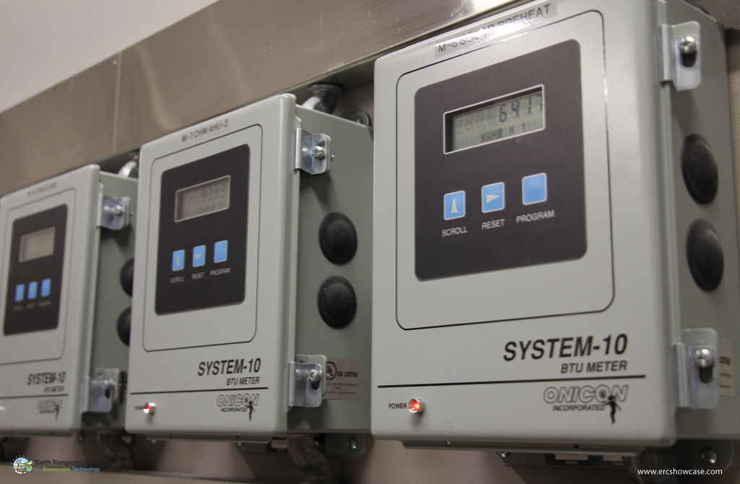
Poor Metering
Notes:
Metering installations poor - done to satisfy Part L. Often in wrong places, don't allow end-use breakdown. Poorly calibrated. No interpretation

Slide 12
2. Metering
Notes:
Metering installations poor - done to satisfy Part L. Often in wrong places, don't allow end-use breakdown. Poorly calibrated. No interpretation

Slide 13

Practical (In)completion
Notes:
Fallacy that buildings are complete at PC. Minimal budget available in operation, constrained by service charge. No money to put things right.

Slide 14


Knowledge Transfer
?
?
?
?
?
?
?
?
?
?
?
?
?
?
?
?
?
?
Notes:
Transfer of knowledge to FMs very poor. Often little or no understanding of complex integrated systems
FMs gen not incentivised to deliver energy efficiency. Incentives based on service level
Don’t spend enough time training operators or users
O&M manuals don’t tell operators how run buildings
provide hundreds of energy & water meters, but no means of analysing
Is it any wonder that buildings often don’t work as well as they should

Slide 15


FM contracts
Efficiency
Service level
Notes:
Standard Fm contracts based on provision of fixed PPM service. Contractors often expected to pay proportion of cost to fix problems identified.
No link to performance
Counter-incentive to identify and fix problems

Slide 16
DATA
Notes:
Need a new approach to managing building performance. In our view, all about data

Slide 17
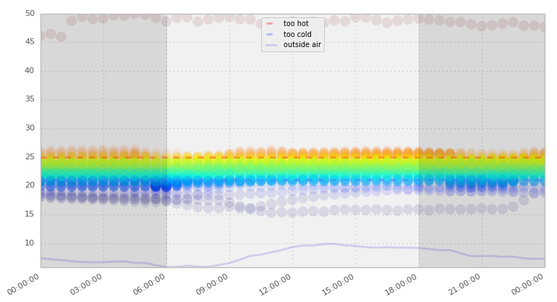
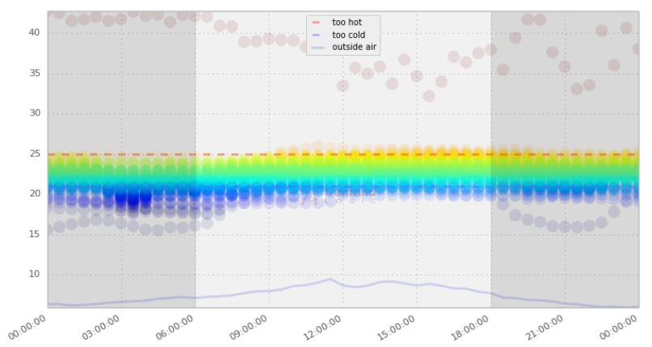
Seasonal Commissioning
Continuous Commissioning
A New Approach
✗
✓

Slide 18
What and When?
Practical Completion
Defects Liability
Pre-Handover
Year 1
Year 2 & 3+
Commissioning
Operational Readiness
Operation
Verification
(is it finished?)
Optimisation
(can we improve it?)
Validation
Contractor de-snagging / re-commissioning
Operational improvement works
Notes:
More structured approach to managing performance through commissioning, defects & beyond. Pro-active approach to performance diagnosis and resolution

Slide 19
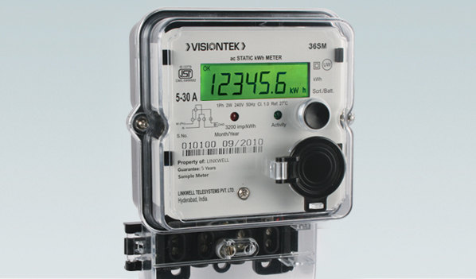
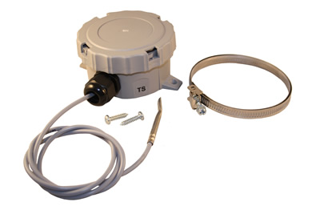
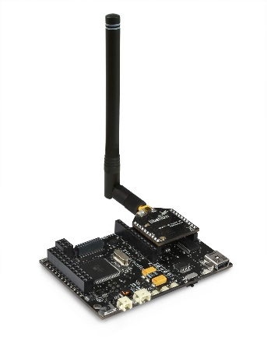
Collect the data
Energy Meters:
BMS Sensors:
IoT Nano-Sensors:
Energy Analysis
Notes:
Been analysing energy data for a while

Slide 20
Collect the data
Energy Meters:
BMS Sensors:
IoT Nano-Sensors:
Systems Analytics
Notes:
Now looking at BMS data through analytics platforms

Slide 21
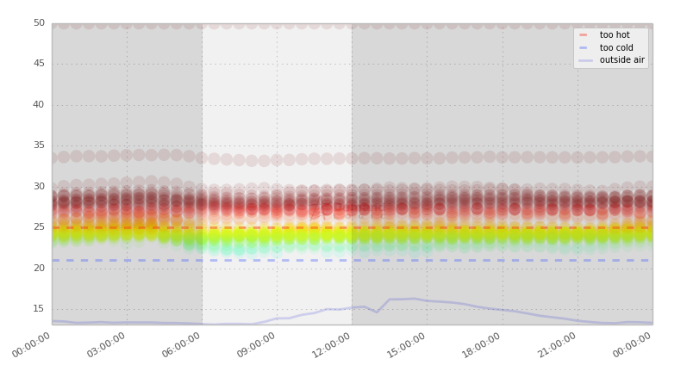
Example findings: Temperature Profiling

Slide 22
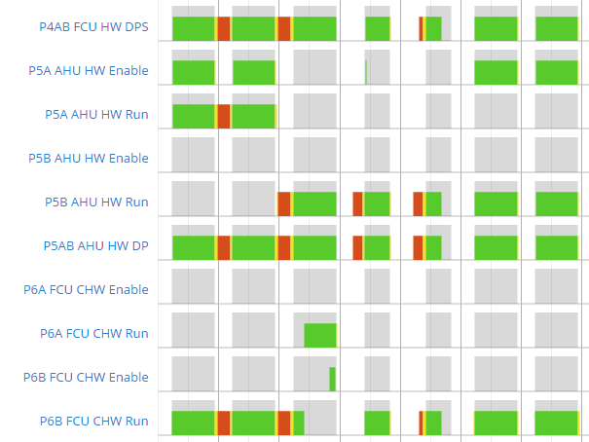
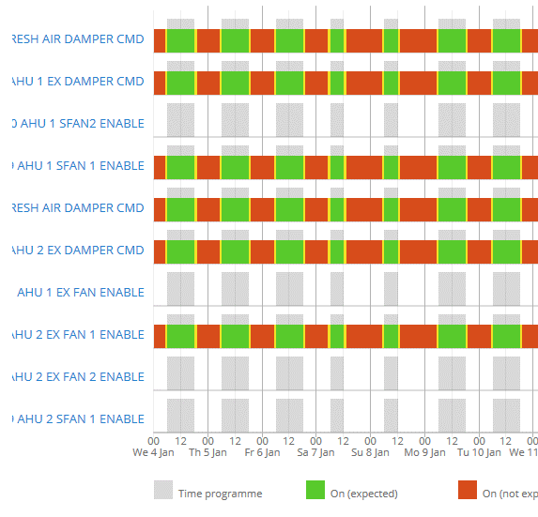
Plant Operating Hours
Main plant schedule aligned to occupancy
Main plant running 24/7

Slide 23
Collect the data
Energy Meters:
BMS Sensors:
IoT Nano-Sensors:
Intelligent Asset
Notes:
Nano sensor allow collection of much more data much more cheaply

Slide 24
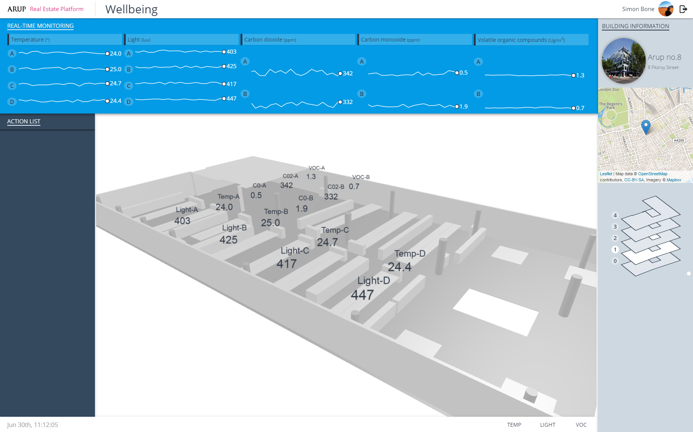
Impax – Intelligent Asset Management
Wellbeing Dashboard
Development proof of concept
wellbeing dash
Notes:
Old street yard pdf - visualisation

Slide 25
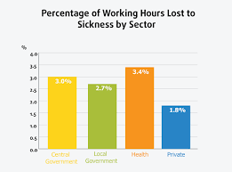



Collect the data
Energy
Meters:
BMS: Data
(Live) perceptive feedback
Wearable Sensors:
IoT Sensors:
HR Data
Intelligent Asset
Notes:
Potential to cast the net much further – wearables, live occupant feedback, hr data.
Having all on single open platform offers huge potential to further understanding of real occupant comfort
Huge opportunity to understand not only performance but the business impact of that performance

Slide 26
Act on the Data
Rectify
Verify
Identify
Notes:
Then can set about improving performance

Slide 27
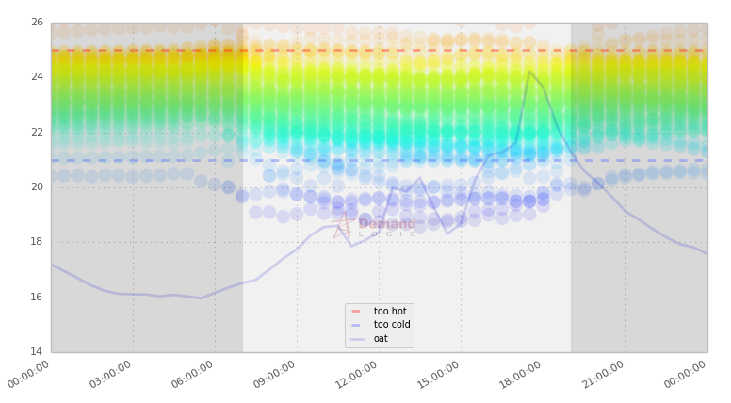
Performance-based maintenance
Priority Action (Too Hot)
Priority Action (Too Cold)
Notes:
Data gives us the ability to prioritise maintenance activity in problem areas

Slide 28
Performance-based maintenance
Service Level Target [95%]
Notes:
Importantly this allows us to move to performance or output based contracts where maintenance companies are required to deliver a level of service, instead of an amount of labour
Has the potential to transform the way we operate and maintain our buildings

Slide 29
DEMAND
Notes:
So technical tools exist to solve problem. But for market to adopt this approach need effective incentives

Slide 30

Notes:
Demand for high performing buildings is weak in the UK market because information on real performance is hard to come by. So tenants make decisions on BREEAM & BCO compliance

Slide 31
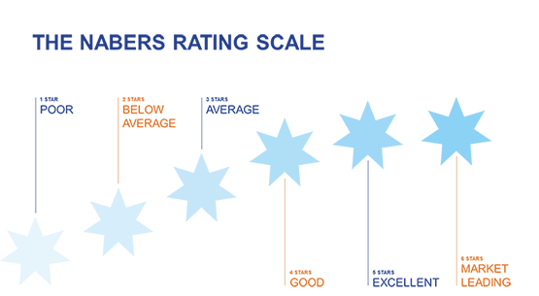

Notes:
Different in Australia where nabers rating is direct indicator of operational performance – energy and environment. Has clear link to property value, proxy for quality

Slide 32

Notes:
BBP leading trial of similar approach here

Slide 33

BREEAM 2018: Verification Stage?
Notes:
BREEAM 2018 may take first step in that direction with verification stage. Yet to see how far will go

Slide 34
1. GENERATE A DEMAND
2. CONTROL THE DATA
3. CREATE A POSITIVE INCENTIVE

Slide 35
Close
Notes:
Leads to performance gap

