Slide 1

Student Sustainability Leaders (Scotland) Roundtable
20th August 2020
14:00-15:30
www.eauc.org.uk

Slide 2

Agenda
14.00 Welcome and Introductions Matt Woodthorpe (EAUC-Scotland) and Amy Smith (Chair; University of Stirling Students’ Union)
14:10 Scene setting – how far has the sector come and where does it need to go? Matt Woodthorpe
14.20 Climate Commission Marta Crispo (Climate Commission)
14.25 Teach The Future Scotland Anna Brown (Teach The Future)
14:30 Breakout Group Discussion Amy Smith / All
14:45 Feedback and Next Steps Amy Smith
14:55 Thanks and Close Amy Smith
15:00 Further networking Matt Woodthorpe
www.eauc.org.uk

Slide 3
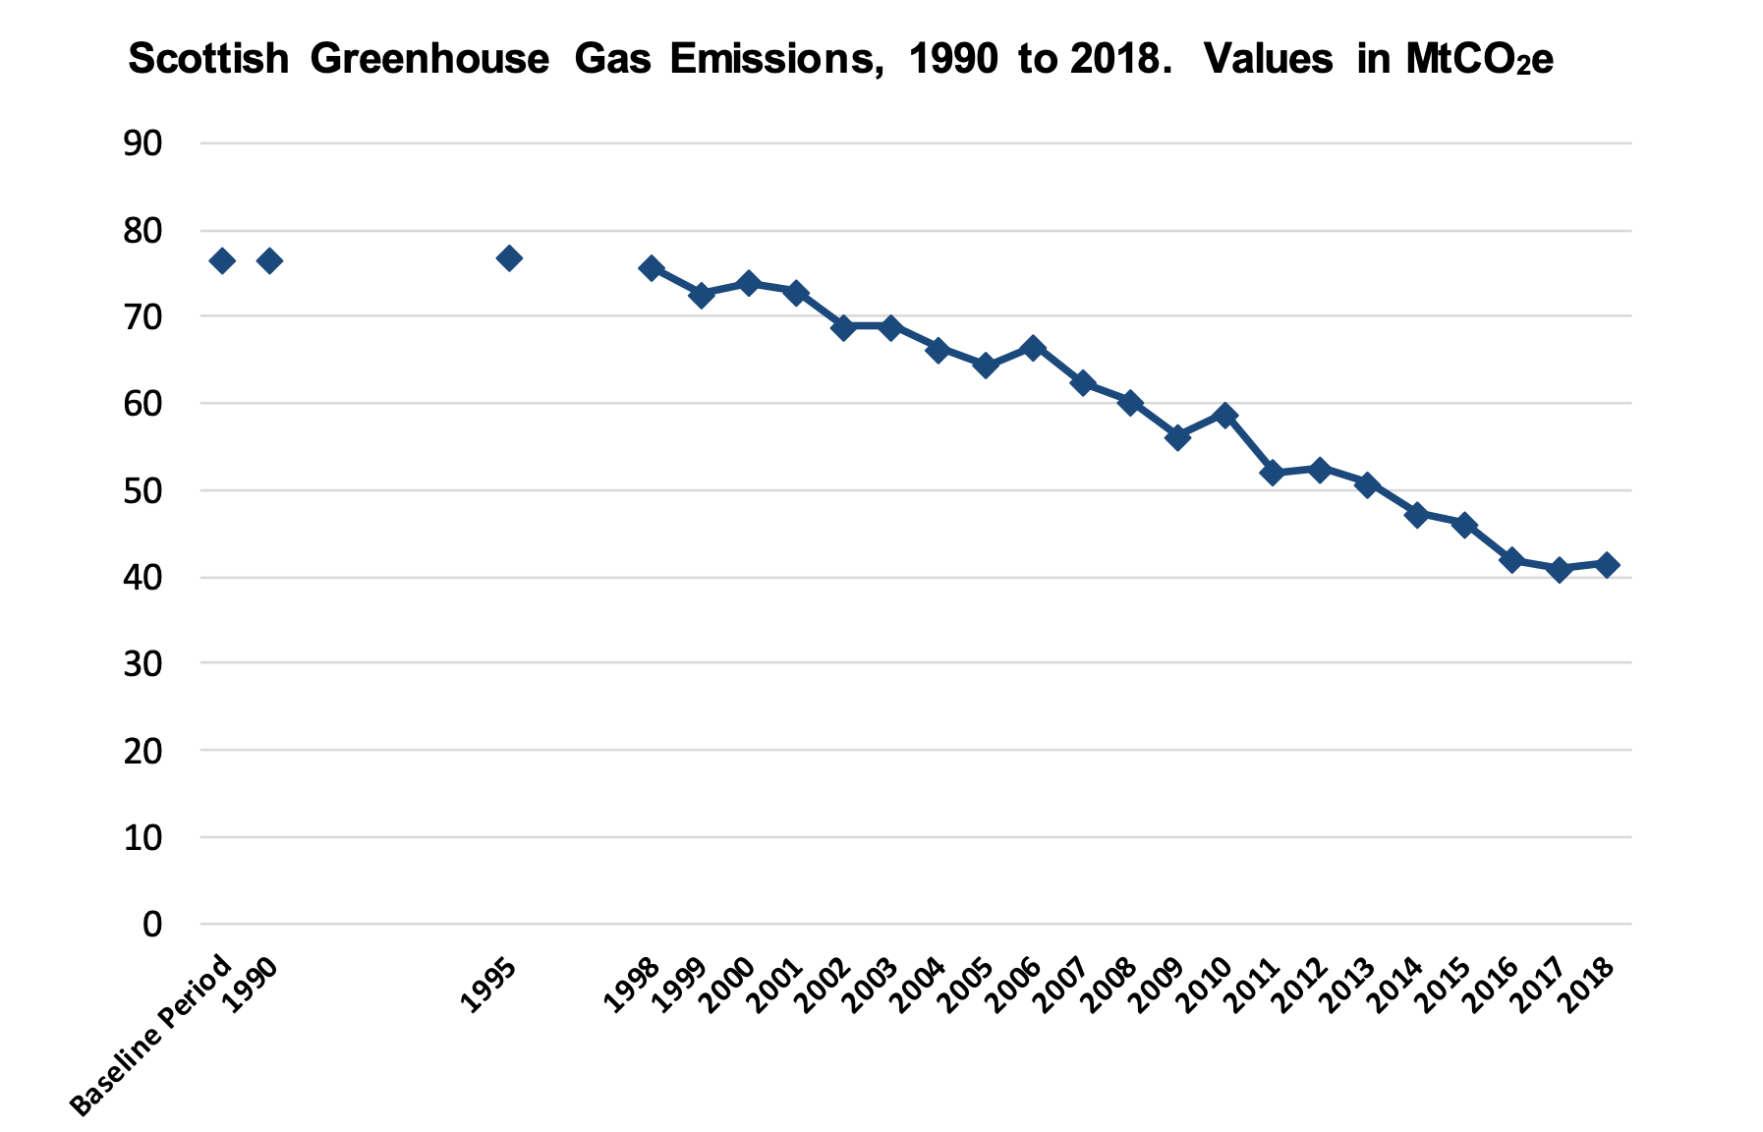
Scene setting - sector responsibility
1 Climate Change (Emissions Reduction Targets) (Scotland) Act 2019
The Climate Change (Emissions Reduction Targets) (Scotland) Act 2019 sets targets to reduce Scotland's emissions of all greenhouse gases to net-zero by 2045 at the latest. This is 5 years ahead of the UK and is based on what the independent Committee on Climate Change (CCC) advice. There are also interim targets for reductions of at least:
56% by 2020
75% by 2030
90% by 2040
Target of 54% reduction by 2018 not met
www.eauc.org.uk

Slide 4
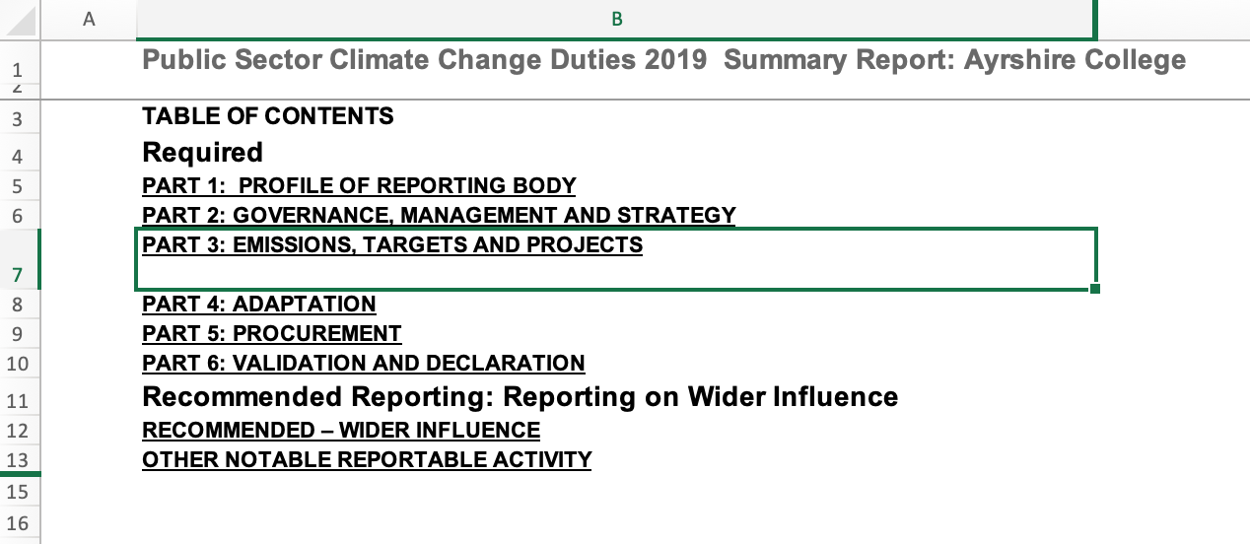
Sector responsibility
2 Public Bodies Climate Change Duties
Public Sector Bodies such as Scottish colleges and universities have a significant role to play in achieving the net-zero goal and the Scottish Government has asked institutions to set targets and actions that reflect this.
Since 2015/16, 44 colleges and universities in Scotland must report annually their progress to date in reducing their institutional greenhouse gas emissions to the Scottish Government through a system known as Public Bodies Climate Change Duties (PBCCD) Reporting.
Reports can be found on the Scottish Sustainability Network website here.
www.eauc.org.uk

Slide 5
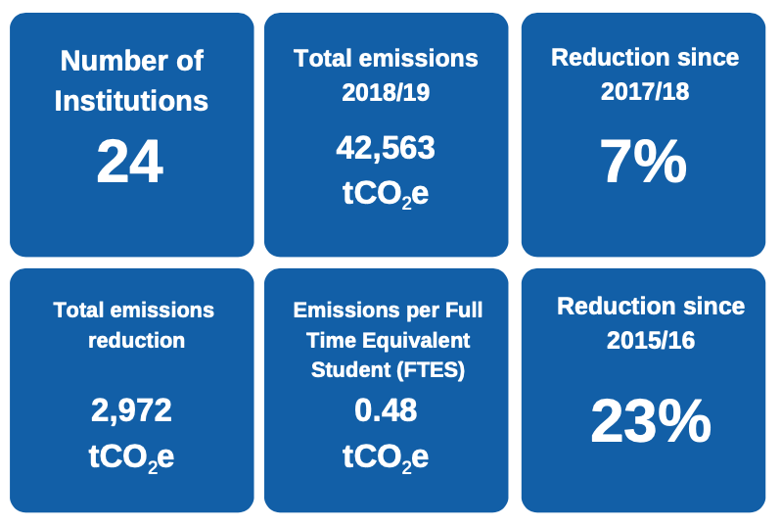
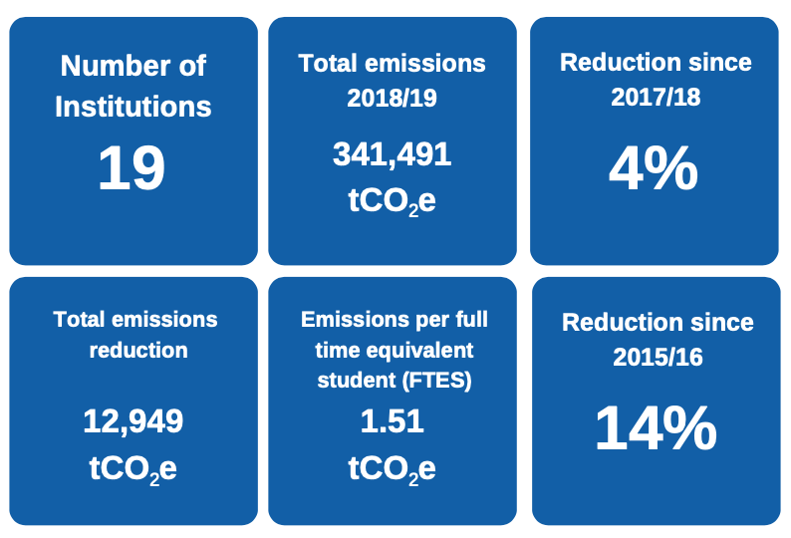
Sector responsibility
2 Public Bodies Climate Change Duties – how are we doing?
EAUC-Scotland completes a sector analysis each year of the reported data, and created separate Scottish FE and HE reports this year.
Colleges
Universities
www.eauc.org.uk

Slide 6

Sector responsibility
2 Public Bodies Climate Change Duties – proposed changes:
From 2022 reports are to include dates for zero or net-zero direct emissions (Scope 1 and 2);
Targets on in-direct emissions (Scope 3);
and how spending lines align with targets.
www.eauc.org.uk

Slide 7
Wider sustainability
Sustainability is not just about carbon.
Plant-based diets
Living Wage
Biodiverse campuses
Growing spaces
Active travel
Curriculum development and content
Period poverty
Black attainment gap
Plastics ban
Accessibility
Health and Wellbeing
www.eauc.org.uk

Slide 8
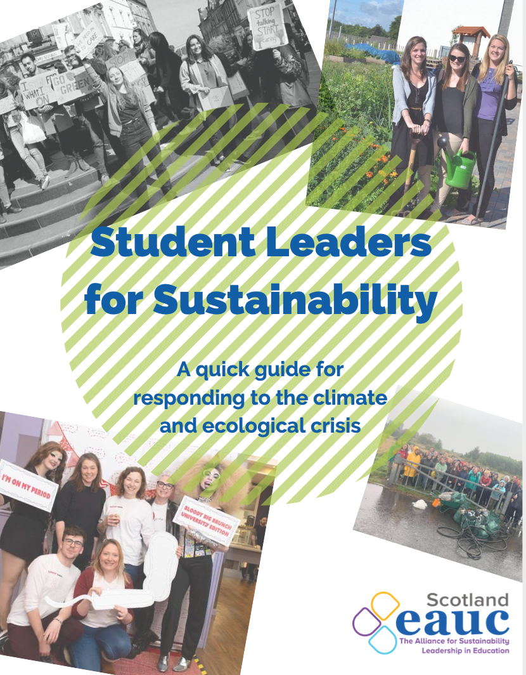
Role of Student Leaders
Students Officers and your respective Students' Union/Association can be a key driver for many types of change, including issues surrounding sustainable development and climate justice. Understanding of the climate and ecological crisis and sustainability within student governance structures and the wider student body is essential to creating a step-change in campus sustainability.
Resources:
Student Leaders for Sustainability Guide
Example Students’ Union / Association SMART Action Plan
Simplified SU / SA GHG emission calculator
You have the platform to create positive change.
www.eauc.org.uk

Slide 9
Thank you
Any further questions please e-mail scotland@eauc.org.uk
www.eauc.org.uk

Slide 10
Agenda
14.00 Welcome and Introductions Matt Woodthorpe (EAUC-Scotland) and Amy Smith (Chair; University of Stirling Students’ Union)
14:10 Scene setting – how far has the sector come and where does it need to go? Matt Woodthorpe
14.20 Climate Commission Marta Crispo (Climate Commission)
14.25 Teach The Future Scotland Anna Brown (Teach The Future)
14:30 Breakout Group Discussion Amy Smith / All
14:45 Feedback and Next Steps Amy Smith
14:55 Thanks and Close Amy Smith
15:00 Further networking Matt Woodthorpe
www.eauc.org.uk

Slide 11
Thank you
Any further questions please e-mail scotland@eauc.org.uk
www.eauc.org.uk

