Slide 1
Student Sustainability Leaders (Scotland) TSN
28th October 2020
14:00-15:30
www.eauc.org.uk

Slide 2
Agenda
14.00 Welcome and Introductions Matt Woodthorpe
14:05 Calculating SU/SA emissions and how to reduce it + Q&A Jill Burnett & Matt Woodthorpe
14.30 Offsetting – what is it? What are the issues? What is best practice? + Q&A Jill Burnett
14.45 Piloting resources and next steps All
14:55 Thanks and Close
15:00 Further networking Matt Woodthorpe
www.eauc.org.uk

Slide 3
Calculating your organisational emissions
Define reporting period
Set operational reporting boundary
Collect activity data
Use calculator to quantify emissions
www.eauc.org.uk

Slide 4
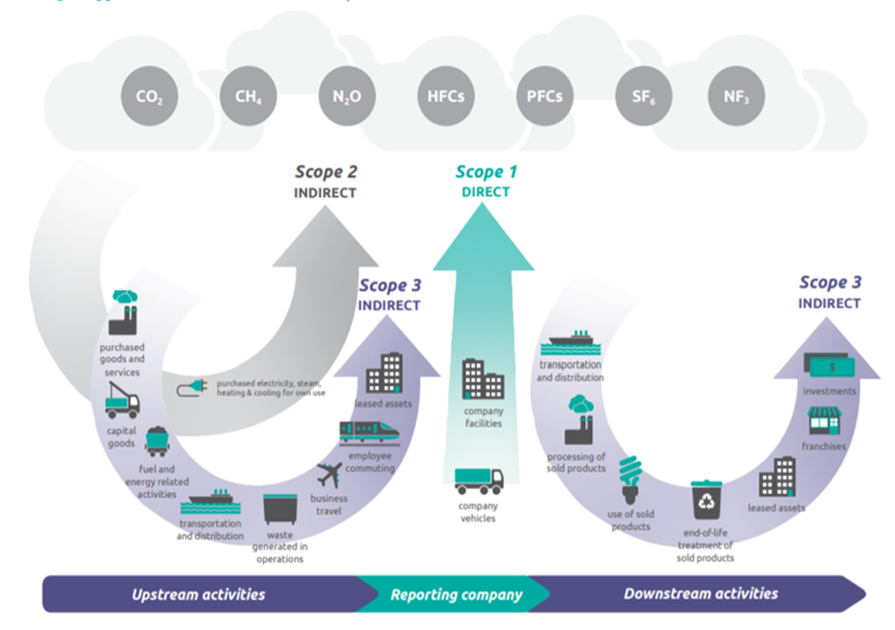
Reporting Scopes
www.eauc.org.uk

Slide 5
Recommended reporting boundary
Scope 1: Building energy & fleet vehicles
Scope 2: Purchased electricity & heat
Scope 3: Electricity transmission & distribution, waste disposal, water supply & treatment, business travel & commuting
www.eauc.org.uk

Slide 6
Building energy – Fuel combustion
Scope 1 emissions from fuel combustion in owned boilers (natural gas, heating oil, biomass etc)
Data easily available from fuel bills
Can be collected in kWh
www.eauc.org.uk
Notes:
Now we are going to look at specific data collection methodologies for the recommended sources of emissions.
First let’s look at building energy consumption – I think everyone is already reporting this so I will just briefly run through it and if anyone has any questions we can return to this at the end of the session
The direct emissions from fuel combustion in owned boilers and generators are Scope 1. This includes natural gas, heating oil & biomass. Data is easily available from fuel bills and can be collected in litres, kWh or tonnes.
Please note that the biogenic CO₂ emissions from biomass are considered to be Out of Scope and should therefore be reported separately. The emissions factors for biomass in ProcXed are for CH₄ and N₂O emissions in their CO₂ equivalence.

Slide 7
Building energy – Electricity
Scope 2 emissions from grid electricity generation or purchased heat/steam
Data available from supplier (kWh)
Scope 3 emissions from transmission & distribution losses
Same consumption data (kWh)
Please note that grid electricity sourced from a green tariff directly from the grid cannot be reported as zero emissions due to double counting
www.eauc.org.uk
Notes:
Grid electricity generation is classed as a Scope 2 indirect emission and again consumption data is available from your supplier.
It is also important to remember to report transmission and distribution losses associated with grid electricity which are Scope 3. This is very easy as you enter the same consumption figures.
Please note that grid electricity sourced from a green tariff directly form the grid cannot be reported as zero emissions due to double counting

Slide 8
Fleet vehicles
Scope 1 emissions from fuel combustion in fleet vehicles (diesel, petrol)
Best quality data is litres of each type of fuel
Data should be available from fuel receipts or service records
www.eauc.org.uk
Notes:
Moving on to fleet vehicles and plant – These are Scope 1 direct emissions from fuel combustion in fleet vehicles & plant (diesel, petrol, marine oil etc)
Best quality data is litres of each type of fuel but can also collect distance travelled by each mode of transport
Data should be available from fuel receipts or odometer records.
Please note that the emissions associated with electric vehicles charged on-site will already be included in total electricity consumption

Slide 9
Waste
Scope 3 emissions from landfill, incineration, recycling & composting
Need weight of material sent to each destination
Data is available from waste contractors
www.eauc.org.uk
Notes:
Waste is a Scope 3 indirect emissions from landfill, incineration, anaerobic digestion, recycling & composting
You’ll need to know the weight of material sent to each destination and this data is available from your waste contractor
Please note that any composting or AD done on site would be classed as Scope 1

Slide 10
Water supply & treatment
Scope 3 emissions from water supply & treatment
Two separate categories so make sure to enter both
Need the volume of water consumed (m³) from supplier
If volume of treated water is not available you can estimate the volume of water treated as 95% of water supply volume
www.eauc.org.uk
Notes:
Scope 3 indirect emissions from water supply & treatment
Two separate categories so make sure to enter both
Need the volume of water consumed in m3 from supplier
If volume of treated water in unavailable you can estimate the volume of water treated as 95% of water supply volume

Slide 11
Business travel
Scope 3 emissions from air, road and rail travel
Distance travelled by each mode of transport in km or passenger km
Data is available from travel booking systems or expenses
Air travel should be broken down by domestic, short-haul & long-haul
Road travel should be broken down by vehicle type
www.eauc.org.uk
Notes:
In terms of data the highest quality you can have is the quantity or cost of each type of fuel consumed during travel which you could obtain from fuel receipts.
Where this data is not available you would collect distance travelled by each mode of transport. This type of data is usually available from your travel booking system or expenses.
For air travel data should be broken down by domestic, short-haul & long-haul. More fuel is used during landing a take-off so shorter flights emit more CO₂ per passenger km.
If possible data should also be broken down by class of travel. The emissions factor for a first class long haul flight is 4 times higher than the economy option.
Road travel should be broken down by vehicle type and fuel type.

Slide 12
Commuting
Scope 3 emissions from staff travel between home and the institution
Best source of data is an annual travel survey
Distance travelled per day one way, number of days per week that staff use a transport type, number of commuting days per week and number of days worked per year
Survey data can be extrapolated from a representative sample
Previous survey data can be used with 2019/20 staff numbers
www.eauc.org.uk
Notes:
Lastly we are going to look at commuting only 9% are currently reporting these emissions and looking back at the GCU footprint we can see these account for 39% of total emissions.
Scope 3 indirect emissions from staff & student travel between home and the institution
Need to know total distance travel by each mode of transport: car, bus, train, motorcycle.
Best source of data is an annual travel survey
You need to ask for distance travelled per day one way
The number of days per week that staff/students use a transport type
The number of commuting days per week and number of days worked per year
Survey data can be extrapolated from a representative sample
If an annual survey is not possible previous survey data can be used with 2018/19 staff & student numbers
You can incentivise survey response rates with prizes or link completion for the survey to permit applications like they have done at Forth Valley College

Slide 13
Reducing your organisational emissions
www.eauc.org.uk

Slide 14
Reducing your organisational emissions
Scope 1 – Action list
Heating:
Programming – is your SU/SA heated during the night?
Are there areas which are heated when not in use (e.g. during quieter periods such as Christmas, over the summer)?
When in use, could the temperature be reduced?
Fleet vehicles:
Log reason for journeys – could journeys be better grouped together? Are they necessary?
If renewing fleet vehicles, look for hybrid or full electric vehicles
www.eauc.org.uk

Slide 15
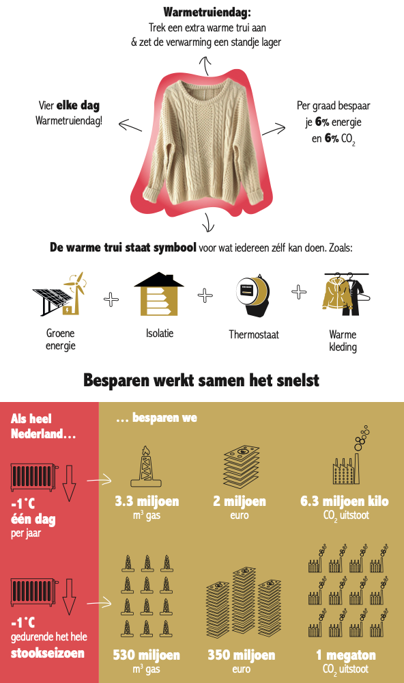
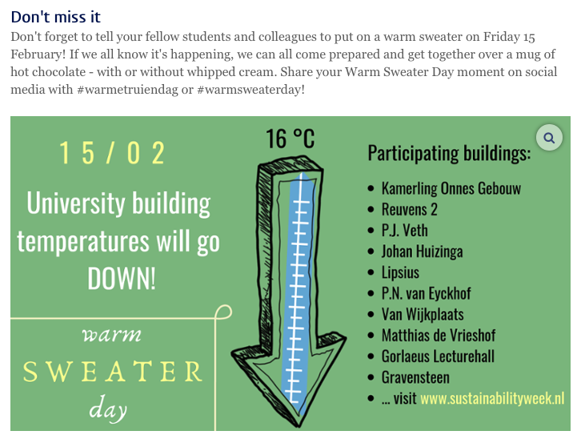
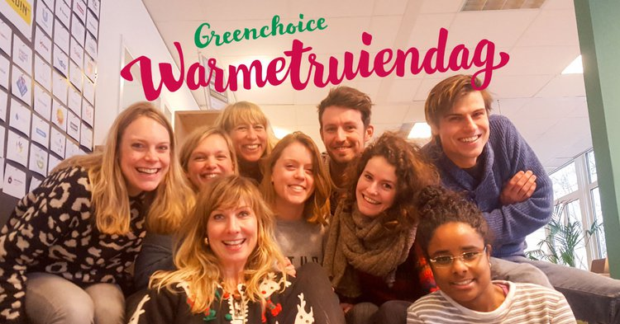
Reducing your organisational emissions
www.eauc.org.uk

Slide 16
Reducing your organisational emissions
Scope 2 – Action list
Electricity use:
Complete a lighting audit to see if you can make any quick wins;
Equipment use – is equipment left on when not needed (particularly during out of office hours);
Commercial services – is equipment efficient (both in electricity use and water); operational hours
Upgrading equipment – ensure its resource efficient from the outset
www.eauc.org.uk

Slide 17
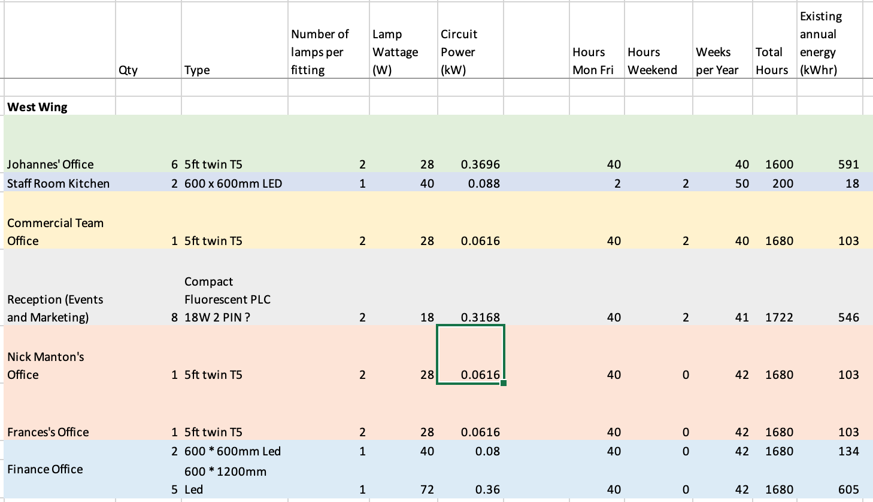
Reducing your organisational emissions
Scope 2 – Action list
www.eauc.org.uk

Slide 18
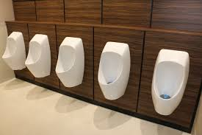
Reducing your organisational emissions
Scope 3
Water use:
Bathroom facilities – water-less urinals; push taps
Catering equipment – dishwasher efficiency
Business travel:
Policy of public transport use over private car / flying
Extra milage payment for car sharing (particularly good for Sports Union travel)
Payment for cycling milage
Cycle to Work Scheme support
“I installed them where I worked 20 years ago. They paid for their installation costs within one year from savings of between 25 to 33% in the water consumption”
Resource use:
Printing audit – how much do each departments print? B&W vs colour? Digitise processes; internal prizes
www.eauc.org.uk

Slide 19
Reducing your organisational emissions
Additional support
EAUC-Scotland – give us a shout!
Your institution – we can help link you up with the sustainability lead
Zero Waste Scotland – SME interest-free loans and scoping studies
www.eauc.org.uk

Slide 20
Offsetting
https://www.eauc.org.uk/sector_briefings
www.eauc.org.uk

Slide 21
Offsetting
High quality offsets - what to look for:
Verification - robust audit trail
Additionality - the carbon savings wouldn’t have happened anyway
Permeance - savings will be sustained over time
No double-counting - reductions are only claimed once
Current prices range from £6-£15 per tonne of CO₂ but may rise
International projects: Plan Vivo & Association for Coastal Ecosystem Services
UK projects: Woodland Carbon Code & Peatland Code
Further information Carbon Offset Guide
www.eauc.org.uk

Slide 22
Thank you
Any further questions please e-mail scotland@eauc.org.uk
www.eauc.org.uk

Slide 23
Further opportunities:
Circular Arts Network - https://www.canarts.org.uk
Single Use Plastics Consultation - https://zerowastescotland.org.uk/our-work/single-use-plastics-public-consultation
www.eauc.org.uk

