Slide 1

Engaging with communities through our supply chains
EAUC Scotland event on community engagement
16th April 2015
Liz Cooper, SRS Research and Policy Manager

Slide 2
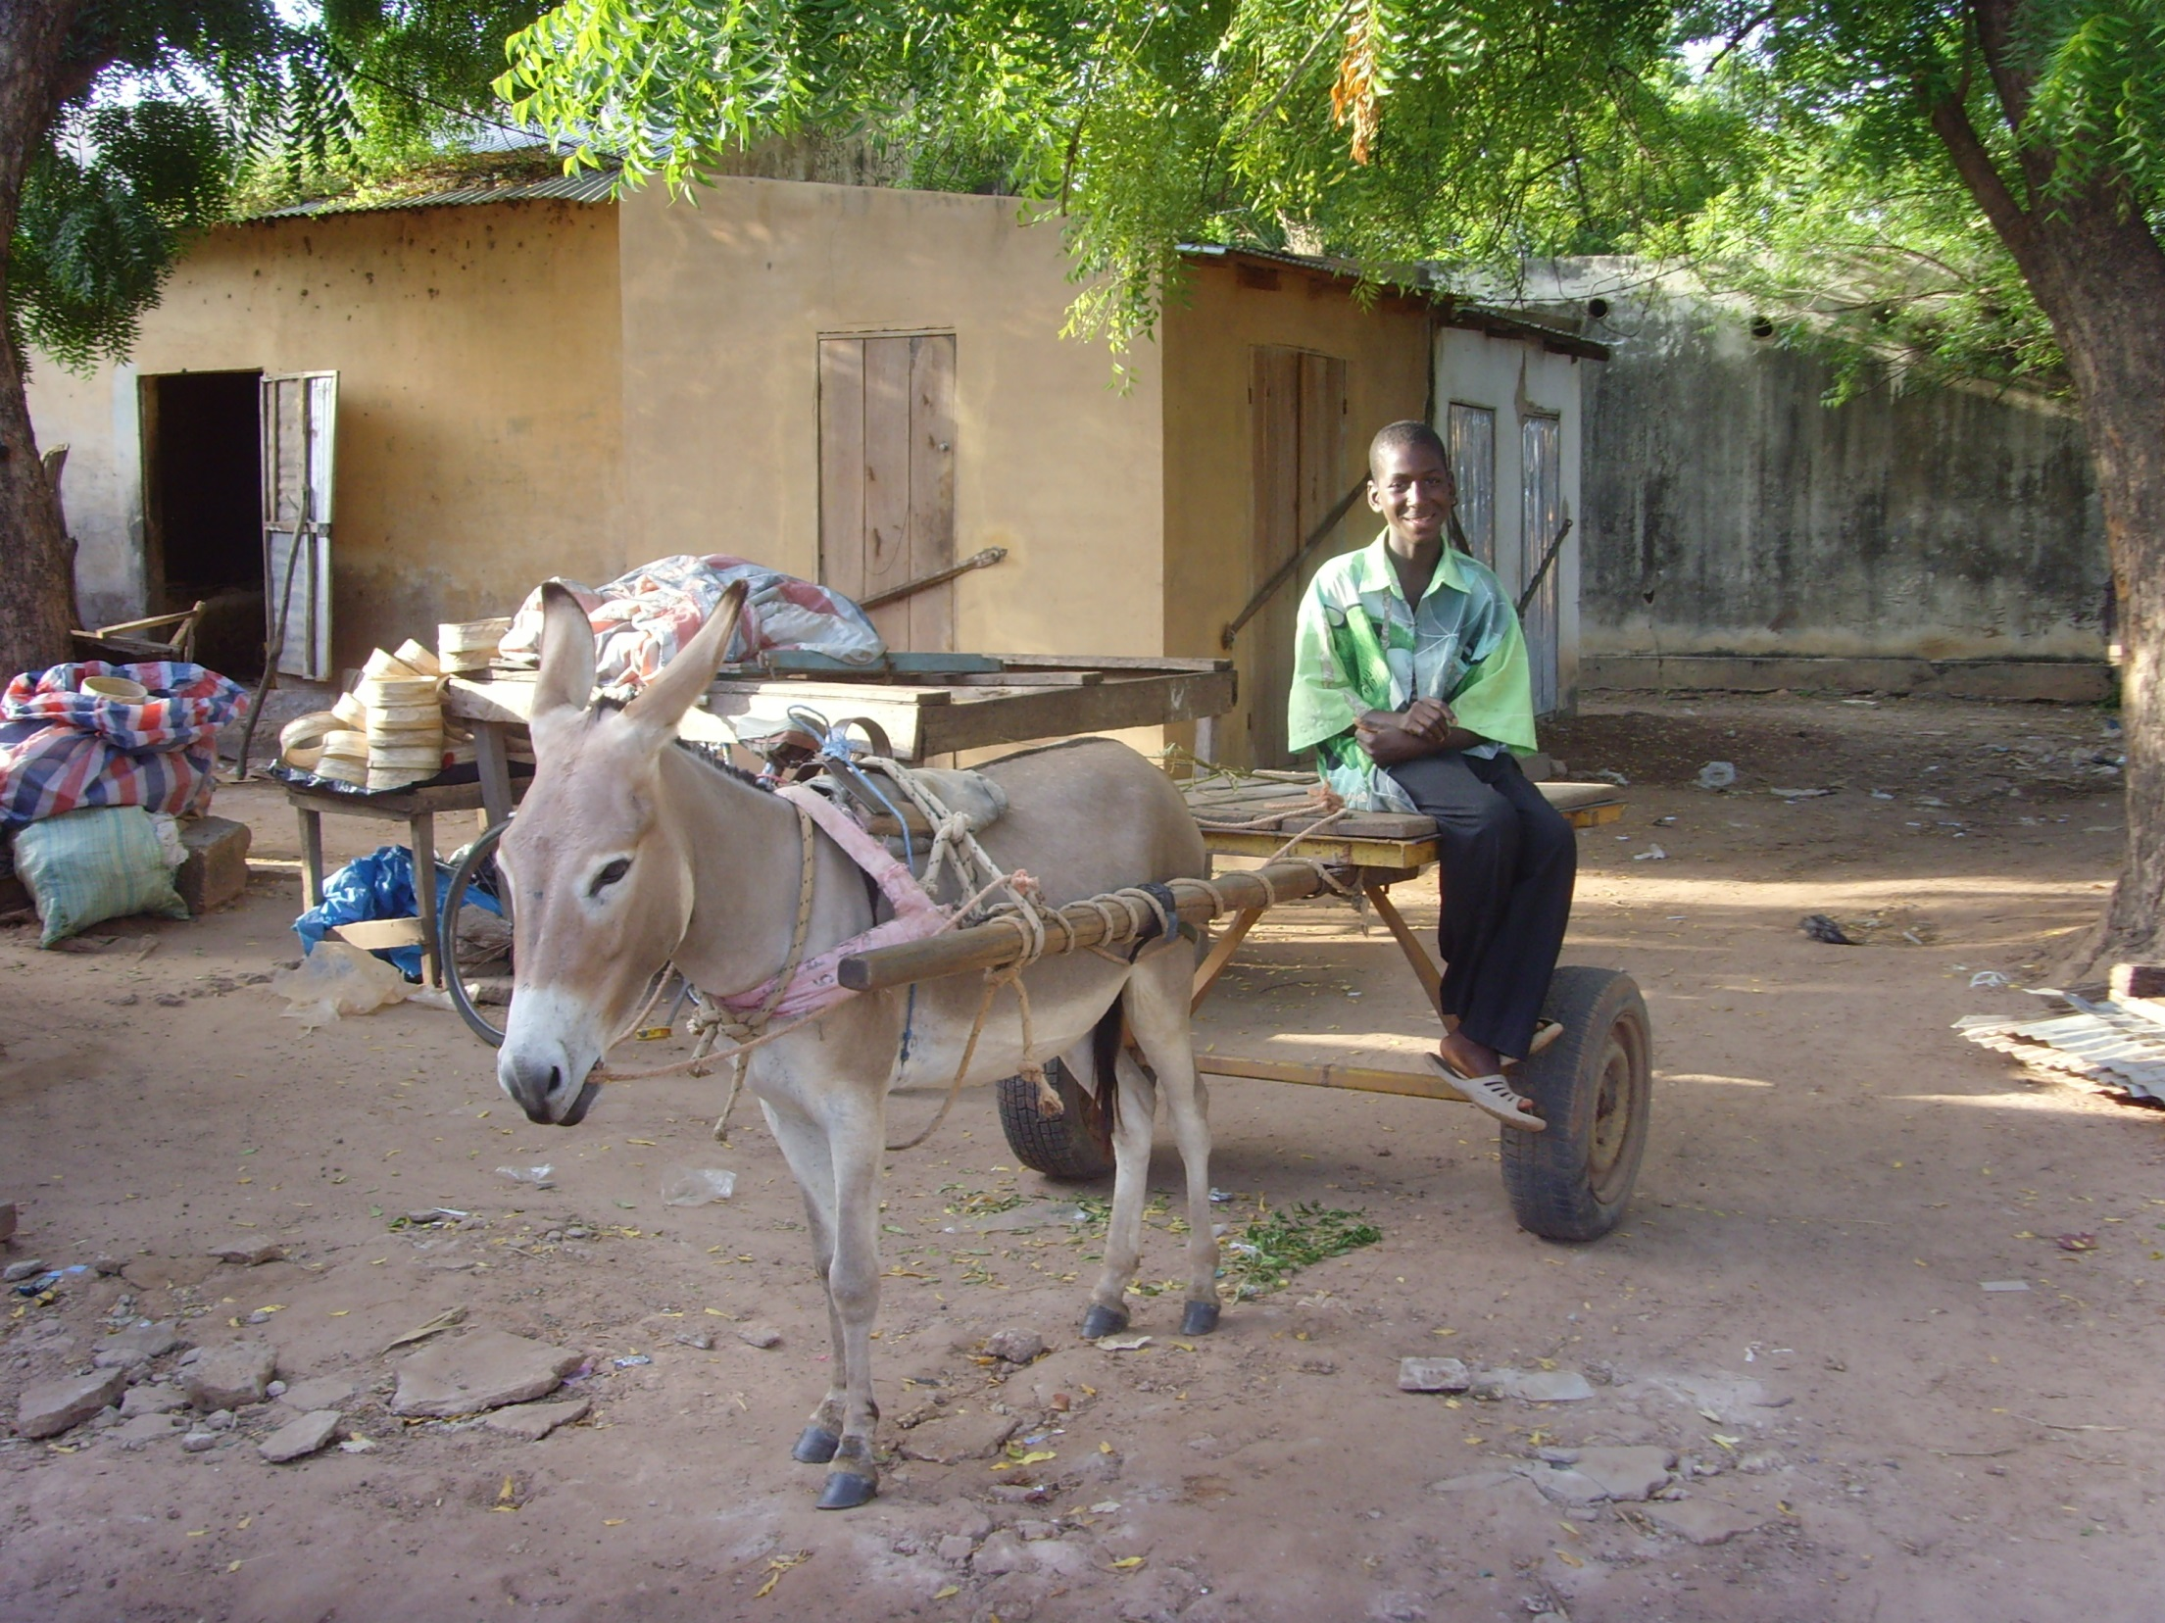
Everything we buy as institutions has an impact on communities around the world

Slide 3
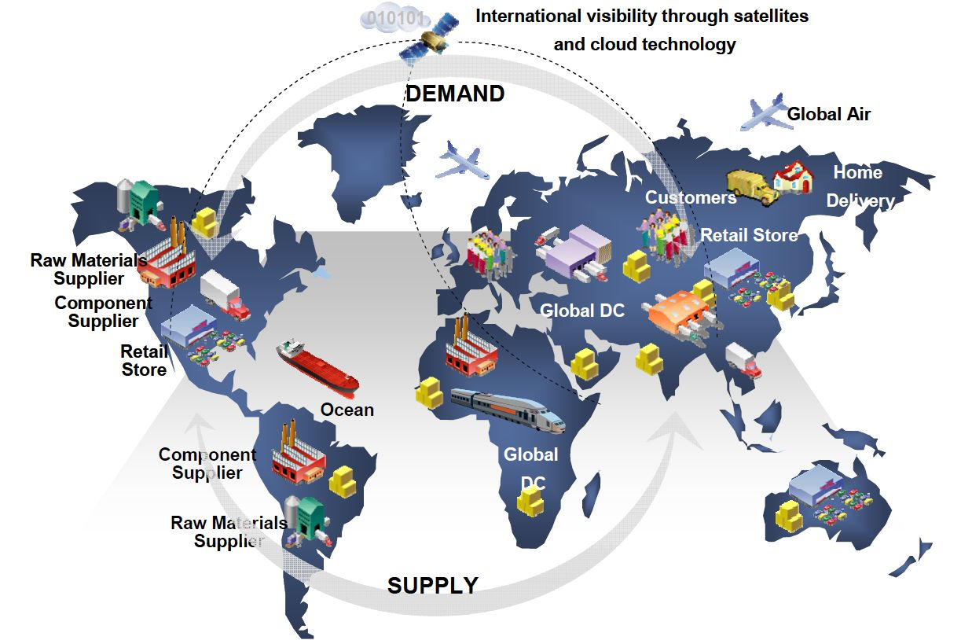
Livelihoods, Pay, Farmers, Extractives/mining, Manufacturing

Slide 4
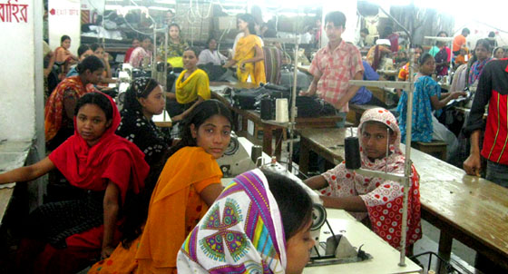
Global trade = lots of negative impacts on communities
- poverty/low pay
- poor conditions
- forced labour
- displacement from land
- pollution
- fluctuating demand for products…
Source: WaronWant.org

Slide 5

Most common way unis/colleges engage = fair trade

Slide 6
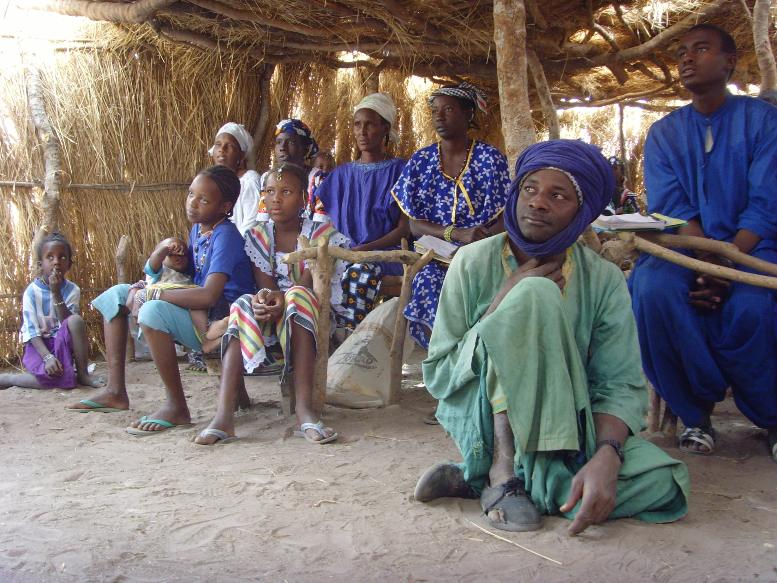
Farmer cooperatives
Premiums for community projects

Slide 7
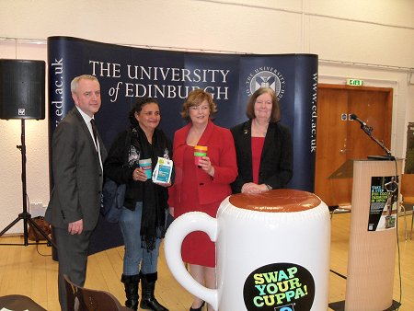
Fair trade producer visits – increase understanding

Slide 8
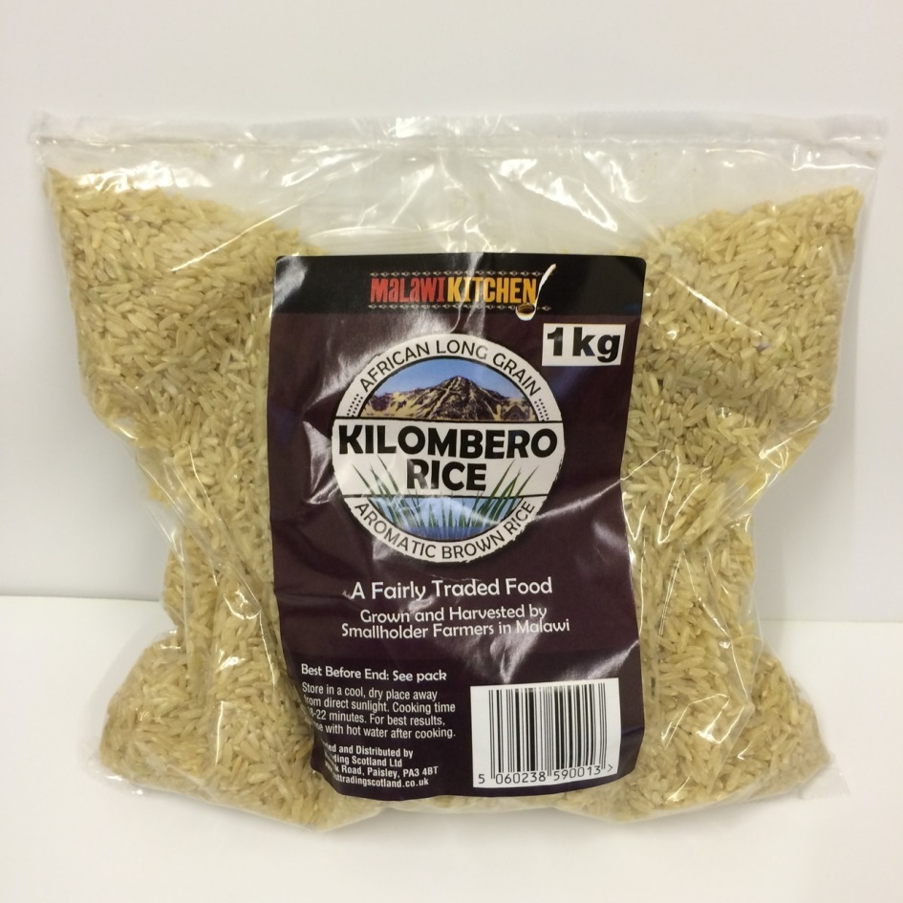
e.g. rice/pulses from Malawi (JTS) bought by public sector

Slide 9
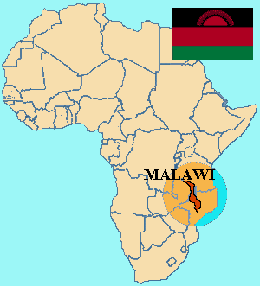
2 MSc dissertation placements in Malawi 2015 to find out more…

Slide 10
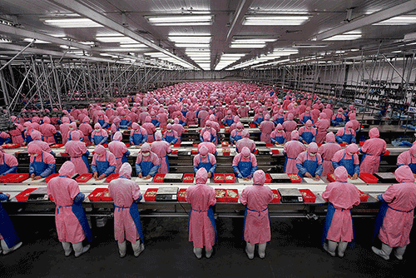
Electronics manufacturing – communities displaced from farming to factories – Electronics Watch
Source: electronicsproducts.com

Slide 11
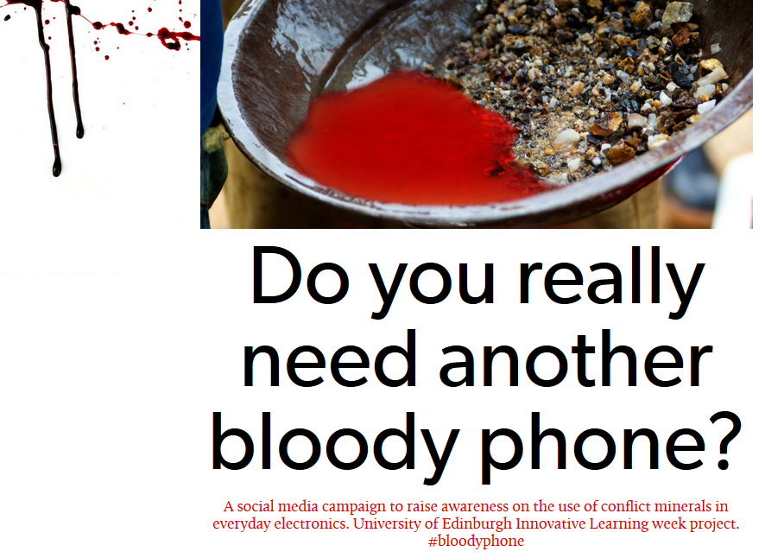
Mining communities – e.g. conflict minerals in DRC (policy work)

Slide 12
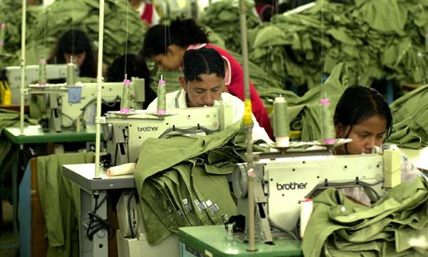
Garment industry (sweatshops)
- university branded clothing
- workwear
- sports kits
= dissertation project on this 2015
Source: theguardian.com

Slide 13
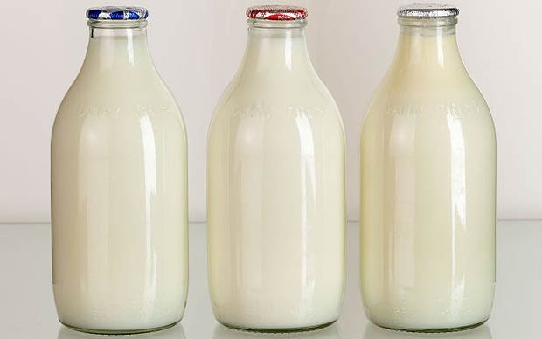
Local supply chains too:
– milk, eggs, meat, agriculture
– food policy work, to explore further

Slide 14
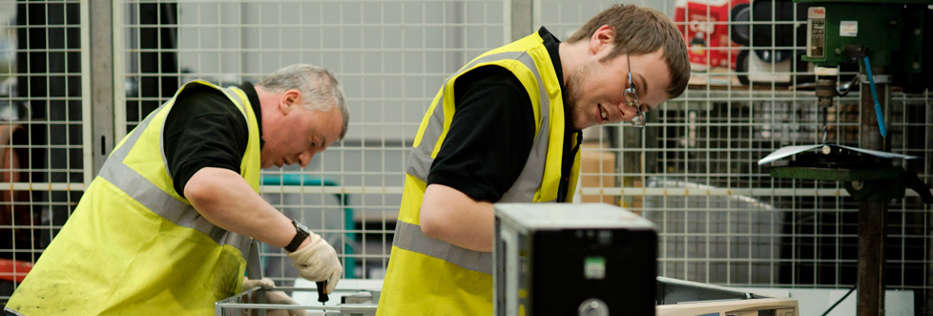
Incorporation of disadvantaged communities in Scotland in supply chains – apprenticeships, supported businesses, prisons/ex offenders?

Slide 15
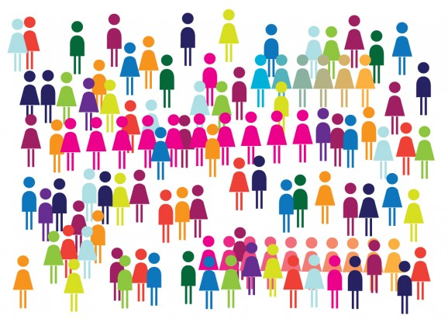
Currently engaging through:
-networks e.g. EW/WRC
- research & dissertation projects…

Slide 16
Lack of transparency on supply chains a problem – various attempts to address
?

Slide 17
Room for more engagement with these often distant communities
- research
- study visits
- projects
- twinning?
- exchanges?

Slide 18
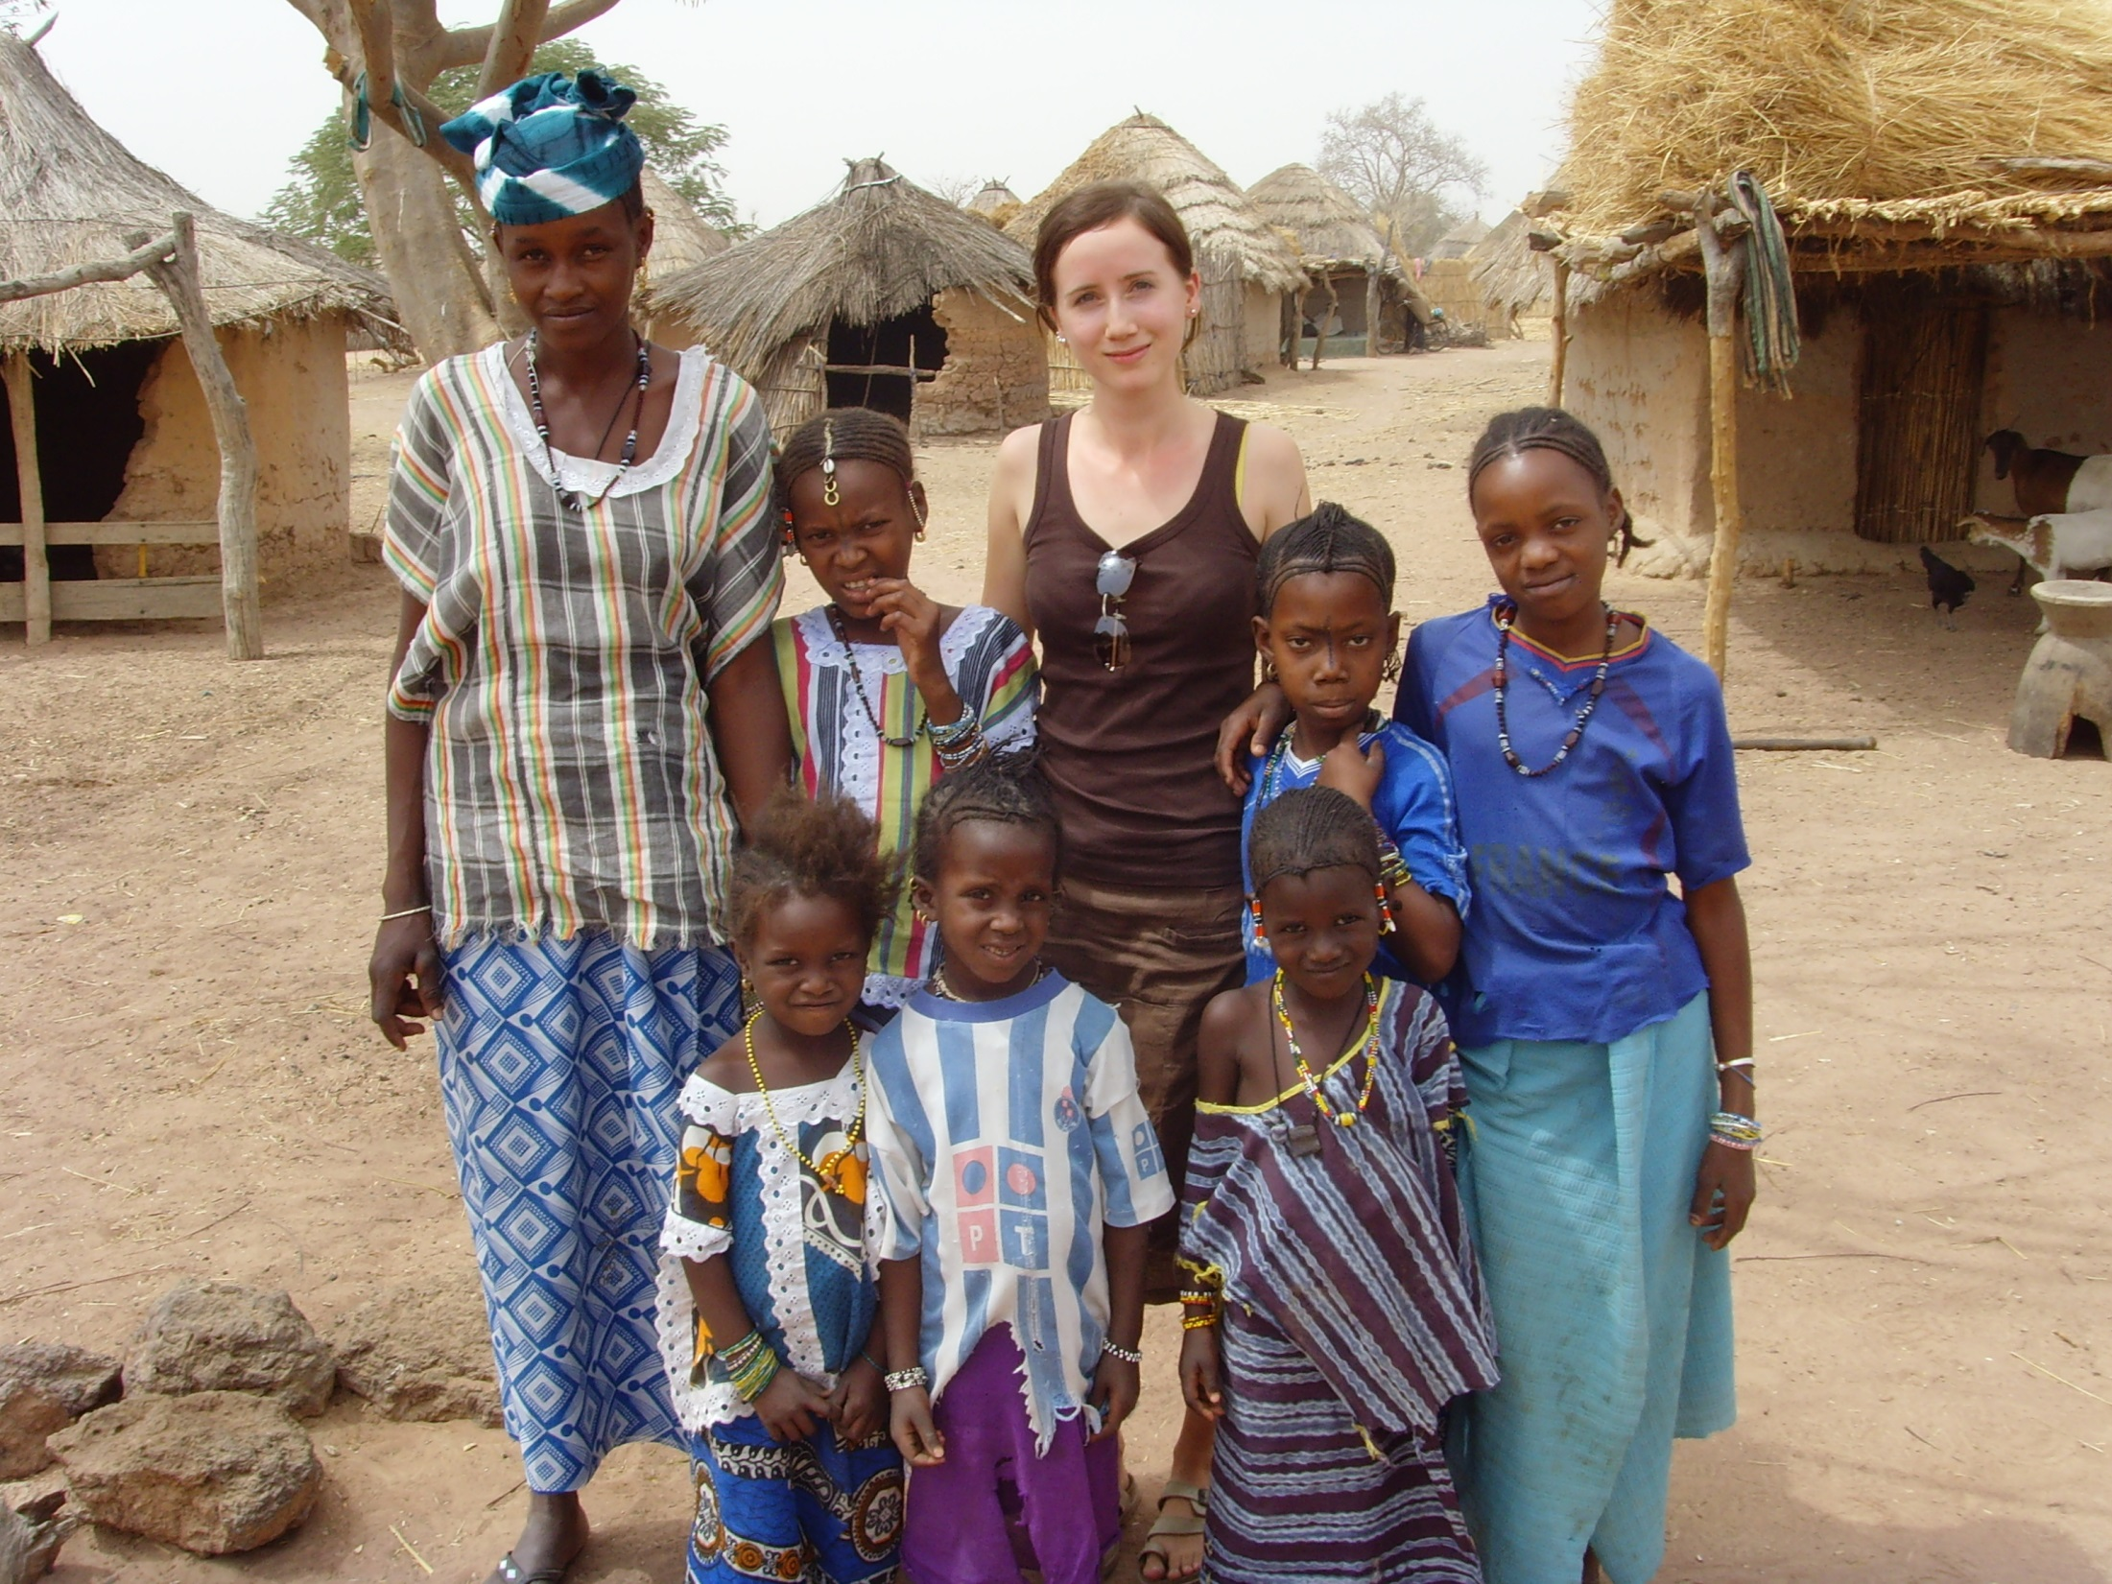
Opportunities to link with universities on ground in developing countries to link closer to communities we affect?...

Slide 19
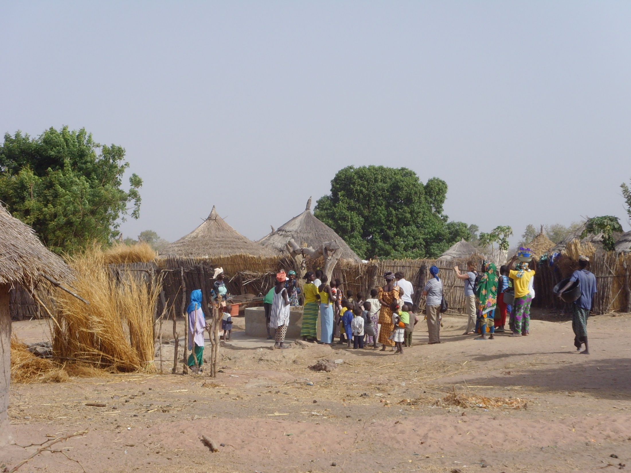
Room for links between socially responsible procurement and other community initiatives in unis/colleges
Again, we affect a lot of people’s lives through our purchasing choices! Thanks.

