Slide 1
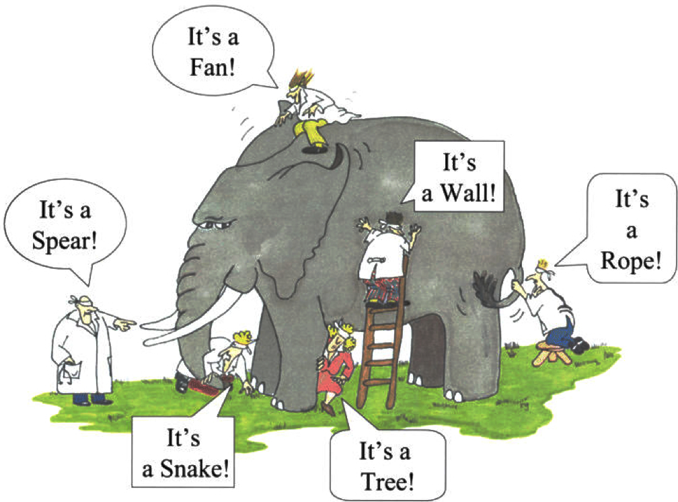

EDUA10151 level 10 – credits 20
Global learning: citizenship & sustainability
Assessment of 2 parts
2,000 word illustrated report on a global issue of the student’s choice
2,000 word report of a case study of the local implications of their chosen global issue and evaluation an educational initiative that engages with the chosen issue locally
B.Ed(Hons) Primary 4
BA Education Studies
MA Sustainable Development
Exploring interconnected systems thinking
Examining different perspectives
Evaluating complex professional issues
areas dealt with by former students include:
child prostitution; seed sovereignty; corporate social responsibility; deforestation; refugees; endangered species; fair trade; food security; air pollution; issues of recycling; habitat fragmentation & extinction; human trafficking; health and transport; poverty; hunger; obesity; fashion industry; waste disposal & landfill
Susan V McLaren

