Slide 1
Don’t forget to follow and tweet us @TheEAUC
Join in the conversation using #Influence2019

Slide 2
Tackling Climate Change Adaptation:
Taking a Business Continuity Approach
Grant Anderson, University of Lincoln
Mark Durdin, Cardiff University
Rebecca Petford, EAUC
Mark Webster, UWE Bristol / HEBCoN

Slide 3



Agenda
Project Background
Climate Readiness Self-Assessment
Making an Elevator Pitch
Taking a Business Continuity Approach
Minimising your Climate Change Risks
Support Resources and Useful Tools

Slide 4
Project Background
Collaboration between EAUC and HEBCoN with AECOM support
Working Group
Institution | Name | Job Title
Bournemouth University | Dr Neil Smith | Sustainability Manager
Bournemouth University | Shona Nairn-Smith | Business Support Manager
Cardiff University | Mark Durdin | Maintenance Officer (Energy and Sustainability)
Fife College | John Wincott | Environmental Services Coordinator
University of Derby | Rosemary Horry | Senior Lecturer in Environmental Management (on secondment - Corporate Lead for Environment & Sustainability)
University of Edinburgh | Dr Elizabeth Vander Meer | Climate Policy Manager
University of Hertfordshire | Neil Allen | Improvement & Change Leader
University of Lincoln | Grant Anderson | Head of Space Strategy, Planning and Sustainability
University of the West of England | Mark Webster | Head of Business Resilience

Slide 5
Climate Readiness Self-Assessment
Which milestone are you working towards?

Slide 6

Making an Elevator Pitch
Why an Elevator Pitch?
Our Elevator Pitch
Pair discussion:
  What do you think?
  How would you adapt this for your institution?

Slide 7
Our Elevator Pitch
“The science is settled. Our climate is changing, and no matter how quickly we reduce greenhouse gas emissions, some major effects are locked in. This will influence nearly every area of our institution, from delivery of teaching, research and examinations, to student recruitment, supply chains, insurance premiums and the profitability of investments. The results will not always be catastrophic, but unless we systematically assess the risks we are driving blind.
Taking action doesn’t necessarily mean ‘reinventing the wheel’ or spending significant amounts of money. Universities and colleges already have well established processes for managing risk – factoring in climate change simply means applying a different lens and set of expertise.
How will our key assets and business processes stand up to a future of more extreme weather? New investments in infrastructure may be around for decades to come – how future-proof will they be? Now is the most cost-effective time to ask these questions and ensure our institution is climate-ready.”

Slide 8
Taking a Business Continuity Approach
Why a Business Continuity Approach?
Critical Functions activity
  How does the climate affect this function in your region?
    Now
    In the future
  What are the top risks to this function?
Example Critical Functions
Learning & Teaching (pedagogy, quality, currency and relevance)
Research
Estates and Infrastructure
Student Recruitment / Market
IT Infrastructure and Systems
People and Wellbeing
Commercial Services (e.g. catering)
Commercial Ventures / Partnerships
Critical Events, such as examinations and graduation

Slide 9
Taking a Business Continuity Approach

Slide 10
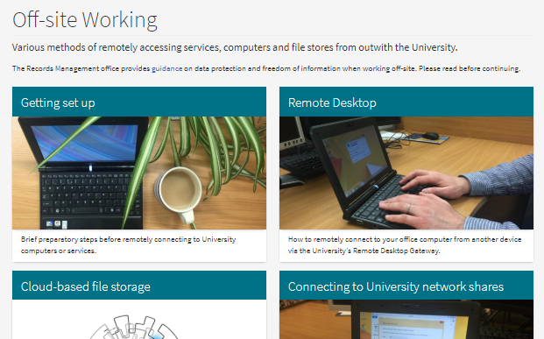

Minimising your Climate Change Risks
Adaptation Approach Type | Examples
Investigation | Flood modelling, feasibility studies
Policy, procedures and systems | Hazard-specific emergency response plans, increase online teaching capacities and working from home options, early warning systems for natural hazards
Behavioural | Communication and advocacy campaigns, establishing / strengthening partnership with other stakeholder organisations such as local authorities
Notes:
Examples:
You can look at the projected changes in different timescales using the UKCP19 data, available through the Met Office. This image considers different projections for precipitation levels during winter in 20161-2080 compared to today, for a high emissions scenario (RCP8.5)
University of Edinburgh Off-site Working webpage
University of Oxford ‘Working During a Heat Wave – Occupational Guidance’

Slide 11
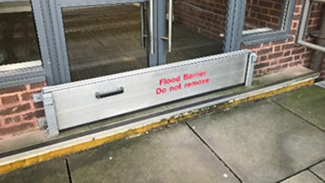
Minimising your Climate Change Risks
Adaptation Approach Type | Examples
Nature-based solutions | Raingardens and permeable pavements, constructed wetland sand reedbeds, expansion of greenspace including green walls / roofs, drought-resistant planting / landscaping, vegetated verges along roadways
Technical (engineered) | Flood barriers and seawalls, passive building design, backflow preventers, solar shading, reinforced roofs and constructions
Notes:
Examples –
Rain garden plan for the very sloped North Portland Street at University of Strathclyde
Removable flood barrier at the entrance of Barnes Wallis building at Nottingham Trent University

Slide 12
Minimising your Climate Change Risks
Which approach(es) and example(s) could most effectively lower the risks to your group’s Critical Function?
Adaptation Approach | Examples
Investigation | Flood modelling, feasibility studies
Policy, procedures and systems | Hazard-specific emergency response plans, increase online teaching capacities and working from home options, early warning systems for natural hazards
Behavioural | Communication and advocacy campaigns, establishing / strengthening partnership with other stakeholder organisations such as local authorities
Nature-based solutions | Raingardens and permeable pavements, constructed wetland sand reedbeds, expansion of greenspace including green walls / roofs, drought-resistant planting / landscaping, vegetated verges along roadways
Technical (engineered) | Flood barriers and seawalls, passive building design, backflow preventers, solar shading, reinforced roofs and constructions

Slide 13
Support Resources
Guide 1: Adapting universities and colleges to a changing climate: Making the case and taking action
Guide 2: Using an existing organisational resilience framework to develop a Climate Change Adaptation Plan
Support Resources: Example Adaptation Strategies and Case Studies from the Sector
www.sustainabilityexchange.org.uk/adaptation

Slide 14


Other Useful Tools
See Guide 1 for a list of other places to find:
Climate Information and Learning Tools
Adaptation Support Tools
Infrastructure Information
Knowledge-sharing Platforms
www.sustainabilityexchange.org.uk/adaptation

Slide 15





The SDG Accord
Thank you!
Headline Sponsor
Don’t forget to follow and tweet us @TheEAUC
Join in the conversation using #Influence2019
End extreme poverty, inequality and climate change
www.sdgaccord.org

