Slide 1

Procuring Better Building Performance
Keynsham Civic Centre Case Study
Tamsin Tweddell
T.Tweddell@maxfordham.com

Slide 2
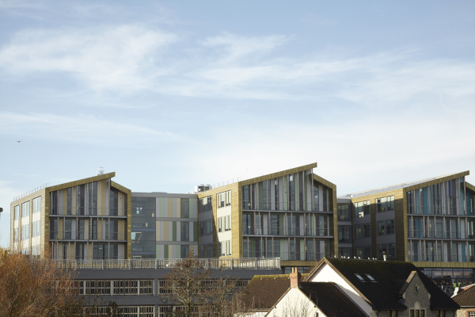
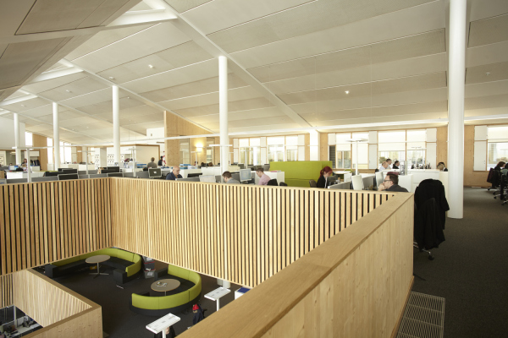
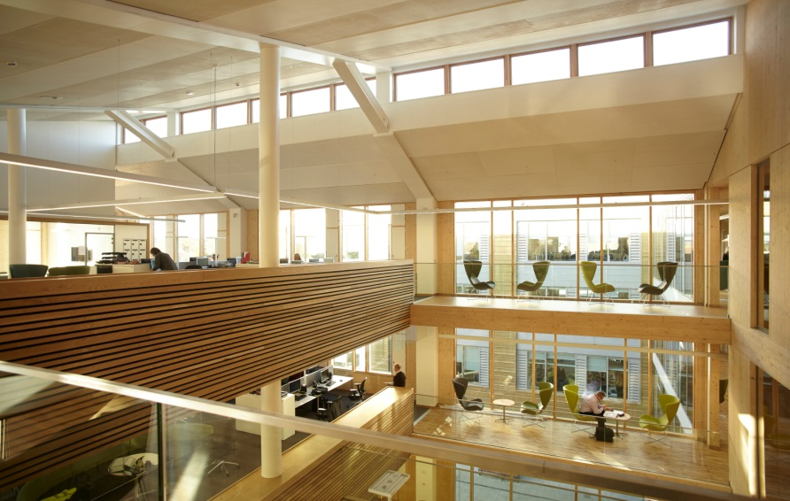
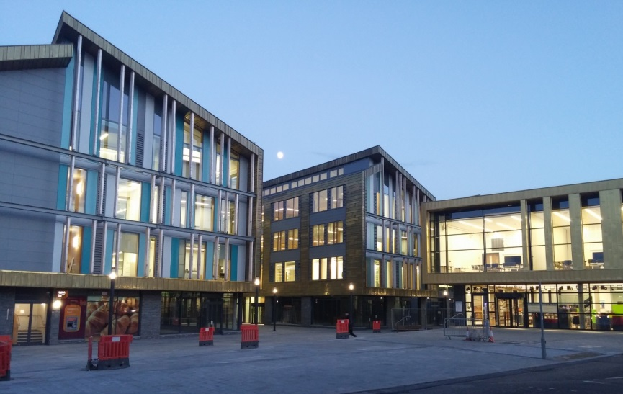
Keynsham civic centre
Notes:
Client: Bath & North East Somerset Council
Architect: ARH (Aedas)
Main Contractor: Willmott Dixon
Commissioning Manager: Core Groupmedium
Area: 6300m² office (+1200m² library, 1600m² retail)
Cost: £23M; £2400/m²
Procurement: 2 stage D&B; we stayed client side
Completion: November 2014
Intended occupancy: 455 people

Slide 3
THE CLIENT’S BRIEF:
Ultimately, the success of the building will be judged on its operational energy use and resultant carbon emissions. Therefore, the current aspiration is that the development should achieve a DEC rating of A by the end of the second full year of operation.

Slide 4
Procuring Soft Landings
CLOSING THE PERFORMANCE GAP:
OUR APPROACH
Low energy design – the easy bit!
Develop an Energy Budget
Energy risk management
Embed in contract
Aftercare programme – monitoring & fine tuning
➔ Lessons learnt

Slide 5
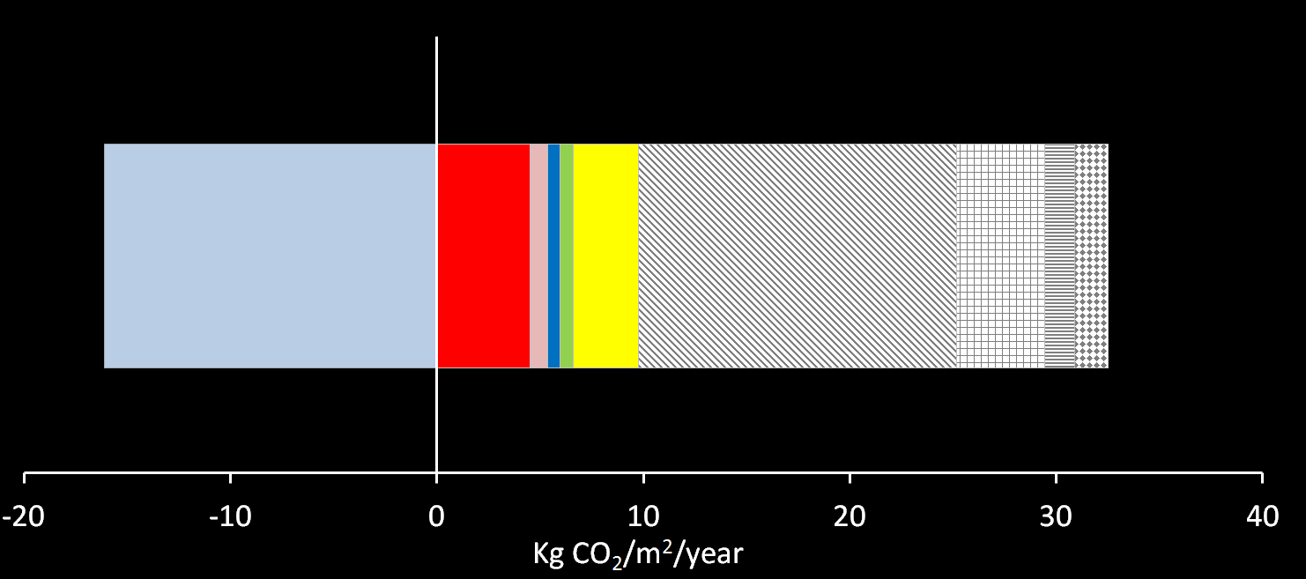
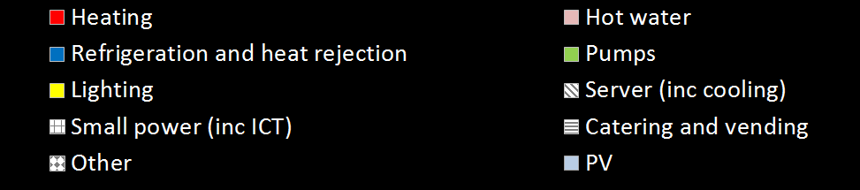
ENERGY BUDGET
PV
Regulated
Unregulated
Server
(incl cooling)
Net CO₂
Notes:
Highlights key risks to operational outcomes (energy, comfort, ease of use etc)
Offers mitigation measures for each stage of the project.
Can be informed by lessons learnt from previous projects, reality checking exercises, usability workshops.

Slide 6

ENERGY RISK MANAGEMENT

Slide 7

LIGHTING
RISK
INADEQUATE CONTROLS INSTALLATION AND/OR COMMISSIONING
USERS DON’T UNDERSTAND CONTROLS OR FIND INCONVENIENT
USE OUTSIDE CORE HOURS NOT ALLOWED FOR, EG FOR CLEANERS
MITIGATION
SIMPLIFY CONTROL STRATEGY
ENGAGE WITH USERS DURING DESIGN
CALCS TO CONSIDER OUT-OF-HOURS USE
MONITOR COMMISSIONING
REVIEW PERFORMANCE POST OCCUPANCY AND FINE-TUNE

Slide 8

REFINE THE ENERGY BUDGET
CIBSE TM 54
Agree operating conditions which
achieve the
energy budget
= Energy Baseline
Understand that reality will be different!

Slide 9
EMBEDDING THE ENERGY BUDGET
IN THE CONTRACT
Assumptions:
Lux levels
Power density
Controls as specified
Within
contractor’s control
Energy use
category
31,000 kWh
16,000 kgCO₂
Annual energy budget
Lighting
Task lights
Hours of operation
External illuminance
Outside contractor’s control

Slide 10
AFTERCARE:
MONITORING & VERIFICATION
Monitor
Review
Identify
Adjust
Notes:
Monitor, review, identify, adjust

Slide 11
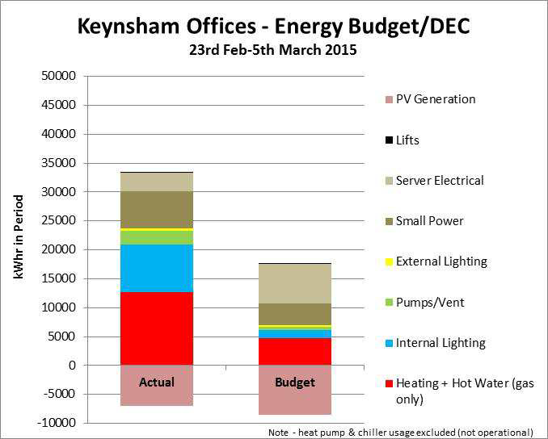

Slide 12
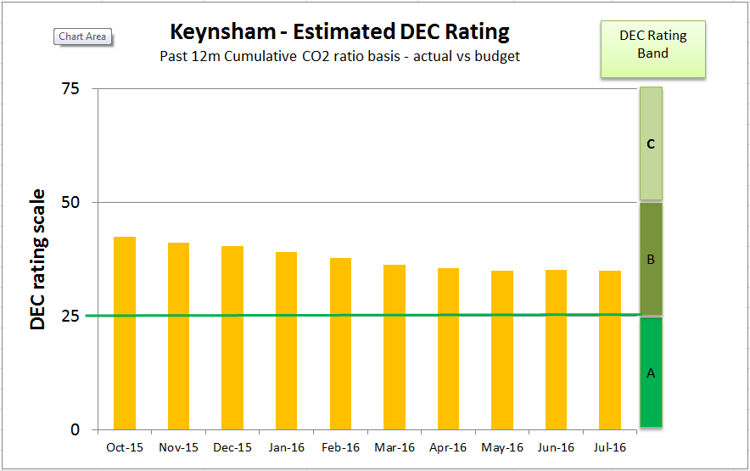

Slide 13
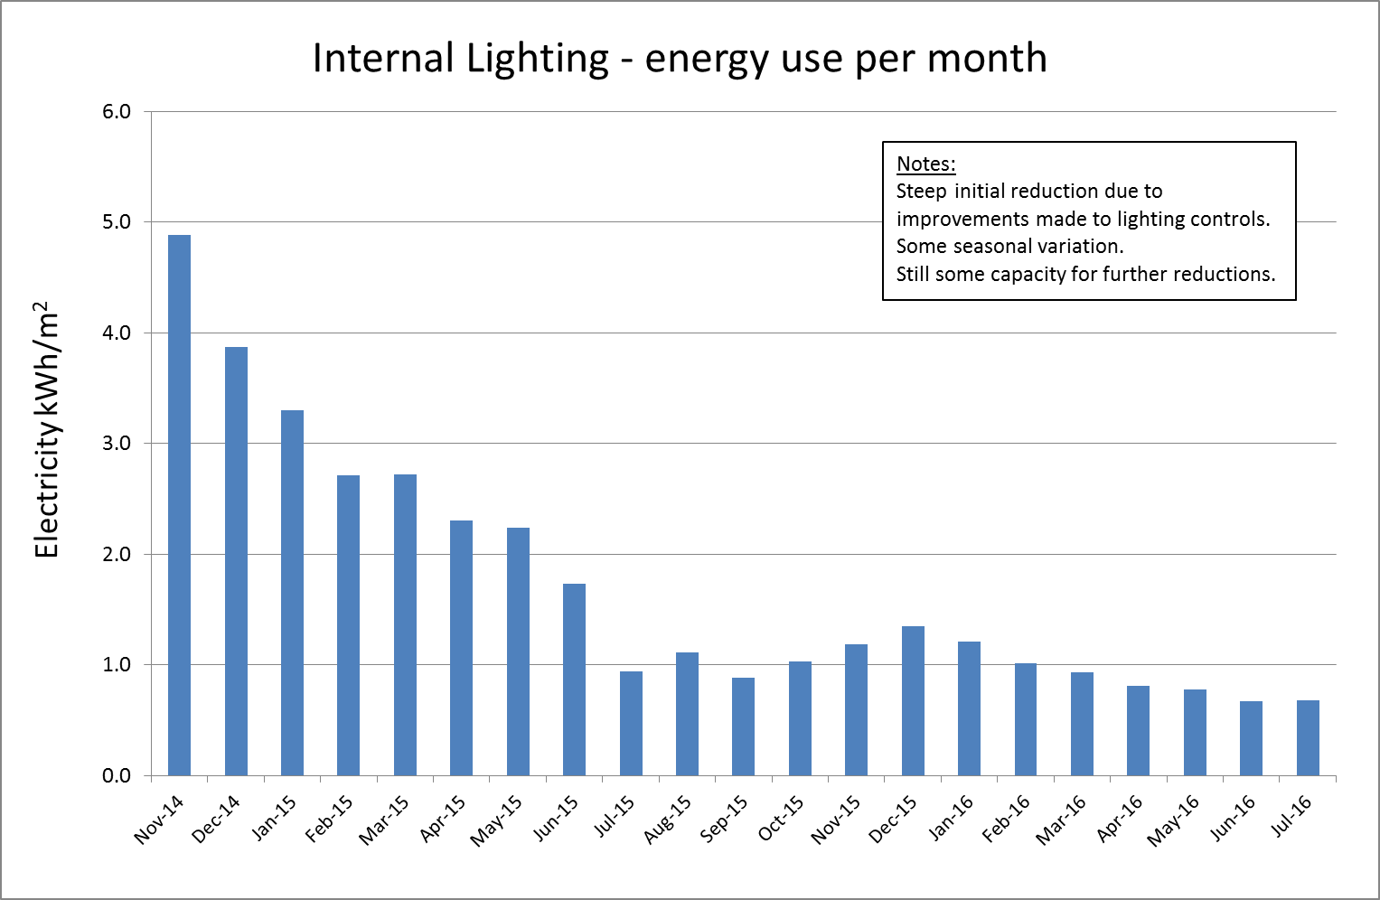
58% reduction, year 1 to 1+9mth
Year 1
Year 1+9mth

Slide 14
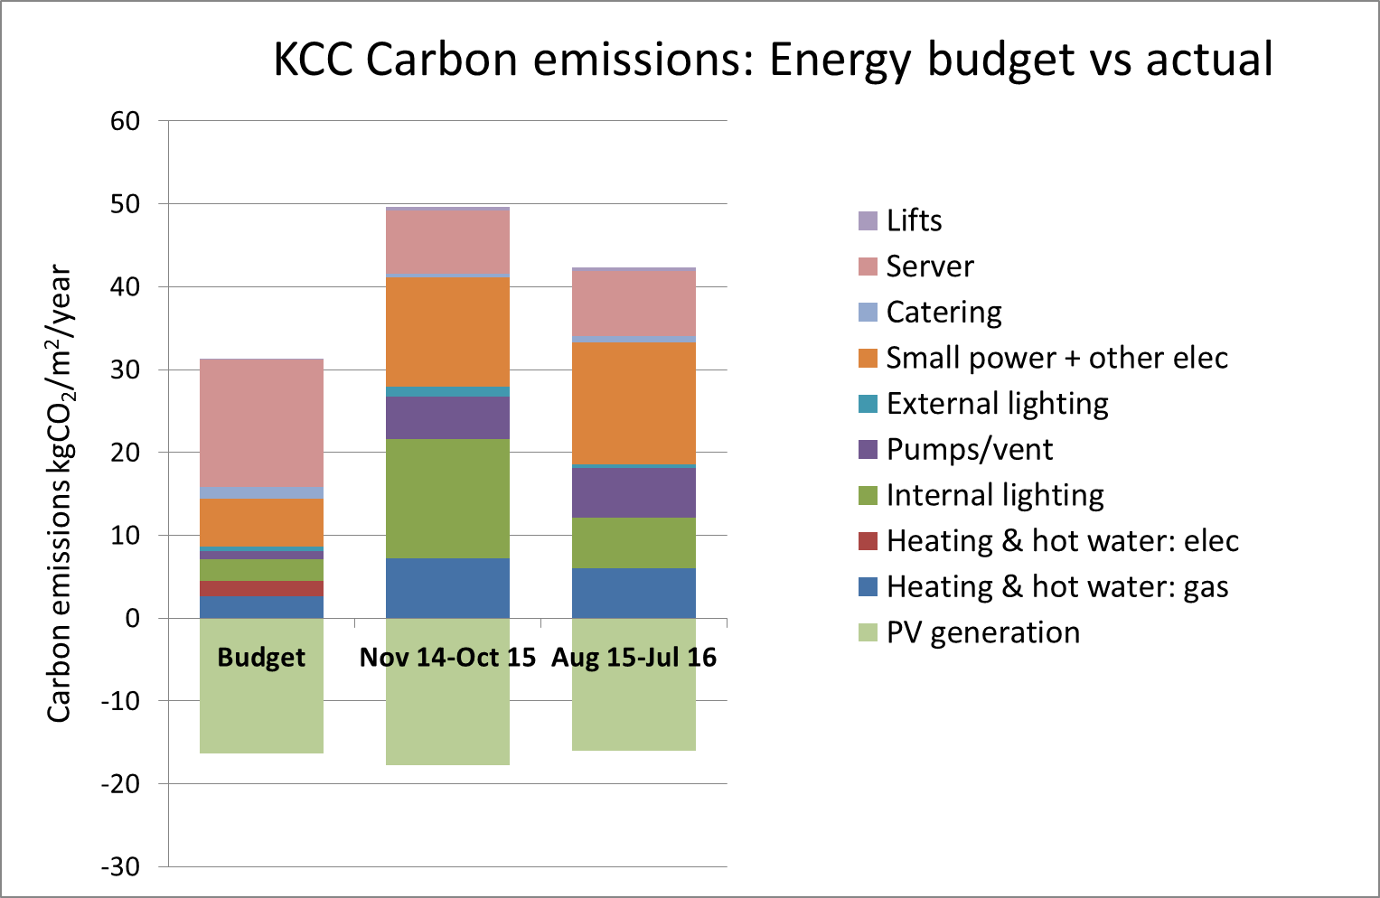
Year 1
Year 1 + 9mths
Notes:
Regulated is 125% over budget
Unregulated only 4% over budget
Commissioning still an issue.

Slide 15

WORKED WELL
COULD DO BETTER
Passive robust design
Energy Budget/Contract
Limited VE
Contractor is still there !?
Commissioning Manager
Stakeholder (FM) engagement
Delivered within local authority budget
Client is very proud of the building
M&E contractor
Lighting controls
BMS – still not working
Energy metering – still read manually

Slide 16
Procuring Soft Landings
LESSONS FOR FUTURE PROJECTS
The value of the independent commissioning manager
The importance of getting the right M&E contractor
Consultants are nervous about ‘predicting’ operational energy use
Notes:
The value of the independent commissioning manager
The importance of getting the right M&E contractor
Tender must enable evaluation on quality, not just price. Clear quality criteria must be set.
M&E must be priced on design, not an allowance

Slide 17
THANK YOU
Tamsin Tweddell
Procuring Better Building Performance
17th May 2017

