Slide 1
The Greta Challenge
Angus Warren
Kate Murray
Rica Bieke
Gemma Stenhouse
24th May 2019

Slide 2
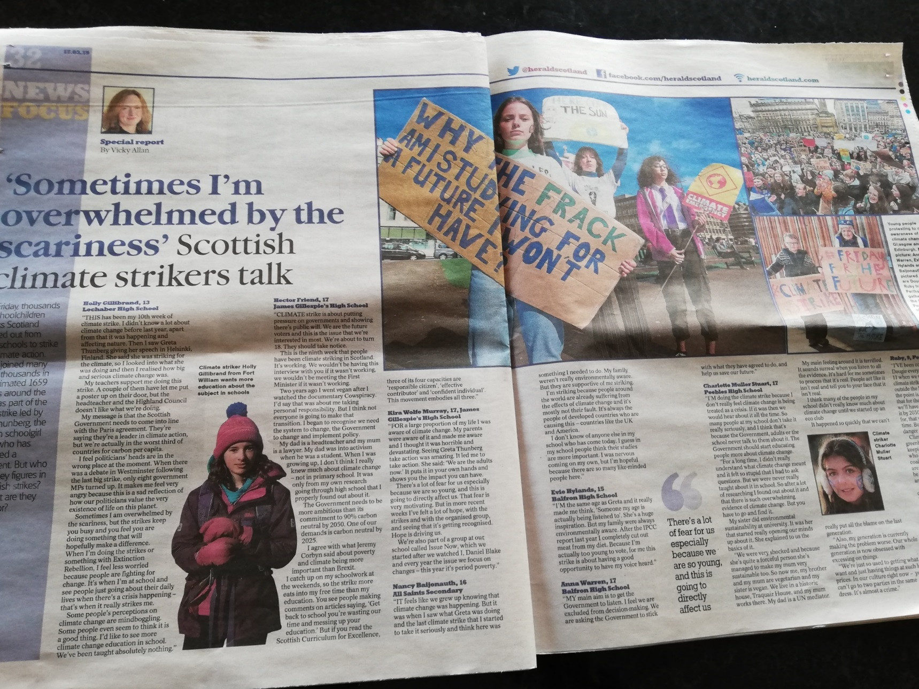

The Greta Challenge
Introduction
Who is Greta ?
Key Question for the Sector - from future potential students:
“Why the frack am I studying for a future I won’t have ?”
www.slido.com

Slide 3
The Greta Challenge
Anxious
Hope??
Fear
How does
Climate Change
make you feel?
Denial
Anger
Grief
Stress
Guilt
Depressed

Slide 4
The Greta Challenge
“Climate change is a large-scale, long-term shift in the planet's weather patterns and average temperatures.” – Met Office
What Is Climate Change?

Slide 5
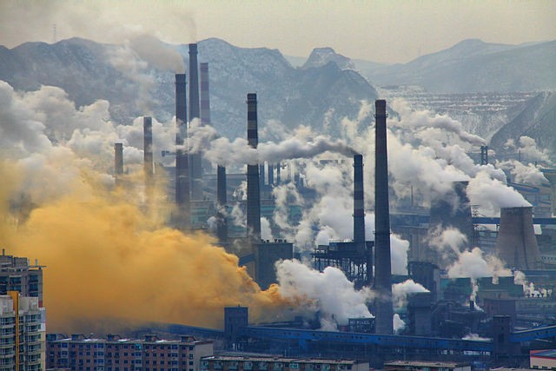
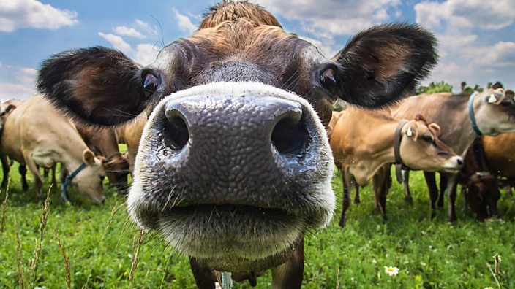

The Greta Challenge
What Causes Climate Change?
Burning Fossil Fuels
Breeding Cattle and Cutting Down Forests
Trapped Carbon Dioxide

Slide 6
The Greta Challenge
“Humanity and life on Earth now face a
direct existential threat”
- UN Secretary General (2018)

Slide 7
The Greta Challenge
IPCC Report 2018
Limiting warming to 1.5˚C requires major and immediate transformation
The World is not on track to limit temperature rise to 1.5°C
Emissions will need to reach net-zero around mid-century.
A 1.5˚C limit to warming is not safe for all…
…but risks associated with warming are substantially lower at 1.5˚C than 2˚C

Slide 8
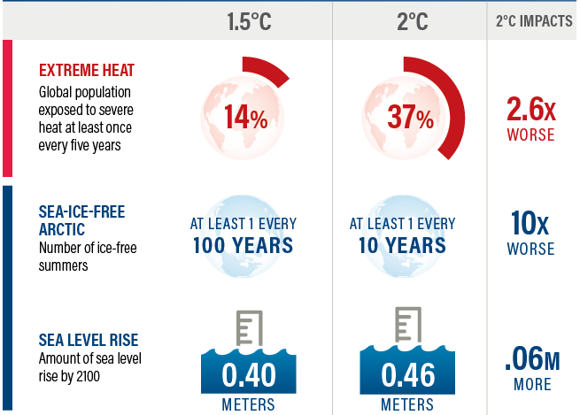
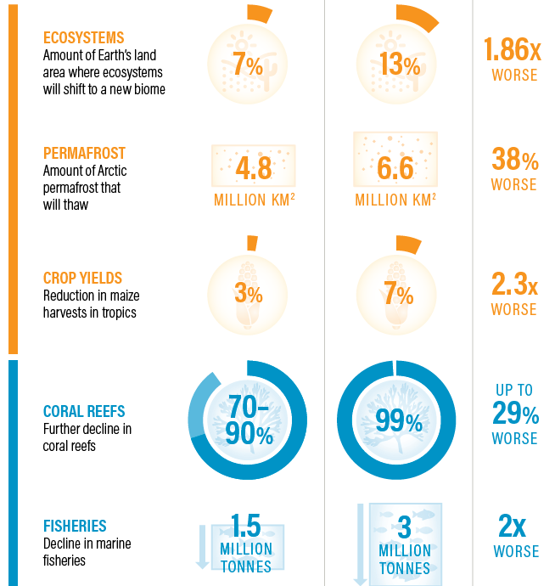
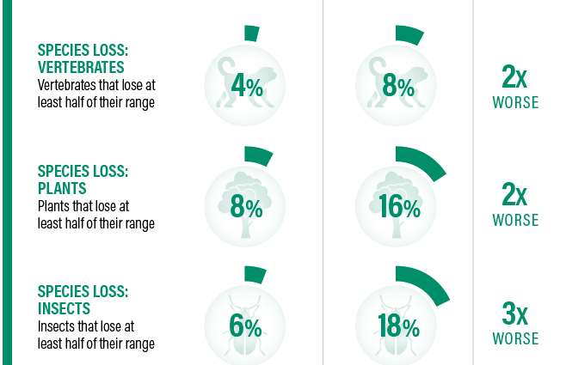
The Greta Challenge
World Resources Institute

Slide 9

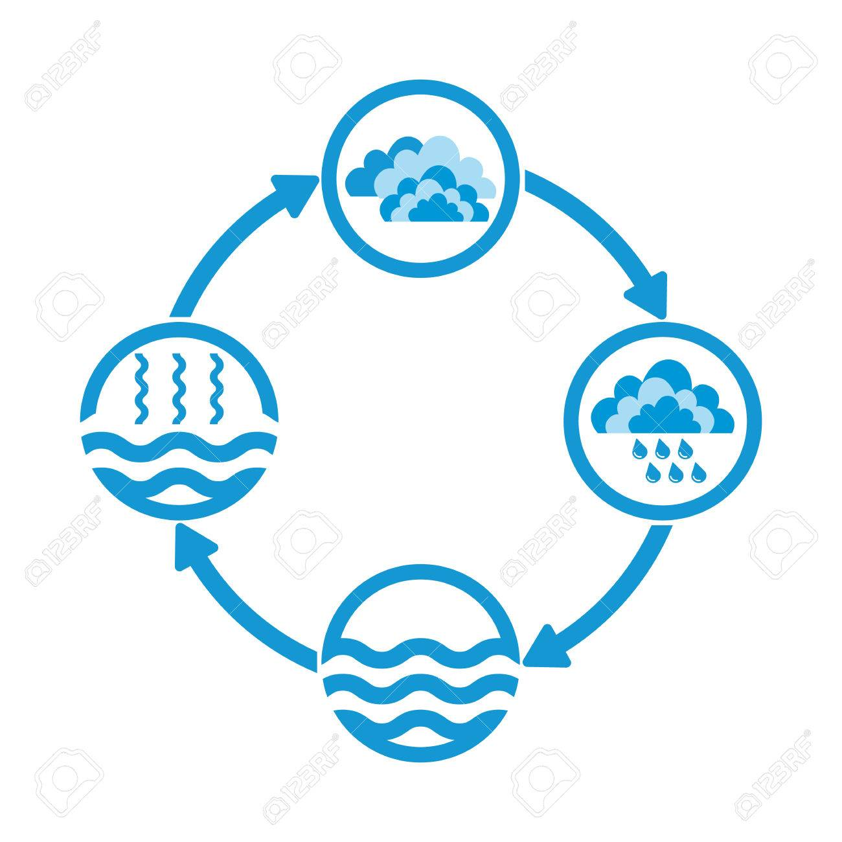
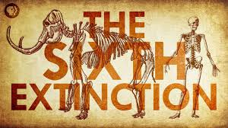

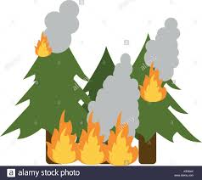








The Greta Challenge
Climate Change

Slide 10






The Greta Challenge

Slide 11
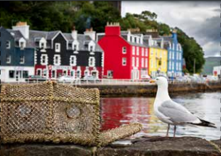
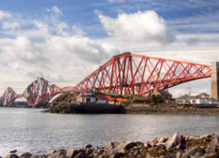
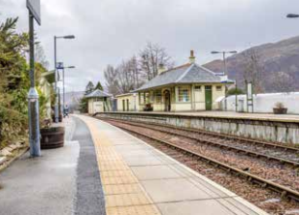
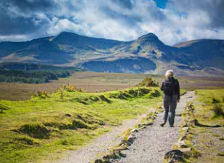
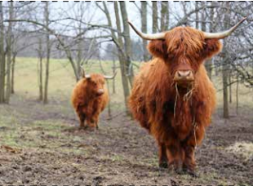
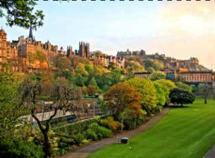
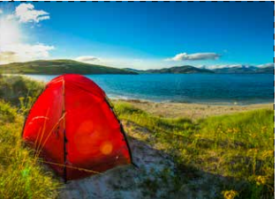
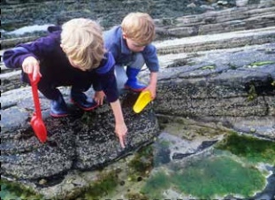
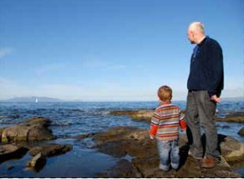
The Greta Challenge

Slide 12
The Greta Challenge
Countries, cities, public sector, private sector, individuals need to strengthen their action, without delay.

Slide 13
The Greta Challenge
What support and pressure is there available for change ?

Slide 14

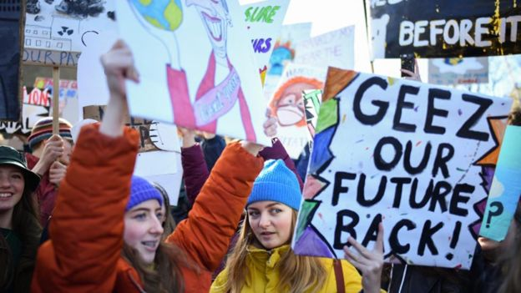
#YouthStrike4Climate
‘The greatest threat to our planet is the belief that someone else will save it.’
____
On the 24th May, students and young people will strike from school and university to demand action on the climate catastrophe. We are waking up to a reality where we can no longer choose to ignore this issue: we must stand up and fight for our future or face an uninhabitable planet.

Slide 15
#YouthStrike4Climate
DEMAND 1
The Government declare a climate emergency and implement a Green New Deal to achieve Climate Justice.
DEMAND 2
The national curriculum is reformed to address the ecological crisis as an educational priority.
DEMAND 3
The Government communicate the severity of the ecological crisis and the necessity to act now to the general public.
DEMAND 4
The Government recognise that young people have the biggest stake in our future, by incorporating youth views into policy making and bringing the voting age down to 16.

Slide 16
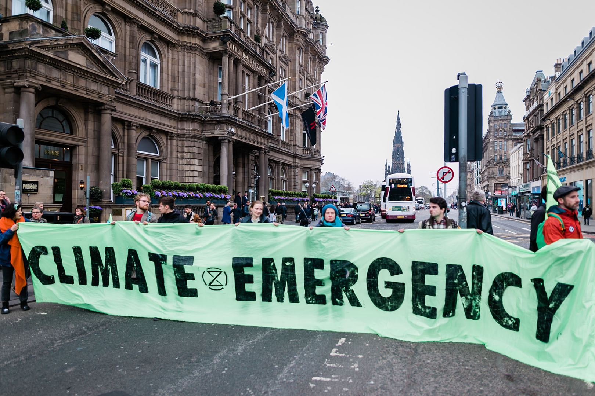
Extinction Rebellion
Strategy of non violent civil disobedience
First direct action in London Nov 2018
Local groups across 11 places in Scotland

Slide 17
Extinction Rebellion
What are Extinction Rebellion’s demands?
The group has three core demands:
Tell the truth
The government must tell the truth about the scale of the ecological crisis by declaring a climate emergency, “working with other groups and institutions to communicate the urgent need for change”.
Zero emissions by 2025
The UK must drastically cut its greenhouse gas emissions, hitting net zero by 2025.
Citizens’ assembly
The government must create a citizens’ assembly to hear evidence and devise policy to tackle the climate crisis.

Slide 18






Climate Emergency

Slide 19
Net Zero Pledge
Scot Gov – net zero greenhouse gas emissions by 2045 (current target 2050)
Carbon neutral target by:
Councils – Edinburgh (2030), Highlands (2025), Glasgow (2037)
Universities - Edinburgh (2040), Glasgow (2050)
Should the sector should have more ambitious targets - possibly more like those set for the Councils mentioned ?

Slide 20
The Greta Challenge
Impacts on Procurement & Procurement’s Role?

Slide 21
Why is CC an issue for Procurement?
Procurement
Influence
Stakeholders
SMT
Social Impact
End-of-Life
Market Development
Environment
Budgets

Slide 22
What impact does CC have on Procurement?
High Impacts
Additional requirements for adaptation
Low Impacts
Cost Increases
Longer Lead Times
Food shortages
Disrupted supply chains
Unavailability
Unaffordability
Infrastructure changes
Trade Agreement changes
Medium Impacts
Product shortages
Radical regulative changes
Inequality

Slide 23
How to have a positive impact?
Energy efficient electronics
Food
e.g. computers, white goods, IT structures, etc
Low energy buildings
Waste
Electric, hybrid or low emissions vehicles
Consumables (Office, Labs, Catering, Cleaning etc)
Textiles
Transport
Circular Economy
Increase of plant-based products
seasonal
Insulation
Room temperature
Lighting
Public Transport Access
Car-sharing
Lease and Hire
Remanufacture
Upgrading
Renewable energy sources
Less
Segregate
Recycling

Slide 24
What if the problem lies within the system…?
Government
Products & Market
Stakeholders
Policies
Budget constraints
Expectations
Knowledge gap
Timescales
Profit is the bottom line
Competition on price
Tender Process
Restrictions on negotiation
Evaluation
Contract lengths
Partnering
Relationship building
SMT Buy In missing

Slide 25
But does it? Clever Procurement is needed!
Collaboration – use of C1 and Framework Agreements
Use of variants, GPP criteria & labels, production methods, etc
Selection Criteria & Award Criteria
Pre-market engagement
Stakeholder engagement
Contract Management
Whole Life Costing
Sustainable / Low Carbon Subject Matter

Slide 26
Last but not least …
Slido:
How are you going to challenge yourself professionally and personally?
For example:
Food
Travel
Buy Less
Reuse
Share
Energy

Slide 27
The Greta Challenge
Audience Questions

Slide 28
The Greta Challenge
Slido Responses Received During Presentation on 24/5/19

Slide 29

Slido Responses Received During Presentation on 24/5/19
How does Climate Change make you feel?
Wordcloud poll
overwhelmed
worried and concerned conflicted
worried
nervous
_{guilt} guilty warm
banning
angry
children disillusioned
confused fear challenged
concerned
powerless hopeful
shopping
generations
unknown anxious
denial
hot
_{try} future
anger
sad
hope uncertain
^{depressed} frustrated
sad and scared
warmer
uncomfortable
helpless

Slide 30

Do you think the sector should have more ambitious targets than those already published by the sector, possibly more like those set for the Councils mentioned ?
Slido Responses Received During Presentation on 24/5/19
Multiple-choice poll
0 8 0
YES
85 %
NO
15 %

Slide 31
Slido Responses Received During Presentation on 24/5/19
What areas will you challenge yourself to change to reduce climate change impact in the next month ?
Wordcloud poll
reuse and buy less
small
process
stepenergy _{time}
environmentally
extending
food
plant
based
meat
driveway
sustainable
intake
_{free} possible
share
plastic_{work}
travel reuse
transport
leave
reduce buy eat
friendly recycle
saved
reuse more_{waste}car
buy less
improve
old
walk
less waste
procurement
air
eat less meat ^{recycling} _{increase}
mondays garden
^{household} reduce energy used
food waste
footprint
food but less recycle more

