Slide 1
Building commitment to social and environmental change: the role of values
Tom Crompton
Common Cause Foundation
tcrompton@commoncausefoundation.org

Slide 2
Overview
1. People’s own values and how to engage them
2. The values that social institutions are seen to encourage
3. People’s perceptions of others’ values
4. Useful new performance measures?

Slide 3
Notes:
Explain relative compassionate values orientation

Slide 4
Four opportunities
Recognise the synergies between different policy areas, established by a values-perspective
Work to better align institutional values with people’s own values
Convey a more accurate perception of others’ values
Develop new indicators of performance

Slide 5
1. People’s own values and how to engage them
The values that social institutions are seen to encourage
People’s perceptions of others’ values
Useful new performance measures?

Slide 6
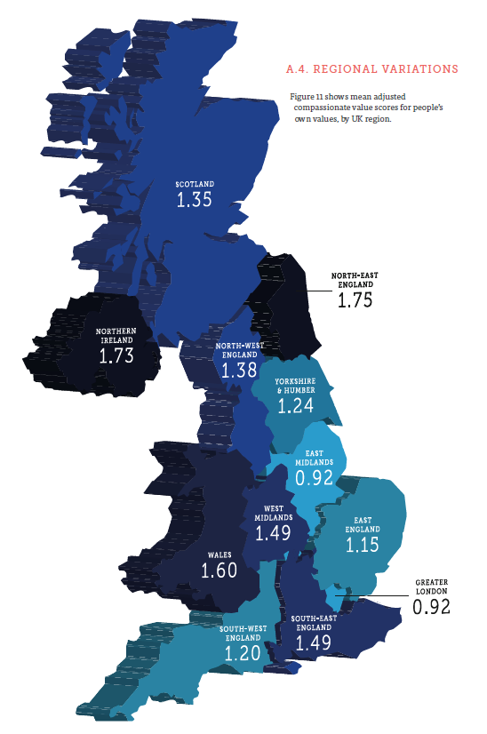
Notes:
For our report ‘Perceptions Matter’ on the UK values survey, see: http://valuesandframes.org/download/Perceptions-Matter-Full-Report.pdf
Findings true whether rich/poor, male/female, young/old, liberal/conservative

Slide 7




Notes:
For a technical report on the research on conservation/disability (the WWF/Scope/Nesta research), see: http://valuesandframes.org/download/reports/No%20Cause%20is%20an%20Island.pdf

Slide 8
Concern about…
…poverty in the UK
…child mortality in developing countries
…loss of the British countryside
…climate change
Civic participation
Notes:
We then interview them about four issues, two environment and two development.
We then transcribed the interviews and sent them blind to a linguist, who therefore didn’t know which group people were in.
We asked him, based on a 3-point subjective scale, a number of questions.
The first was, how intrinsic or extrinsic was their general speech, and this is what we found…

Slide 9
Our work
The importance of environmental protection is still often overlooked and is not adequately reflected in planning and policy. One reason for this is that people’s inherent appreciation of, and love for, the natural world is often forgotten. Reminding people of the intrinsic importance that they attach to nature can help to address this problem.

Slide 10
Our work
The importance of environmental protection is still often overlooked and is not adequately reflected in planning and policy. One reason for this is that people’s inherent appreciation of, and love for, the natural world is often forgotten. Reminding people of the intrinsic importance that they attach to nature can help to address this problem.
Notes:
Spillover happens between values

Slide 11
Our work
Natural assets, and the benefits that they provide, are still often overlooked and are not adequately reflected in planning and policy. One reason for this is that the financial value of the environment, and the commercial benefits that people derive, is often overlooked. Putting a monetary value on nature can help to address this problem.
Notes:
Which of these do you think prove to be most effective in promoting people to donate for either charity, volunteer or campaign for either charity?
Does this depend on the type of person who we’re asking?
I’m going to say something about recent work in social psychology qhich will help you to answer these questions.

Slide 12
Our work
Natural assets, and the benefits that they provide, are still often overlooked and are not adequately reflected in planning and policy. One reason for this is that the financial value of the environment, and the commercial benefits that people derive, is often overlooked. Putting a monetary value on nature can help to address this problem.
Notes:
Which of these do you think prove to be most effective in promoting people to donate for either charity, volunteer or campaign for either charity?
Does this depend on the type of person who we’re asking?
I’m going to say something about recent work in social psychology qhich will help you to answer these questions.

Slide 13
Love of
nature
Economic case for environment
Support for conservation
Notes:
The more intrinsic text – WWF-A – was more effective

Slide 14
Our work
We work with disabled people and their families at every stage of their lives. We believe that disabled people should have the same opportunities as everyone else, enabling them to live the lives they choose. Yet today, disabled people are more likely to live in poverty, more likely to experience negative attitudes or prejudice, and are more likely to live alone. They still face marginalisation and discrimination.

Slide 15
Our work
We work with disabled people and their families at every stage of their lives. We believe that disabled people should have the same opportunities as everyone else, enabling them to live the lives they choose. Yet today, disabled people are more likely to live in poverty, more likely to experience negative attitudes or prejudice, and are more likely to live alone. They still face marginalisation and discrimination.

Slide 16
Our work
We work with disabled people and their families at every stage of their lives. We believe in giving disabled people the chance to achieve greater success in their lives, so that they can fully contribute to the economy. Yet today, disabled people are more likely to be unemployed and receiving benefits.
Notes:
Which of these do you think prove to be most effective in promoting people to donate for either charity, volunteer or campaign for either charity?
Does this depend on the type of person who we’re asking?
I’m going to say something about recent work in social psychology qhich will help you to answer these questions.

Slide 17
Our work
We work with disabled people and their families at every stage of their lives. We believe in giving disabled people the chance to achieve greater success in their lives, so that they can fully contribute to the economy. Yet today, disabled people are more likely to be unemployed and receiving benefits.
Notes:
Which of these do you think prove to be most effective in promoting people to donate for either charity, volunteer or campaign for either charity?
Does this depend on the type of person who we’re asking?
I’m going to say something about recent work in social psychology qhich will help you to answer these questions.

Slide 18
Empowering disabled people
Economic case for supporting disabled people
Support for Scope
Support for WWF
Notes:
But did the way we talked about disability have an impact on intention to help an environmental organisation?
You bet! Intrinsic was best.

Slide 19
Love of
nature
Economic case for supporting environment
Support for Scope
Support for WWF
Notes:
And did the way in which we talked about conservation have an impact on people’s intention to help a disability org?
You bet. Intrinsic was best.

Slide 20
Love of
nature
Support for Scope
Support for WWF
Notes:
Love of nature was better than the extrinsic nature text in both cases

Slide 21
Empowering disabled people
Support for Scope
Support for WWF
Notes:
Intrinsic disability text was best in both cases.

Slide 22
Indistinguishable in their effectiveness
Love of
nature
Empowering disabled people
Support for Scope
Support for WWF
Notes:
But was one more effective than the other?
Nope – they were each equally effective in leading people to state support for either cause.

Slide 23
Indistinguishable in their effectiveness
Love of
nature
Empowering disabled people
Support for Scope
Support for WWF
Support for many other causes
Notes:
If this is true of disability and conservation, we’d expect it to be true of many other causes aswell.

Slide 24
Economic case for supporting environment
Economic case for supporting disabled people
Indistinguishable in their (in)effectiveness
Support for Scope
Support for WWF
Notes:
And what of the two less effective texts? Did their relative ineffectivenss depend upon the cause we were asking people to support?
No! Both were equally ineffective in elliciting support for either cause.

Slide 25
Economic case for supporting environment
Economic case for supporting disabled people
Indistinguishable in their (in)effectiveness
Support for Scope
Support for WWF
Support for many other causes
Notes:
If this is true of disability and conservation, we’d expect it to be true of many other causes aswell.

Slide 26
Opportunity 1: Recognise the synergies between different policy areas
Work across causes – the work of one will impact on the work of others.
Ambitious progress on some causes (e.g. climate change) may be impossible without concerted work across causes.
It’s not just about communication – what is people’s experience?

Slide 27
Working in awareness of these synergies could:
Help to build public concern about issues that are sometimes difficult to tackle head-on: climate change
Strengthen the values upon which civic participation, community cohesion and social concern are built
Increase public support for the work of government

Slide 28
Will it be possible to build public acceptance for ambitious action on climate change by working on climate change alone?
Policy areas which are particularly salient in people’s day-to-day lives (e.g. health) will be especially important.

Slide 29
People’s own values and how to engage them
2. The values that social institutions are seen to encourage
People’s perceptions of others’ values
Useful new performance measures?

Slide 30
Notes:
Why’s it a problem when most people already care most about compassionate values?

Slide 31
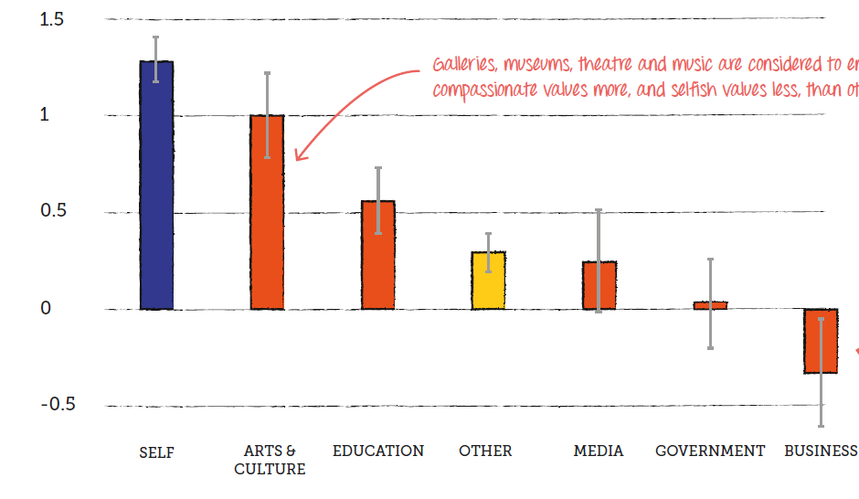

Slide 32
Opportunity 2: Work to better align institutional values with people’s own values
Claim the mandate of citizens’ own values (would require Scottish-specific survey)
Work across a range of key institutions (we’re beginning to work in this way at a municipal level in Manchester and Bristol)

Slide 33
Working in this way could:
Increase public support for action on climate change, public health, social exclusion, inequality…
Increase motivation for pro-environmental behaviours
Reduce cultural estrangement and alienation
Improve public trust in government

Slide 34
People’s own values and how to engage them
The values that social institutions are seen to encourage
3. People’s perceptions of others’ values
Useful new performance measures?

Slide 35
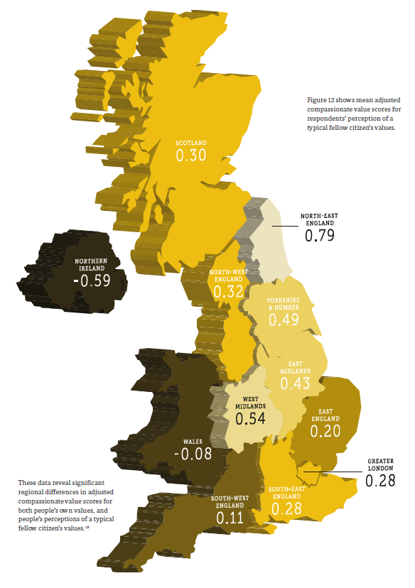

Slide 37
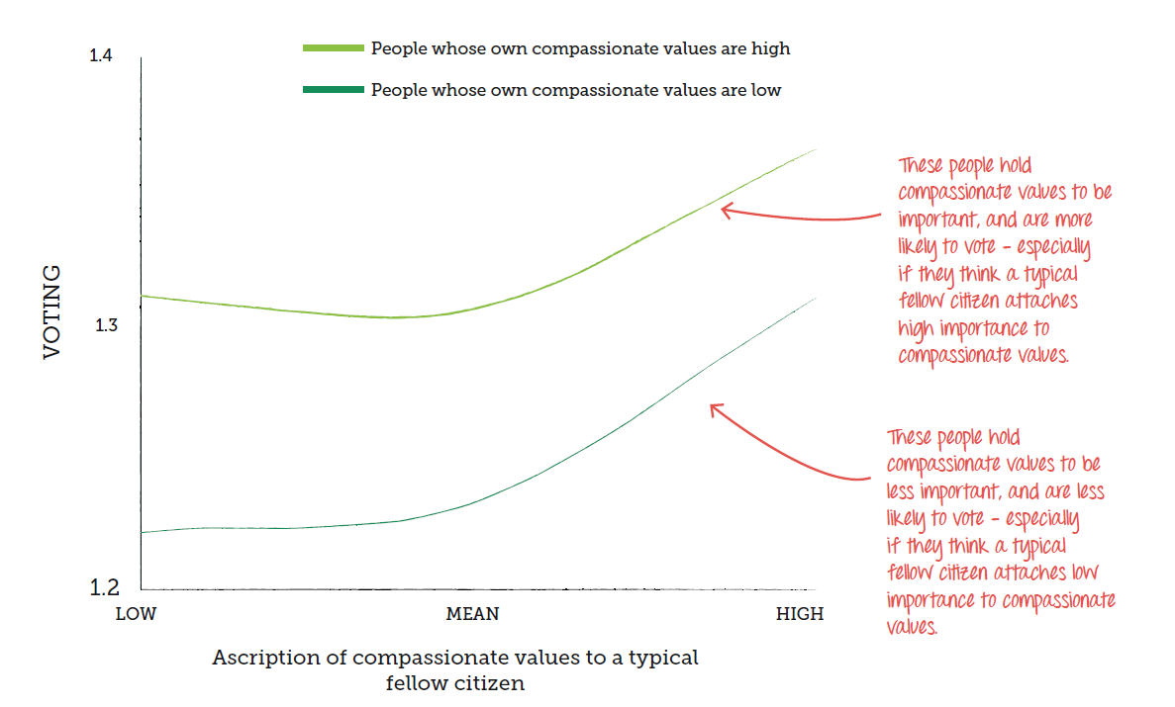

Slide 38
Opportunity 3: Convey a more accurate perception of others’ values
Communicate a simple and important truth about what most people in Scotland value
Disseminate this through your work and through new collaborations

Slide 39
Working in this way could:
Increase public support for action on climate change, public health, social exclusion & inequality
Promote civic participation
Improve community cohesion
Reduce cultural estrangement and alienation

Slide 40
People’s own values
The values that social institutions are seen to encourage
People’s perceptions of others’ values
4. Useful new performance measures?

Slide 41
Opportunity 4: Performance indicators
To what extent are the values that people in Scotland hold to be most important seen to be encouraged by the Scottish Government?
How accurate is a typical person’s understanding about the values that fellow citizens hold to be important?

Slide 42
Thanks!
Tom Crompton
tcrompton@commoncausefoundation.org

Slide 43
Two questions
How might your own organisation or community respond to these opportunities?
What new collaborations might you establish in pursuing these opportunities?

