Slide 1
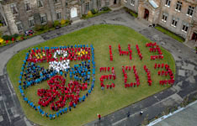

Engaging with External & Global Communities
Notes:
This is a quick overview of some of the ways that we at Transition University of St Andrews engage with our local and global communities, with the aim of sharing some project inspiration and ideas, and to reflect on some learning points.
Transition’s activities form part of a wider picture of a sustainable University of St Andrews, across our estates, governance, teaching and research

Slide 2

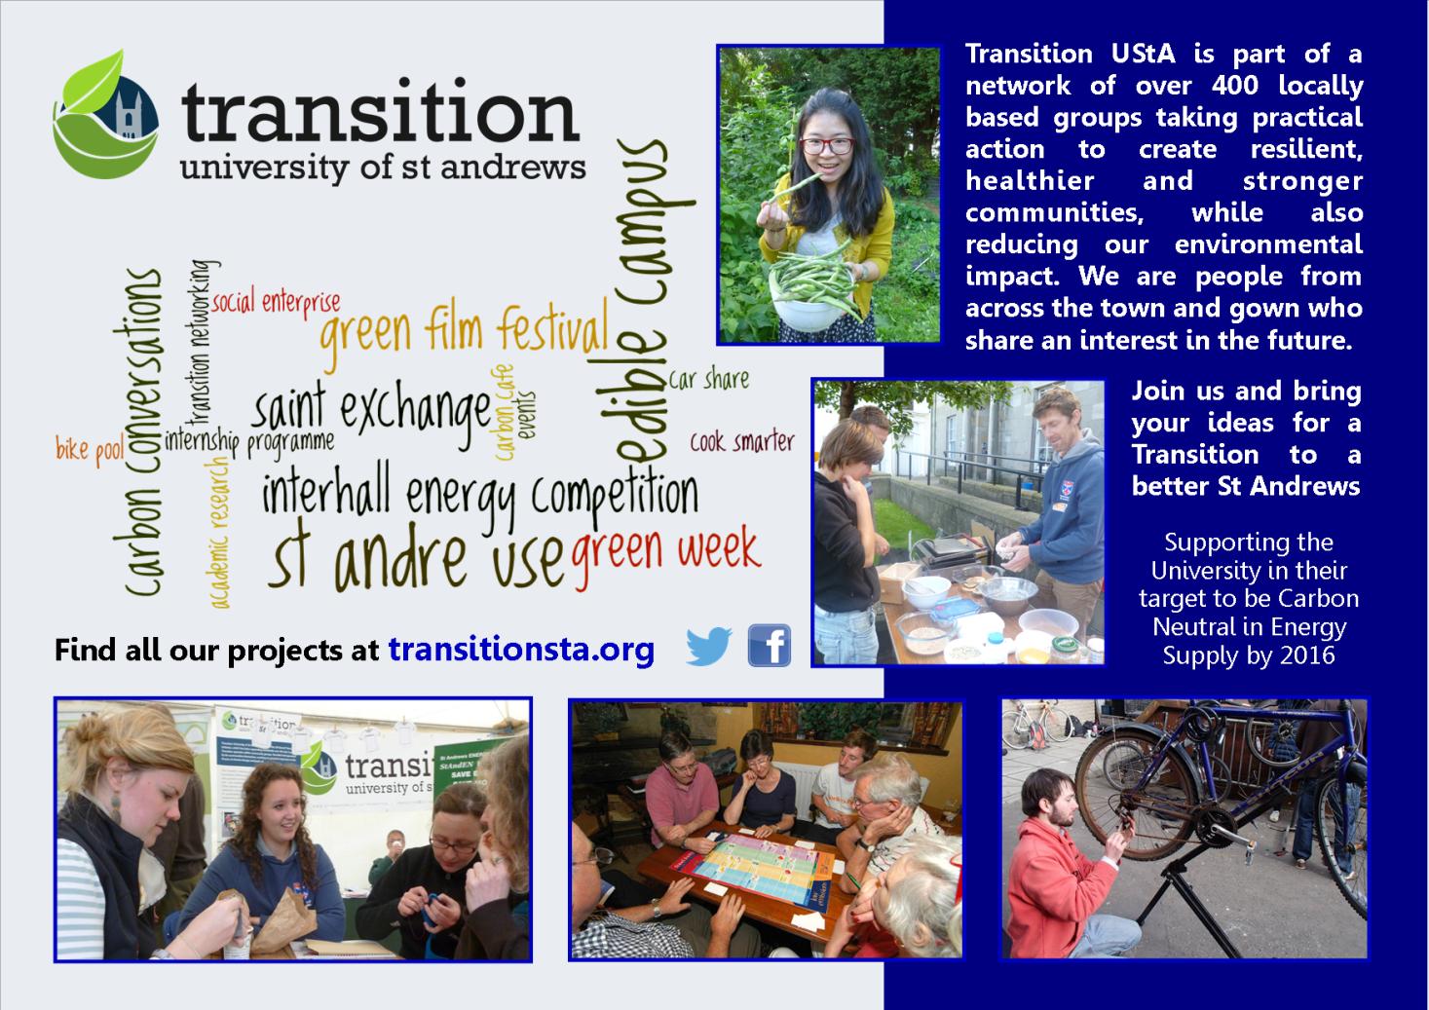
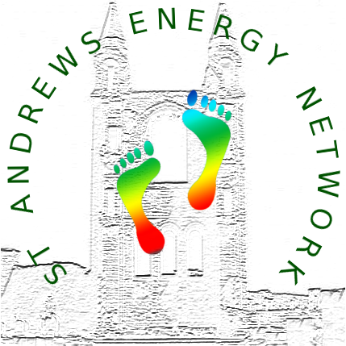
“St Andrews Communities
Working Together”
Notes:
Transition are funded by CCF as a joint bid in partnership with the St Andrews Environmental Network as St Andrews Communities Working together.
Our steering group is made up of community members as well as staff and students

Slide 3
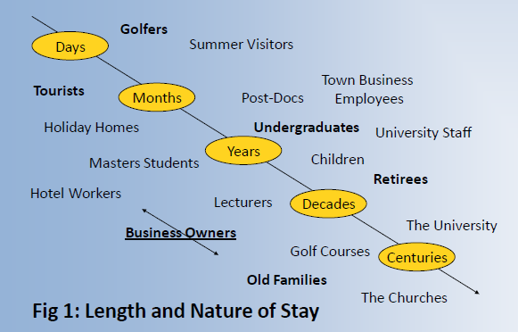
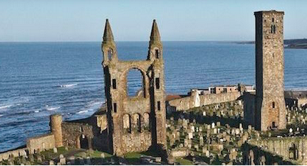


Our external communities:
St Andrews Residents to the World (via Fife and Scotland)
Notes:
As with any community, St Andrews in not homogenous or static. Unpicking that made an interesting research prject for one of our student steering group members,.
We also engage with regional and national communities of interest, for instance transition network, Scottish and UK universities etc and local green groups.
Looking at our projects now,

Slide 4
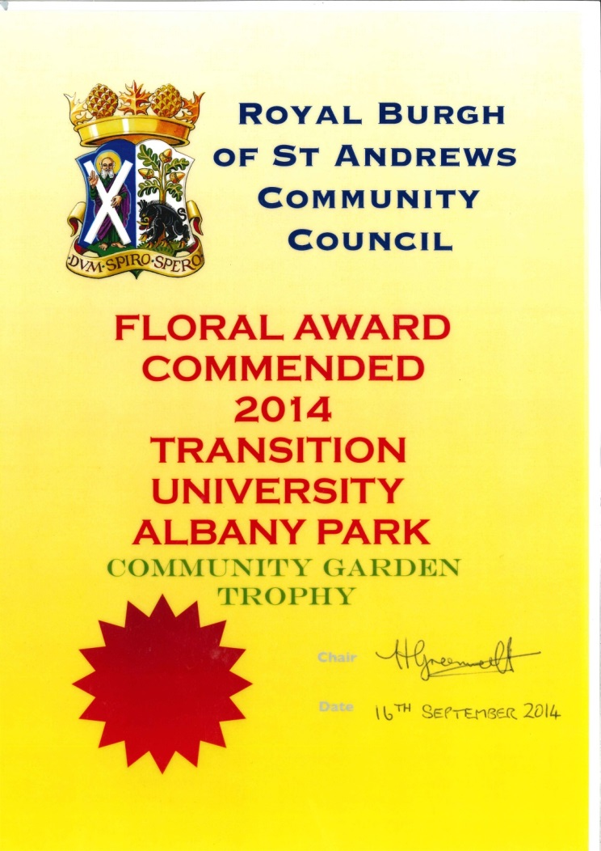
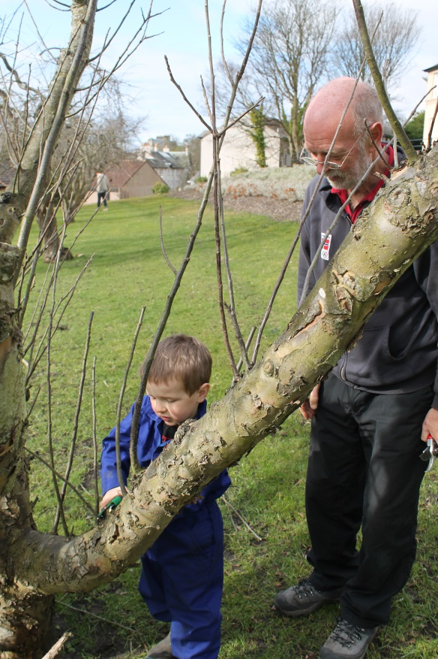
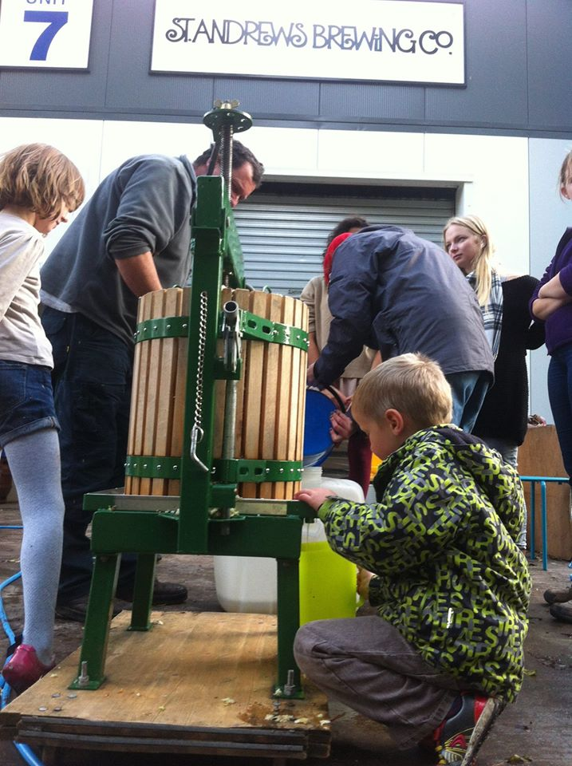
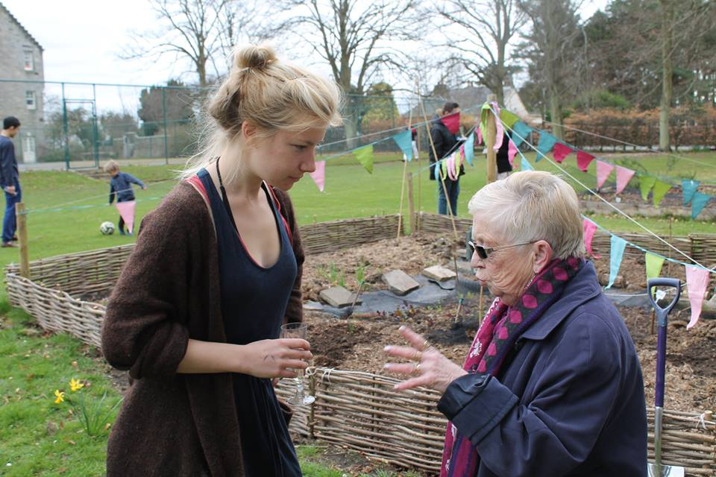
Edible Campus: Engagement via growing
Notes:
Gardens are great! Our Edible Campus gardens and activities are open to residents of the town as well as students, and even form part of the St Andrews in Bloom judging round.
There is good community involvement in specific events such as Tree planting / pruning workshops, although most of the regular growing participants are students.

Slide 5


Saint Exchange: Engagement through Trade
Notes:
Our SaintExchange LETS system makes use of community buildings for trading events and socials.
Had 10 trading mornings, 102 members in total, with a good number from outwith the University

Slide 6
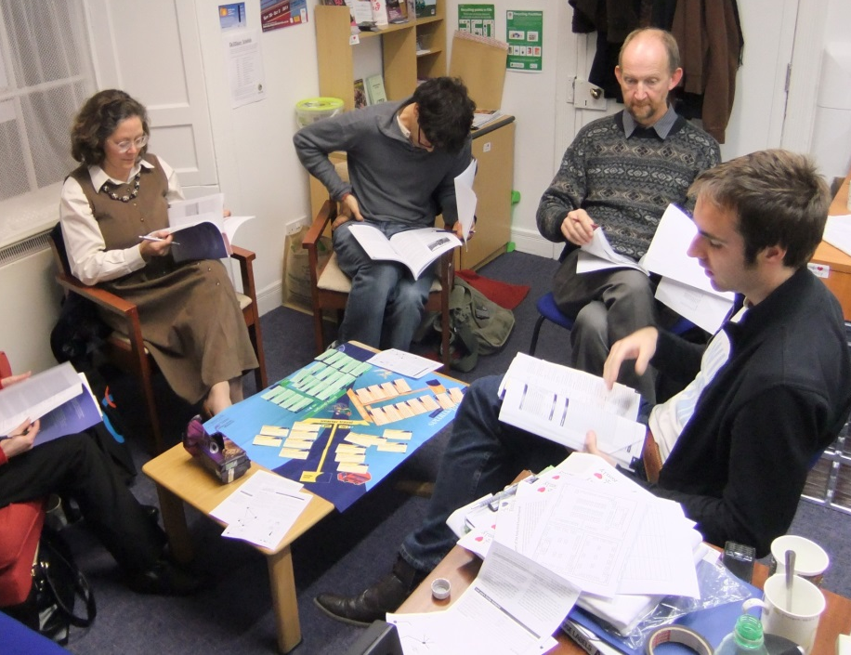

Carbon Conversations: Engagement over tea & biscuits
Notes:
Carbon Conversations sessions have attracted some very deep and lasting engagements with community members, although they only made up 20% of attendees over the past 3 year.
The next part of project is taking CC to the home in the form of Carbon Conversations streets to try to increase engagement with people from the town

Slide 7

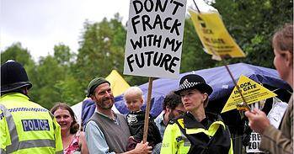


Green Film Festival:
Engagement through film and debate
Notes:
The Green Film festival has grown in scope since its first year in 2013. Attracts a wide audience across students, town and Scotland. Not limited to thought-provoking films, there is space for active debate and discussion of the issues with directors and speakers.

Slide 8

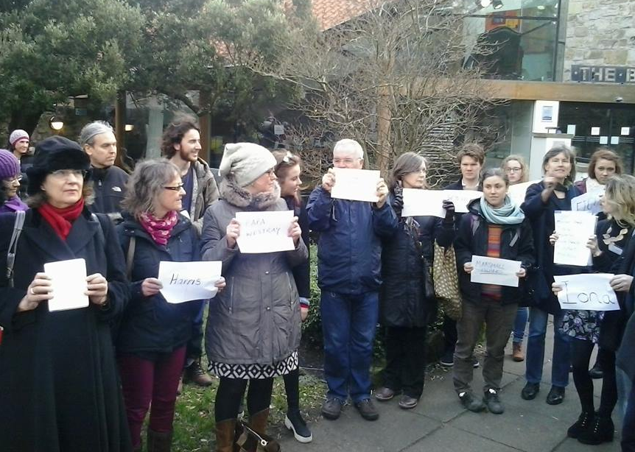

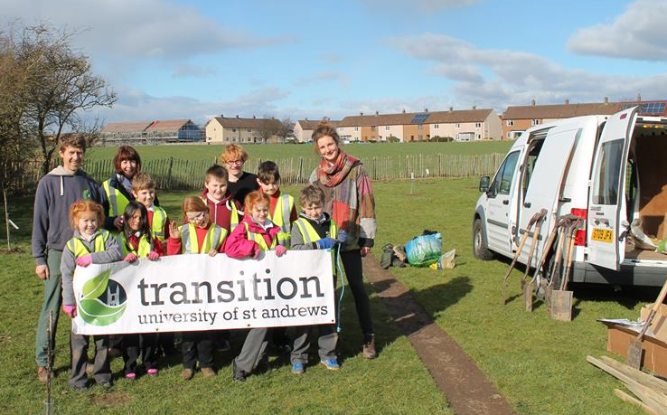
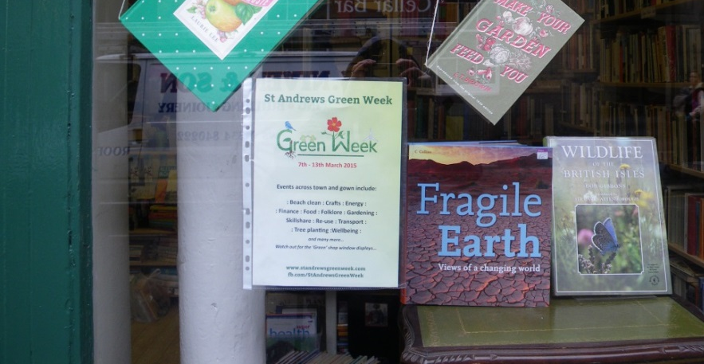
Green Week
Notes:
Green Week links events across town and university.
Highlights of external engagement this year include linking with the StAnza Poetry festival for an impromptu climate change reading in the Saturday of the London Climate march, Tree planting with local schools, and encouraging the local charity shops to do a green shop window display in solidarity with Green week and Pass it on week.

Slide 9
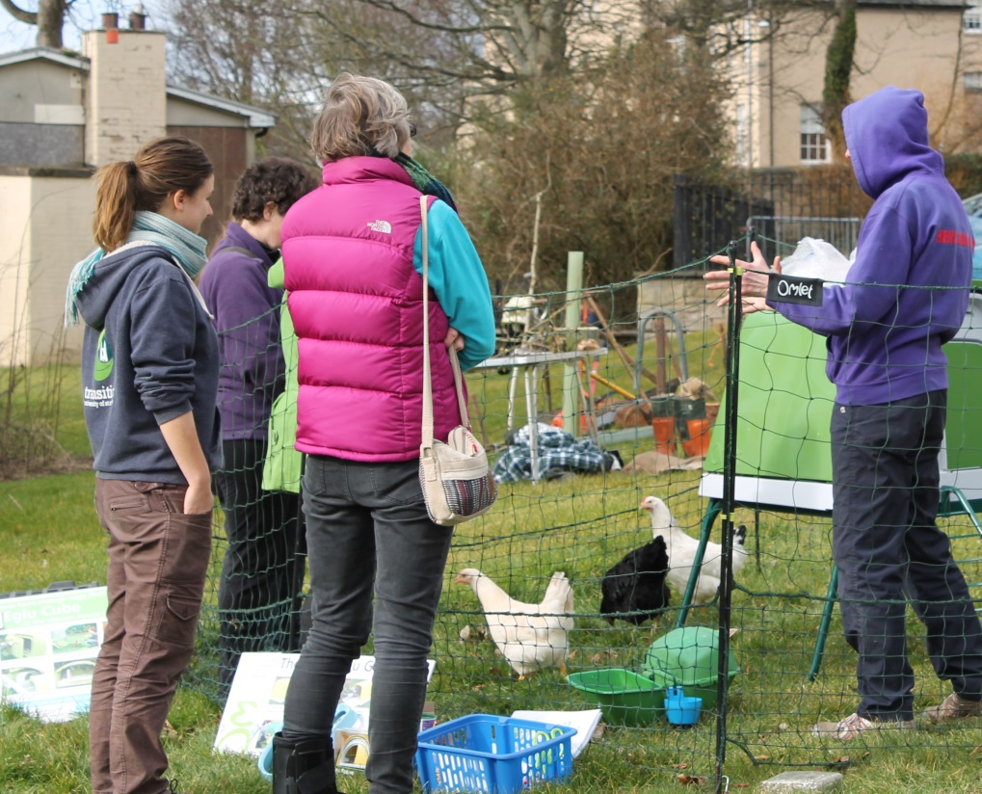
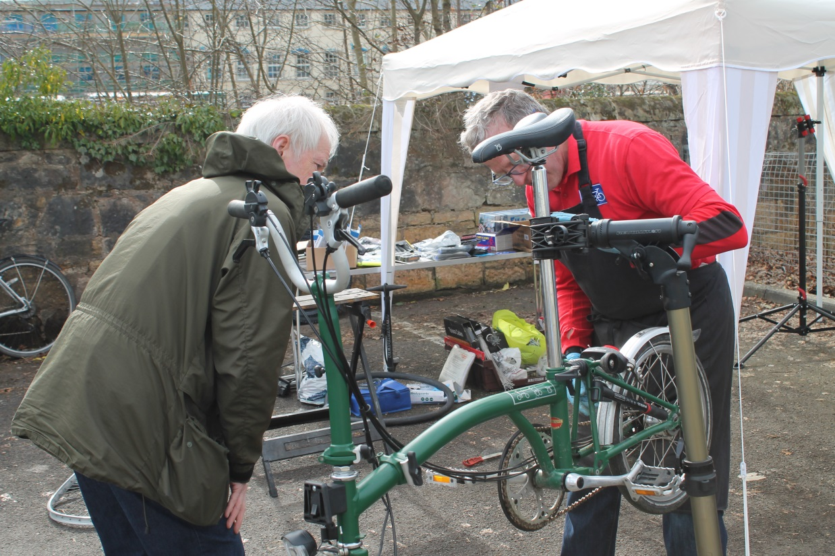
Skillshare
Notes:
Our Skillshare Extravaganza was the highlight of green week
We took over the local community centre with a host of drop in sessions – everything from juggling to chicken keeping, yoga to bike maintenance.
One of our best community engagement events: about 300 attendees, with a third from the town, many of whom were not our regular ‘green’ followers

Slide 10
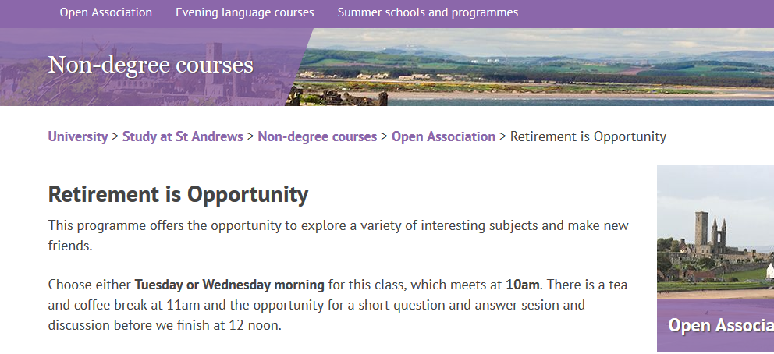
Channels of Engagement:
Open Association and other learning engagement / MUSA
Notes:
Tapping into existing external engagement networks makes a lot of sense
The University has a lifelong learning community outreach arm called Open Association, and Transition have contributed a number of sessions on climate change, and carbon conversations via this network.
We have also given talks to schools and other community groups.
(about 5 seconds left)

Slide 11

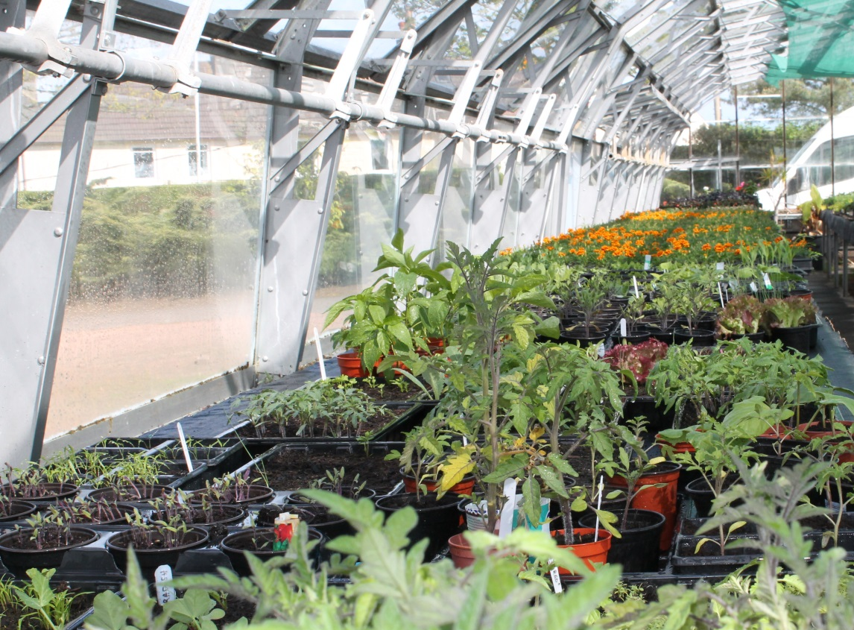
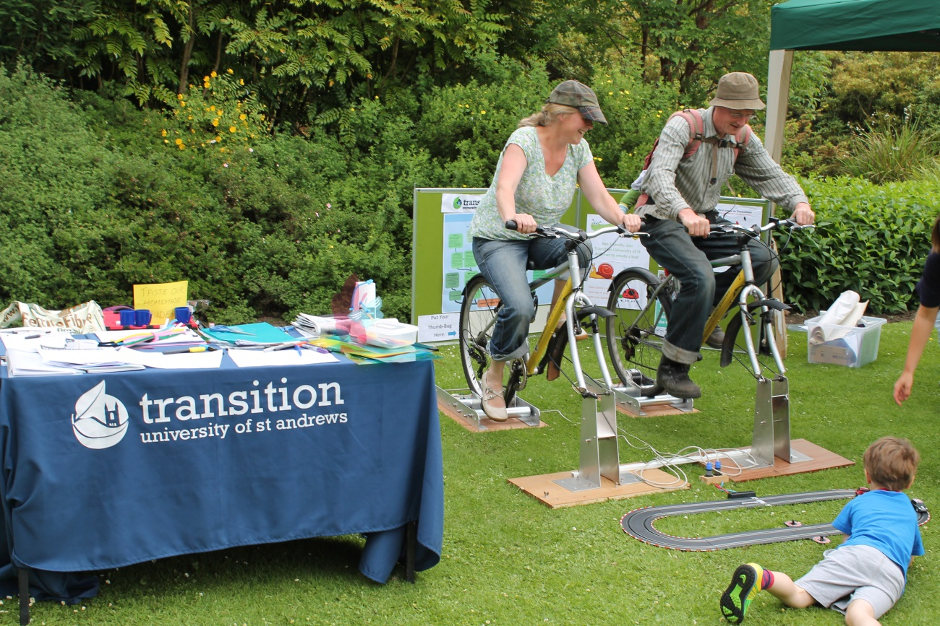
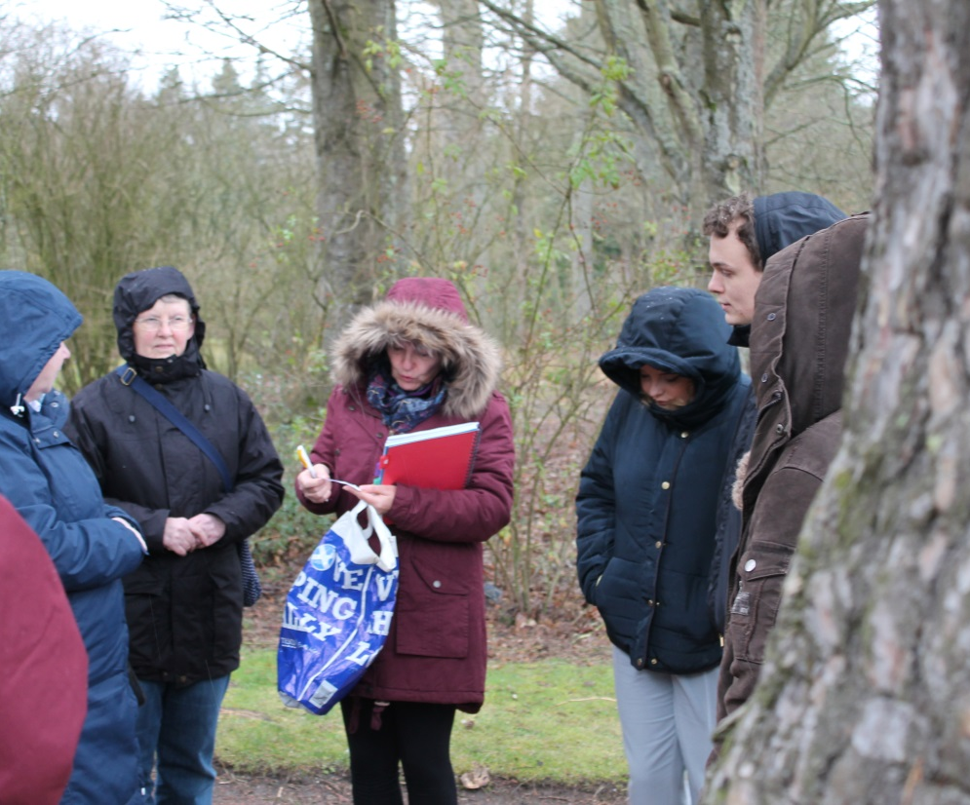
A place to grow plants & people; knowledge and friendship
Notes:
The St Andrews Botanic Garden is fabulous community hub which has helped us to extend engagement beyond our usual followers.
We have the use of a Greenhouse for propagation for the edible campus project. Hold Green Week events such as the Tree Folklore walk with an environmental poet, and attract a lot of families to our summer festivals in the garden.

Slide 12

Engagement via infrastructure:

Slide 13
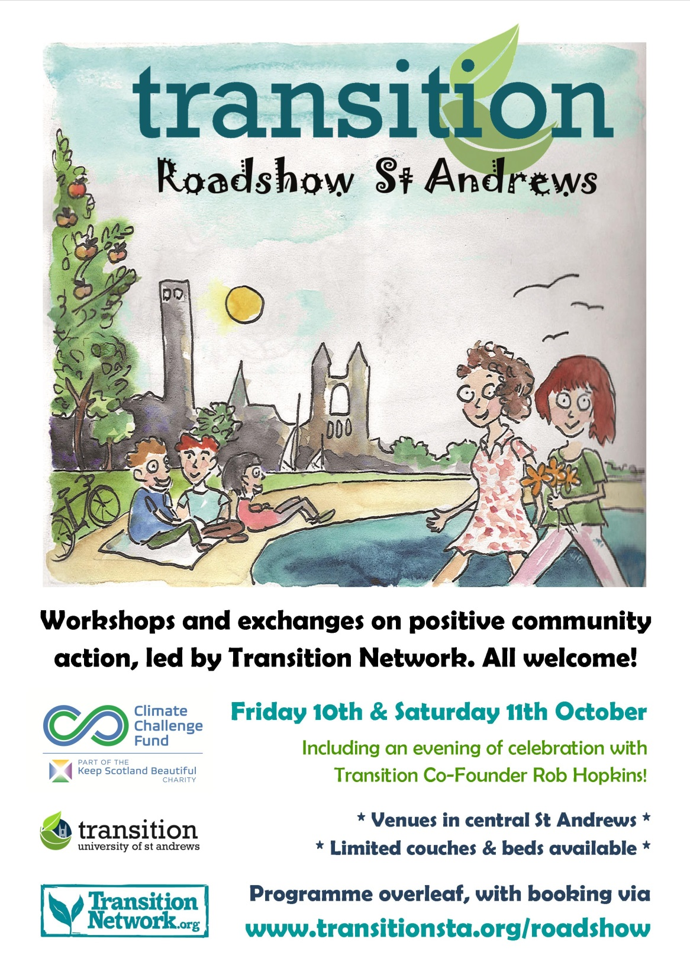
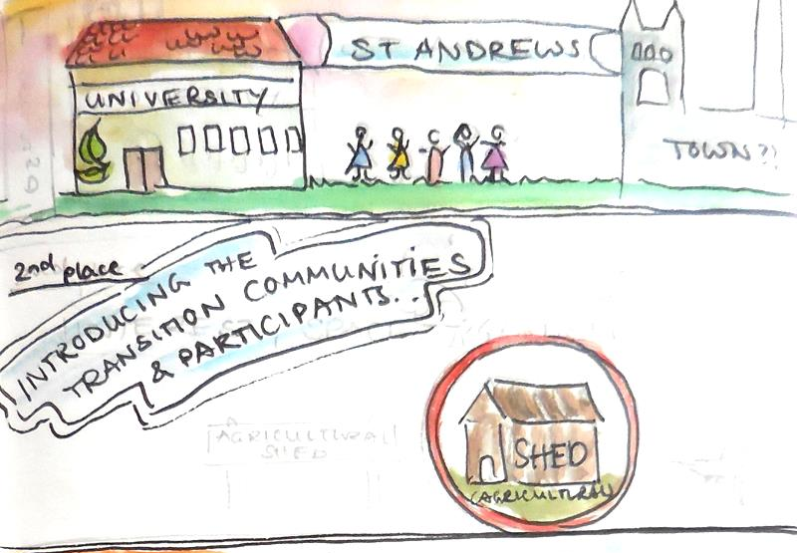
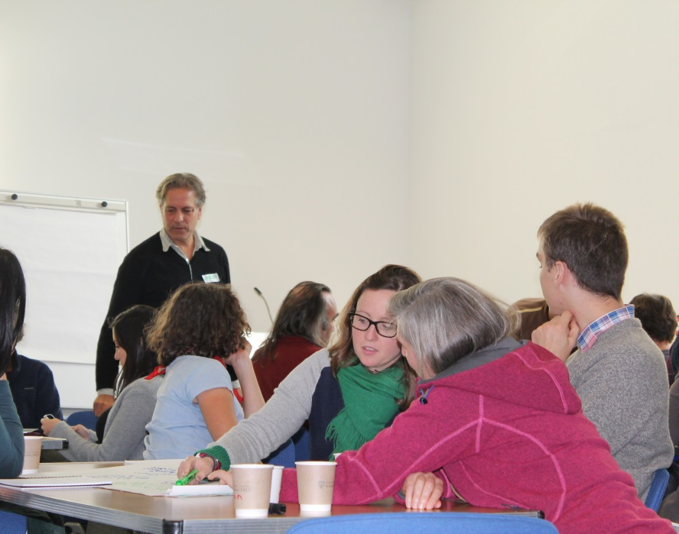
Notes:
Looking further afield, we’ve been engaging with the national Transition agenda, hosting a Transition Network Roadshow last October
Approx 45 people from across Scotland for two brilliant days of ideas exchange
This sparked further collaborations, leading a submission to the Smith Commission consultation post-referendum and have since engaged with Scottish Community Climate Action Network to facilitate further climate change action across Scotland

Slide 14

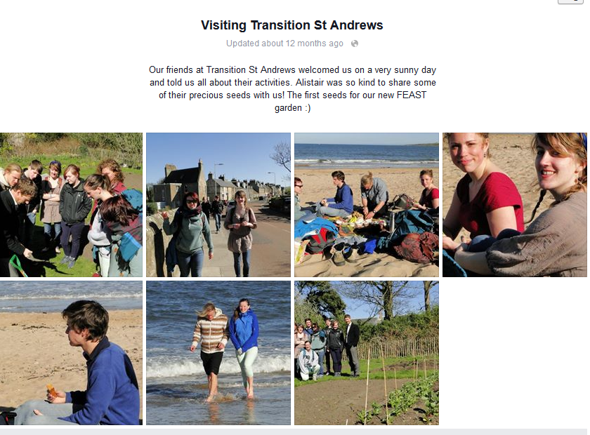
Notes:
Other universities come and visit to share ideas – this is Stirling Uni visiting our edible campus spaces and beach, and we’ve recently been back up to a conference they hosted
Also welcomed visitors from University West of Scotland, Edinburgh, & Aberdeen

Slide 15
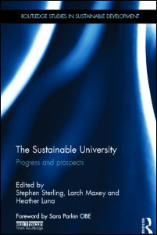

Critically reflecting on engagement
Student Action for Sustainability Conference
29th-30th October 2013, Keele University
Community engagement TSN
ESD HE Topic Support Network
2nd WORLD SYMPOSIUM ON SUSTAINABLE DEVELOPMENT AT UNIVERSITIES (WSSD-U-2014)
Abertay University Head hands and heart 2014
Scottish Colloquium on Food and Feeding
Notes:
We are also active in engaging through critical reflection on our activities and dissemination of these reflections through formal academic teaching activities, research publications and conferences These allow analysis and reflection on our community engagement
For example, transition folk lecture within the SD Programme; students do research dissertations on local sustainability issues; staff undertake critical reflexive research and have published on what community is or might be, how our community has evolved and how it feeds into wider attempts to create a ‘sustainable university’

Slide 16
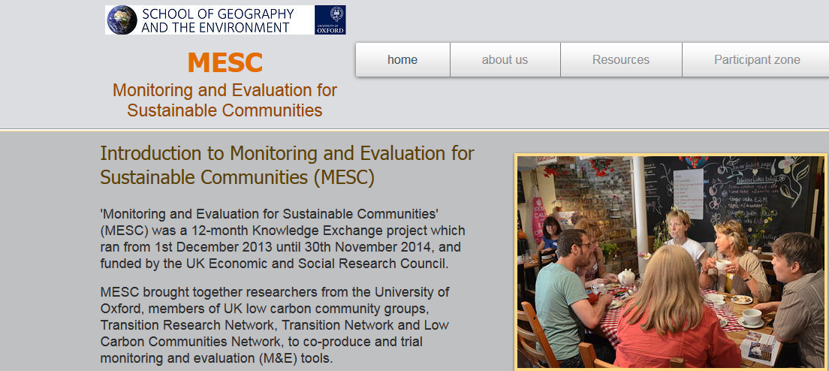
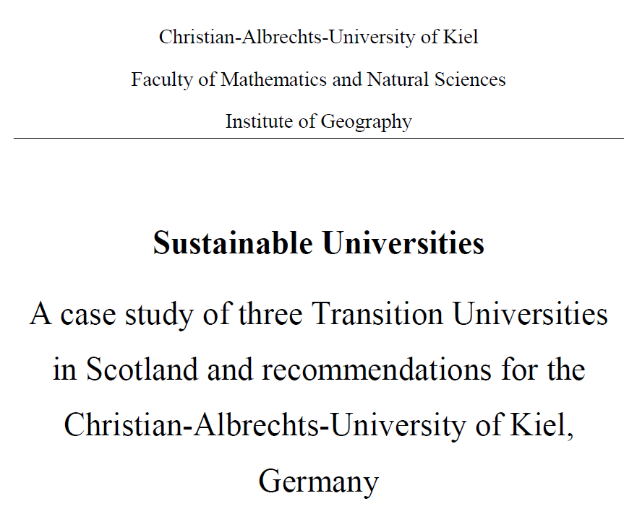
Engagement through being researched
Notes:
Participation in research projects and engaging with other low carbon networks

Slide 17
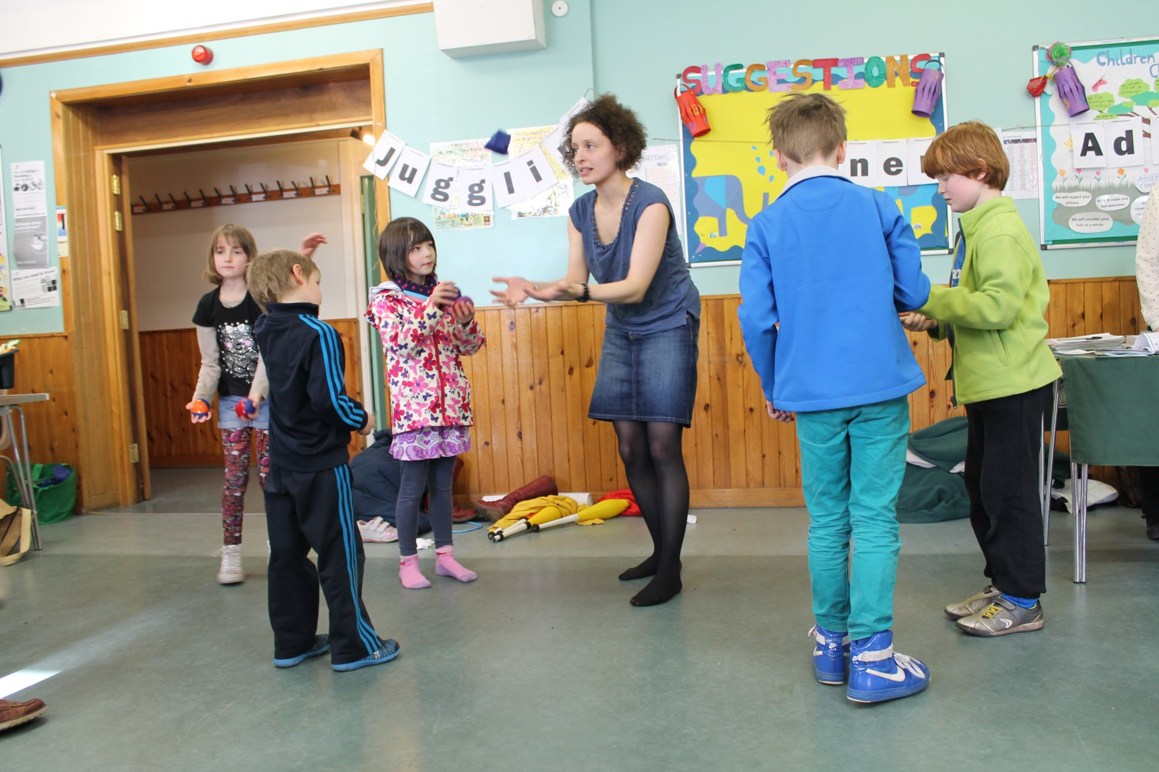
What works well?
Notes:
Use community venues like town hall, botanic gardens, community centre
Use existing networks and organisations
Drop the green branding sometimes
Give stuff away: great to have community members on board to help with summer gardens glut

Slide 18
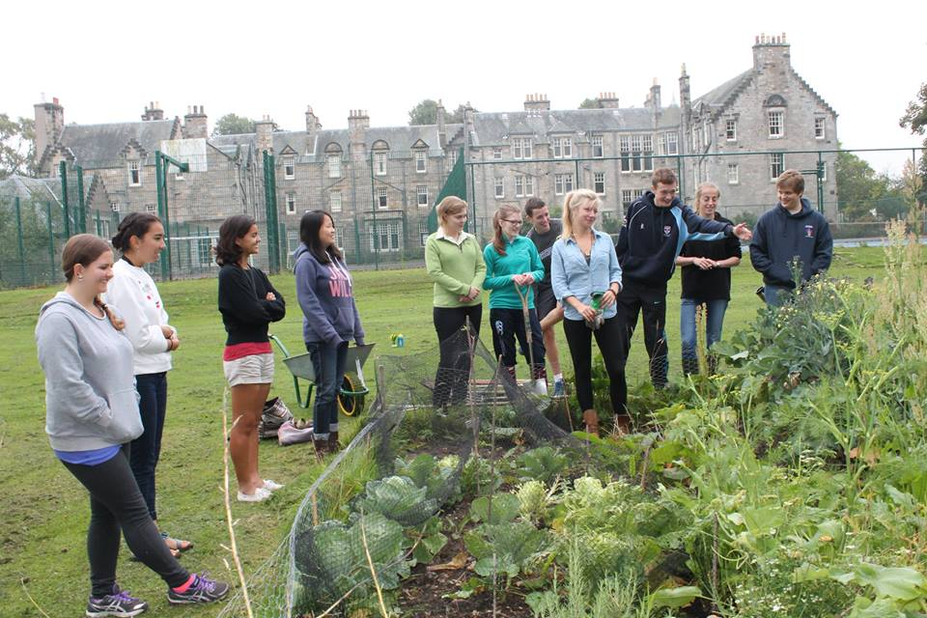
What’s more challenging?
Notes:
Our photos do not reflect diversity especially in age (offputting for some members of the community)
Challenge of the town/gown divide
Getting out beyond the ‘already green’
Transient Community (also a benefit)

Slide 19
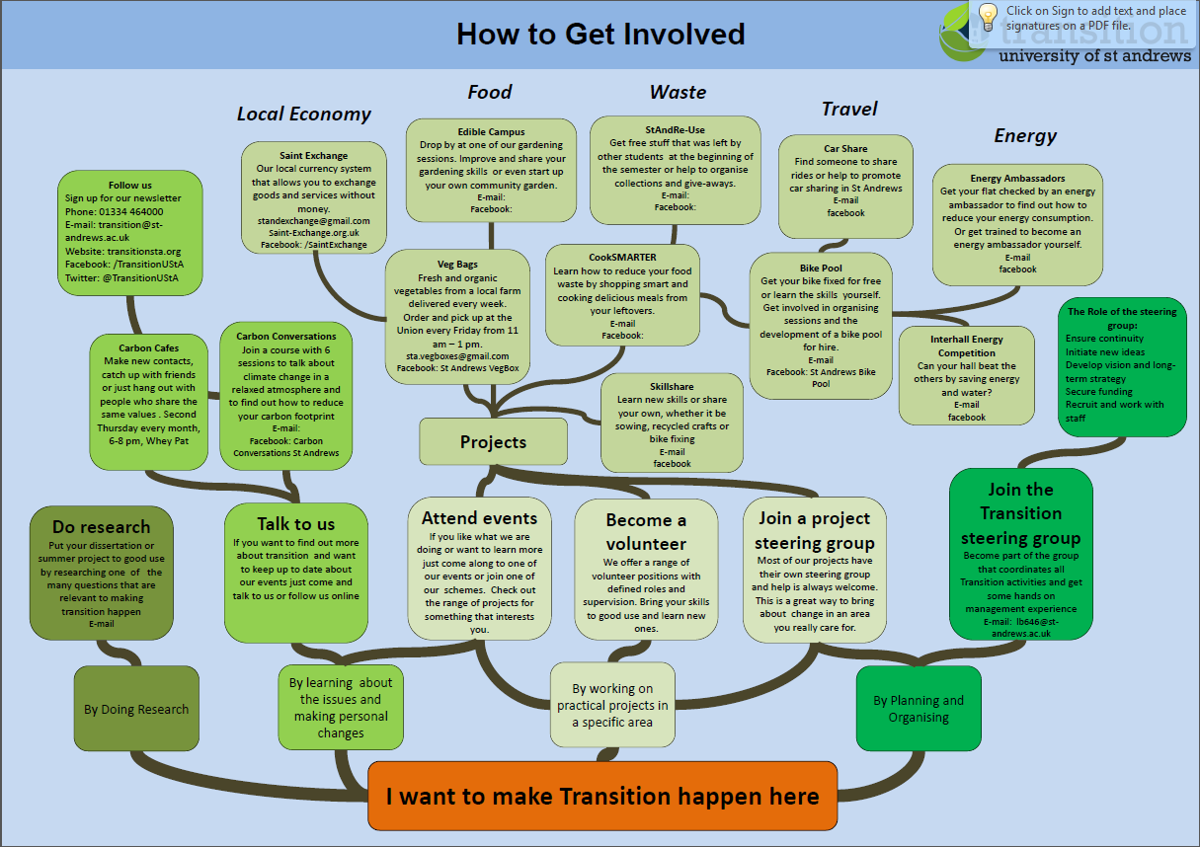
Notes:
Another challenge is lack of a clear ‘membership’ or involvement route
Which spurred us to map how people can engage with us helps to help identify routes in and guide people through the various ways of getting involved – but its still complicated!

Slide 20
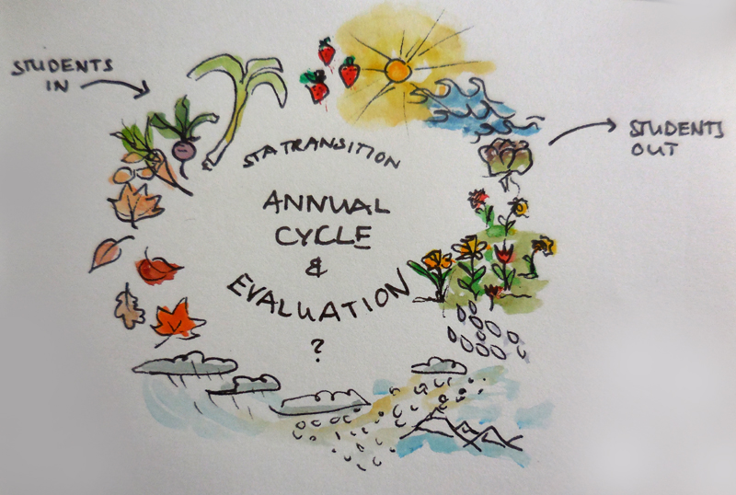
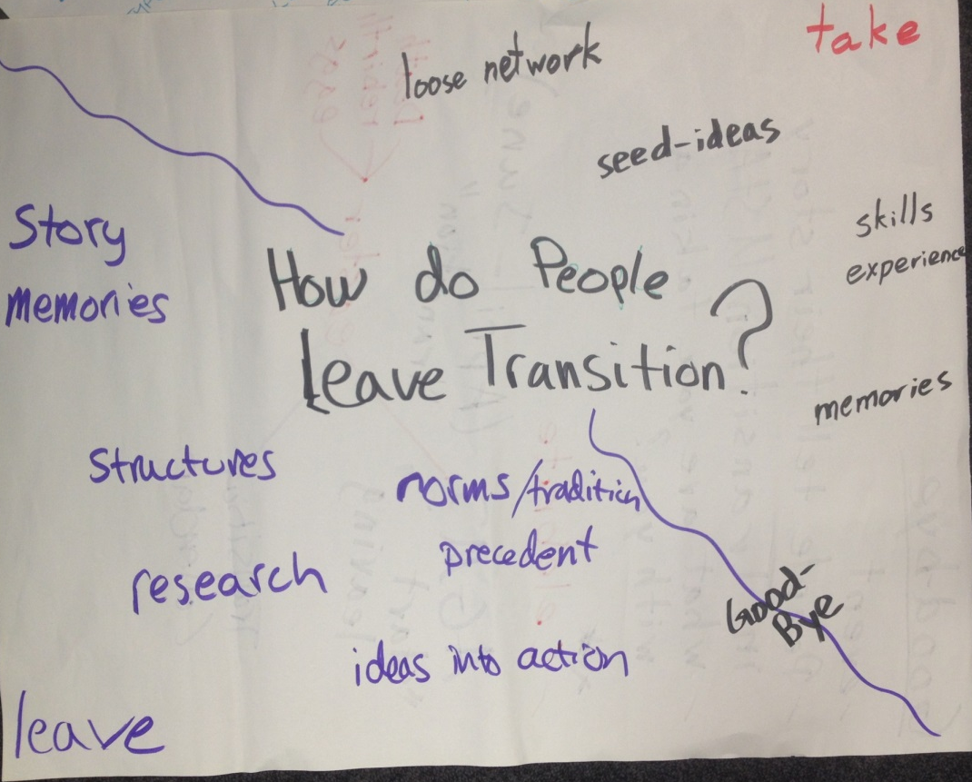
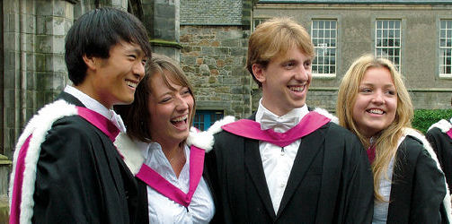
Global spread of ideas
Notes:
A reflection from our Transition Network Thrive training was the realisation that all is not lost when our students leave – they will be sowing the seeds of transition as part of a greater global engagement..

