Slide 1


Salary Sacrifice Cars working in Partnership with the EAUC
26th May, 2015

Slide 2


What is Salary Sacrifice?
A salary sacrifice happens when an employee gives up the right to receive part of the cash pay due under his or her contract of employment. Usually the sacrifice is made in return for the employer’s agreement to provide the employee with some form of non-cash benefit. The 'sacrifice' is achieved by varying the employee’s terms and conditions of employment relating to pay.
HMRC definition

Slide 3

Salary sacrifice car scheme specialists
Market Leaders
215+ Schemes

Slide 4

Salary sacrifice car scheme specialists
Bespoke solutions to cater
for all employees

Slide 5

Salary sacrifice car scheme specialists
Best in industry systems,
processes and marketing

Slide 6

Salary sacrifice car scheme specialists
Normally fully outsourced to Tusker

Slide 7

KEY Fundamentals & certification
ISO 27001 accredited – your data is in a safe pair of hands.
ISO 9001 accredited – Quality Management Systems
ISO 14001 accredited – Environmental Management

Slide 8

KEY Fundamentals & certification
All our schemes are Carbon Neutral

Slide 9
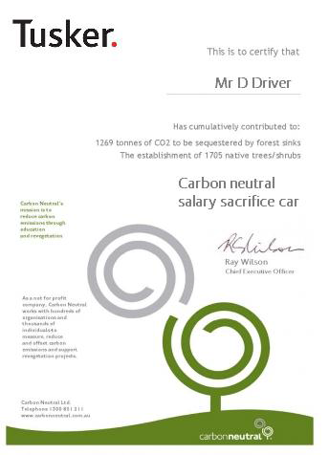
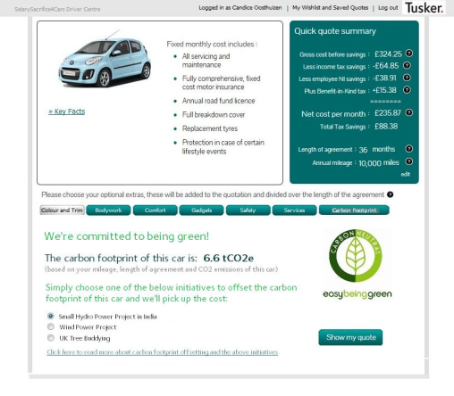
Carbon offsetting

Slide 10
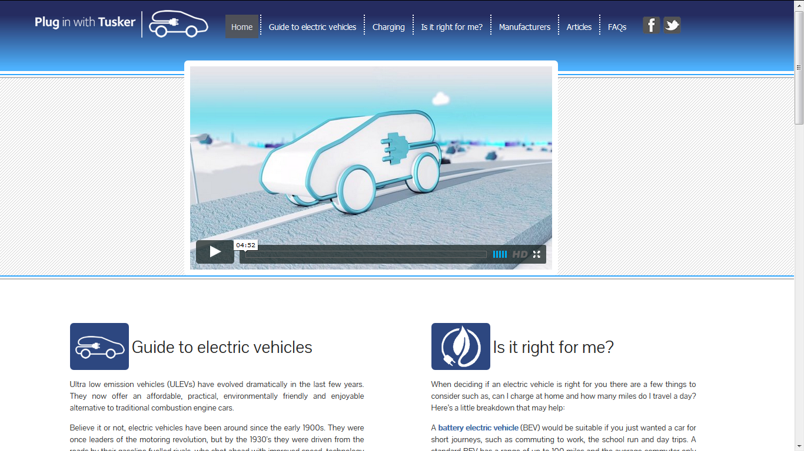
Go electric -

Slide 11

KEY Fundamentals & certification
All our schemes have been HMRC approved

Slide 12

Awards & certification
2014 & 2015
Golden Green Apple
Carbon Reduction

Slide 13
Awards & certification
2014 & 2015
Business Techies Awards Finalists
Best Green Development

Slide 14

Awards & certification
2014 & 2015
WSB Awards Finalists
Car Scheme Provider of the year

Slide 15

Awards & certification
2014 & 2015
Best Car Scheme UK 2015
Business Excellence Awards

Slide 16


















DIVERSE customer base
Tusker have done all the work in terms of promoting the scheme formally. We might suggest a good time or location for a roadshow, but they do the rest.
- Public Sector Customer
They are a lovely crew to deal with. They are
really helpful and supportive of me. For example, I recently asked for a list of all our contracts and I got it very quickly which is key when our resources are being increasingly stretched.
Tusker produce marketing material on our behalf, and then we distribute them. They’ve even done bespoke products like air fresheners, which people really liked.
We have had no problems with Tusker so far really. Unfortunately I can’t say the same for some of the other providers in the benefits suite.
- Third Sector Customer
- Public Sector Customer
- Private Sector Customer

Slide 17








A selection of our 100+ Public Sector customers

Slide 18
OJEU Frameworks
OJEU Reference 2011/S 204-332353
Awarded May 2012
OJEU Ref 2013/S 234-406233
Awarded August 2014
OJEU Ref – 2013/S 090-153356
Awarded Oct 2013
VOLUNTARY BENEFITS AND SALARY SACRIFICE PAN
GOVERNMENT SCHEME (EVERYBODY BENEFITS)
OJEU Ref – 228891 - Awarded Dec 2013

Slide 19




What makes us different?
Specialists
Risk Removal
& Management
Employee engagement & administration
Award winning systems

Slide 20
How it works?
Employer leases car from Tusker
Employee sacrifices from gross salary (Income tax and NI saved)
Employee pays BIK tax on the benefit – company car. (Lower Co2 = bigger saving)
Employer saves Class 1 NI on the sacrificed salary
Employer pays Class 1A NI on the value of the benefit

Slide 21
Key Benefits
Financial
Environmental
Human Resources
Employers can save NI contributions
HMRC approved mileages rates
No cost to implement with Tusker
Framework access - No costly Procurement exercise
Access to CCS fleet discounts
Competitive corporate insurance policy
Potential pension savings for Council/NHS and employee
Introduce a CO2 cap for scheme and encourage low carbon emitting cars
Help to meet scope 3 objectives giving ability to measure indirect emissions from employee vehicles
Employees able to offset carbon footprint of salary sacrifice car – Tusker picks up the cost
Encourage employees to reduce their carbon footprint
Improve your CSR with reporting available
Provide a high worth and cherished benefit to your employees
Meets duty of care obligations
Provide a benefit that can save your employees money in tax and NI
Minimal administration required
SS4C = an all inclusive, salary sacrifice car motoring package

Slide 22
Example employer savings
Average P11D | £17,000
Vehicle scale rate | 15%
Average gross sal sac | £380 per month
Class 1a per month | £29.32 per month (£17000*15%*13.8%/12)
Class 1 NI saving | £52.44 per month (£380*13.8%)
Net saving | £23.11 per month
Net saving | £277.32 per annum
Saving per 3,000 eligible employees at 3% engagement
= £149,753 after 3 years

Slide 23






What’s included?
Maintenance & servicing including
all tyres
European Breakdown & Recovery
Annual Road
Fund Licence
Accident Management
Fully comp motor insurance. Business cover. GAP
Annual driver
licence check
A SALARY SACRIFICE CAR

Slide 24







innovation
Culture of continuous improvement
StopGap cars
Carbon offsetting
Robust
Employee Communication
USPs
Fuel savings calculator
Tusker Rewards
WhatCar? reviews

Slide 25



Employee and driver support
Devoted team accessed through dedicated support line, email inbox and live chat.
Additional support for employees through our engagement team to guide and help employees through the decision making and order process
A branded website will make your employees and drivers feel like they are dealing with an in-house team.

Slide 26

insurance
Flexibility to have either Tusker or own managed insurance
One call number for all employees motoring needs & ability to add under 21 year old employees or siblings

Slide 27
Early termination protection
Protection to mitigate any costs arising from resignation, redundancy,
maternity, paternity, adoption and long term sickness
1
2
3
Full protection of ET costs
Employee and employer protected
Typical 6 month exclusion period

Slide 28




IMPLEMENTATION PROCESS
6-8 week
process
Highly skilled
implementation team
Project
managed
Excellent communication
Kick off meeting
(on site)
Paperwork
Weekly conference calls or on site meetings
Final
on site meeting
Attendees to include: Project Leader & representatives
for Payroll HR, Marketing & Legal
Tusker to complete set up form to include scheme requirements
Provide an update on
scheme progress
Finalise scheme
communications
Scheme design, system
integration and reporting
Client to review & agree to Master Contract Hire Agreement
Update on action points,
questions & identification of
any critical barriers
Project Plan update
Agree scheme processes
& key touch points
Client to improve employee agreement docs (salary sacrifice agreement, FAQs & scheme policy)
Agree marketing plan & scheme awareness for Tusker to implement

Slide 29
Employee communications
Exciting and engaging employee communications designed
to leverage all available communication channels.
ONGOING COMMS SUPPORT
Key
differentiator
Proven success in driving employee take up
Dedicated marketing specialist
12 month plan regularly reviewed

Slide 30
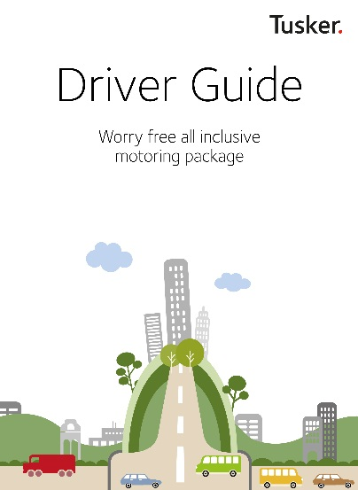
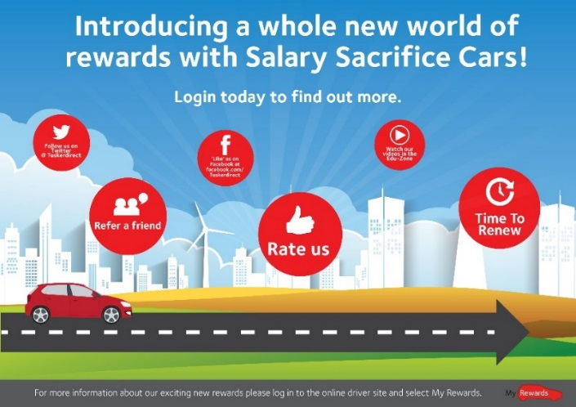




Marketing examples

Slide 31
Any questions?
Contact details
Mark Pennington
Business Development Manager
07824 141 999 www.tuskerdirect.com

