Slide 1


EAUC Scotland Forum Meeting
University of Abertay Case Study
Andy Samuel
Lecturer in Sociology

Slide 2
Abertay: It’s Genesis
Founded as Technical College in 1888
University Title in 1994
Full-time Undergraduates | 3348
Part-Time Undergraduates | 193
Postgraduates | 283
Non-degree Students | 291
Off-Campus students (elsewhere in Scotland, in Europe and in Asia) | 325

Slide 3
Abertay: Academic Structure
School of Arts, Media and Computer Games
  Incorporating the Scottish University Centre for Excellence in Computer Games Education, the School of Arts, Media and Computer Games offers innovative and ground breaking opportunities for students. The university is part of the PlayStation®First Academic Development Programme. This offers students to enhance their skills on the latest PlayStation® hardware.
School of Science, Engineering and Technology
  With full time to part time postgraduate and undergraduate courses, the school offers a wide range of disciplines. Food, Nutrition & Health, Forensic sciences, Energy, Water and Environmental Management and Food and Drink innovation are just a few areas in which the school excel in.
Dundee Business School
  From Business studies to EU Security and Transnational Criminal Justice, the school offers an exciting range of courses for national and international students.
School of Social Health and Sciences
  Four specialised divisions of Mental Health Nursing and Counselling, Psychology, Sociology and Sport and Exercise Sciences enable students to study the specific and universal skills needed to succeed in their future careers.

Slide 4
Abertay: Sustainability
As part of the Universities Strategic Plan, we are committed to:
“promoting a clear understanding of and commitment to sustainable development so that all people can contribute to the overall goal through their individual decision”
Two aspects to this policy:
  Estate Strategy; and,
  Academic Strategy

Slide 5
Teaching and Learning Enhancement Strategy: Objectives
Reforming our curriculum to revolutionise the delivery and design of our programmes which will advance students’ knowledge; enhance students’ preparedness for post-graduation and the world of work; and recognises and facilitates different modes of learner journey.
Incentivising students’ performance through a new integrated approach to all aspects of assessment (formative, summative and recording achievement) with a focus on programme level learning outcomes, joint Honours/ GPA degree classification and implementation of the HEAR for 2014-15 entrants.
Raising the status of teaching in the institution in terms of: leadership, professional recognition, reward and development by developing a holistic, staff centred approach to L and T CPD from 2014-15.

Slide 6
Teaching and Learning Enhancement Strategy: Outcomes
“A distinctive, transformational Abertay student experience supported by high quality learning and teaching.”
“Excellent Abertay Graduates, knowledgeable in their subjects, able to work independently and with others, extending their boundaries through curiosity and creativity.”
“Our teaching staff will feel empowered, valued and confident professionals who employ a range of innovative, efficient and effective learning, teaching and assessment methods all of whom, from 2017, will have achieved appropriate national recognition of their teaching professionalism e.g. through the HEA.”

Slide 7
A Transformational Experience
  “Starting in 2014, we will review the first and second stages of all undergraduate programmes as part of a whole institutional curriculum reform that will also support student transitions into higher education.”
  “The first year will form an important foundation, critically engaging students in university education, offering a combination of breadth and depth of knowledge and experiences that will provide wider inspiration developed further during programmes’ following stages.”
  “From 2015-16, all students at levels 1-3 will be required to choose and undertake a module from a new suite of cross-disciplinary themes with emphases on interdisciplinary, enquiry-based, state of the art technology-enhanced teaching and learning.”
    Electives

Slide 8
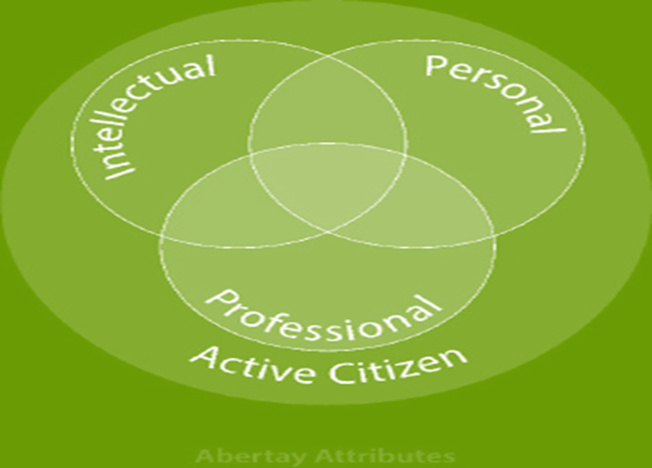
Abertay Attributes
“We will enhance our graduates’ employability and enterprising skills through evolving our Graduate Attributes to provide a framework for student progression throughout their time at the University and inform staff development and strategic planning.”

Slide 9
Geddes: Hand, Herat and Head.
Learning by doing
  Patrick Geddes believed that education was a catalyst for social change and active citizenship. He explored the ways in which people learn most effectively. He developed an educational philosophy which emphasised the combination of 'hand, heart, and head', in that order of priority.
  He believed learning should engage the emotions, and include physical activity. This included 'learning by doing', as well as more traditional methods of learning from books and lectures.
  Geddes also promoted an interdisciplinary approach to learning, highlighting the useful connections and synergies between different subject areas and disciplines.
Abertay Attributes
  Professional related to Hand
  Personal related to Heart
  Intellectual Related to Head
Taken together, our attributes lead to active citizenship;
a ‘civic consciousness’.

Slide 10
Sustainability and Tertiary Ed., in Scotland
A firm advocate of the civic tradition and ‘generalism’ in education, Geddes distinguished himself as an urban planner and social activist, influencing cities as diverse as Edinburgh, Bombay, and Tel Aviv, while he taught extensively in Scotland, including much of East Scotland, including Dundee
As Davies (1961) has argued, the ‘generalism’ of the Scottish tradition acted as a barrier to an individualistic notion of learning and in so doing bridged the gap between the expert few and the lay majority; in other words, it created an association between varies aspects of Scottish society and the Scottish academy per se, one that allowed the academy to remain in touch with the wider community, retaining a strong sense of social responsibility and, in turn, helping create a civic identity.
This is the ‘democratic intellect’; ‘democratic’ because it ensured the social distribution of intellectual knowledge.

