Slide 1
Plastic waste in Life Sciences
Towards a sustainable solution for plastic
Dr Axel Knebel, Staff Biochemist,
MRC-PPU, School of Life Sciences, University of Dundee

Slide 2
A problem of scale
Global Life Sciences plastics usage reported as 5.5m tons per year
= > similar to the total annual plastics use of the UK !
35 - 40 tons annually at the School of Life Sciences, Dundee
=> We produce much more plastic waste at work than at home !
Difficult to get national data ( is this even accounted for ? )
Net impact: are we producing more detriment than benefit?

Slide 3
Why do we use so much plastic in the Life Sciences?
Plastic laboratory consumables are:
sterile,
safe,
avoiding cross contamination,
transparent, compatible with microscopy,
mechanically strong ( e.g. centrifuge vials),
easy to work with,
light,
cheap

Slide 4
Why do we not recycle plastic ?
1) Plastic items in the life sciences may be contaminated
- biologically (DNA, RNA, proteins, micro-organisms)
- chemically (acids, bases, toxic compounds )
2) Laboratories are simply not used to recycling
-> no infrastructure
-> no dedicated space
-> not been considered during the planning phases

Slide 5
Main types of plastic in the life sciences:
Examples

Slide 6
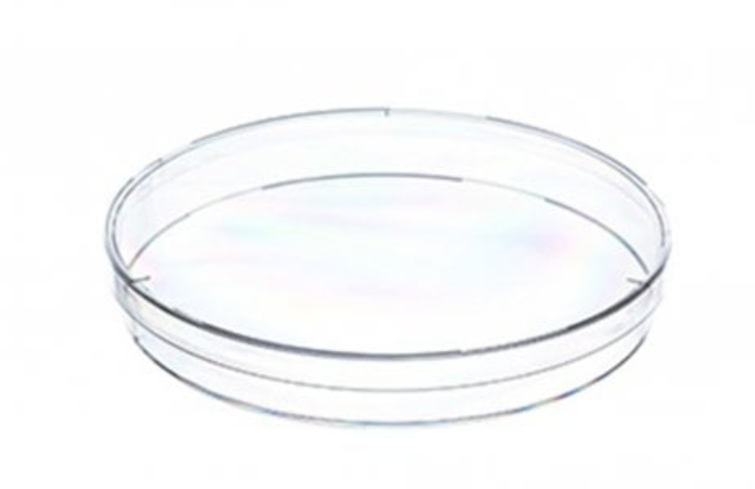
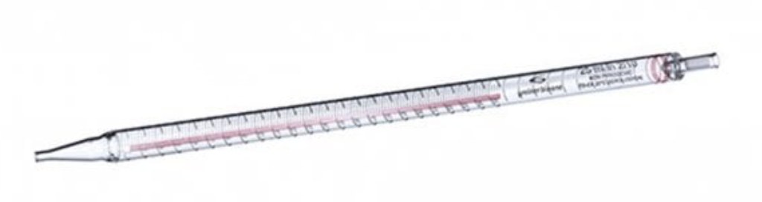
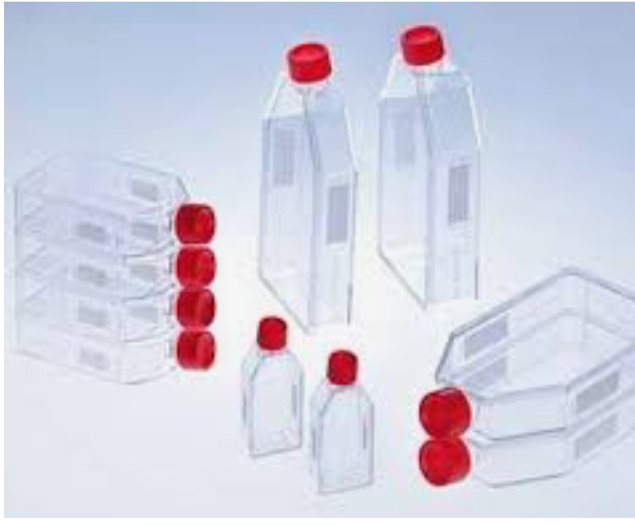
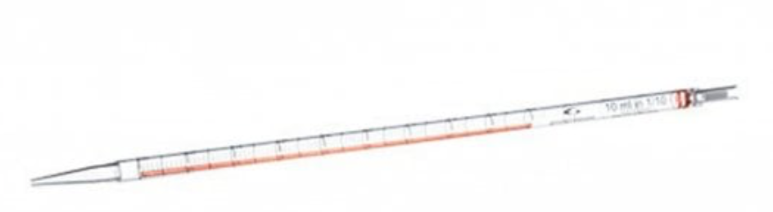
Polystyrene
In cell culture:
Dishes, flasks and pipettes

Slide 7
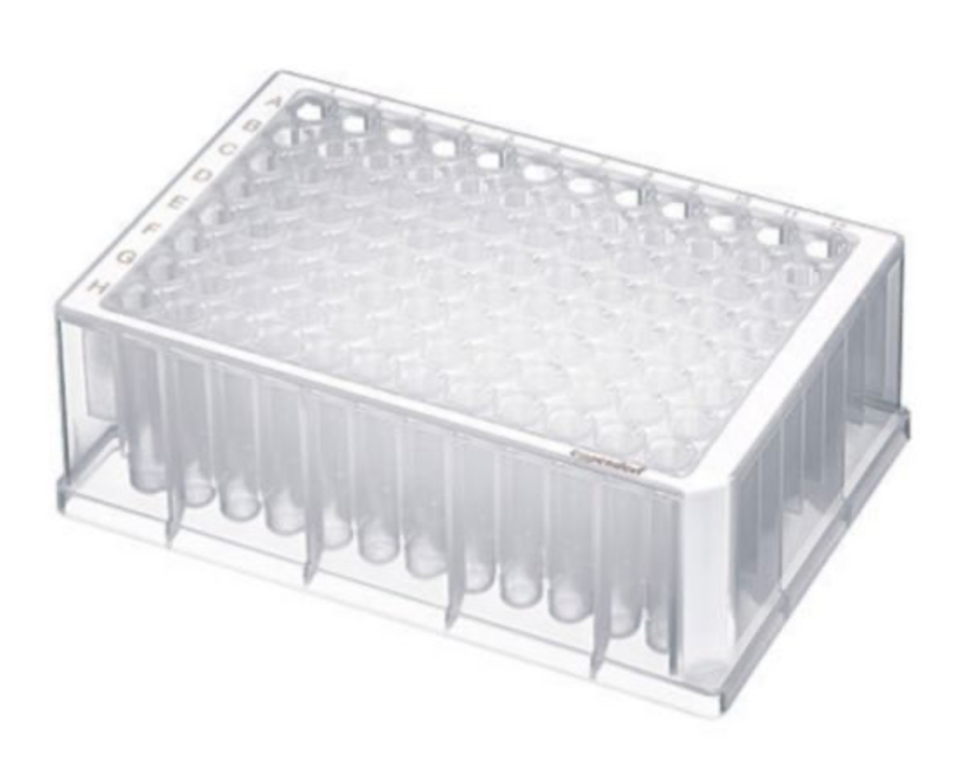
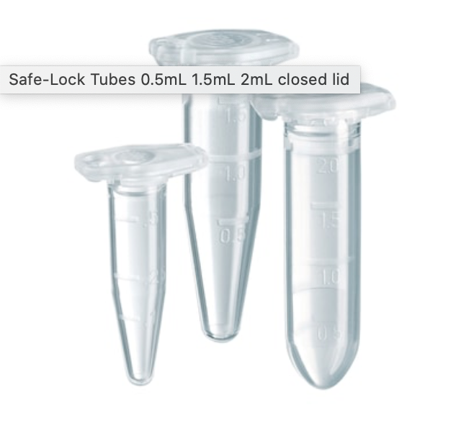
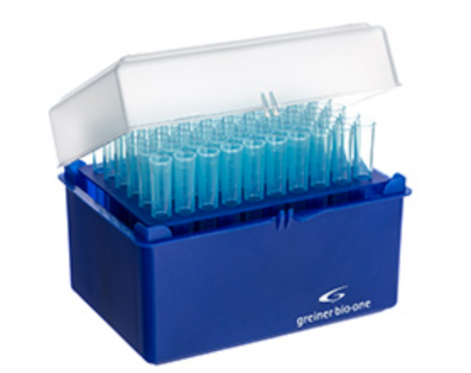
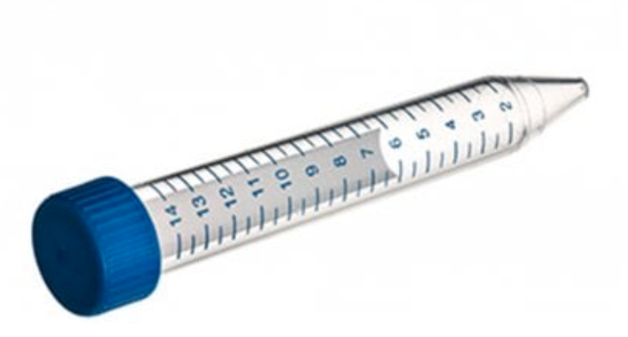
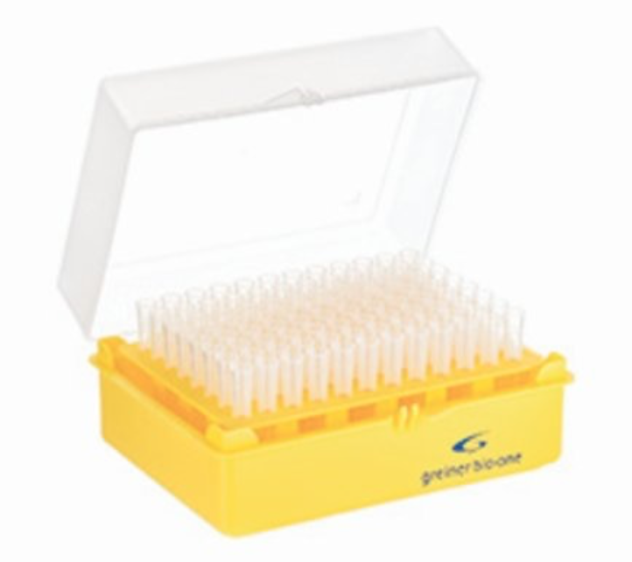
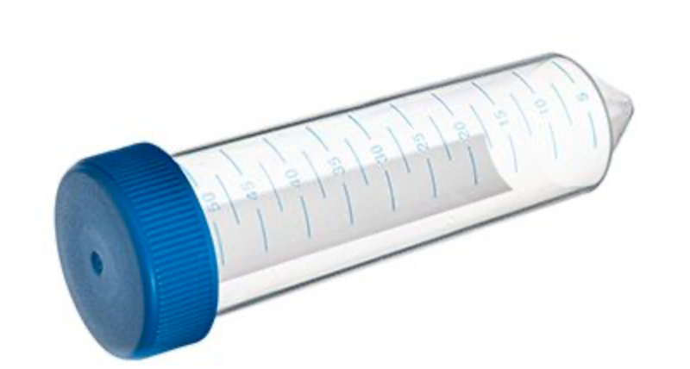
Polypropylene
For molecular biology, biochemistry, cell culture...
Liquid handling: Vials, tubes, pipette tips

Slide 8
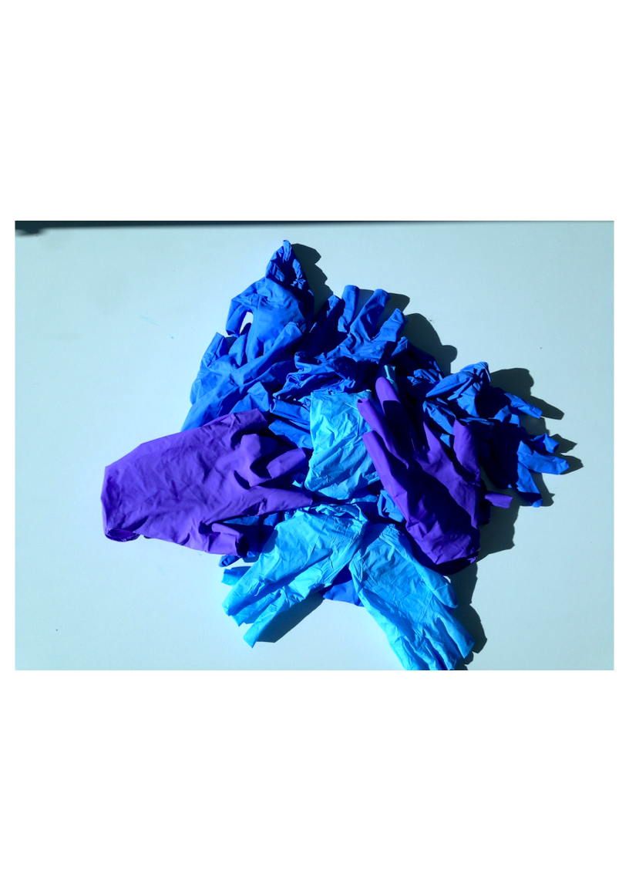
Nitrile gloves
For every type of lab work
Protecting scientist & samples

Slide 9
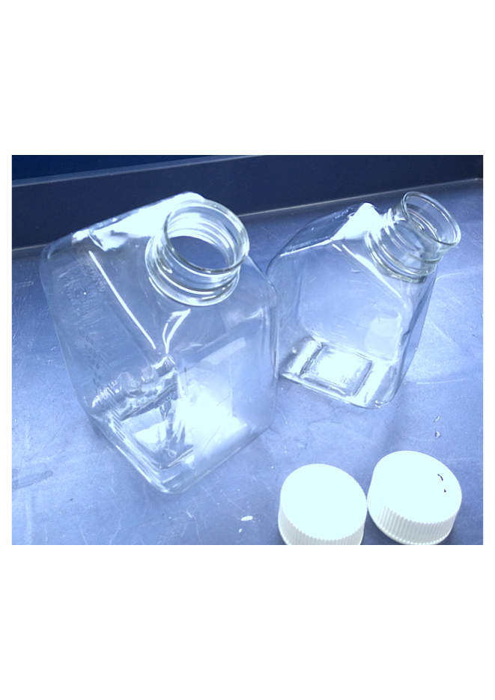
PET (polyethylene terephthalate )
PET flasks are used for cell culture
- PBS
- Media
- Supplements
Used in very large numbers.
These are normally not biologically contaminated !

Slide 10
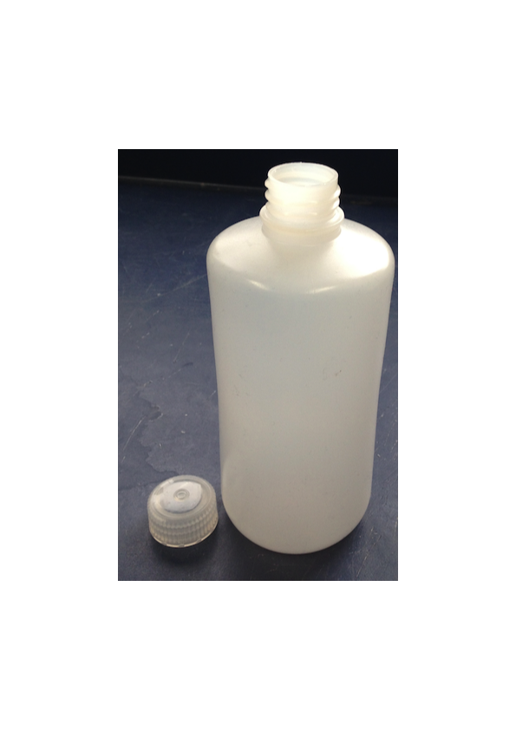
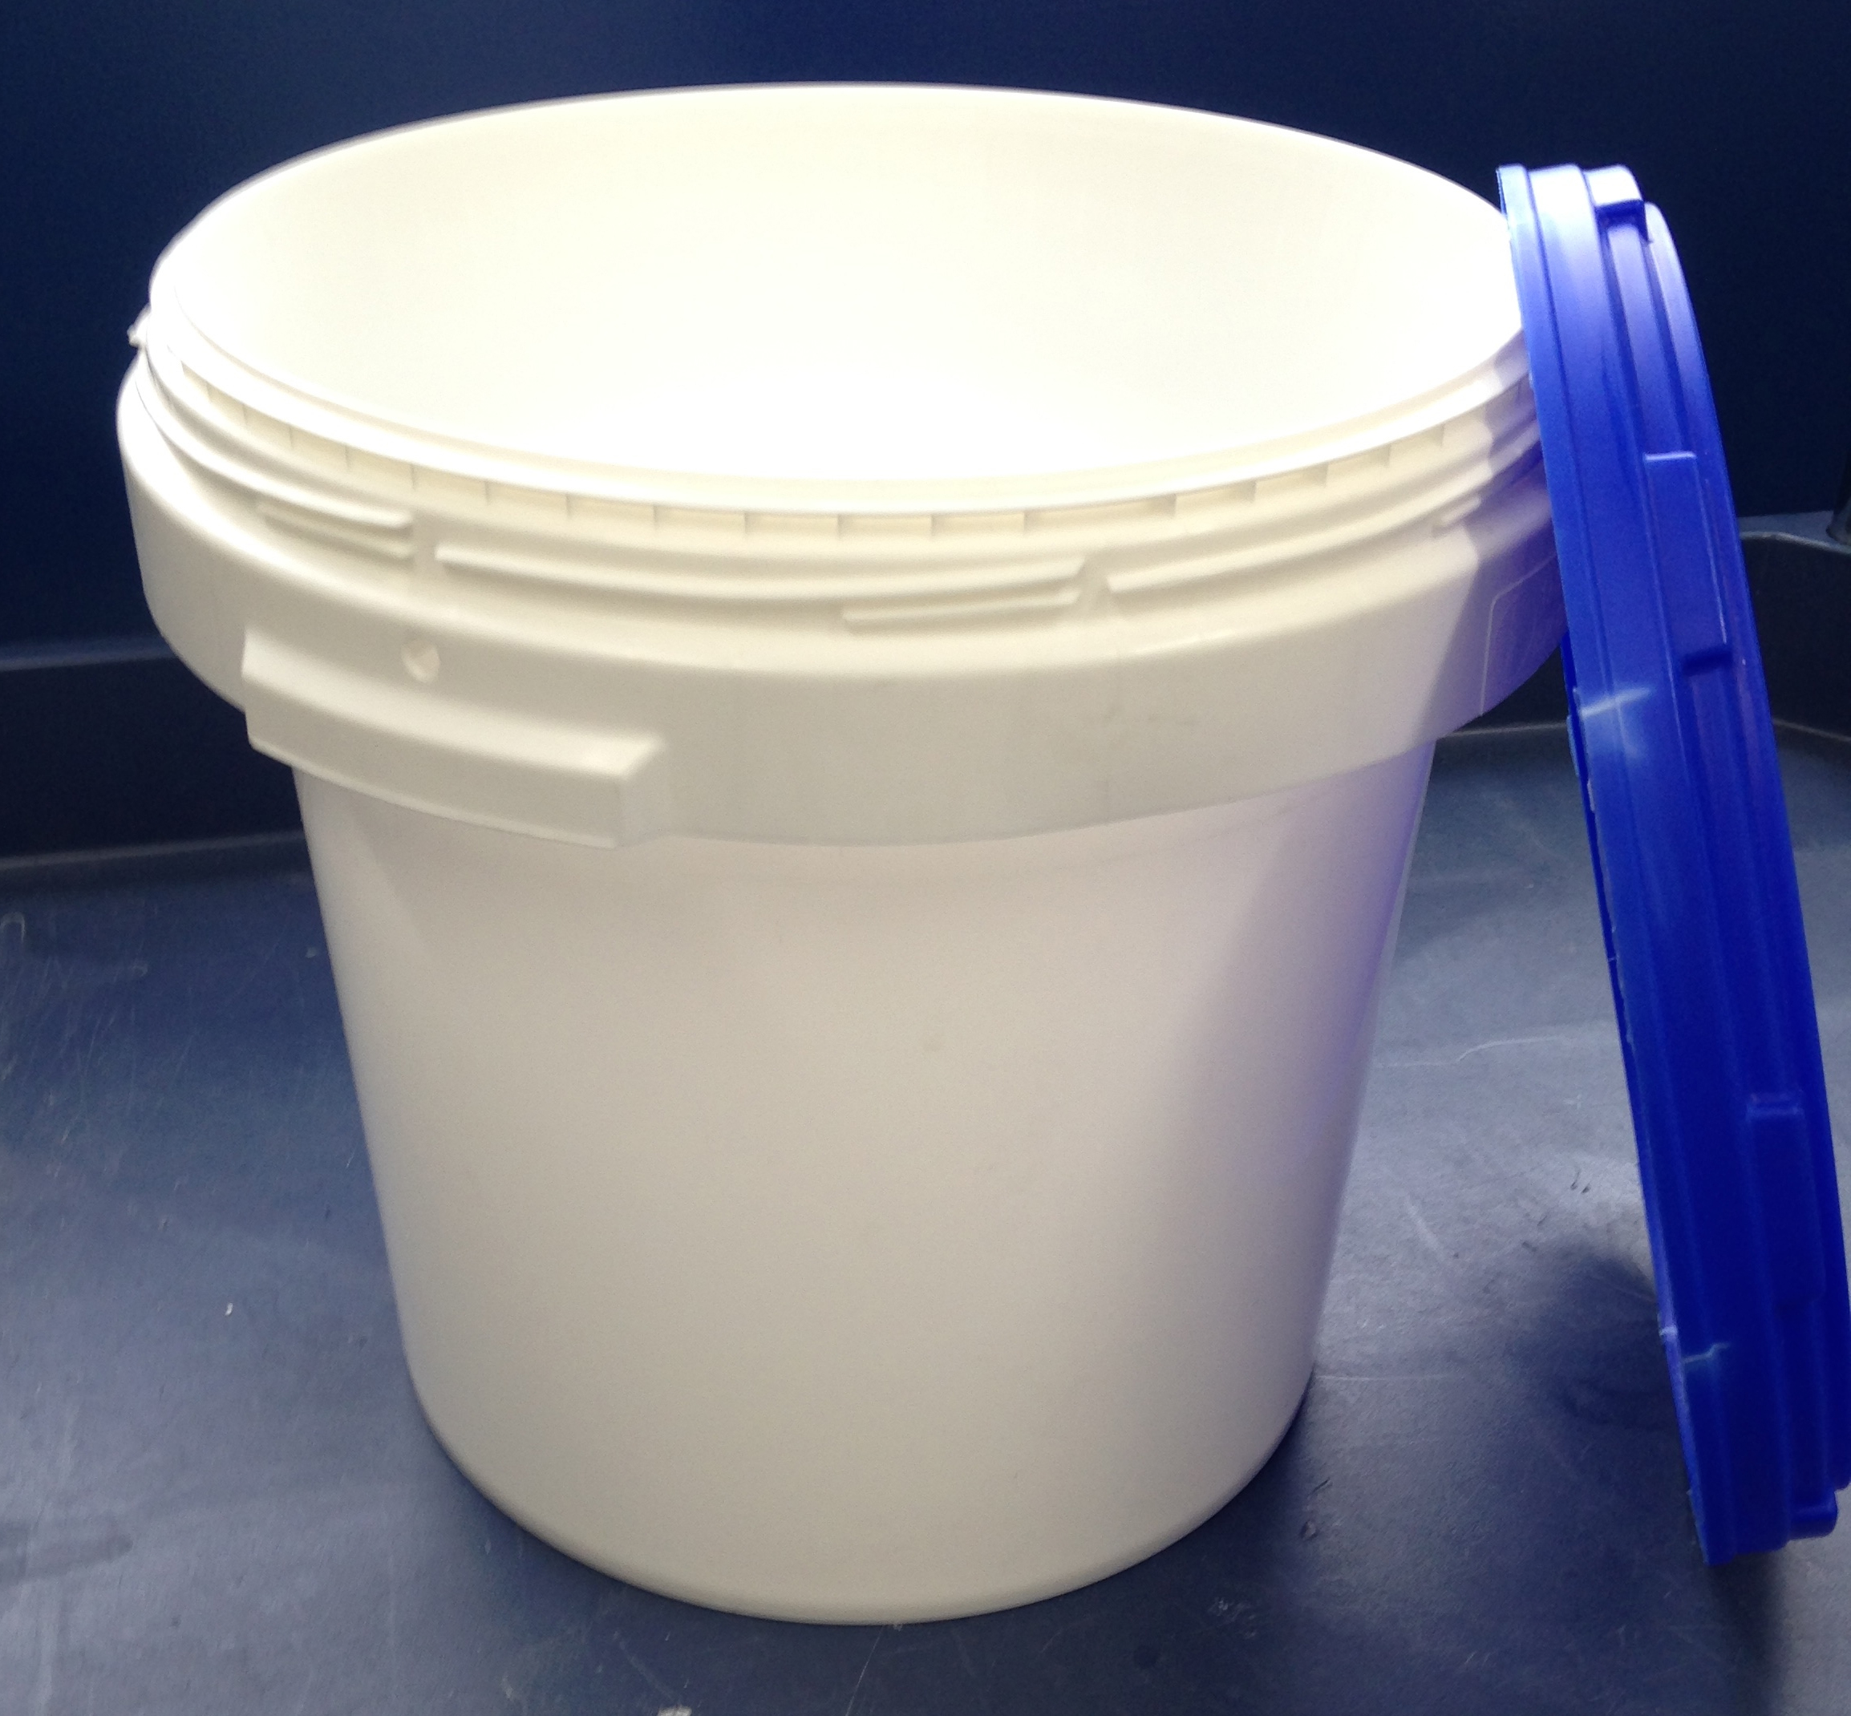
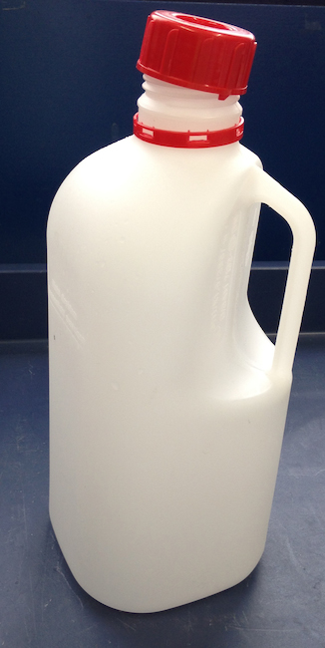
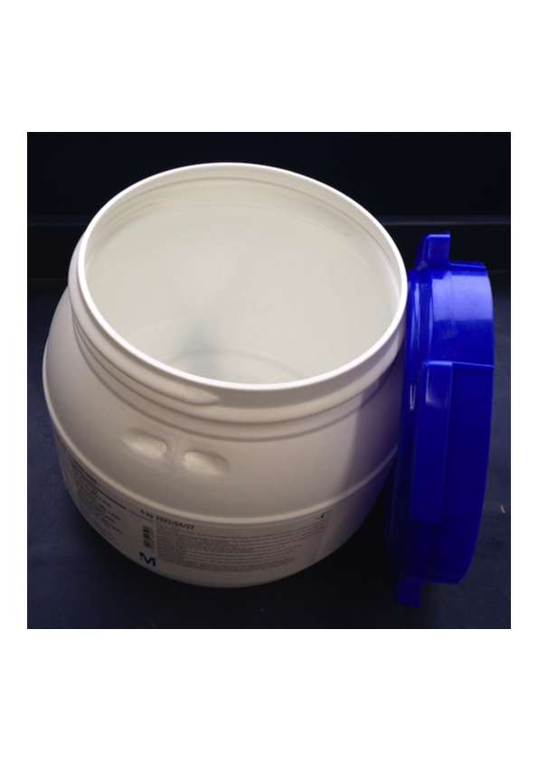
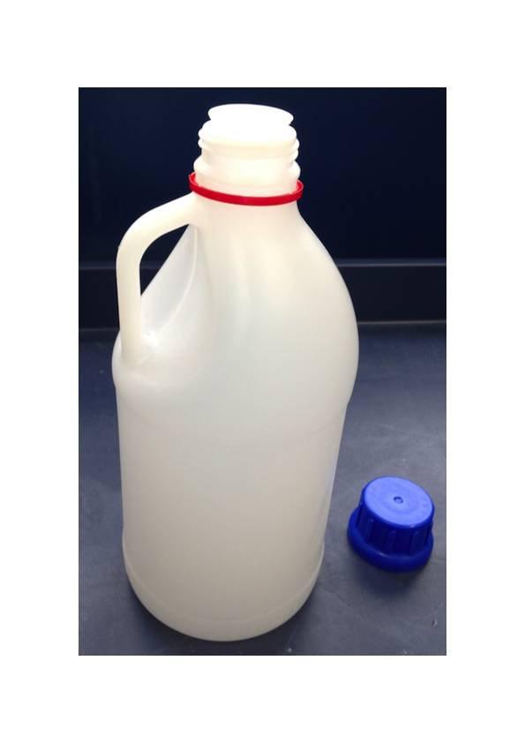
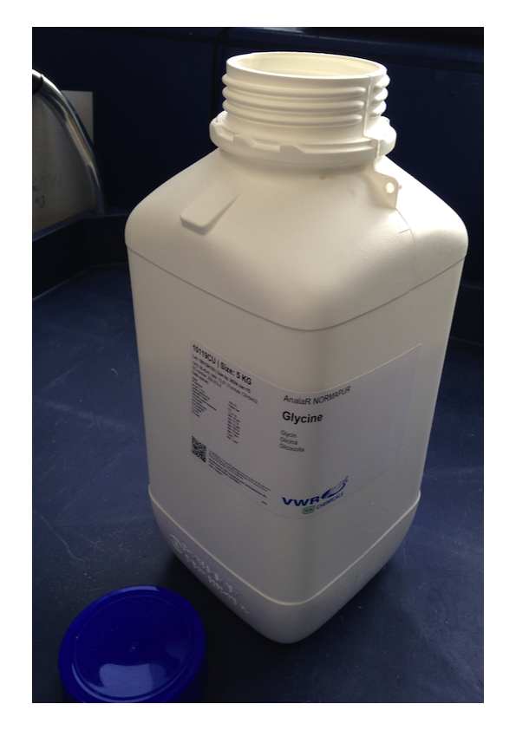
HDPE ( High density polyethylene )

Slide 11
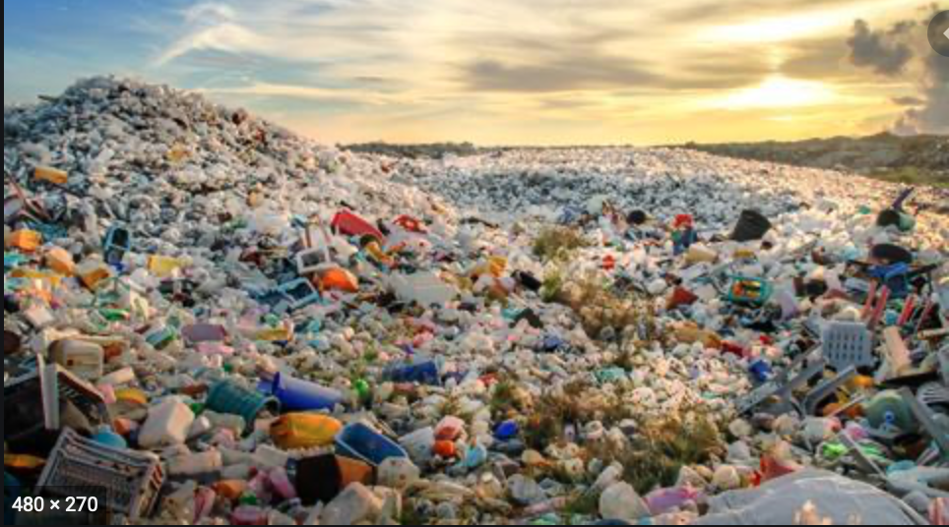
Disposal routes of plastic waste
Until 2018 almost all the plastic waste was sent to landfill
Some of us did guerilla - recycling.
A plastic waste management policy existed.
The policy was hidden away.
The policy was not implemented

Slide 12
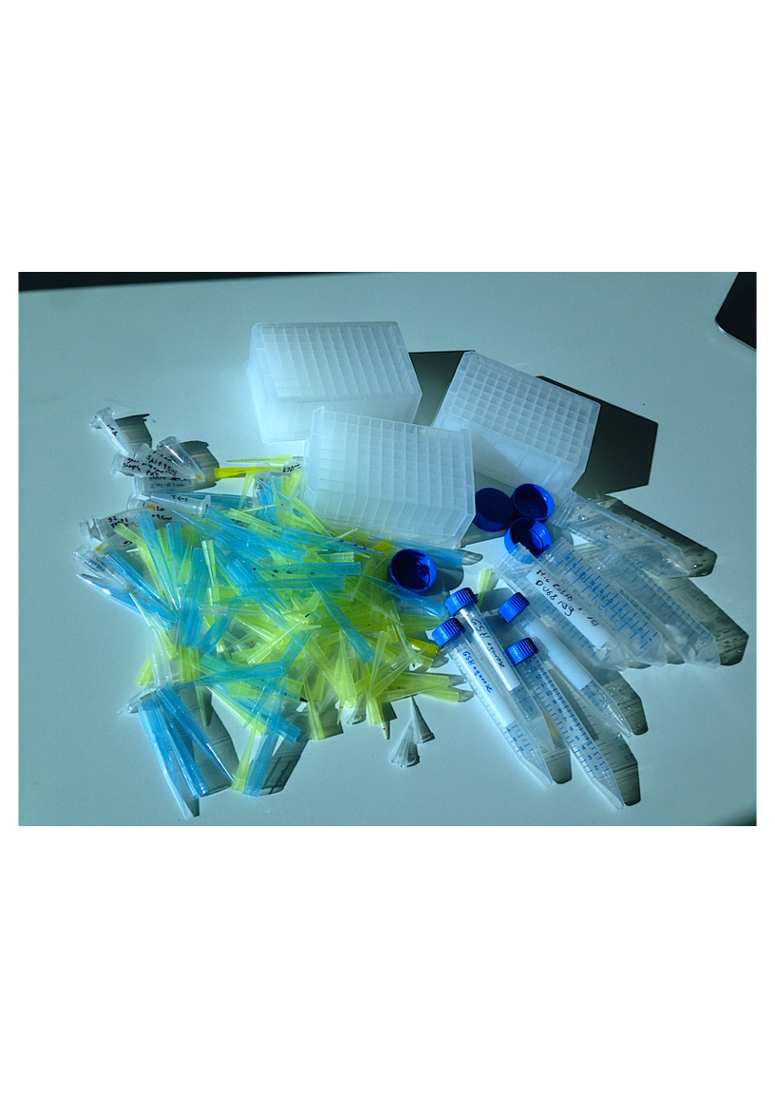
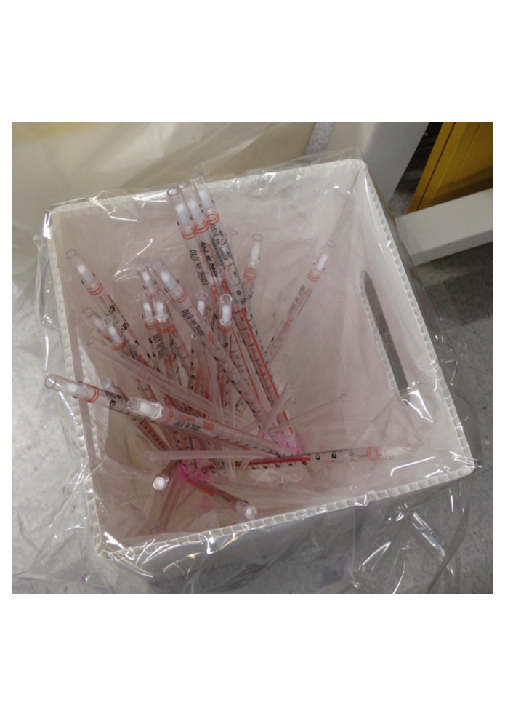
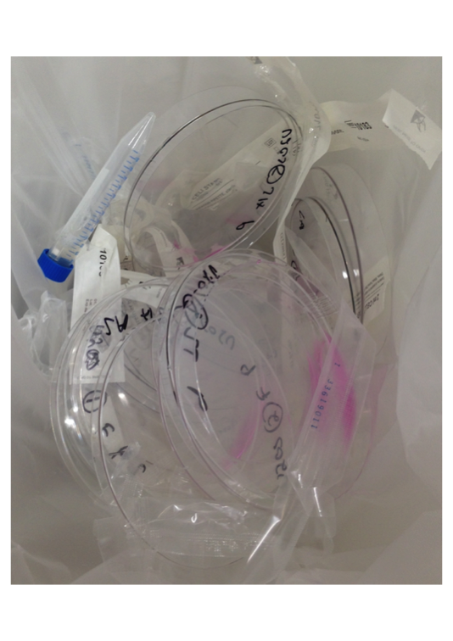
Disposal route: autoclaved and land filled after single use

Slide 13
2018: time for change
Me and others became increasingly frustrated at the situation.
This was seriously undermining my motivation to do research.
After many years of unofficial recycling efforts, I contacted our Dean of Research to highlight the issue.

Slide 14
Setting up a Sustainability Action Team
In early 2019 Letitia Gibson, our Technical Services Manager got involved:
Letitia Gibson and I set up a Sustainability Action Team
Members include:
Michael Hannan ( Stores Manager )
Dr Ryan Webster (Central Technical Services )
Technicians
PhD students
Postdocs
One academic ( Prof Kate Storey )

Slide 15
Sustainability Action Team
The team met once a months to look into sustainability issues:
Plastic waste
Other waste
Energy ( e.g. ULT freezers, computers etc.)
Travel
For the purpose of plastic recycling we needed to identify relevant stakeholders

Slide 16
Stakeholders
Health &
Safety
Policy makers
Purchase
Dept.
Local
Waste collection
Vendors
User = Lab scientist
Waste storage
Producers
Recycling facility
Commercial
Waste collection

Slide 17
Communicate with Stakeholders
Internal: Lab managers, local waste collectors, storage facility
External: Waste contractor, Vendors

Slide 18
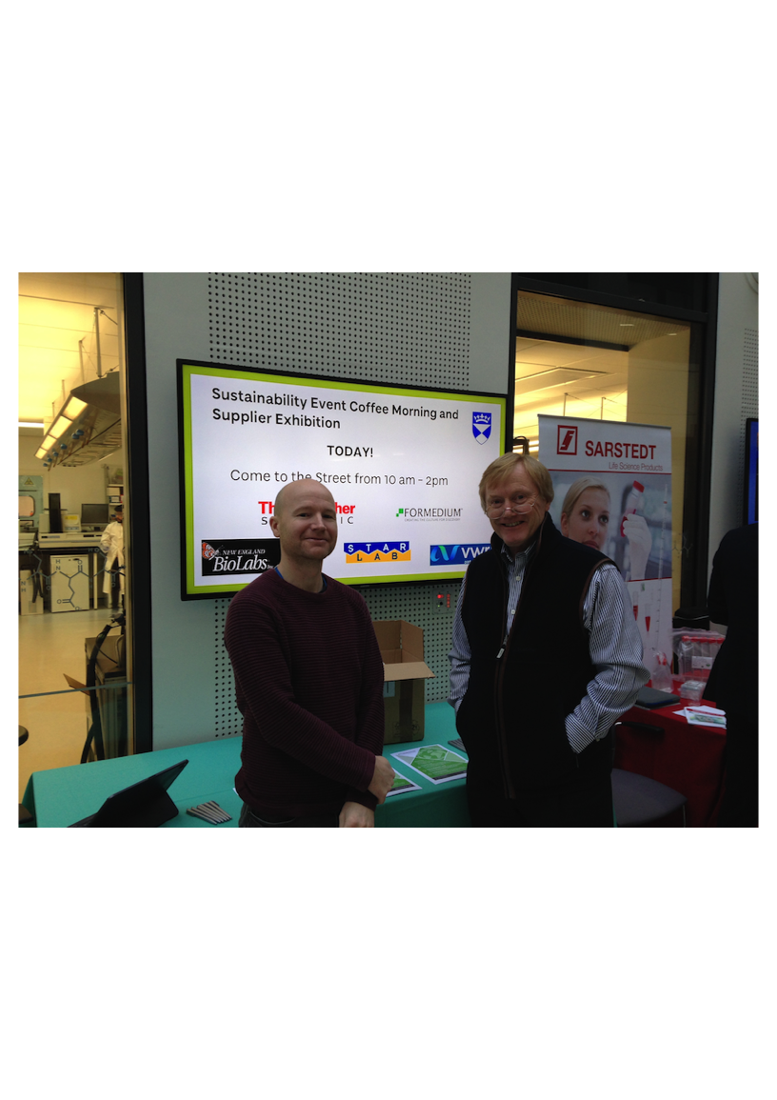
Vendor sustainability exhibition (2019)

Slide 19
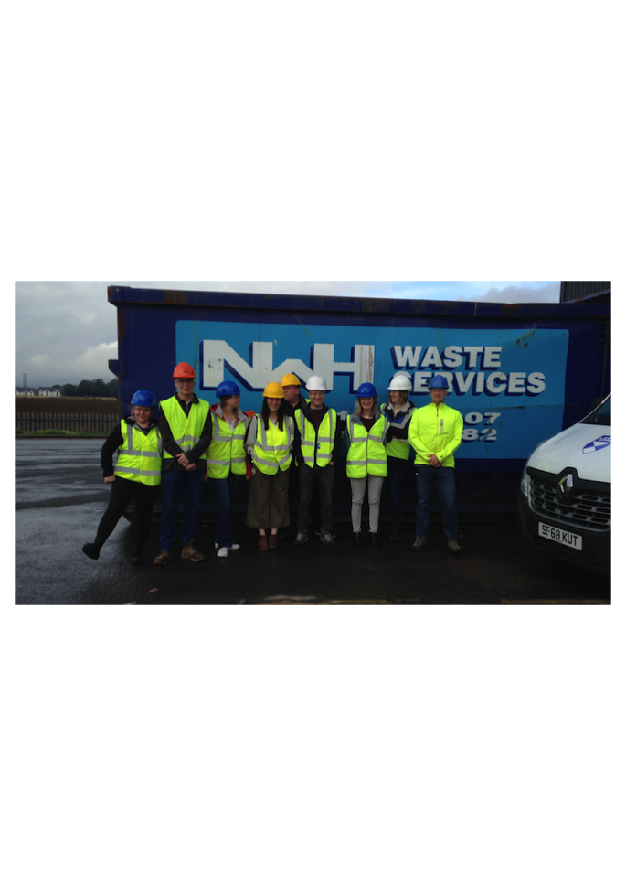
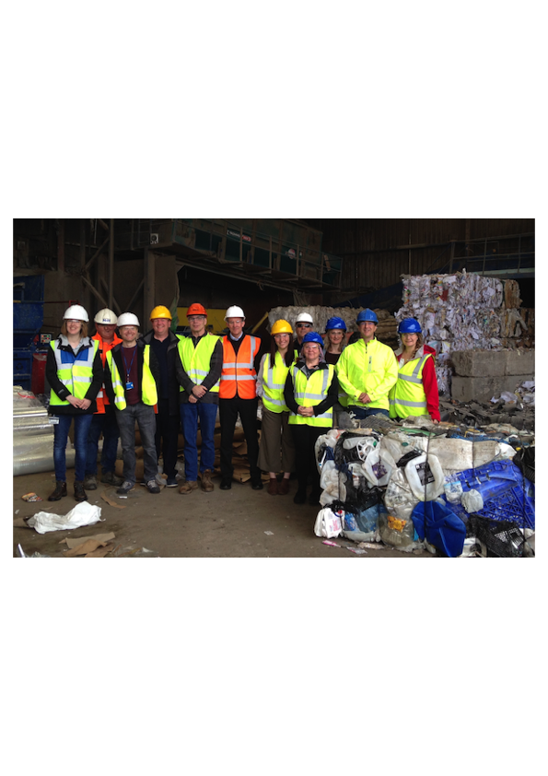
Active communication between stakeholders
In 2019 we organized a visit to our waste collector NWH.
We discussed the details of plastic recycling.
This led to an agreement that we can recycle certain types of laboratory waste

Slide 20
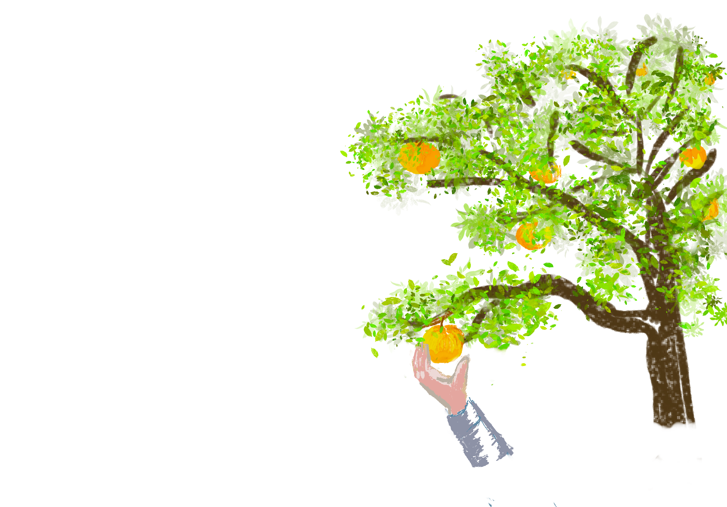
Recycling: guiding principles
Maximum impact with minimum effort
Numerous, large or heavy items are best
Compatible with
laboratory management practices
effective lab work
Health and Safety

Slide 21
We agreed a recycling strategy with NWH
Plastic must be clean, uncontaminated and firm (millable)
HDPE bottles and tubs
PET bottles e.g. cell culture media and PBS
Some packaging
Plates from Novex gels….

Slide 22
Implementation
Letty Gibson oversaw the implementation
Michael Hannan ( Stores ) helped with storage space
Ryan Webster (CTS) agreed to pick up from labs
Lab Managers found space and organized bins
NWH agreed to pick up and recycle
Research staff agreed to collect, clean and dry items.
This is working well now.
We should probably work out how much we recycle.

Slide 23
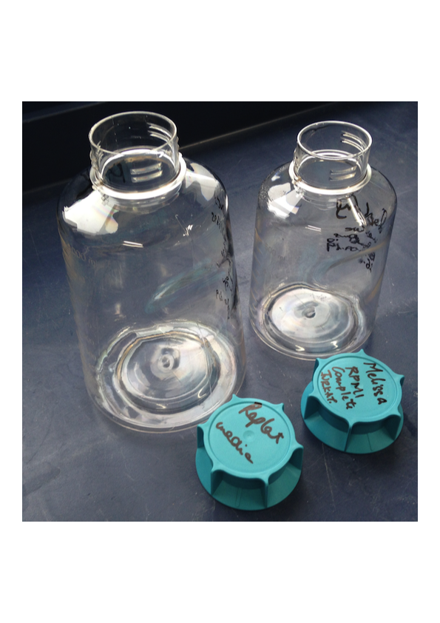
Plastic waste streams
Recycling
Landfill

Slide 24
Currently not suitable for recycling
Why ? => Contaminated or not millable / firm
Such as:
latex and nitrile gloves
Contaminated tubes, vials, reaction vessels
cell culture plastic
pipettes, pipette tips
multi-well plates and blocks
Mixed plastics
Foils and membranes

Slide 25
Can we do better?
Suppliers are working hard to reduce plastic content & complexity
in their products and shipping containers.
We reuse certain items multiple times
( e.g. 96 well deep well blocks and 50ml tubes for protein work )
We may need to review our provider of gloves.
Should we use glass pipettes again?
The polypropylene waste may be suitable for pyrolysis.
Pyrolysis breaks down plastic into char, wax, oil and gas components.

Slide 26
New plastic sorting and pyrolysis facility in Perth
Recycling Technologies are building an
advanced sorting and pyrolysis facility in Perth.
I have contact to John Ferguson, who is involved with this.

Slide 27
So, can we do better ? Let’s discuss !

