Slide 1
Lab Plastic Waste Reduction at University of Edinburgh
Andrew Arnott
Department for Social Responsibility & Sustainability

Slide 2

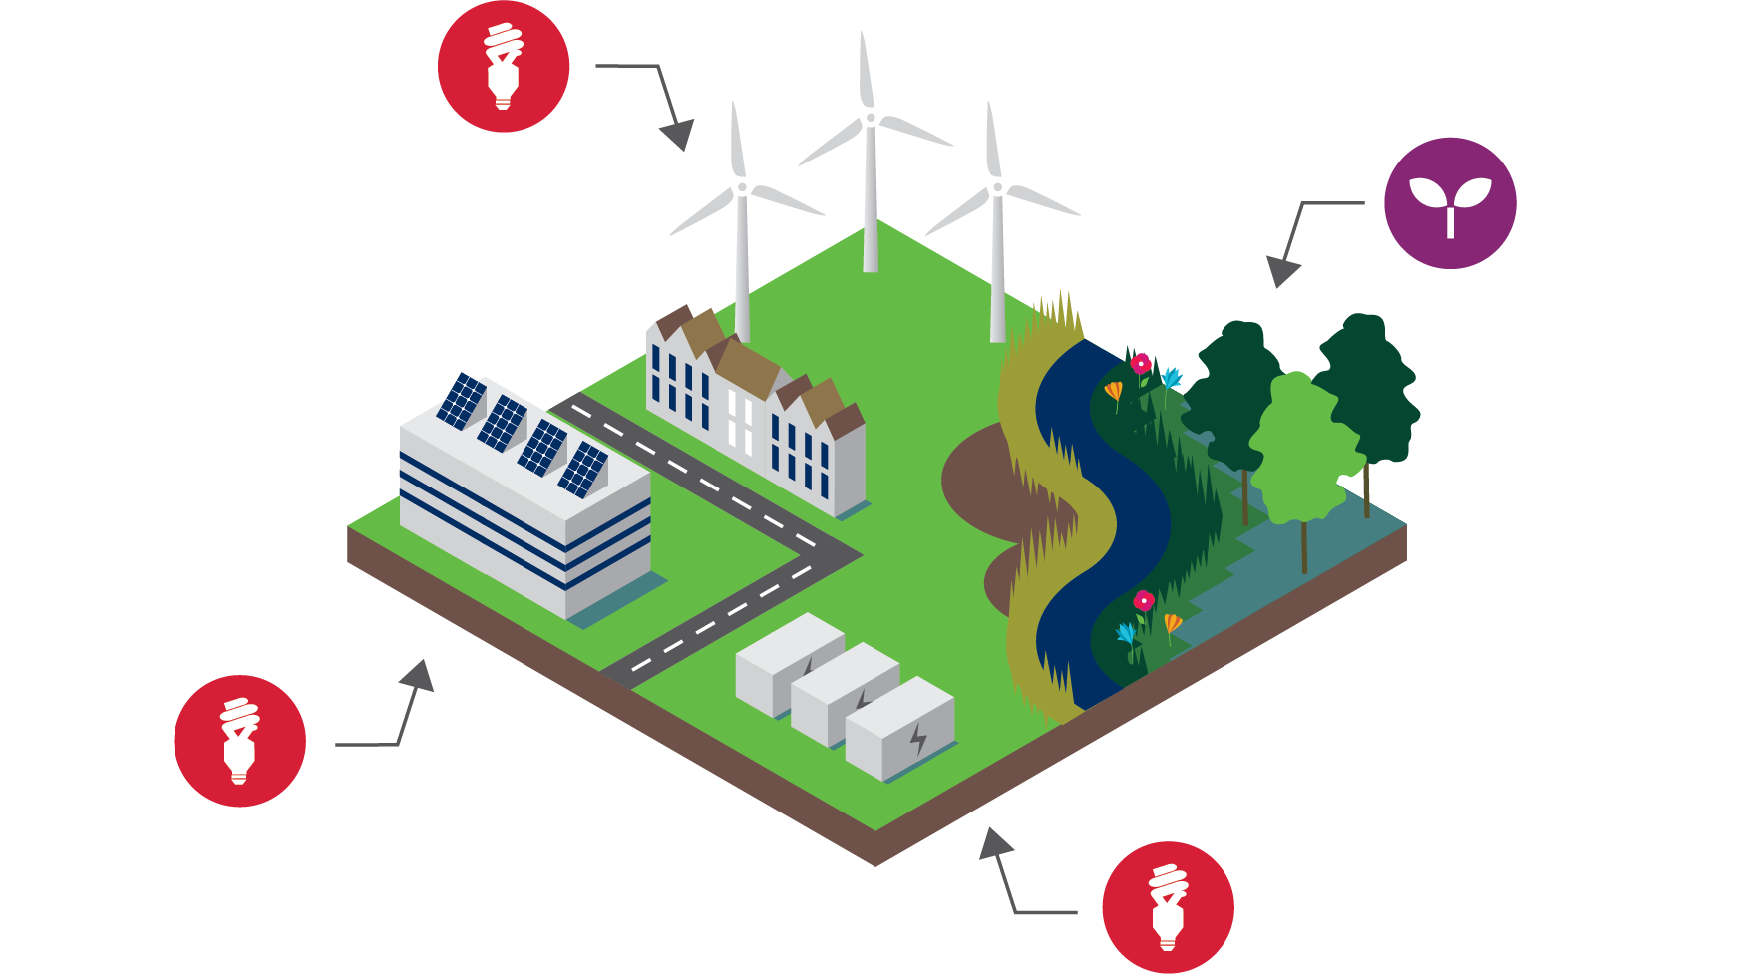
University Targets
Reducing the amount of carbon we produce
Investing in renewable energy and legitimate land—based offsetting (e.g. peatland restoration and forestry)
Eliminating avoidable plastic waste by 2030
Commitment to civic and social responsibility
Notes:
The Uni has a target to net Zero Carbon by 2040
We are going to do this through lowering our carbon footprint
Investing in renewable energy

Slide 3
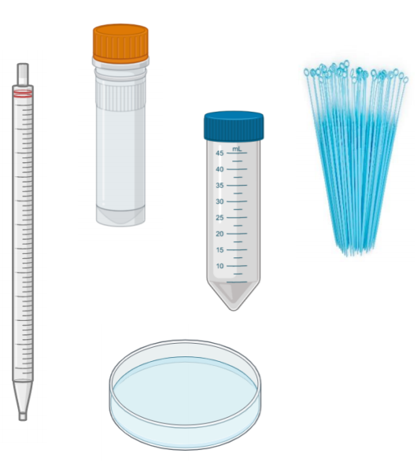
Lab Plastics
Purchasing power!
  Choose suppliers who offer:
    take-back schemes for packaging (and even old products)
    reduced packaging (especially polystyrene)
    recyclable packaging (even for cold chain)
Notes:
Recommendation
Substitute single-use plastic for glass.
Substitutions which have been found effective are:
Falcon tubes
Pipettes
Filter bottles
Petri dishes
Bijou bottles
Test tubes
Replace plastic weigh boats with watch glass
Washing and autoclave capabilities are necessary for sterile procedure. Baskets or boxes recommended for storage and autoclaving.
Substitute single-use plastic for other reusable materials, or reuse current single-use items.
Substitutions which have been found effective are:
Reuse pipettes and pipette tips when aliquoting
Reuse weigh boats
Reuse gloves (decontaminate with ethanol)
Substitute plastic pipette tips with metal ones
Reuse tubes and cuvettes (with a rinse between)
Reuse beaker or tip-collecting container, rather than single-use ‘dispo jars’
Reusable items can have comparable performance to single-use items, even in sterile procedures.
However, if there is concern, consider starting these substitutions in situations where sterile procedure is not necessary, such as bench work.
Reduce packaging plastics.
Suggested ways to reduce are:
Purchase bagged falcons and reuse original racks
Reuse pipette tip boxes and refill with bulk tips
Reduce the number of suppliers, thereby reducing number of deliveries
Only purchase single-packaged stripettes when specifically necessary
Increase laboratory plastic recycling.
NOTE (October 2019) To be updated. – Discussions are ongoing with our waste contractor about this, so this action cannot be taken immediately, but see below for future actions.
Commonly accepted items:
Tip boxes
Non-contaminated media bottles
Non-contaminated solvent bottles
Items accepted in specific locations:
Non-contaminated gloves
Many buildings and schools have collection points for lab items (particularly gloves and tip boxes). Identify the closest or coordinate a new one.
Consider implementing a further recycling scheme:
Non-contaminated gloves
Collection points for packaging take-back schemes from suppliers
Create a decontamination station for recyclable plastics (see note above about discussions with waste contractor)
Ensure your decontamination process is appropriate for the materials you work with.
Example decontamination process: 24-hour soak in a high-level disinfectant followed by a rinse for chemical decontamination.
Plan experiments to reduce single-use plastic.
Some effective examples include:
Calculate minimum tubes/plates required
Prepare bulk master mix to reduce tips and tubes
Use the smallest container possible for aliquots, tubes, bottles
Prepare culture media in bulk
Reduce aliquot numbers and procedure steps
Refill solutions rather than using new bottles
Where possible, share common items to reduce ordering.
Some examples include:
Building-wide sharing programmes for reagents and consumables
Utilise bottle top dispensers.
This can reduce tips, pipettes, and other intermediary containers.
Reduce plastic used for labelling.
Some methods include:
Wipe labels with ethanol and reuse
Cut labels in half
When plastic is unavoidable, use recycled sources rather than virgin plastic.
Some substitutions include:
Reaction tubes
Make changes in teaching labs where sterile procedure is not as high priority.
Suggestions include:
Use multi-media aids, such as having students load a sample then use a video to model the gel
Refill solutions between practicals, rather than using a new bottle
Use bottle top dispensers for measuring
Reuse gloves
Reuse weigh boats
Reuse tubes and cuvettes with a rinse between
Use paper cups, wooden coffee stirs, wooden swabs, wooden toothpicks in place of plastic items
If reliant on bottled ultra-pure water, consider replacing with an in house system

Slide 4
Lab Plastics
https://www.ed.ac.uk/files/atoms/files/lab_plastic_guidance_list_oct_2019_-_for_website.pdf
Specific guidance on lab plastics 2019:
  Re-use your durable plastic items where possible
  Substitute single-use plastic for alternatives (glass, metal, wood durable plastic)
Notes:
Recommendation
Substitute single-use plastic for glass.
Substitutions which have been found effective are:
Falcon tubes
Pipettes
Filter bottles
Petri dishes
Bijou bottles
Test tubes
Replace plastic weigh boats with watch glass
Washing and autoclave capabilities are necessary for sterile procedure. Baskets or boxes recommended for storage and autoclaving.
Substitute single-use plastic for other reusable materials, or reuse current single-use items.
Substitutions which have been found effective are:
Reuse pipettes and pipette tips when aliquoting
Reuse weigh boats
Reuse gloves (decontaminate with ethanol)
Substitute plastic pipette tips with metal ones
Reuse tubes and cuvettes (with a rinse between)
Reuse beaker or tip-collecting container, rather than single-use ‘dispo jars’
Reusable items can have comparable performance to single-use items, even in sterile procedures.
However, if there is concern, consider starting these substitutions in situations where sterile procedure is not necessary, such as bench work.
Reduce packaging plastics.
Suggested ways to reduce are:
Purchase bagged falcons and reuse original racks
Reuse pipette tip boxes and refill with bulk tips
Reduce the number of suppliers, thereby reducing number of deliveries
Only purchase single-packaged stripettes when specifically necessary
Increase laboratory plastic recycling.
NOTE (October 2019) To be updated. – Discussions are ongoing with our waste contractor about this, so this action cannot be taken immediately, but see below for future actions.
Commonly accepted items:
Tip boxes
Non-contaminated media bottles
Non-contaminated solvent bottles
Items accepted in specific locations:
Non-contaminated gloves
Many buildings and schools have collection points for lab items (particularly gloves and tip boxes). Identify the closest or coordinate a new one.
Consider implementing a further recycling scheme:
Non-contaminated gloves
Collection points for packaging take-back schemes from suppliers
Create a decontamination station for recyclable plastics (see note above about discussions with waste contractor)
Ensure your decontamination process is appropriate for the materials you work with.
Example decontamination process: 24-hour soak in a high-level disinfectant followed by a rinse for chemical decontamination.
Plan experiments to reduce single-use plastic.
Some effective examples include:
Calculate minimum tubes/plates required
Prepare bulk master mix to reduce tips and tubes
Use the smallest container possible for aliquots, tubes, bottles
Prepare culture media in bulk
Reduce aliquot numbers and procedure steps
Refill solutions rather than using new bottles
Where possible, share common items to reduce ordering.
Some examples include:
Building-wide sharing programmes for reagents and consumables
Utilise bottle top dispensers.
This can reduce tips, pipettes, and other intermediary containers.
Reduce plastic used for labelling.
Some methods include:
Wipe labels with ethanol and reuse
Cut labels in half
When plastic is unavoidable, use recycled sources rather than virgin plastic.
Some substitutions include:
Reaction tubes
Make changes in teaching labs where sterile procedure is not as high priority.
Suggestions include:
Use multi-media aids, such as having students load a sample then use a video to model the gel
Refill solutions between practicals, rather than using a new bottle
Use bottle top dispensers for measuring
Reuse gloves
Reuse weigh boats
Reuse tubes and cuvettes with a rinse between
Use paper cups, wooden coffee stirs, wooden swabs, wooden toothpicks in place of plastic items
If reliant on bottled ultra-pure water, consider replacing with an in house system

Slide 5
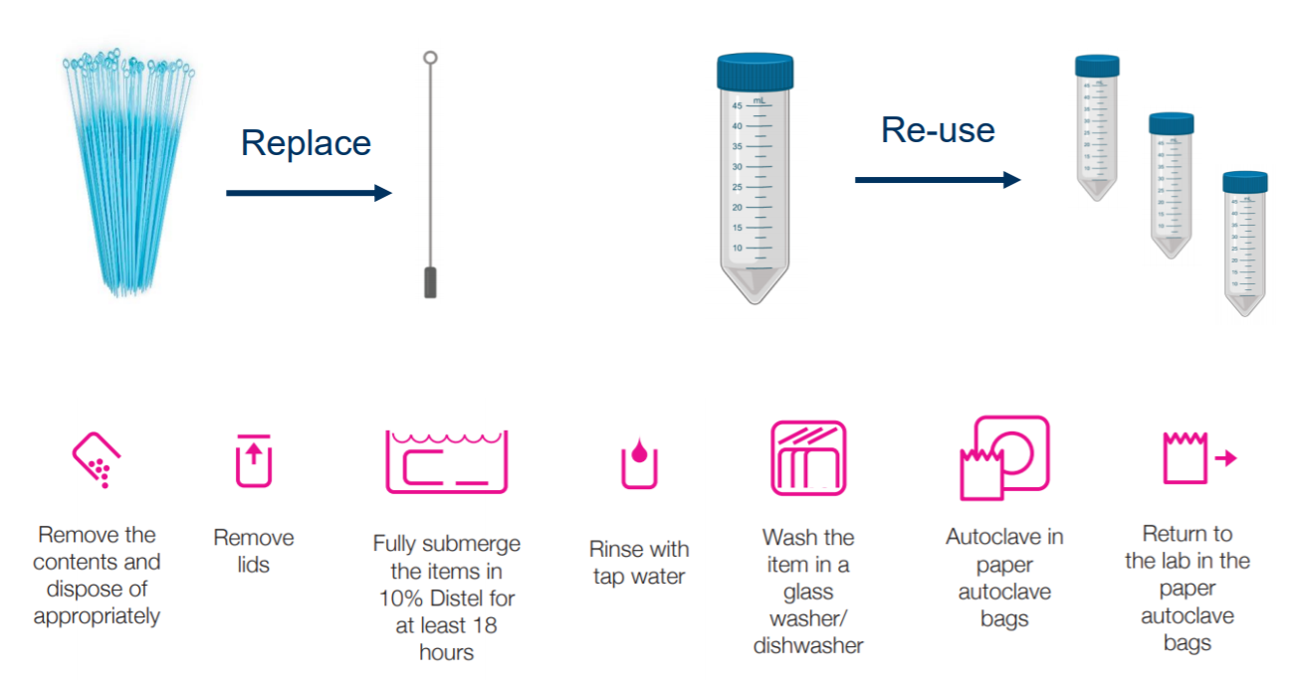
Lab Plastics – Pilot study 1- Roslin
Notes:
Recommendation
Substitute single-use plastic for glass.
Substitutions which have been found effective are:
Falcon tubes
Pipettes
Filter bottles
Petri dishes
Bijou bottles
Test tubes
Replace plastic weigh boats with watch glass
Washing and autoclave capabilities are necessary for sterile procedure. Baskets or boxes recommended for storage and autoclaving.
Substitute single-use plastic for other reusable materials, or reuse current single-use items.
Substitutions which have been found effective are:
Reuse pipettes and pipette tips when aliquoting
Reuse weigh boats
Reuse gloves (decontaminate with ethanol)
Substitute plastic pipette tips with metal ones
Reuse tubes and cuvettes (with a rinse between)
Reuse beaker or tip-collecting container, rather than single-use ‘dispo jars’
Reusable items can have comparable performance to single-use items, even in sterile procedures.
However, if there is concern, consider starting these substitutions in situations where sterile procedure is not necessary, such as bench work.
Reduce packaging plastics.
Suggested ways to reduce are:
Purchase bagged falcons and reuse original racks
Reuse pipette tip boxes and refill with bulk tips
Reduce the number of suppliers, thereby reducing number of deliveries
Only purchase single-packaged stripettes when specifically necessary
Increase laboratory plastic recycling.
NOTE (October 2019) To be updated. – Discussions are ongoing with our waste contractor about this, so this action cannot be taken immediately, but see below for future actions.
Commonly accepted items:
Tip boxes
Non-contaminated media bottles
Non-contaminated solvent bottles
Items accepted in specific locations:
Non-contaminated gloves
Many buildings and schools have collection points for lab items (particularly gloves and tip boxes). Identify the closest or coordinate a new one.
Consider implementing a further recycling scheme:
Non-contaminated gloves
Collection points for packaging take-back schemes from suppliers
Create a decontamination station for recyclable plastics (see note above about discussions with waste contractor)
Ensure your decontamination process is appropriate for the materials you work with.
Example decontamination process: 24-hour soak in a high-level disinfectant followed by a rinse for chemical decontamination.
Plan experiments to reduce single-use plastic.
Some effective examples include:
Calculate minimum tubes/plates required
Prepare bulk master mix to reduce tips and tubes
Use the smallest container possible for aliquots, tubes, bottles
Prepare culture media in bulk
Reduce aliquot numbers and procedure steps
Refill solutions rather than using new bottles
Where possible, share common items to reduce ordering.
Some examples include:
Building-wide sharing programmes for reagents and consumables
Utilise bottle top dispensers.
This can reduce tips, pipettes, and other intermediary containers.
Reduce plastic used for labelling.
Some methods include:
Wipe labels with ethanol and reuse
Cut labels in half
When plastic is unavoidable, use recycled sources rather than virgin plastic.
Some substitutions include:
Reaction tubes
Make changes in teaching labs where sterile procedure is not as high priority.
Suggestions include:
Use multi-media aids, such as having students load a sample then use a video to model the gel
Refill solutions between practicals, rather than using a new bottle
Use bottle top dispensers for measuring
Reuse gloves
Reuse weigh boats
Reuse tubes and cuvettes with a rinse between
Use paper cups, wooden coffee stirs, wooden swabs, wooden toothpicks in place of plastic items
If reliant on bottled ultra-pure water, consider replacing with an in house system

Slide 6
Lab Plastics – Pilot study 1- Roslin
Reused:
  Autoclavable pipette tips (and raised awareness about using these in preference to filter tips)
  Weigh boats
  Plastic stripettes/serological pipettes
    For pipetting common non-sterile solutions (e.g. ethanol, concentrated buffered solutions)
  Cuvettes
  Tip collecting jars
  Plastic petri dishes
    If used in with media only can be reused for agar media with antibiotics
Notes:
Recommendation
Substitute single-use plastic for glass.
Substitutions which have been found effective are:
Falcon tubes
Pipettes
Filter bottles
Petri dishes
Bijou bottles
Test tubes
Replace plastic weigh boats with watch glass
Washing and autoclave capabilities are necessary for sterile procedure. Baskets or boxes recommended for storage and autoclaving.
Substitute single-use plastic for other reusable materials, or reuse current single-use items.
Substitutions which have been found effective are:
Reuse pipettes and pipette tips when aliquoting
Reuse weigh boats
Reuse gloves (decontaminate with ethanol)
Substitute plastic pipette tips with metal ones
Reuse tubes and cuvettes (with a rinse between)
Reuse beaker or tip-collecting container, rather than single-use ‘dispo jars’
Reusable items can have comparable performance to single-use items, even in sterile procedures.
However, if there is concern, consider starting these substitutions in situations where sterile procedure is not necessary, such as bench work.
Reduce packaging plastics.
Suggested ways to reduce are:
Purchase bagged falcons and reuse original racks
Reuse pipette tip boxes and refill with bulk tips
Reduce the number of suppliers, thereby reducing number of deliveries
Only purchase single-packaged stripettes when specifically necessary
Increase laboratory plastic recycling.
NOTE (October 2019) To be updated. – Discussions are ongoing with our waste contractor about this, so this action cannot be taken immediately, but see below for future actions.
Commonly accepted items:
Tip boxes
Non-contaminated media bottles
Non-contaminated solvent bottles
Items accepted in specific locations:
Non-contaminated gloves
Many buildings and schools have collection points for lab items (particularly gloves and tip boxes). Identify the closest or coordinate a new one.
Consider implementing a further recycling scheme:
Non-contaminated gloves
Collection points for packaging take-back schemes from suppliers
Create a decontamination station for recyclable plastics (see note above about discussions with waste contractor)
Ensure your decontamination process is appropriate for the materials you work with.
Example decontamination process: 24-hour soak in a high-level disinfectant followed by a rinse for chemical decontamination.
Plan experiments to reduce single-use plastic.
Some effective examples include:
Calculate minimum tubes/plates required
Prepare bulk master mix to reduce tips and tubes
Use the smallest container possible for aliquots, tubes, bottles
Prepare culture media in bulk
Reduce aliquot numbers and procedure steps
Refill solutions rather than using new bottles
Where possible, share common items to reduce ordering.
Some examples include:
Building-wide sharing programmes for reagents and consumables
Utilise bottle top dispensers.
This can reduce tips, pipettes, and other intermediary containers.
Reduce plastic used for labelling.
Some methods include:
Wipe labels with ethanol and reuse
Cut labels in half
When plastic is unavoidable, use recycled sources rather than virgin plastic.
Some substitutions include:
Reaction tubes
Make changes in teaching labs where sterile procedure is not as high priority.
Suggestions include:
Use multi-media aids, such as having students load a sample then use a video to model the gel
Refill solutions between practicals, rather than using a new bottle
Use bottle top dispensers for measuring
Reuse gloves
Reuse weigh boats
Reuse tubes and cuvettes with a rinse between
Use paper cups, wooden coffee stirs, wooden swabs, wooden toothpicks in place of plastic items
If reliant on bottled ultra-pure water, consider replacing with an in house system

Slide 7
Lab Plastics – Pilot study 1- Roslin
Replaced:
  PS (non autoclavable) universal tubes with 15 and 50ml autoclavable falcon tubes (Greiner Bio-one) where autoclave sterility levels were acceptable
    Not used when non-pyrogenic conditions are required - i.e. tissue culture
  Plastic inoculation loops with metal inoculation loops (flamed and cooled between uses)
  Plastic stirrers with wooden stirrers (autoclavable) for bacterial colony picking from agar plates
Notes:
Recommendation
Substitute single-use plastic for glass.
Substitutions which have been found effective are:
Falcon tubes
Pipettes
Filter bottles
Petri dishes
Bijou bottles
Test tubes
Replace plastic weigh boats with watch glass
Washing and autoclave capabilities are necessary for sterile procedure. Baskets or boxes recommended for storage and autoclaving.
Substitute single-use plastic for other reusable materials, or reuse current single-use items.
Substitutions which have been found effective are:
Reuse pipettes and pipette tips when aliquoting
Reuse weigh boats
Reuse gloves (decontaminate with ethanol)
Substitute plastic pipette tips with metal ones
Reuse tubes and cuvettes (with a rinse between)
Reuse beaker or tip-collecting container, rather than single-use ‘dispo jars’
Reusable items can have comparable performance to single-use items, even in sterile procedures.
However, if there is concern, consider starting these substitutions in situations where sterile procedure is not necessary, such as bench work.
Reduce packaging plastics.
Suggested ways to reduce are:
Purchase bagged falcons and reuse original racks
Reuse pipette tip boxes and refill with bulk tips
Reduce the number of suppliers, thereby reducing number of deliveries
Only purchase single-packaged stripettes when specifically necessary
Increase laboratory plastic recycling.
NOTE (October 2019) To be updated. – Discussions are ongoing with our waste contractor about this, so this action cannot be taken immediately, but see below for future actions.
Commonly accepted items:
Tip boxes
Non-contaminated media bottles
Non-contaminated solvent bottles
Items accepted in specific locations:
Non-contaminated gloves
Many buildings and schools have collection points for lab items (particularly gloves and tip boxes). Identify the closest or coordinate a new one.
Consider implementing a further recycling scheme:
Non-contaminated gloves
Collection points for packaging take-back schemes from suppliers
Create a decontamination station for recyclable plastics (see note above about discussions with waste contractor)
Ensure your decontamination process is appropriate for the materials you work with.
Example decontamination process: 24-hour soak in a high-level disinfectant followed by a rinse for chemical decontamination.
Plan experiments to reduce single-use plastic.
Some effective examples include:
Calculate minimum tubes/plates required
Prepare bulk master mix to reduce tips and tubes
Use the smallest container possible for aliquots, tubes, bottles
Prepare culture media in bulk
Reduce aliquot numbers and procedure steps
Refill solutions rather than using new bottles
Where possible, share common items to reduce ordering.
Some examples include:
Building-wide sharing programmes for reagents and consumables
Utilise bottle top dispensers.
This can reduce tips, pipettes, and other intermediary containers.
Reduce plastic used for labelling.
Some methods include:
Wipe labels with ethanol and reuse
Cut labels in half
When plastic is unavoidable, use recycled sources rather than virgin plastic.
Some substitutions include:
Reaction tubes
Make changes in teaching labs where sterile procedure is not as high priority.
Suggestions include:
Use multi-media aids, such as having students load a sample then use a video to model the gel
Refill solutions between practicals, rather than using a new bottle
Use bottle top dispensers for measuring
Reuse gloves
Reuse weigh boats
Reuse tubes and cuvettes with a rinse between
Use paper cups, wooden coffee stirs, wooden swabs, wooden toothpicks in place of plastic items
If reliant on bottled ultra-pure water, consider replacing with an in house system

Slide 8
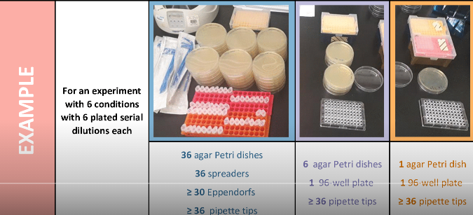
Lab Plastics – Pilot study 1- Roslin
Changed practices:
  New method for colony unit counts
    Drop or track instead of spread
Notes:
Recommendation
Substitute single-use plastic for glass.
Substitutions which have been found effective are:
Falcon tubes
Pipettes
Filter bottles
Petri dishes
Bijou bottles
Test tubes
Replace plastic weigh boats with watch glass
Washing and autoclave capabilities are necessary for sterile procedure. Baskets or boxes recommended for storage and autoclaving.
Substitute single-use plastic for other reusable materials, or reuse current single-use items.
Substitutions which have been found effective are:
Reuse pipettes and pipette tips when aliquoting
Reuse weigh boats
Reuse gloves (decontaminate with ethanol)
Substitute plastic pipette tips with metal ones
Reuse tubes and cuvettes (with a rinse between)
Reuse beaker or tip-collecting container, rather than single-use ‘dispo jars’
Reusable items can have comparable performance to single-use items, even in sterile procedures.
However, if there is concern, consider starting these substitutions in situations where sterile procedure is not necessary, such as bench work.
Reduce packaging plastics.
Suggested ways to reduce are:
Purchase bagged falcons and reuse original racks
Reuse pipette tip boxes and refill with bulk tips
Reduce the number of suppliers, thereby reducing number of deliveries
Only purchase single-packaged stripettes when specifically necessary
Increase laboratory plastic recycling.
NOTE (October 2019) To be updated. – Discussions are ongoing with our waste contractor about this, so this action cannot be taken immediately, but see below for future actions.
Commonly accepted items:
Tip boxes
Non-contaminated media bottles
Non-contaminated solvent bottles
Items accepted in specific locations:
Non-contaminated gloves
Many buildings and schools have collection points for lab items (particularly gloves and tip boxes). Identify the closest or coordinate a new one.
Consider implementing a further recycling scheme:
Non-contaminated gloves
Collection points for packaging take-back schemes from suppliers
Create a decontamination station for recyclable plastics (see note above about discussions with waste contractor)
Ensure your decontamination process is appropriate for the materials you work with.
Example decontamination process: 24-hour soak in a high-level disinfectant followed by a rinse for chemical decontamination.
Plan experiments to reduce single-use plastic.
Some effective examples include:
Calculate minimum tubes/plates required
Prepare bulk master mix to reduce tips and tubes
Use the smallest container possible for aliquots, tubes, bottles
Prepare culture media in bulk
Reduce aliquot numbers and procedure steps
Refill solutions rather than using new bottles
Where possible, share common items to reduce ordering.
Some examples include:
Building-wide sharing programmes for reagents and consumables
Utilise bottle top dispensers.
This can reduce tips, pipettes, and other intermediary containers.
Reduce plastic used for labelling.
Some methods include:
Wipe labels with ethanol and reuse
Cut labels in half
When plastic is unavoidable, use recycled sources rather than virgin plastic.
Some substitutions include:
Reaction tubes
Make changes in teaching labs where sterile procedure is not as high priority.
Suggestions include:
Use multi-media aids, such as having students load a sample then use a video to model the gel
Refill solutions between practicals, rather than using a new bottle
Use bottle top dispensers for measuring
Reuse gloves
Reuse weigh boats
Reuse tubes and cuvettes with a rinse between
Use paper cups, wooden coffee stirs, wooden swabs, wooden toothpicks in place of plastic items
If reliant on bottled ultra-pure water, consider replacing with an in house system

Slide 9
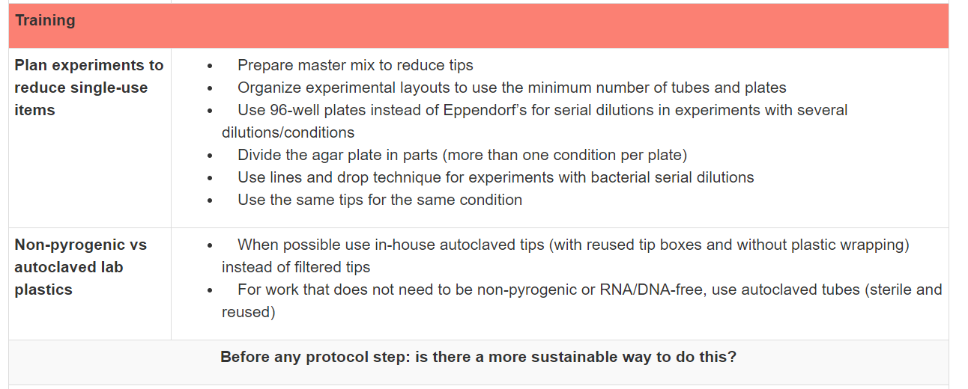
Lab Plastics – Pilot study 1- Roslin
Changed practices
Notes:
Recommendation
Substitute single-use plastic for glass.
Substitutions which have been found effective are:
Falcon tubes
Pipettes
Filter bottles
Petri dishes
Bijou bottles
Test tubes
Replace plastic weigh boats with watch glass
Washing and autoclave capabilities are necessary for sterile procedure. Baskets or boxes recommended for storage and autoclaving.
Substitute single-use plastic for other reusable materials, or reuse current single-use items.
Substitutions which have been found effective are:
Reuse pipettes and pipette tips when aliquoting
Reuse weigh boats
Reuse gloves (decontaminate with ethanol)
Substitute plastic pipette tips with metal ones
Reuse tubes and cuvettes (with a rinse between)
Reuse beaker or tip-collecting container, rather than single-use ‘dispo jars’
Reusable items can have comparable performance to single-use items, even in sterile procedures.
However, if there is concern, consider starting these substitutions in situations where sterile procedure is not necessary, such as bench work.
Reduce packaging plastics.
Suggested ways to reduce are:
Purchase bagged falcons and reuse original racks
Reuse pipette tip boxes and refill with bulk tips
Reduce the number of suppliers, thereby reducing number of deliveries
Only purchase single-packaged stripettes when specifically necessary
Increase laboratory plastic recycling.
NOTE (October 2019) To be updated. – Discussions are ongoing with our waste contractor about this, so this action cannot be taken immediately, but see below for future actions.
Commonly accepted items:
Tip boxes
Non-contaminated media bottles
Non-contaminated solvent bottles
Items accepted in specific locations:
Non-contaminated gloves
Many buildings and schools have collection points for lab items (particularly gloves and tip boxes). Identify the closest or coordinate a new one.
Consider implementing a further recycling scheme:
Non-contaminated gloves
Collection points for packaging take-back schemes from suppliers
Create a decontamination station for recyclable plastics (see note above about discussions with waste contractor)
Ensure your decontamination process is appropriate for the materials you work with.
Example decontamination process: 24-hour soak in a high-level disinfectant followed by a rinse for chemical decontamination.
Plan experiments to reduce single-use plastic.
Some effective examples include:
Calculate minimum tubes/plates required
Prepare bulk master mix to reduce tips and tubes
Use the smallest container possible for aliquots, tubes, bottles
Prepare culture media in bulk
Reduce aliquot numbers and procedure steps
Refill solutions rather than using new bottles
Where possible, share common items to reduce ordering.
Some examples include:
Building-wide sharing programmes for reagents and consumables
Utilise bottle top dispensers.
This can reduce tips, pipettes, and other intermediary containers.
Reduce plastic used for labelling.
Some methods include:
Wipe labels with ethanol and reuse
Cut labels in half
When plastic is unavoidable, use recycled sources rather than virgin plastic.
Some substitutions include:
Reaction tubes
Make changes in teaching labs where sterile procedure is not as high priority.
Suggestions include:
Use multi-media aids, such as having students load a sample then use a video to model the gel
Refill solutions between practicals, rather than using a new bottle
Use bottle top dispensers for measuring
Reuse gloves
Reuse weigh boats
Reuse tubes and cuvettes with a rinse between
Use paper cups, wooden coffee stirs, wooden swabs, wooden toothpicks in place of plastic items
If reliant on bottled ultra-pure water, consider replacing with an in house system

Slide 10
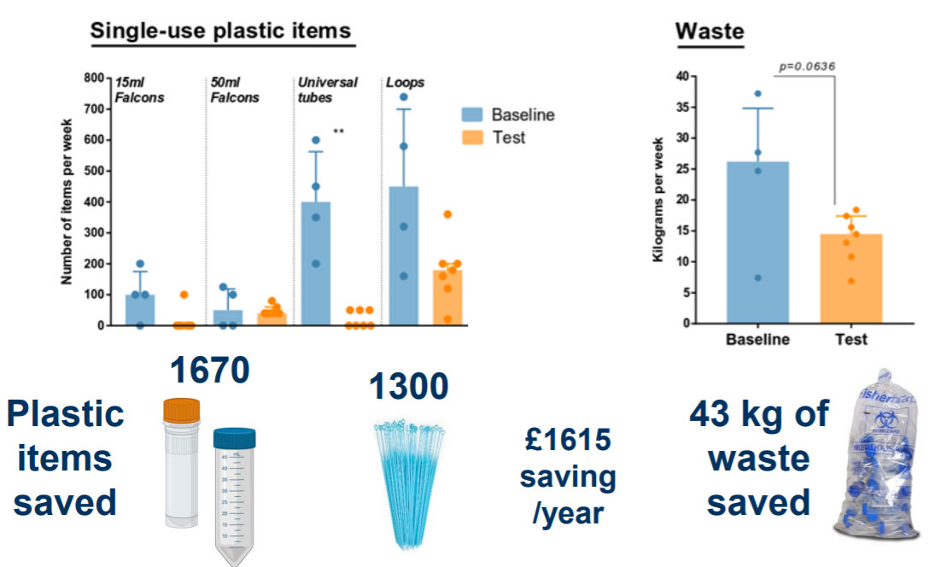
Lab Plastics – Pilot study 1- Roslin
Notes:
Recommendation
Substitute single-use plastic for glass.
Substitutions which have been found effective are:
Falcon tubes
Pipettes
Filter bottles
Petri dishes
Bijou bottles
Test tubes
Replace plastic weigh boats with watch glass
Washing and autoclave capabilities are necessary for sterile procedure. Baskets or boxes recommended for storage and autoclaving.
Substitute single-use plastic for other reusable materials, or reuse current single-use items.
Substitutions which have been found effective are:
Reuse pipettes and pipette tips when aliquoting
Reuse weigh boats
Reuse gloves (decontaminate with ethanol)
Substitute plastic pipette tips with metal ones
Reuse tubes and cuvettes (with a rinse between)
Reuse beaker or tip-collecting container, rather than single-use ‘dispo jars’
Reusable items can have comparable performance to single-use items, even in sterile procedures.
However, if there is concern, consider starting these substitutions in situations where sterile procedure is not necessary, such as bench work.
Reduce packaging plastics.
Suggested ways to reduce are:
Purchase bagged falcons and reuse original racks
Reuse pipette tip boxes and refill with bulk tips
Reduce the number of suppliers, thereby reducing number of deliveries
Only purchase single-packaged stripettes when specifically necessary
Increase laboratory plastic recycling.
NOTE (October 2019) To be updated. – Discussions are ongoing with our waste contractor about this, so this action cannot be taken immediately, but see below for future actions.
Commonly accepted items:
Tip boxes
Non-contaminated media bottles
Non-contaminated solvent bottles
Items accepted in specific locations:
Non-contaminated gloves
Many buildings and schools have collection points for lab items (particularly gloves and tip boxes). Identify the closest or coordinate a new one.
Consider implementing a further recycling scheme:
Non-contaminated gloves
Collection points for packaging take-back schemes from suppliers
Create a decontamination station for recyclable plastics (see note above about discussions with waste contractor)
Ensure your decontamination process is appropriate for the materials you work with.
Example decontamination process: 24-hour soak in a high-level disinfectant followed by a rinse for chemical decontamination.
Plan experiments to reduce single-use plastic.
Some effective examples include:
Calculate minimum tubes/plates required
Prepare bulk master mix to reduce tips and tubes
Use the smallest container possible for aliquots, tubes, bottles
Prepare culture media in bulk
Reduce aliquot numbers and procedure steps
Refill solutions rather than using new bottles
Where possible, share common items to reduce ordering.
Some examples include:
Building-wide sharing programmes for reagents and consumables
Utilise bottle top dispensers.
This can reduce tips, pipettes, and other intermediary containers.
Reduce plastic used for labelling.
Some methods include:
Wipe labels with ethanol and reuse
Cut labels in half
When plastic is unavoidable, use recycled sources rather than virgin plastic.
Some substitutions include:
Reaction tubes
Make changes in teaching labs where sterile procedure is not as high priority.
Suggestions include:
Use multi-media aids, such as having students load a sample then use a video to model the gel
Refill solutions between practicals, rather than using a new bottle
Use bottle top dispensers for measuring
Reuse gloves
Reuse weigh boats
Reuse tubes and cuvettes with a rinse between
Use paper cups, wooden coffee stirs, wooden swabs, wooden toothpicks in place of plastic items
If reliant on bottled ultra-pure water, consider replacing with an in house system

Slide 11
Lab Plastics – Pilot study 1- Roslin
Lessons learned
  Speak to everyone first!
    Take your team with you
    H&S
    Facilities/washup (these people are key!)
    Sustainability
  Measure impact to communicate progress
    motivation
Notes:
Recommendation
Substitute single-use plastic for glass.
Substitutions which have been found effective are:
Falcon tubes
Pipettes
Filter bottles
Petri dishes
Bijou bottles
Test tubes
Replace plastic weigh boats with watch glass
Washing and autoclave capabilities are necessary for sterile procedure. Baskets or boxes recommended for storage and autoclaving.
Substitute single-use plastic for other reusable materials, or reuse current single-use items.
Substitutions which have been found effective are:
Reuse pipettes and pipette tips when aliquoting
Reuse weigh boats
Reuse gloves (decontaminate with ethanol)
Substitute plastic pipette tips with metal ones
Reuse tubes and cuvettes (with a rinse between)
Reuse beaker or tip-collecting container, rather than single-use ‘dispo jars’
Reusable items can have comparable performance to single-use items, even in sterile procedures.
However, if there is concern, consider starting these substitutions in situations where sterile procedure is not necessary, such as bench work.
Reduce packaging plastics.
Suggested ways to reduce are:
Purchase bagged falcons and reuse original racks
Reuse pipette tip boxes and refill with bulk tips
Reduce the number of suppliers, thereby reducing number of deliveries
Only purchase single-packaged stripettes when specifically necessary
Increase laboratory plastic recycling.
NOTE (October 2019) To be updated. – Discussions are ongoing with our waste contractor about this, so this action cannot be taken immediately, but see below for future actions.
Commonly accepted items:
Tip boxes
Non-contaminated media bottles
Non-contaminated solvent bottles
Items accepted in specific locations:
Non-contaminated gloves
Many buildings and schools have collection points for lab items (particularly gloves and tip boxes). Identify the closest or coordinate a new one.
Consider implementing a further recycling scheme:
Non-contaminated gloves
Collection points for packaging take-back schemes from suppliers
Create a decontamination station for recyclable plastics (see note above about discussions with waste contractor)
Ensure your decontamination process is appropriate for the materials you work with.
Example decontamination process: 24-hour soak in a high-level disinfectant followed by a rinse for chemical decontamination.
Plan experiments to reduce single-use plastic.
Some effective examples include:
Calculate minimum tubes/plates required
Prepare bulk master mix to reduce tips and tubes
Use the smallest container possible for aliquots, tubes, bottles
Prepare culture media in bulk
Reduce aliquot numbers and procedure steps
Refill solutions rather than using new bottles
Where possible, share common items to reduce ordering.
Some examples include:
Building-wide sharing programmes for reagents and consumables
Utilise bottle top dispensers.
This can reduce tips, pipettes, and other intermediary containers.
Reduce plastic used for labelling.
Some methods include:
Wipe labels with ethanol and reuse
Cut labels in half
When plastic is unavoidable, use recycled sources rather than virgin plastic.
Some substitutions include:
Reaction tubes
Make changes in teaching labs where sterile procedure is not as high priority.
Suggestions include:
Use multi-media aids, such as having students load a sample then use a video to model the gel
Refill solutions between practicals, rather than using a new bottle
Use bottle top dispensers for measuring
Reuse gloves
Reuse weigh boats
Reuse tubes and cuvettes with a rinse between
Use paper cups, wooden coffee stirs, wooden swabs, wooden toothpicks in place of plastic items
If reliant on bottled ultra-pure water, consider replacing with an in house system

Slide 12
Lab Plastics – Pilot study 2 - Biology
What worked:
  Glass substitutes
    Stripettes
    Falcon tubes replaced with small glass bottles
    Glass beads for plating cells
  Making their own resources (e.g. protein gels)
  Tip box and insert recycling - Starlab
Notes:
Recommendation
Substitute single-use plastic for glass.
Substitutions which have been found effective are:
Falcon tubes
Pipettes
Filter bottles
Petri dishes
Bijou bottles
Test tubes
Replace plastic weigh boats with watch glass
Washing and autoclave capabilities are necessary for sterile procedure. Baskets or boxes recommended for storage and autoclaving.
Substitute single-use plastic for other reusable materials, or reuse current single-use items.
Substitutions which have been found effective are:
Reuse pipettes and pipette tips when aliquoting
Reuse weigh boats
Reuse gloves (decontaminate with ethanol)
Substitute plastic pipette tips with metal ones
Reuse tubes and cuvettes (with a rinse between)
Reuse beaker or tip-collecting container, rather than single-use ‘dispo jars’
Reusable items can have comparable performance to single-use items, even in sterile procedures.
However, if there is concern, consider starting these substitutions in situations where sterile procedure is not necessary, such as bench work.
Reduce packaging plastics.
Suggested ways to reduce are:
Purchase bagged falcons and reuse original racks
Reuse pipette tip boxes and refill with bulk tips
Reduce the number of suppliers, thereby reducing number of deliveries
Only purchase single-packaged stripettes when specifically necessary
Increase laboratory plastic recycling.
NOTE (October 2019) To be updated. – Discussions are ongoing with our waste contractor about this, so this action cannot be taken immediately, but see below for future actions.
Commonly accepted items:
Tip boxes
Non-contaminated media bottles
Non-contaminated solvent bottles
Items accepted in specific locations:
Non-contaminated gloves
Many buildings and schools have collection points for lab items (particularly gloves and tip boxes). Identify the closest or coordinate a new one.
Consider implementing a further recycling scheme:
Non-contaminated gloves
Collection points for packaging take-back schemes from suppliers
Create a decontamination station for recyclable plastics (see note above about discussions with waste contractor)
Ensure your decontamination process is appropriate for the materials you work with.
Example decontamination process: 24-hour soak in a high-level disinfectant followed by a rinse for chemical decontamination.
Plan experiments to reduce single-use plastic.
Some effective examples include:
Calculate minimum tubes/plates required
Prepare bulk master mix to reduce tips and tubes
Use the smallest container possible for aliquots, tubes, bottles
Prepare culture media in bulk
Reduce aliquot numbers and procedure steps
Refill solutions rather than using new bottles
Where possible, share common items to reduce ordering.
Some examples include:
Building-wide sharing programmes for reagents and consumables
Utilise bottle top dispensers.
This can reduce tips, pipettes, and other intermediary containers.
Reduce plastic used for labelling.
Some methods include:
Wipe labels with ethanol and reuse
Cut labels in half
When plastic is unavoidable, use recycled sources rather than virgin plastic.
Some substitutions include:
Reaction tubes
Make changes in teaching labs where sterile procedure is not as high priority.
Suggestions include:
Use multi-media aids, such as having students load a sample then use a video to model the gel
Refill solutions between practicals, rather than using a new bottle
Use bottle top dispensers for measuring
Reuse gloves
Reuse weigh boats
Reuse tubes and cuvettes with a rinse between
Use paper cups, wooden coffee stirs, wooden swabs, wooden toothpicks in place of plastic items
If reliant on bottled ultra-pure water, consider replacing with an in house system

Slide 13

Lab Plastics – Pilot studies
Next steps
  Consider purchasing tip washers
    IF we can get enough neighbouring groups to join in
Roslin case study write-up published in Access Microbiology, October 2020
https://www.microbiologyresearch.org/content/journal/acmi/10.1099/acmi.0.000173
Roslin contact = amy.pickering@ed.ac.uk
Biology contact = ella.thornton@ed.ac.uk
Notes:
Recommendation
Substitute single-use plastic for glass.
Substitutions which have been found effective are:
Falcon tubes
Pipettes
Filter bottles
Petri dishes
Bijou bottles
Test tubes
Replace plastic weigh boats with watch glass
Washing and autoclave capabilities are necessary for sterile procedure. Baskets or boxes recommended for storage and autoclaving.
Substitute single-use plastic for other reusable materials, or reuse current single-use items.
Substitutions which have been found effective are:
Reuse pipettes and pipette tips when aliquoting
Reuse weigh boats
Reuse gloves (decontaminate with ethanol)
Substitute plastic pipette tips with metal ones
Reuse tubes and cuvettes (with a rinse between)
Reuse beaker or tip-collecting container, rather than single-use ‘dispo jars’
Reusable items can have comparable performance to single-use items, even in sterile procedures.
However, if there is concern, consider starting these substitutions in situations where sterile procedure is not necessary, such as bench work.
Reduce packaging plastics.
Suggested ways to reduce are:
Purchase bagged falcons and reuse original racks
Reuse pipette tip boxes and refill with bulk tips
Reduce the number of suppliers, thereby reducing number of deliveries
Only purchase single-packaged stripettes when specifically necessary
Increase laboratory plastic recycling.
NOTE (October 2019) To be updated. – Discussions are ongoing with our waste contractor about this, so this action cannot be taken immediately, but see below for future actions.
Commonly accepted items:
Tip boxes
Non-contaminated media bottles
Non-contaminated solvent bottles
Items accepted in specific locations:
Non-contaminated gloves
Many buildings and schools have collection points for lab items (particularly gloves and tip boxes). Identify the closest or coordinate a new one.
Consider implementing a further recycling scheme:
Non-contaminated gloves
Collection points for packaging take-back schemes from suppliers
Create a decontamination station for recyclable plastics (see note above about discussions with waste contractor)
Ensure your decontamination process is appropriate for the materials you work with.
Example decontamination process: 24-hour soak in a high-level disinfectant followed by a rinse for chemical decontamination.
Plan experiments to reduce single-use plastic.
Some effective examples include:
Calculate minimum tubes/plates required
Prepare bulk master mix to reduce tips and tubes
Use the smallest container possible for aliquots, tubes, bottles
Prepare culture media in bulk
Reduce aliquot numbers and procedure steps
Refill solutions rather than using new bottles
Where possible, share common items to reduce ordering.
Some examples include:
Building-wide sharing programmes for reagents and consumables
Utilise bottle top dispensers.
This can reduce tips, pipettes, and other intermediary containers.
Reduce plastic used for labelling.
Some methods include:
Wipe labels with ethanol and reuse
Cut labels in half
When plastic is unavoidable, use recycled sources rather than virgin plastic.
Some substitutions include:
Reaction tubes
Make changes in teaching labs where sterile procedure is not as high priority.
Suggestions include:
Use multi-media aids, such as having students load a sample then use a video to model the gel
Refill solutions between practicals, rather than using a new bottle
Use bottle top dispensers for measuring
Reuse gloves
Reuse weigh boats
Reuse tubes and cuvettes with a rinse between
Use paper cups, wooden coffee stirs, wooden swabs, wooden toothpicks in place of plastic items
If reliant on bottled ultra-pure water, consider replacing with an in house system

Slide 14

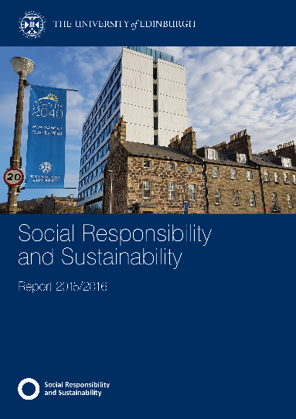

edin.ac/labs
Questions?
andrew.arnott@ed.ac.uk
www.ed.ac.uk/sustainability

