Slide 1
NDEE Case Study
David Stutchfield Sustainability Manager

Slide 2
Project Development
Financed through Scottish Funding Council’s University Carbon
Reduction Fund scheme
(Funding bid submitted Nov 2017 and money received Mar 2018)
Developed to aspirationally achieve an annual reduction of 4,500 t.CO2
Part of the University’s Carbon Neutral Strategy
NDEE Project initiated July 2018
Dedicated Project Team involved, supported by Senior Management
Working in collaboration with NDEE Framework PSU
30 shortlisted buildings available to bidders

Slide 3
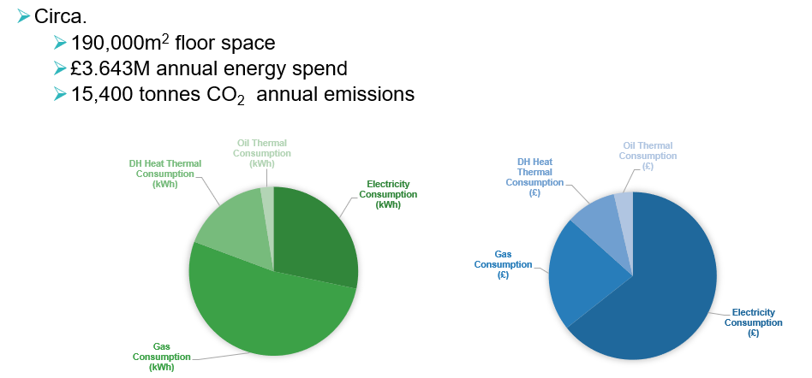
Shortlisted sites - 30 largest energy consumers

Slide 4
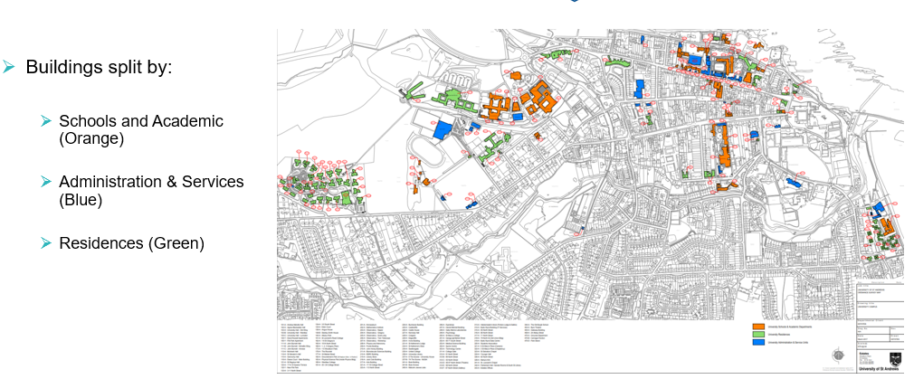
Shortlisted sites

Slide 5
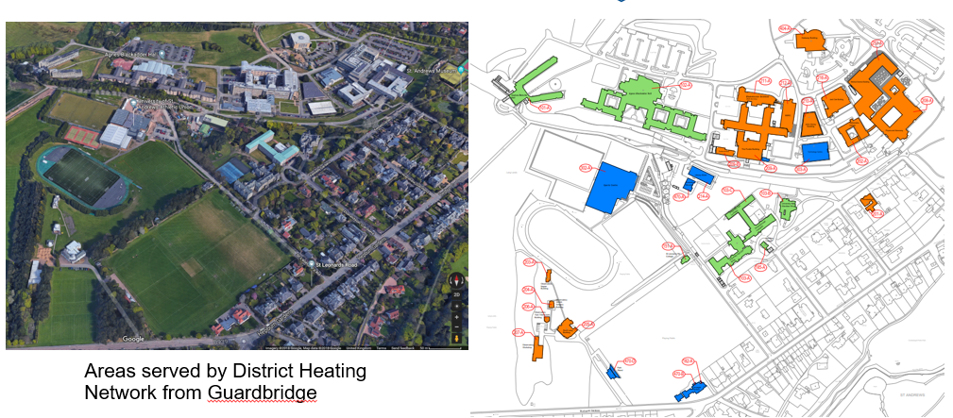
North Haugh Buildings

Slide 6
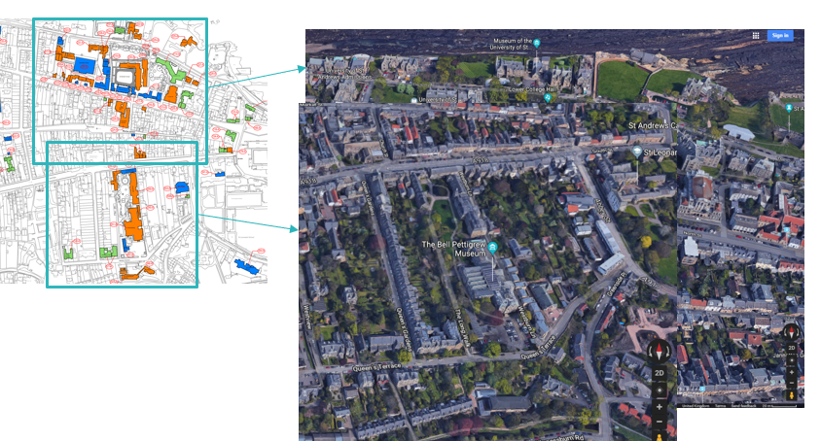
Town Centre Buildings

Slide 7
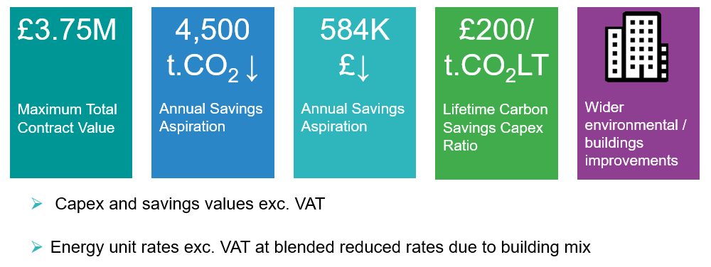
Project Development

Slide 8
Programme
Proposed Actual
ITMC Responses: 22nd Oct 2018 Nov 18
ITMC Evaluation: Early Nov 2018 Dec 18
Shortlisted Bidder Appointment: Early Nov 2018 End Dec 18
Development Agreement Signed: Early Nov 2018 End Dec 18
Investment Grade Proposal: Nov 2018 – Jan 2018 June 19
Develop & Sign EnPC Jan/Feb 2019 25th Jun 19
Construction Feb – Jun 2019 Jun 19 – Feb 20
Testing & Commissioning End Jul 2019 Feb 20
Op Verification and Snagging: End Jul 2019 Feb 20
Milestone Payment 1: End Jul 2019 Feb 20
Milestone Payment 2: Summer 2020 Feb 21

Slide 9
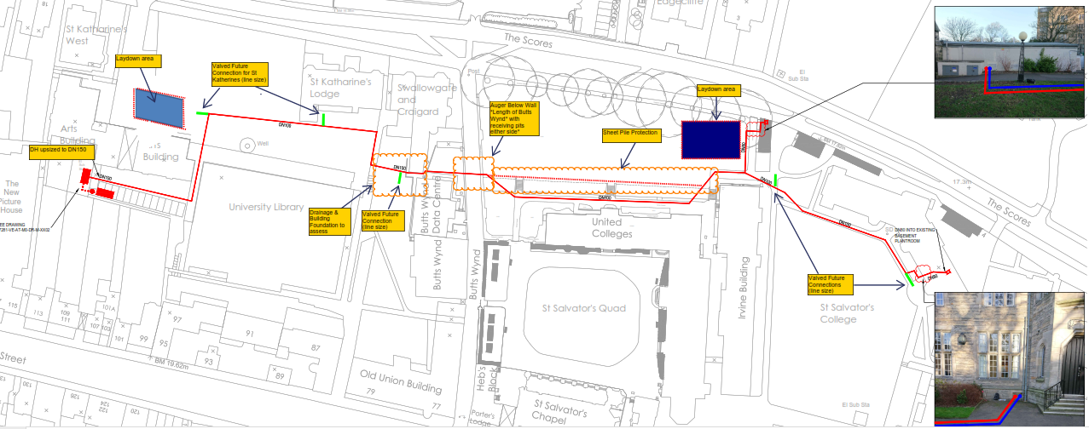
Key innovation in successful bid

Slide 10
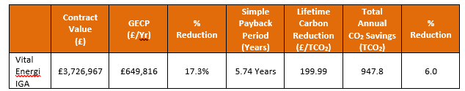
IGA summary

Slide 11
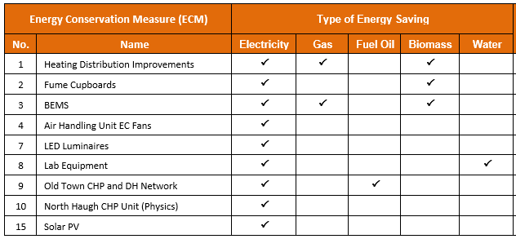
Technologies

Slide 12
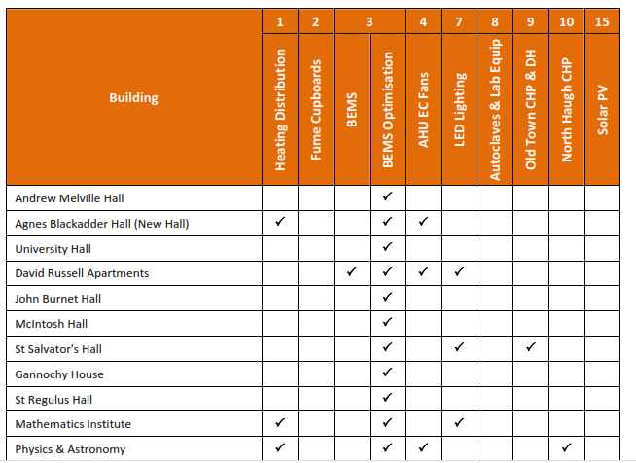
ECM / Building Matrix

Slide 13
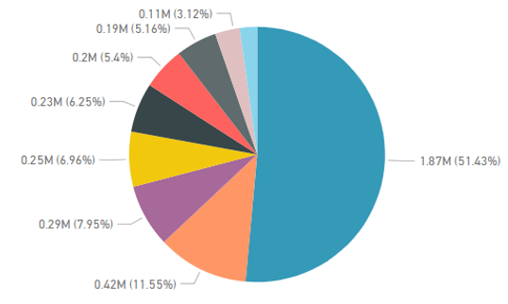
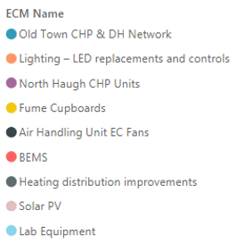
Project spend by technology

Slide 14
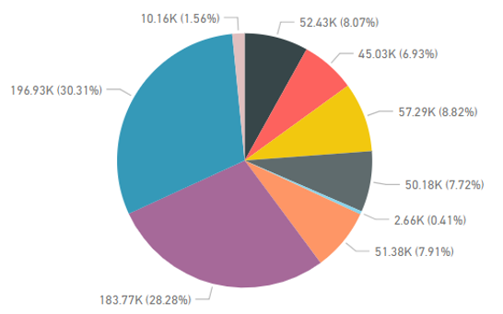
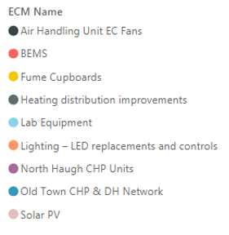
Project saving by category

Slide 15
Summary
NDEE has helped us procure a complex multi building multi technology project.
NDEE Support Unit crucial in process.
Two bidders were very close on price and saving – the quality score (due to innovation) and slightly higher paybacks tipped the decision for winning contractor.
Technologies and buildings chosen during IGP phase to minimise risk of delays due to asbestos – not necessarily best carbon saving

Slide 16
Summary
Contractors project spreadsheet allowing options appraisal useful.
Payments will be made on completed ECM by building basis. Final completion when all measures installed.
University adding works at additional cost – increasing size of DH pipework to futureproof it, using University desired LED drivers.
University has 1 project manager and two full time staff performing clerk of works role.
Real surprise how long the IGP phase has taken.
Get NDEE involved early in the project

