Slide 1
Modern Slavery – University of Edinburgh approach
Liz Cooper, SRS Research and Policy Manager
EAUC Sustainable Procurement Topic Support Network October 2016

Slide 2
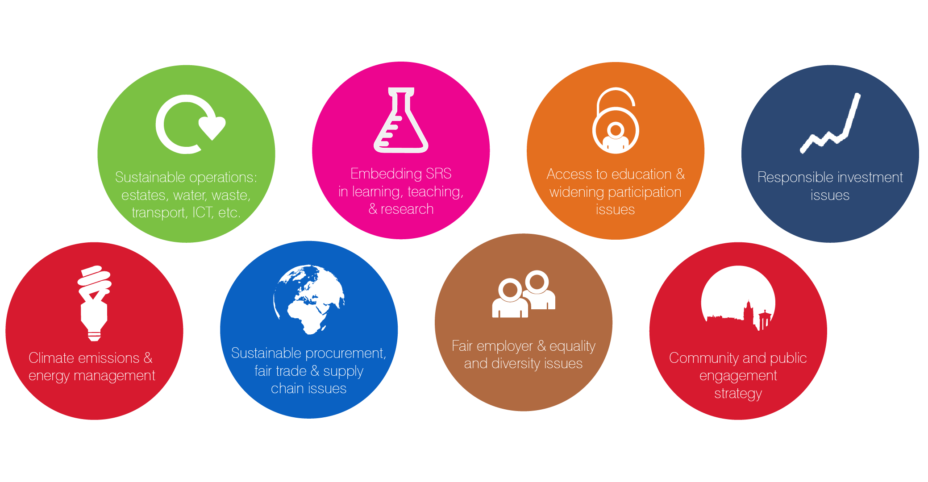
Working areas
Notes:
…and this means these areas. We’re working with others on all of them, and leading on only a few – most importantly on the University’s Climate Strategy.

Slide 3
Why modern slavery?
Increasing visibility of the issue in media and research
Estimated 11,700 people living in modern slavery in the United Kingdom in 2016 and 45.8 million around the world (Global Slavery Index)
UK Modern Slavery Act
Sustainable Procurement duty
Extension of ongoing work on SRS issues in procurement, from fair trade to workers’ rights…

Slide 4
UK Modern Slavery Act
Definition includes: slavery/servitude, forced labour, human trafficking, bonded labour
Requirements of Act
  Commercial organisations with turnover of more than £36 million/annum must publish an annual statement outlining actions taken (in own business and in supply chains), on front page of website
  Applies to financial years starting on/after 1st April 2016
Applicable to universities too if over threshold

Slide 5
Risks that could affect a university
In global supply chains – numerous reports of seafood industry slavery e.g. Thailand prawns
In local area – numerous reports of forced migrant labour in UK agriculture e.g. Kent apples
In disposal - risk in picking lines in UK for waste disposal/recycling – migrant labour
In our international offices/collaborations – risk among local staff, construction overseas…
Particular risks where: migrant labour, agency work, low skilled work, informal labour, temporary/seasonal work, in countries where labour regulation lacking/not enforced, conflict zones, where cultural acceptance of slavery
Not just legal requirement but social responsibility

Slide 6
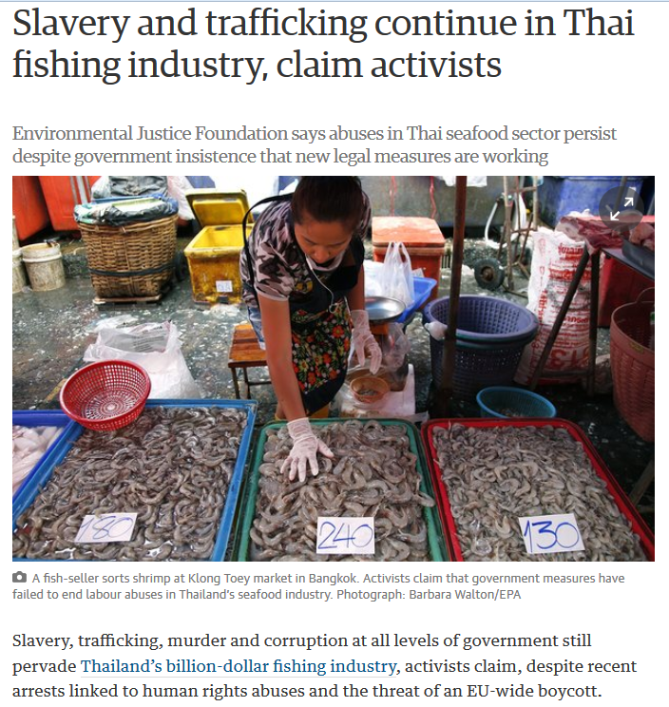
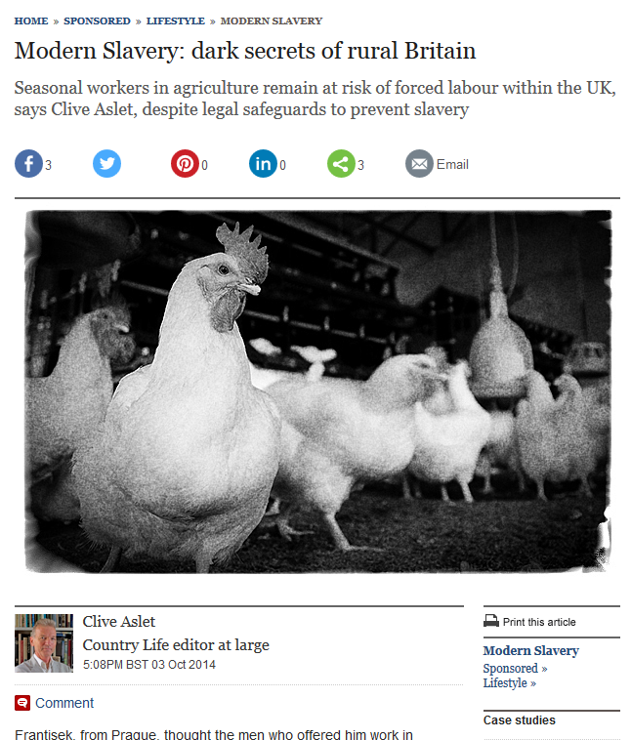
Examples
UK agriculture – migrant workers in bonded labour from Eastern Europe
Thai seafood slavery and trafficking
http://www.theguardian.com/global-development/2016/feb/25/slavery-trafficking-thai-fishing-industry-environmental-justice-foundation
http://www.telegraph.co.uk/sponsored/lifestyle/modern-slavery-britain/11134160/forced-agriculture-work-uk.html

Slide 7
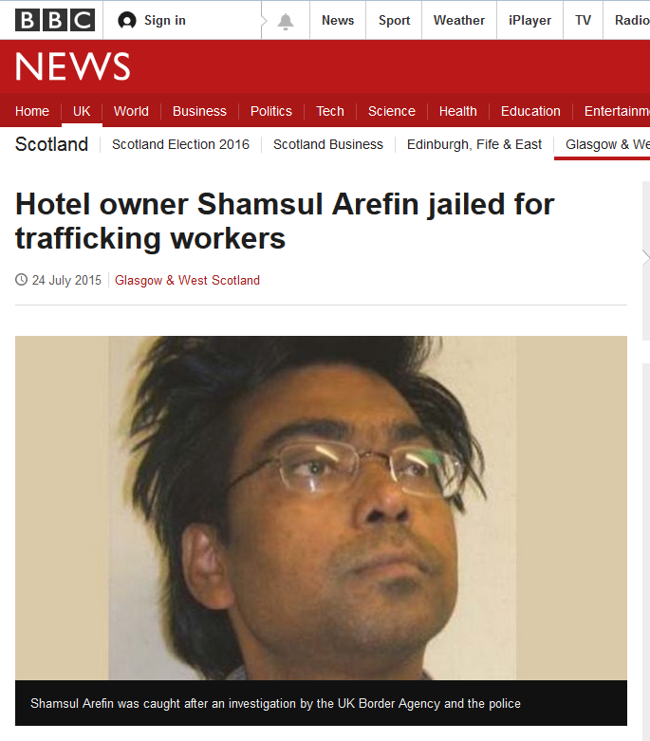
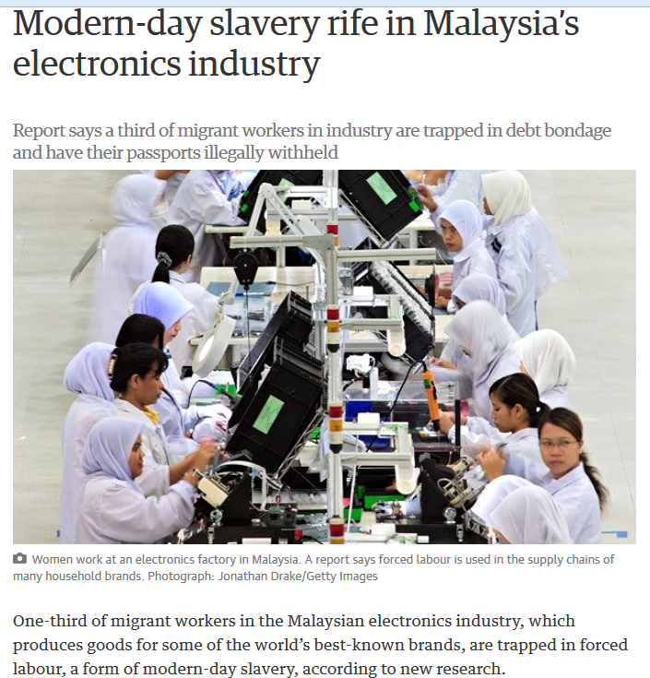
Examples
Human trafficking in a Scottish hotel
Modern slavery in Malaysian electronics factories
http://www.theguardian.com/global-development/2014/sep/17/modern-day-slavery-malaysia-electronics-industry
http://www.bbc.co.uk/news/uk-scotland-glasgow-west-33653553

Slide 8
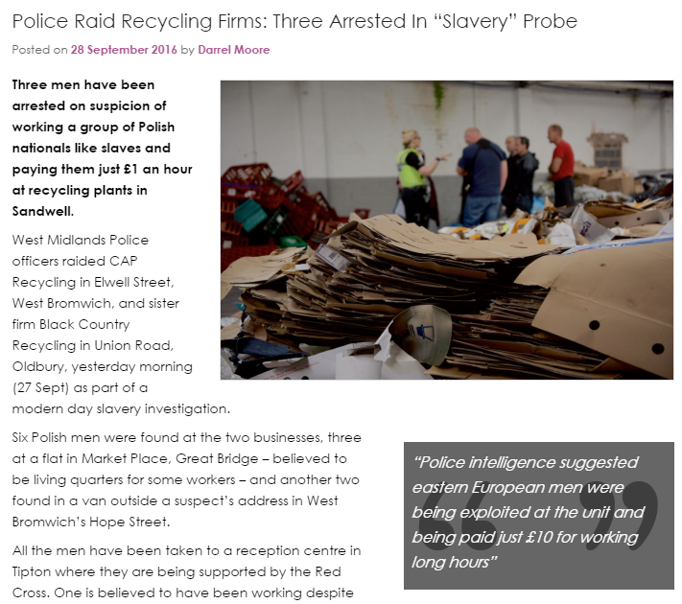
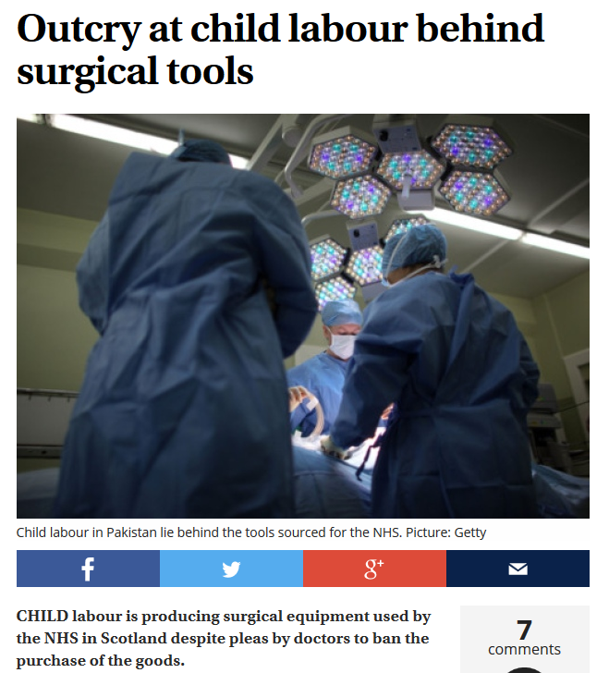
Examples
http://www.ciwm-journal.co.uk/police-raid-recycling-firms-three-arrested-slavery-probe/
Child labour in Pakistan making surgical instruments
Eastern European workers paid £1/hour in West Midlands recycling
http://www.scotsman.com/news/outcry-at-child-labour-behind-surgical-tools-1-2386196
And many more…

Slide 9
UoE approach in 2016
Preliminary research on risk factors, high risk areas, scope of relevance to university practices
Stakeholder workshop May 2016
Small working group to draft statement including action plan
Research briefing commissioned
Ensuring modern slavery embedded in SPPT assessment work

Slide 10
Stakeholder workshop
Invited: SRS, Procurement, HR, Waste and Recycling, International Office, academics (e.g. Law and Geography), Legal, Court Services, Students Association
Discussed and recorded for different areas of operations: risks, opportunities and actions already taken

Slide 11
Working group – drafting the statement
Collaborators:
  SRS
  Legal Services
  Court Services
  Procurement
Liaison with other key units
Statement includes:
  University structure and activities
  Our supply chains and recognition of risks
  Risks in other areas
  Due diligence processes
  Future action plan

Slide 12
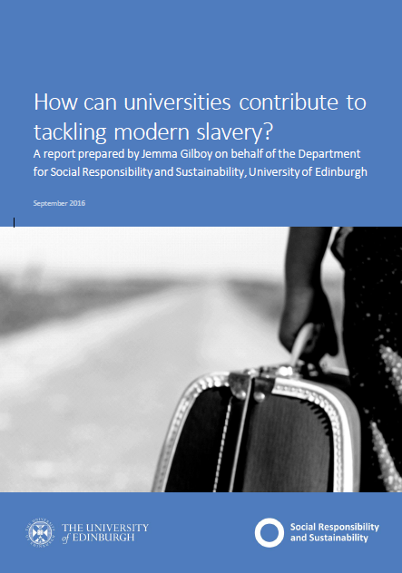
Research briefing for universities
Research report commissioned summer 2016
‘How can universities contribute to tackling modern slavery?’
Designed as resource for the sector
  Globalised business and organised crime
  Risks for universities/HE
  Best practice examples from business/HE

Slide 13
Next steps
Statement to go through committees then to University Court
  Continue to ask suppliers about their actions to tackle modern slavery in their supply chains
  Continue to assess and mitigate risks in prioritised procurement categories
  Academic and student research projects to inform our approach
  Ensure greater awareness of modern slavery risks – training?
  Develop links between our central procurement and HR procedures and those undertaken in our International Offices
  Ensure staff and students undertaking overseas partnerships consider potential modern slavery risks and how to mitigate them
How to collaborate across the sector?

Slide 14


Questions?
Liz.Cooper@ed.ac.uk
www.ed.ac.uk/sustainability

Slide 15
Conflict minerals – University of Edinburgh approach
Liz Cooper, SRS Research and Policy Manager
EAUC Sustainable Procurement Topic Support Network October 2016

Slide 16
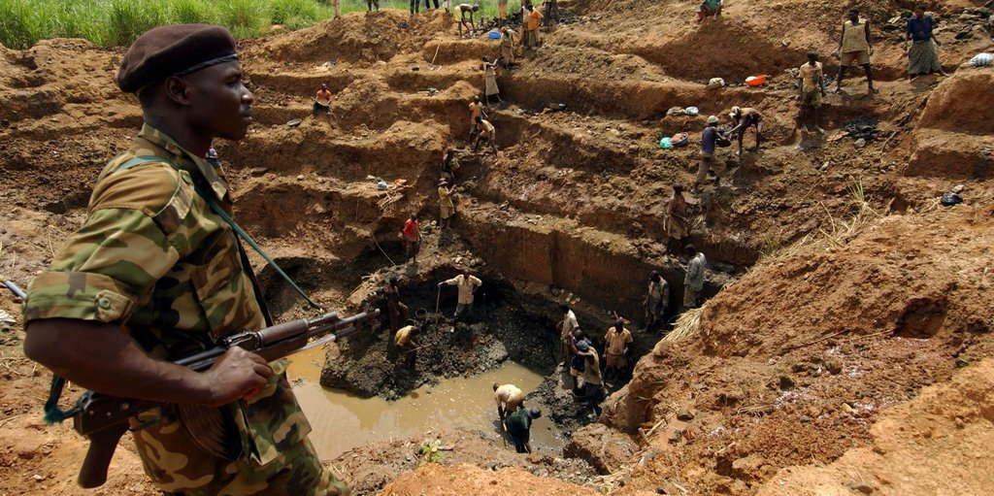
Why conflict minerals?
Profits from mining in many parts of
world being used to fund armed conflict
Key example = DRC, 3Ts and G
Also lithium, cobalt – Central Asia, Latin America…
Regulation – Dodd-Frank Act in US requires transparency on mineral sourcing, new voluntary regulation in EU (obligations for smelters and refiners to source responsibly - http://europa.eu/rapid/press-release_IP-16-2231_en.htm)

Slide 17
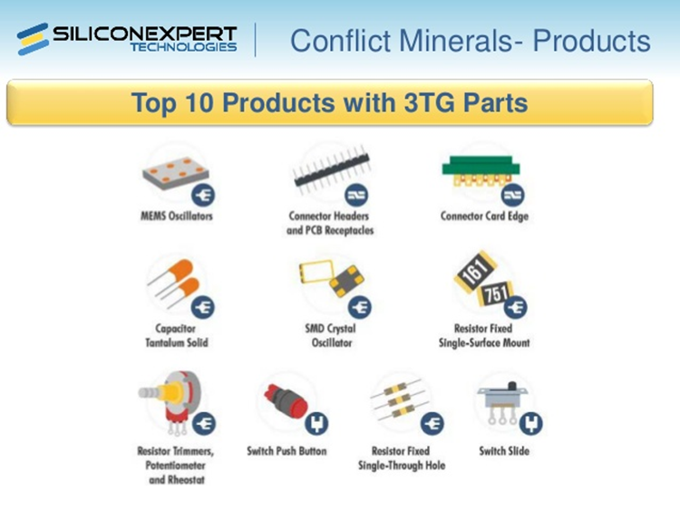
Conflict minerals and universities
ICT
Any electronics e.g. in labs
Raw form minerals in labs?
Vehicles
Light fittings
Etc.

Slide 18
Developing our conflict minerals policy
In 2014: background research/sector engagement, Ethics Forum event
In 2015: Innovative Learning Week workshop (http://bloodyphone.tumblr.com/ ), iterative policy development
2015: SRS Department, Procurement Office, EUSA and academics worked together to develop policy
February 2016: policy published after committee approval

Slide 19
UoE Conflict Minerals Policy
Public commitment to continuing to work collaboratively to eradicate conflict minerals from the goods the University buys through:
  Working to get conflict minerals questions in tenders; embedding issue in contract management
  Awareness-raising re individual purchases
  Academic and student research
  Collaboration with sector
Available at http://www.ed.ac.uk/about/sustainability/about/programmes/fairness-trade-sustainable-procurement/conflict-minerals
Response – media, other organisations, senior staff…
Awareness raising impact important

Slide 20
Next steps re conflict minerals
Ongoing research – academics, students
Further engagement with suppliers and consortia
Further events and campaigns, and embedding in training
Collaboration with the sector? How?
Thanks!

