Slide 1
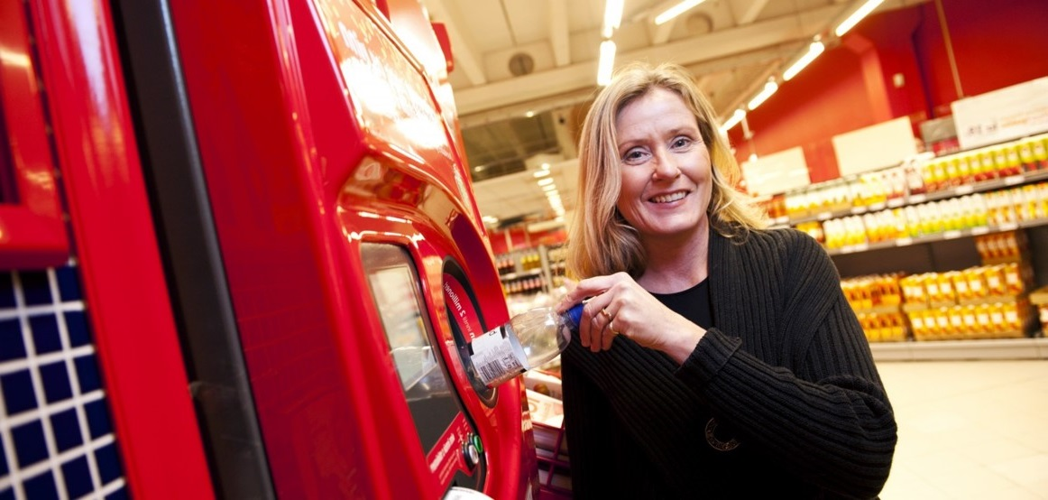
DEPOSIT RETURN SCHEME IN SCOTLAND
GRAHAM KERR
SEPA
OCTOBER 2020

Slide 2
DEPOSIT RETURN
SCHEME IN SCOTLAND
OVERVIEW
The Deposit and Return Scheme for Scotland Regulations 2020 were passed by the Scottish Parliament on 13 May.
From 1 July 2022, consumers will pay a deposit on drinks that they buy that will be refunded when they return the empty container for recycling.
Measure under the Climate Change Act – to reduce our climate change emissions, and to reduce litter
Notes:
My name is Graham Kerr and I principal policy officer for SEPA.
I am part of SEPAs recently started project team working on the Deposit Return Scheme for Scotland. In May the regulations were passed by the Scottish Parliament.
In a nutshell, consumers will pay a deposit when they purchase a drink, and when they return the empty container for recycling the deposit will be refunded.
The aim of the Regs is to decrease climate change emissions, and to decrease litter.
45 countries and territories run Similar schemes and for example in Sweden and Denmark and have achieved more than 90% recycling rates for drinks containers.

Slide 3
DEPOSIT RETURN
SCHEME IN SCOTLAND
Scotland’s DRS: the basics
Scheme articles: drinks containers made of PET plastic, metal, glass that are 50ml<3000ml. 1.2bn POM pa;
Deposit level: 20p, flat rate;
Return points: all retailers (including online), limited exemptions, voluntary return points; est 17,000;
Producers: brand owners in the UK, or importers, est 4,100;
Targets: 90% by Year 3 of operation;
Go-live date: July 2022;
Enforcement authority: SEPA.
Notes:
So – just to run through the basic features of the scheme.
What is included – any drink container made of PET, plastic or glass; between 50ml and 3l in size. There are no exemptions based on the contents. We estimate around 1.2bn of these POM in Scotland each year.
The deposit level is set at 20p (it’s a flat rate per item of any type)
Consumers can return containers to any retailer (there will be limited exemptions available; and the opportunity for community groups / schools etc to set up as a return point if they want).
It’s a form of producer responsibility. Producers will have to organise and pay for the operation of the scheme. And they are legally obligated to meet recycling targets – 90% by year 3 of operation. 76,000 extra tonnes of recycling a year
So who is a producer? Any brand owner in the UK. If outwith the UK then it is the importer that has the obligation. We estimate there are around 4100 producers.
The go-live date is 1 July 2022. Which sounds like it’s a long time away, but there is a lot to do to get ready.
SEPA is the enforcement authority, and we are setting up a new regulatory function.

Slide 4
DEPOSIT RETURN
SCHEME IN SCOTLAND
Scotland’s DRS: who is involved
Scottish Government
Zero Waste Scotland
SEPA
Producers
Retailers
Materials and waste industry
Scheme Administrator
Public
Notes:
So who is going to be involved in the scheme
Scottish Government: set the regulations and the targets to improve
Zero Waste Scotland: providing support and advice with regard to implementation of the regulations
SEPA: will be the enforcement authority of the new regulations
Producers: brand owners or importers
Retailers: selling and taking back items
Materials and waste industry
Scheme administrator: running the scheme
The public: Everyone who buys a drink will be involved
A partnership and collaborative approach is going to be key to ensuring all the stakeholders know where they fit in the scheme and get it up and running on time.

Slide 5
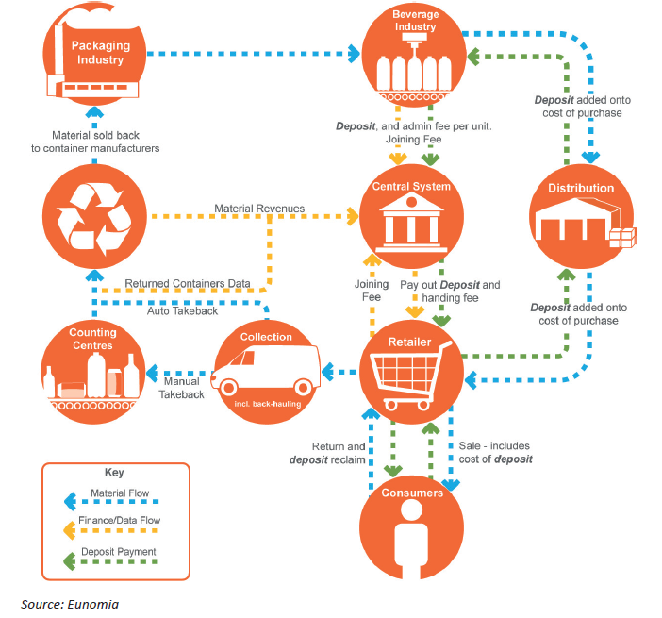
DEPOSIT RETURN
SCHEME IN SCOTLAND
How does
a DRS work?

Slide 6
DEPOSIT RETURN
SCHEME IN SCOTLAND
Producer obligations
Register with SEPA;
Charge the deposit;
Arrange for collection;
Pay a reasonable handling fee to retailers;
Meet targets
Producers can choose to take on these obligations themselves, or to join a Scheme Administrator.

Slide 7
DEPOSIT RETURN
SCHEME IN SCOTLAND
Retailer obligations
Only sell from registered producers;
Charge the deposit;
Display the deposit separate from the price of the article;
Provide information to consumers on how to return items;
Act as a return point (unless exempt);
Accept empty bottles from customers;
Refund the deposits;
Store containers safely for collection;
Provide consumer information on how to complain.

Slide 8
DEPOSIT RETURN
SCHEME IN SCOTLAND
SEPA’s role
Regulator overseeing the proper functioning of the scheme;
Producer registration;
Audit (producers, retailers, return points, Scheme Administrator);
Enforcement:
  FMP, VMP, EU;
  Reporting to the PF;
Data analysis and reporting;
Comms to obligated businesses.

Slide 9
DEPOSIT RETURN
SCHEME IN SCOTLAND
Scottish DRS timeline
13 May 2020 – Regulations passed;
22 June 2020 - applications open to be a Scheme Administrator;
1Jan 2021 – retailers exemption applications;
1 Jan 2022 – producers register with SEPA;
1 July 2022 – Scottish DRS scheme goes live.

Slide 10
DEPOSIT RETURN
SCHEME IN SCOTLAND
The DRS challenges
Short timescale;
Nationwide scheme;
Scotland doing DRS before England and Wales;
COVID-19;
Ensuring all interested parties are aware of DRS in Scotland;
Processing registrations;
Being ready to regulate scheme.
Notes:
Short timescale – July 2022 is the go live date, but there are steps even earlier than that for scheme to be ready for the public
Nationwide scheme – Whole of Scotland are going to be involved from city centres to the Islands
Scotland doing DRS before England and Wales – Recent announcement from England moved DRS there back
COVID–19 – has had widespread impacts on all aspects of preparation and on all stakeholders
Ensuring all interested parties are aware of DRS in Scotland – Non Scottish companies will be involved if they sell to Scotland
Processing registrations – Retailers can only sell products from producers who have registered
Being ready to regulate scheme – New role for SEPA – bit different from our current activities and regulations so setting up our regulatory function for that.

Slide 11
DEPOSIT RETURN
SCHEME IN SCOTLAND
What’s happening now and next
SEPA has carried out discovery meetings with various groups likely to be involved with the scheme – moving into sense making;
Planning rules have recently been changed to remove the need for planning permission for an RVM;
SEPA working on position statement to ensure no extra waste permissions needed for RVMs involved in deposit return;
SEPA working on guidance for producers and retailers regarding DRS;
Scheme Administrator will begin and make companies aware – timescale unknown.
Notes:
First step of discovery has been for retailers and producers and will then move into the sense making process where we pull out key themes, concerns that people have. This was partially done through the COVID period.

Slide 12
DEPOSIT RETURN
SCHEME IN SCOTLAND
SEPA’s DRS project team
For any questions or further details on SEPA’s role on deposit return scheme we have an email address:
depositreturn@sepa.org.uk

Slide 13


Contact details
Graham Kerr
Principle Policy Officer, Deposit Return Scheme
Email: Graham.Kerr@sepa.org.uk
ScottishEnviromentProtectionAgency
ScottishEPA

