Slide 1

WARPIT and PC Cascading
Alan Peddie, SRS Projects Coordinator
alan.peddie@ed.ac.uk
Notes:
Hi my name is Alan Peddie, SRS Projects Coordinator at the UoE
Thanks for having me etc. What am I going to be talking about today
1 – A little bit about who I am, what I do and how I got involved in this project
2 – The challenges at the University in terms of reuse and equipment exchange
3 – What is WARPIT and how we used the WARPIT system
4 – A bit about how we are integrating PC cascading into the project
5 – The results from using the system so far and possible next steps

Slide 2
Who am I?
Who?
What?
Where?
Why?
Notes:
Get out of the way early that I am neither a waste nor procurement, life cycle or IT expert. I have managed to get myself some waste training.
I work at the Department for Social Responsibility and Sustainability where I work as a Projects Coordinator and am our departments main contact when it comes to waste where we have a very close and frankly fantastic relationship with.
My work is quite varied but essentially I manage projects and spend a lot of my time trying to link people up to other people.
At the moment I am helping work as varied as reuse at the University, audits for café waste, an electric bike scheme, our own departments monthly training workshops and even occasionally lecture students about things like behaviour change and sustainability work.
About two and half years ago I was asked to do some work with the Waste and Recycling Department looking into reuse.

Slide 3

Dunfermline
50,000
University of Edinburgh
42,500
Dumfries
33,000
Source: UK 2011 Census, UoE Governance and Strategic Planning (2014)
Notes:
Before we even started trying to address reuse we realised there were three main challenges
Challenge 1 – we are HUGE, 32,500 students, 10,000 staff, 700+ locations
If we were a city we would sit somewhere between Dumfries and Dunfermline

Slide 4
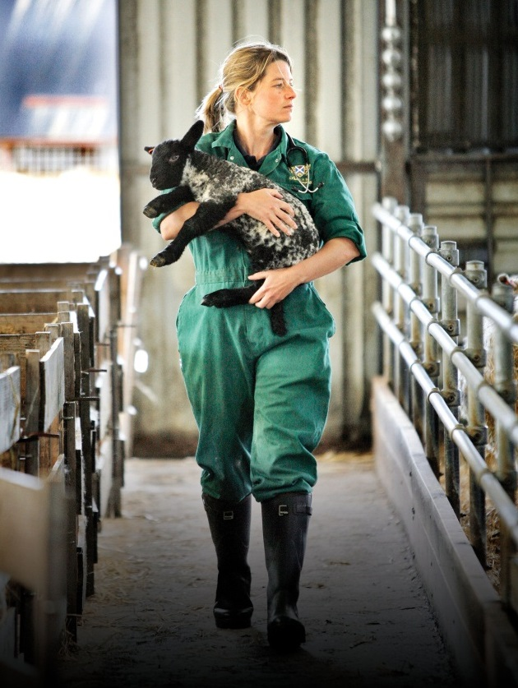
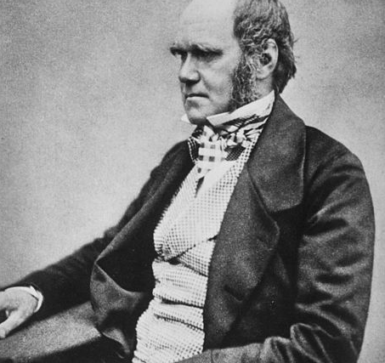

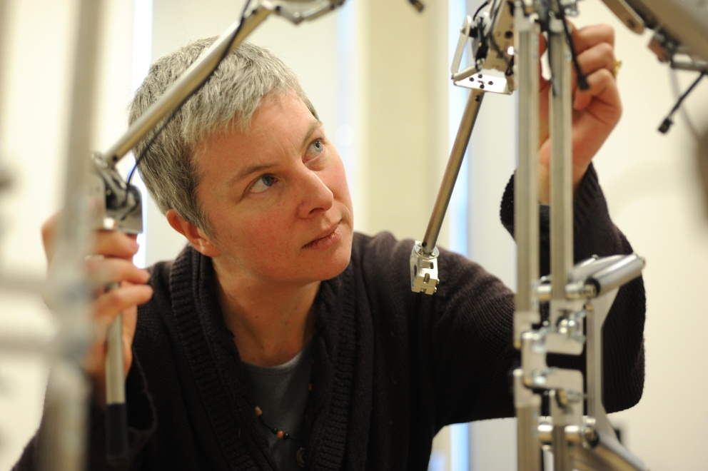
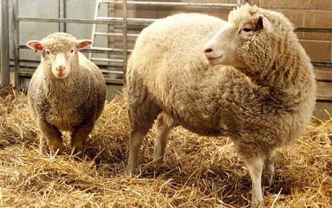
Notes:
Challenge 2 – Academic freedom
I don’t want to tell Peter Higgs or the guys who made Dolly the sheep that they need to make sure they get as much use out of left over stationary as possible

Slide 5
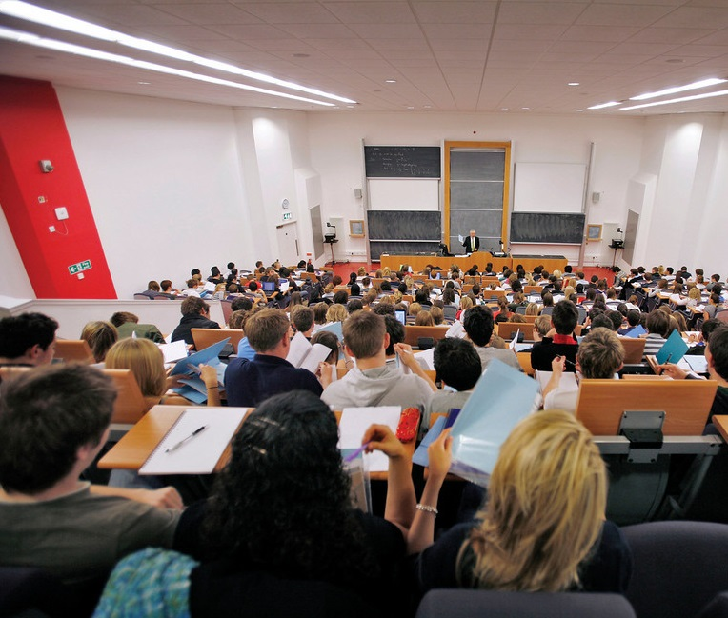
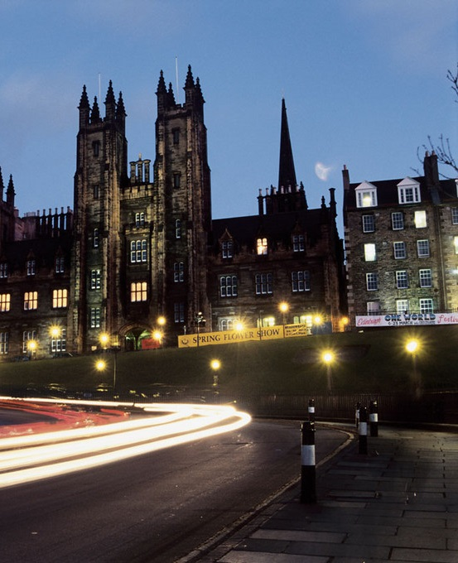
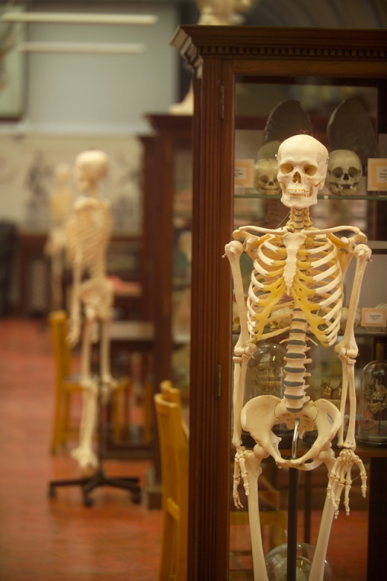
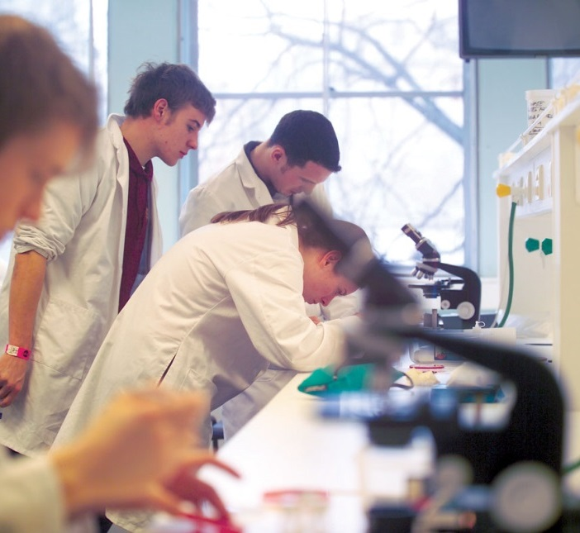
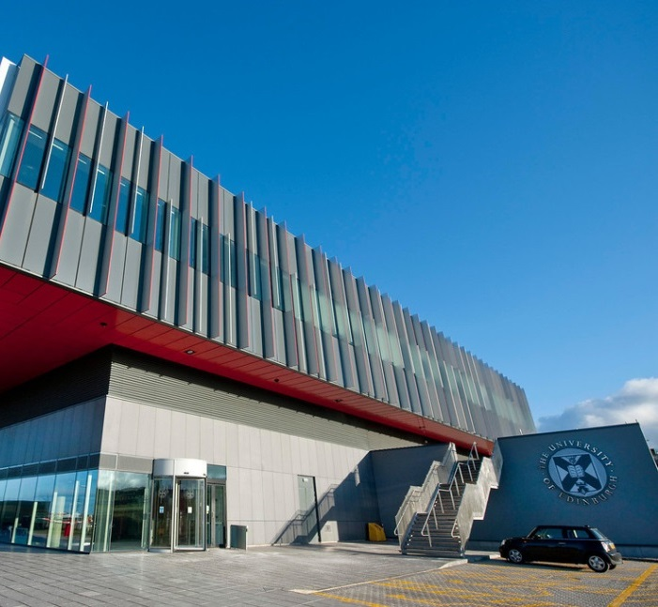
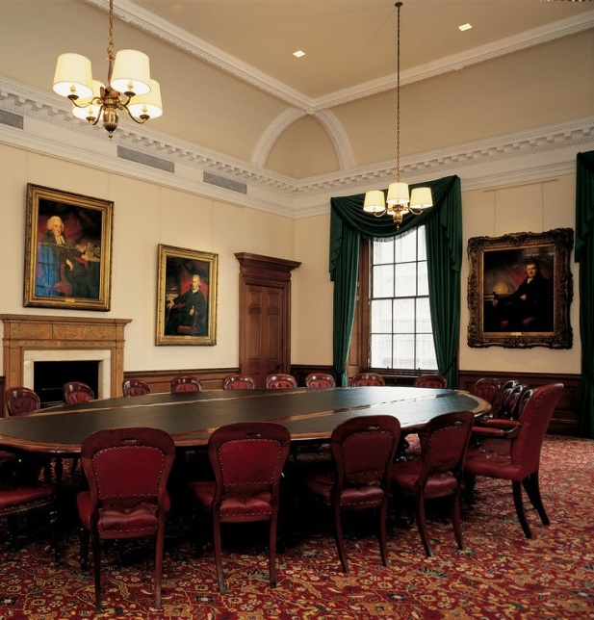
Notes:
Challenge 3
No centralised system
Departments, schools, individuals, can be entities unto themselves, differing types of staff and students, managers, people, etc, etc

Slide 6
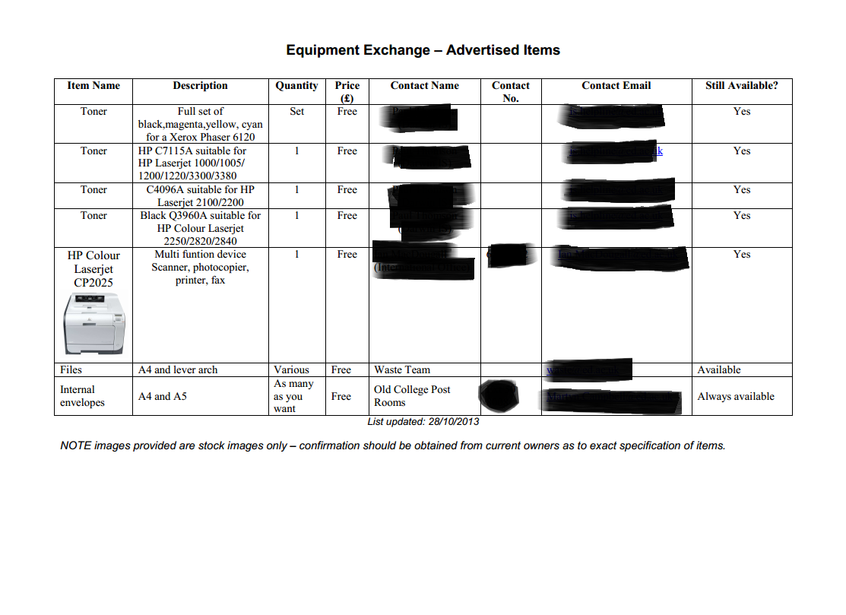
What was going on?
Notes:
How did these challenges end up manifesting themselves
Furniture, procurement, e-procurement, School of Chemistry, Waste and Recycling
all doing various things
Not much link up, little data
We felt that with better reuse and based on some organisations savings we could potentially make less of an environmental impact, save money and build better connections between people and departments

Slide 7
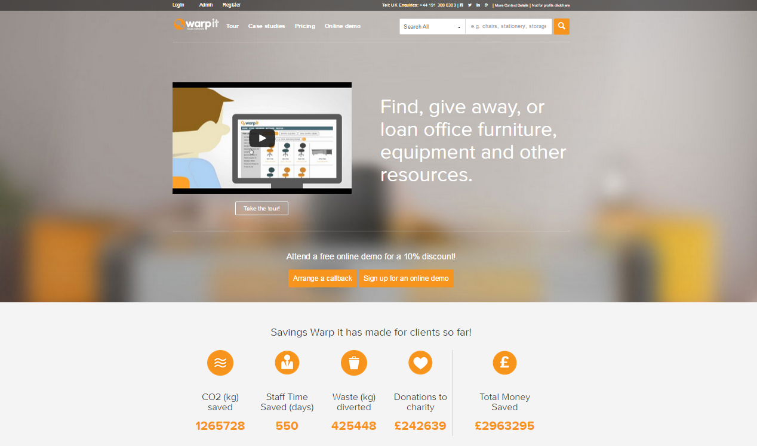
Notes:
What is WARPIT? It is a reuse system that looks just like eBay
WARPIT – waste action reuse portal
Redistribution system for your organization that allows people to freely exchange items

Slide 8
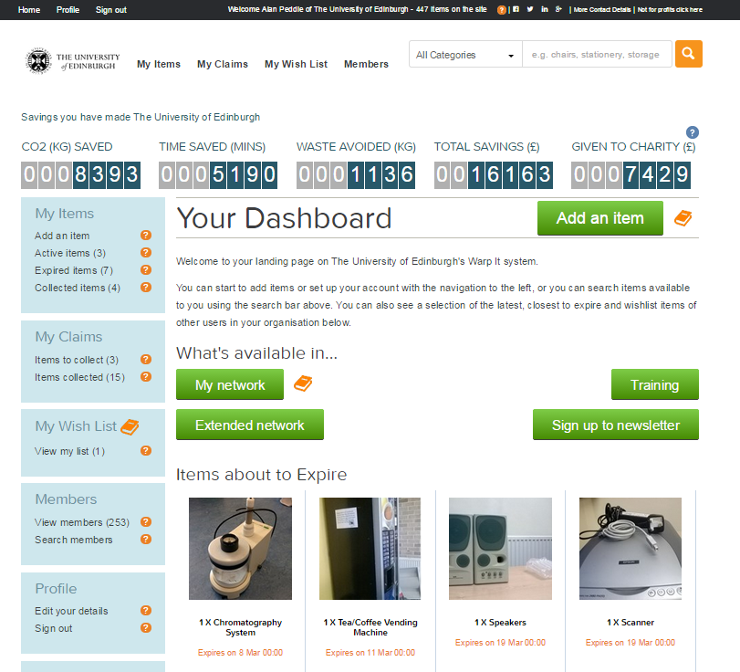
Notes:
The site in action
Dashboard – looks and is easy to use
Main categories on the left, adding an item, claiming and item, searching for an item even wishing for items (write out a wee shopping list and people might realise they have it spare)

Slide 9
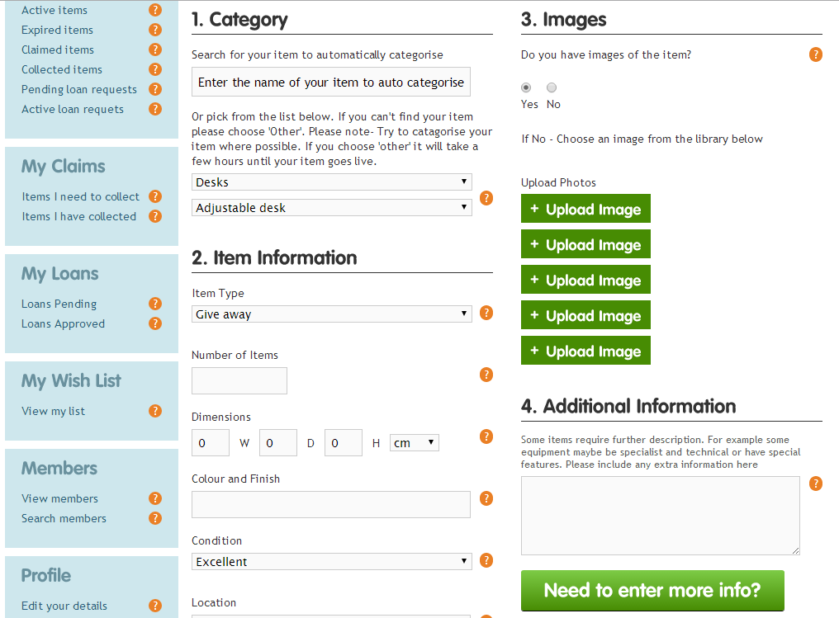
Notes:
Adding an item
4 compulsory questions
Makes you answer if you have electronic materials to say if it is PAT Tested

Slide 10
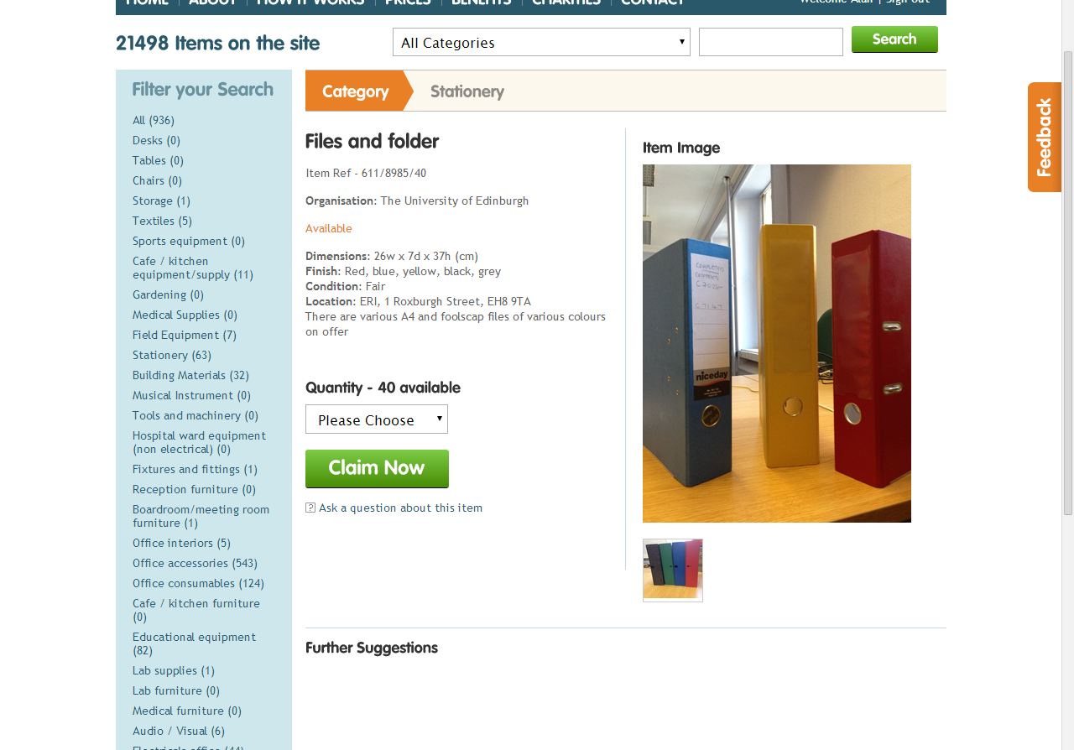
Notes:
Claiming an item
Click on the item, click claim (or amount)
Email triggers to person who uploaded the item

Slide 11
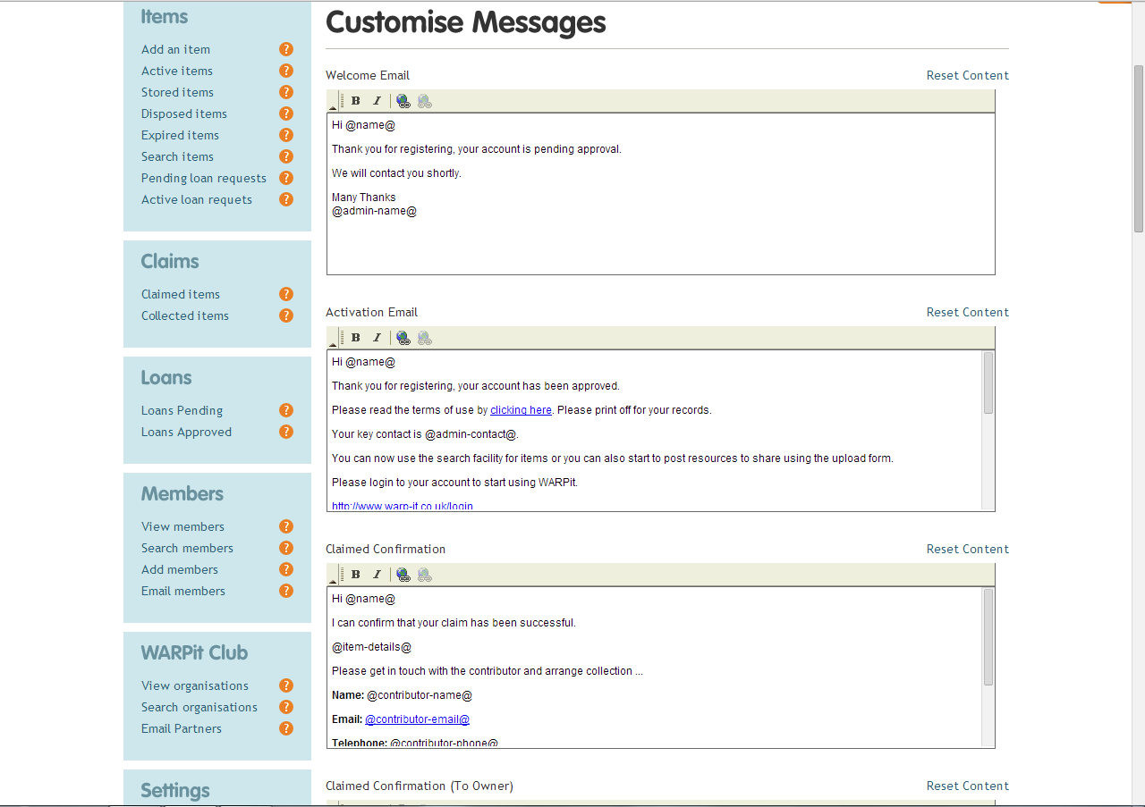
Notes:
Back of house you can customize messages that go to people using the site
Particular way of disposing of electronic waste, it can trigger an email explaining what to do with it
Claim confirmation email, etc, etc

Slide 12
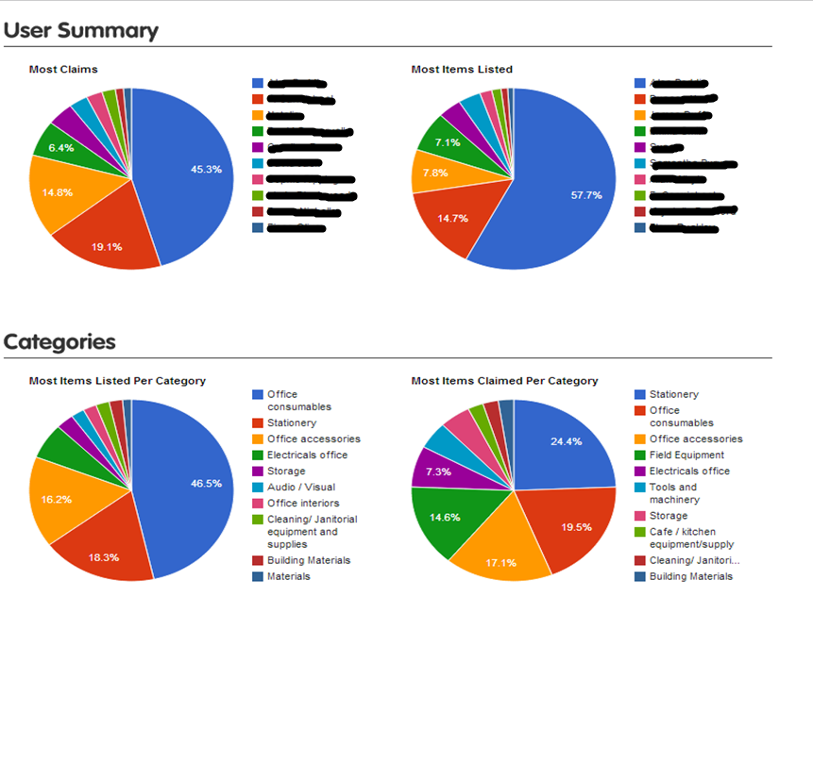
Notes:
Does reporting for you
Transactions report, convert to excel files
User reports, who is claiming, who is listing, types of items shifting, types of items not shifting

Slide 13

Pilot
Notes:
Now we know the challenged, now we know how the site works, lets put it in action
Let a select group of people use an online portal to swap a limited amount of items and see if it works (Mid December – March)
After 1 month we realized the site worked fine
Upped membership through more emails via our SRS Newsletter, putting some information on parts of the Uni website

Slide 14
KPIs
Notes:
Measuring success? In a year and half of usage
Just over 250 members, in a year and a half just over 170 separate transactions
Wanted it to be cost effective, or as close as possible so we could give it another year. In the first year and half
Aim £3750
Charity donations £7429
So far £16163

Slide 15
Other savings
Notes:
Other savings
CO2 8393kg

Slide 16
Other savings
Notes:
Other savings
Waste 1136kg

Slide 17
Electronics
Non data
PAT Tested
1.5 years = 61 transactions = 157 items
Where do we go next?
Notes:
So we stipulated early on that we didn’t want any items with data on the site (we wanted to make it as uncontroversial as possible)
We wanted to make sure that items were PAT Tested
And results show that items did change hands, we are taking keyboards, monitors, mice, desktop printers, speakers, etc, etc

Slide 18
Computers Bought and Disposed
Notes:
So last year we sent 2907 PC’s were disposed of

Slide 19
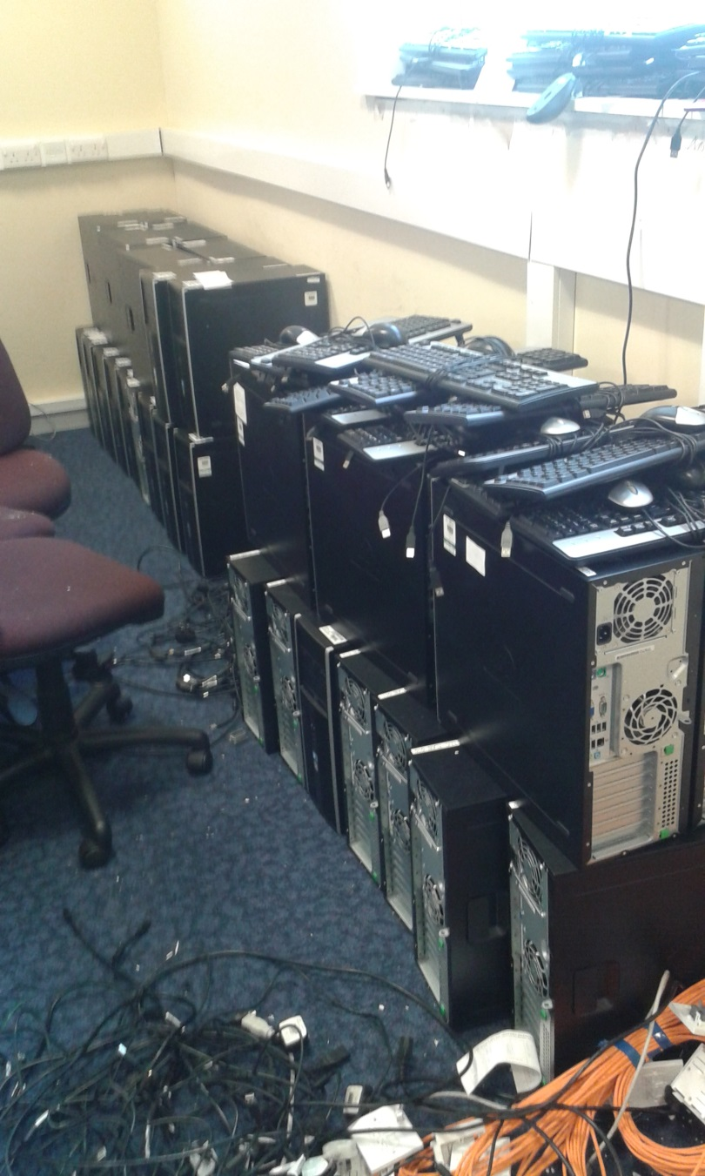
Notes:
Basement of a building that was being emptied, 33 PCs, HP8000s, all fine, bout around 2011. So around 3-4 years old.
We actually went through 3 separate locations and in those rooms, set aside for waste were 83 PCs, 60 keyboards, 60 mice.
Now this is just the stuff we have managed to get our hands on in the short term, so if it was shop we wouldn’t be worried about getting stock.

Slide 20
PC Cascading
PC Cascading
Waste and Recycling
Records management
SRS
IS
Notes:
Now one way of looking at the University is to say that because we have so many different departments it makes it hard to get things through the system.
NOW, one massive advantage this has for me is that very slowly step by step I learn how a thing like PC Cascading works from one step to the next bit by bit and it means that hopefully when the time comes I can make sure it works as the internal politics of the University are not to be underestimated.
But also by having a large organisation you have a lot of people willing to help you and give you really expert advice.
It all really started with the guidance we got from Information Services, then it allowed us to plan a bit better and iron out a few challenges here and there before we went back to Waste and Recycling. Then data was an issue so we spent a bit of time speaking to Records Management to iron challenges there.

Slide 21
PC Cascading plan
Challenges
PC Reps
Guidance
Other PCs
Notes:
So the back of house challenges were making sure we knew what we wanted to happen to each PC and appreciating that each PC is different. Some might come from HR or Finance Departments so on the off chance there is some High Risk person data. We don’t want them as they are deemed inappropriate by Records. But Medium or low risk, boom get on with it.
So, in a very general sense we had to ascertain 1) what types of PCs do we want to cascade 2) how do you cascade them 3) who should deal with all of this
An already existing network of PC reps exist, our contact from IS is tapped into them so go via him and roll out our plans to them and only allow them to do the cascading.
We previously had written up Lab Equipment terms and conditions similarly so we knew it wouldn’t take a lot of administrative work once the idea was cemented. Back of house lots of work, operationally, not much work.
SO. We have a few pieces of guidance that we give to all the reps but the bears bones of it is 1) is the PC within a certain time period? Last five years? Have you wiped the data using the method our IS folk recommend, is it for single use? Have you made a note of the serial number. Go ahead and upload it to WARPit and see if anyone wants it.

Slide 22

How do you solve the data challenge?
Notes:
We are in the very early stages of trying to see if there are any organisations out there that would want PCs minus a hard drive.
The good news is that yes there are.
Our hope is that we can integrate this little extra option in our process so that the last option for any piece of IT kit (as long as it is appropriate) can be swapped internally but then go to one of these organisations who specialize in upcycle and reusing PCs and similar equipment.
Remade are social enterprise based in Edinburgh that “Remade in Edinburgh is a social enterprise which teaches repair skills and works in partnership to campaign for goods to be built to last.”

Slide 23
A new look?
Staff
Third parties
Disposal
Notes:
We are hoping more and more to integrate this way of thinking into our practices and hopefully joining up the work that is already going on and making it more consistent and ultimately lowering our waste and environmental impact.
Thank you any questions?

