Slide 1
Planning menus to prevent food waste
WRAP is a registered charity (no. 1159512) and a company limited by guarantee.
Notes:
WRAP are funded by all UK governments and work with the HaFS sector to reduce waste and increase recycling rates. This presentation will give you an overview of the menu planning process works and how you can influence it to improve your business performance.

Slide 2
Who this presentation is aimed at
Development chefs in larger businesses.
Procurement professionals in Hospitality and Food Service businesses.
Chefs with purchasing authority in Hospitality and Food Service business units.
Finance offices in Hospitality and Food Service businesses.
Those who are training in any of the above roles/functions.
Notes:
The presentation is aimed at all individuals and departments within a business that has some degree of influence on the menu planning process.

Slide 3
What we will cover today
Why menu planning is key to waste prevention.
Notes:
The presentation is aimed at all individuals and departments within a business that has some degree of influence on the menu planning process.

Slide 4
Why menu planning is key to waste prevention
Notes:
Caterers often believe that the management of food waste is mostly to do with things like order and stock levels, or not cooking off too much at once. This is of course correct, but a significant reductions can be made simply by designing menus well, so that waste is eliminated even before the food reaches the kitchen in the first place. Efficient menu planning is intrinsically linked to avoiding waste prevention, so it’s important to continually review and assess menu options. This presentation aims to show how.

Slide 5
Objectives of this presentation
Provide an insight to the importance of effective menu planning and how it can save money and help you reduce food waste.
Help you understand the cost implications of the choices made when procuring, processing, storing and disposing of food.
Pin point opportunities for food waste prevention in your business with some examples of good practice.
Help signatories deliver the Hospitality and Food Service Agreement targets.
Notes:
This presentation aims to:
Provide an insight to the importance of effective menu planning, how it can help your business save money and help you reduce food waste.
Help you understand the cost implications of the choices made when procuring, processing, storing and disposing of food.
Pin point opportunities for food waste prevention in your business with some examples of good practice.
For those who are signatories to WRAP’s Hospitality and Food Service Agreement, this presentation will help you work towards the targets. If you’re not yet familiar with the Agreement and how it can help your business, visit www.wrap.org.uk/hospitality

Slide 6
Source: www.wrap.org.uk/content/food-waste-hospitality-and-food-service-sector
Notes:
Wastage of food in the hospitality industry is a significant problem. If we look at WRAP’s research, we can see that the cost of food waste isn’t just the cost of buying the food, it also includes the costs of storing the food, preparing it, cooking, serving and disposing of it.
Food waste costs the hospitality and food service sector and estimated £2.5 billon per year in 2011 and this is expected to rise to £3.0 billion by 2016
¾ of all food that ends up in the bin could have been eaten
On average, food waste costs each Hospitality and Food Service outlet £10,000 per annum
So apart from this being important from an environmental perspective, it also makes for good housekeeping too.

Slide 7
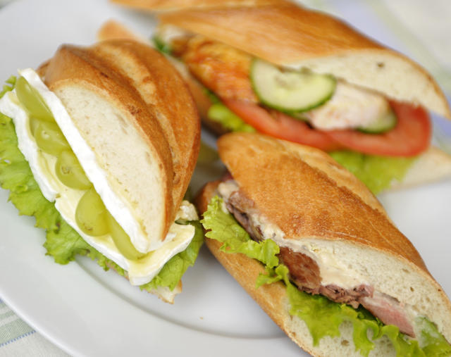
Source: www.wrap.org.uk/content/food-waste-hospitality-and-food-service-sector
Equivalent to 1.3 billion meals a year in the UK being thrown away
1 in 6 meals
Notes:
WRAP’s research shows that the equivalent of 1.3billion meals are thrown away each year. This is equivalent to one meal being thrown away for every six meals that is produced.

Slide 8
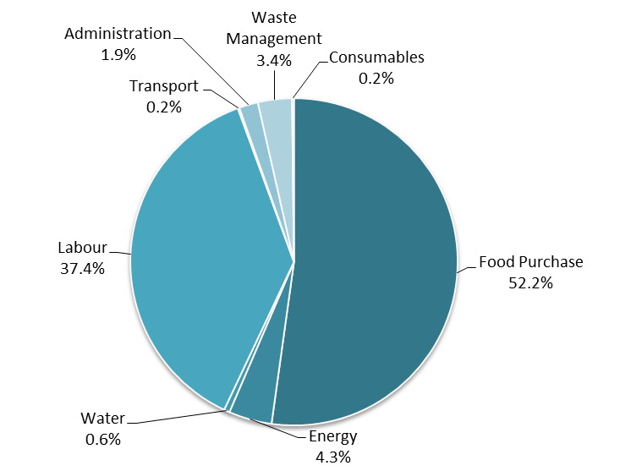
The cost of food waste by cost element
Source: www.wrap.org.uk/content/overview-waste-hospitality-and-food-service-sector
Notes:
When we talk about food waste, many Hospitality and Food Service businesses think just about the costs of waste disposal. These costs are, however, only a tiny proportion of the total cost of waste (at just 3.4% of the total)
What this slides shows is that the majority of the cost of waste lies in the purchase cost of the food and the labour that is required to process it. These two components equate to almost 90% of the cost.
Many of these costs are increasing and so the embedded costs associated with food waste are likely to increase.
Planning menus effectively can ensure food waste is reduced or avoided.

Slide 9
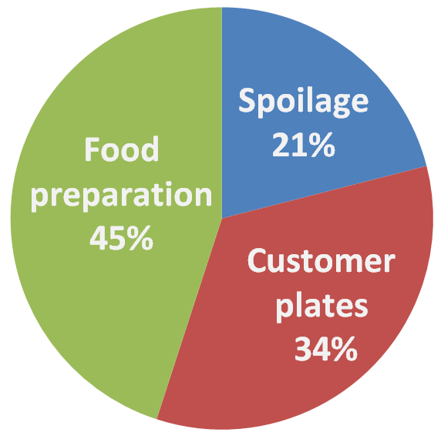
Where does food waste arise?
Source: www.wrap.org.uk/content/true-cost-waste-hospitality-and-food-service
Notes:
Food waste arises across the three areas of Hospitality and Food Service businesses with food preparation making the largest contribution.
Often Hospitality and Food Service businesses place most emphasis on spoilage and food preparation waste (because these are the areas in which they think they can most easily influence change). Customer plate waste, however, is also important and may provide invaluable information about portion sizes or the level of satisfaction with specific menu items.

Slide 10
Composition of food wasted in the HaFS
Source: http://www.wrap.org.uk/content/overview-waste-hospitality-and-food-service-sector
Notes:
Here we can see the breakdown of the type of food wasted in the hospitality and food service sector it shows 40% of food that is wasted is carbohydrates, including potato, bread, pasta and rice. Reduced wastage in carbohydrates would have a significant impact on the total amount of food being wasted by weight. The value of items in the waste, however, is different to the waste profile. Items in the waste that have highest value are often meat & fish and fruit & vegetables.

Slide 11
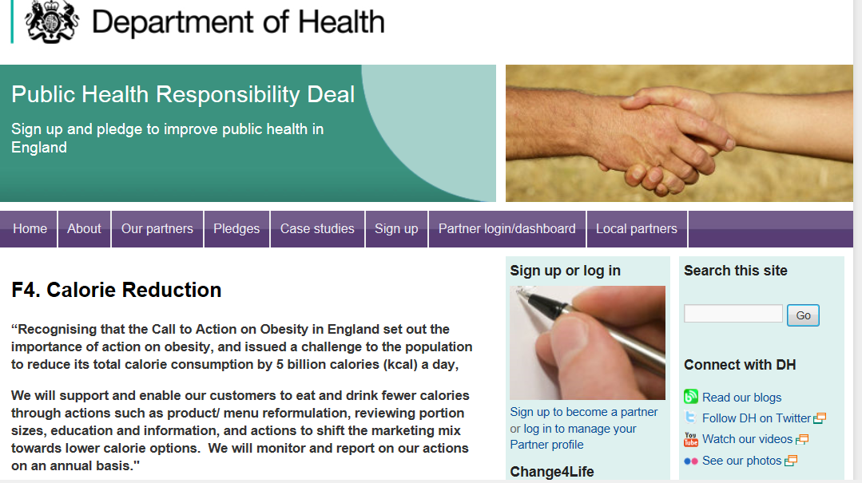
Health responsibility deal
Notes:
Many of the opportunities for waste prevention at the menu planning stage can help to meet other Government policy aims, such as the health responsibility deal on portion size: Reductions to portion sizes of existing products/ menu items
The health responsibility deal also has additional aims (taken from Department of Health website January 2014) such as:
Reformulation: Recipe/ menu changes to decrease energy density; fat and sugar reduced in products, or substituted with other lower calorie ingredients
Development of lower calorie options; Baked products replacing fried e.g. savoury snacks; Calorie restricted products e.g. 99 kcal chocolate bars
Encouraging consumers to choose healthier options: Promotion of smaller portion sizes to encourage down-sizing; other ‘substitution’ promotions to favour lower calorie options
Satiety enhancers: Potential to increase the content of satiating ingredients to decrease overall energy intake e.g. fibre
Balance of portfolio/ menu/ etc: Companies may expand or change their offering to include a greater proportion of ‘healthier’ products/ menu items; Procurement and default options offered to customers are the healthy options e.g. coffee shops use of lower fat milks, caterers and retailers use of reduced fat cheeses, spreads and lower fat meats etc.
Activity intended to inform and educate consumers towards making healthier choices: This could, for example, extend into meal composition and food preparation, such as funding healthier eating sessions in local schools - such action should ideally accompany other actions.

Slide 12
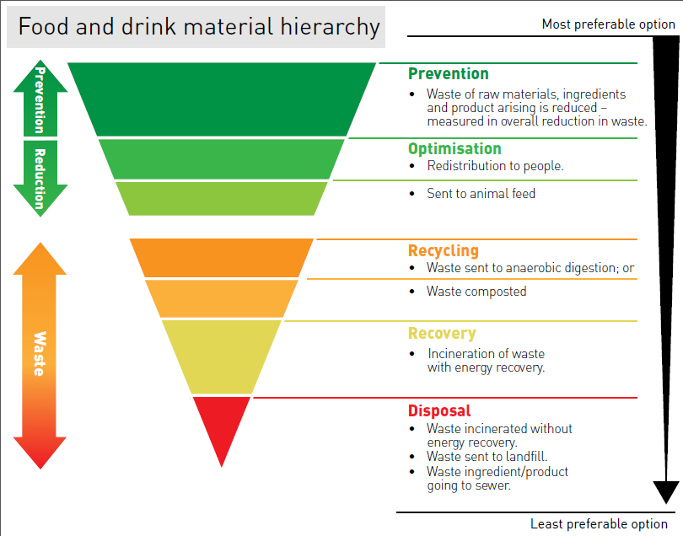
Opportunities for waste prevention
Source: www.wrap.org.uk/content/foodredistribution
Notes:
When we view waste prevention within the waste hierarchy we see that waste prevention comes at the top of the hierarchy. – preventing waste arising in the first place will be the best way to deliver financial as well as environmental savings.

Slide 13
Menu planning can help to prevent waste by:
Managing the supply chain.
Minimising packaging.
Using all your stock.
Minimising preparation waste.
Optimising portion sizes.
Redistributing and reusing food items that have not been sold.
Notes:
The most important thing to remember on menu planning is that in general more complication generates more waste. As caterers we are always keen to give our customers plenty of choice, which of course is good – but when that extra choice is made without good thought and planning, the result can be impact on the amount of food wasted.

Slide 14
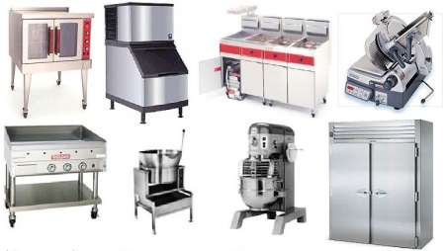
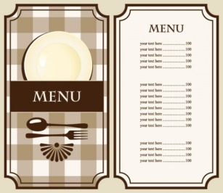
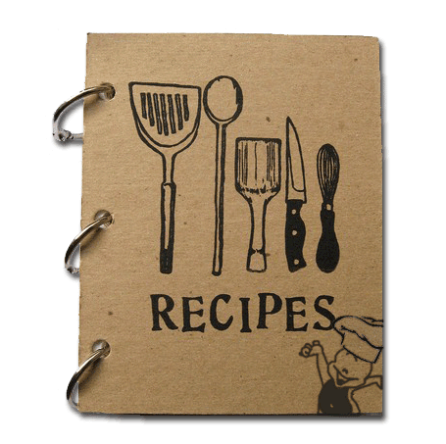
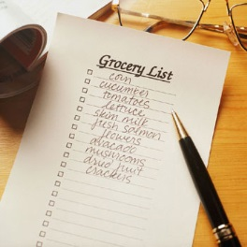
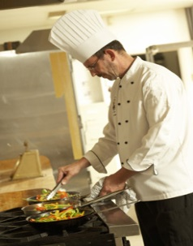
Value chain in overview
 |  |  | Equipment
Concept | Menu | Dishes | SKU’s | Guest Experience
 |  |  | Process
Notes:
In order to understand how menu planning can positively impact food waste it’s helpful to see catering as a “value chain”. When someone sets up a catering organisation they do so with a vision for what will make it special. This is then interpreted into menus, which in turn generate recipes. These turn into ingredient lists, and are cooked on kitchen equipment, by chefs. The result is usually a delicious experience for the diner. But along the way, lots of decisions get made, most of which can and do impact on the amount of food that ends up being wasted. Some menus for example have as little as 8 dishes on them, others over 100. Which one will typically generate the most waste? As you can guess, it is the menu with over 100 dishes.

Slide 15
Why menu planning is key to waste prevention
Business strategy
Define your:
Vision
Mission
Route-map
Competitive difference
Establish how you are:
Unique
Different
Better
Menu planning
Analyse:
Range
Product
Price
Volume
Production planning
Define your:
Equipment
Storage
Skills
Make v Buy
Store/Order
Recipe
Define:
SKUs
Specific- ations
Consider make /buy options
Sourcing & Distribution
Define your:
Manage source
Optimise distribution
The Food Service Value Chain
Notes:
This is a more formal way of looking at a food value chain. Almost all of the items contain decisions that can impact on the amount of food being wasted. Take the Recipe box for example. The higher number of SKUs (ingredients) used to deliver the menu the more food that has to be purchased, stored and ultimately either eaten or thrown away. Meat portioned to the ideal weight for the consumer will prevent plate returns, and part baked bread with a long shelf life will allow smaller batches to be cooked and less waste to occur. Similar opportunities exist within almost every box in the value chain above.

Slide 16
How can menu planning prevent waste?
Menu range
Ingredients
Supply capability/pack size/packaging
Stock levels
Stock turn
Make versus buy
Shelf life
Storage
Equipment
Skills
Portion size
Notes:
When you pause to consider it there are so many ways in which menu planning can influence waste prevention. These include:
Giving your customer the right amount of choice. Look around at your competition or peer organisations. There are many examples of successful caterers delighting their customers with a more limited choice of dishes. The 60:40 rule applies to menu planning – i.e. 60% of menu items will comprise 90% of orders in many businesses. The remaining 40% account for the remaining 10%. The more items there are on the menu, the greater the number of ingredients and mise en place required to service them and the higher the potential for waste.
Cross utilise ingredients so that more than one menu item uses each ingredient.
Buy small quantities of short shelf life items, or utilise ingredients with a longer shelf life.
Keep the range of ingredients down, so that more of each ingredient is used – so that there is greater stock turn on every line.
Ensure your equipment is fit for purpose and the layout of the kitchen is optimal for your requirements
Making sure staff are trained on how to reduce spoilage and kitchen waste.
Offer customers the choice of different portion sizes e.g. for smaller portions you could offer a refill/second helping.
Consider offering customers options for side dishes so that they can order what they prefer and will not leave food on the plate.
Do less batch production and cook more to order.

Slide 17
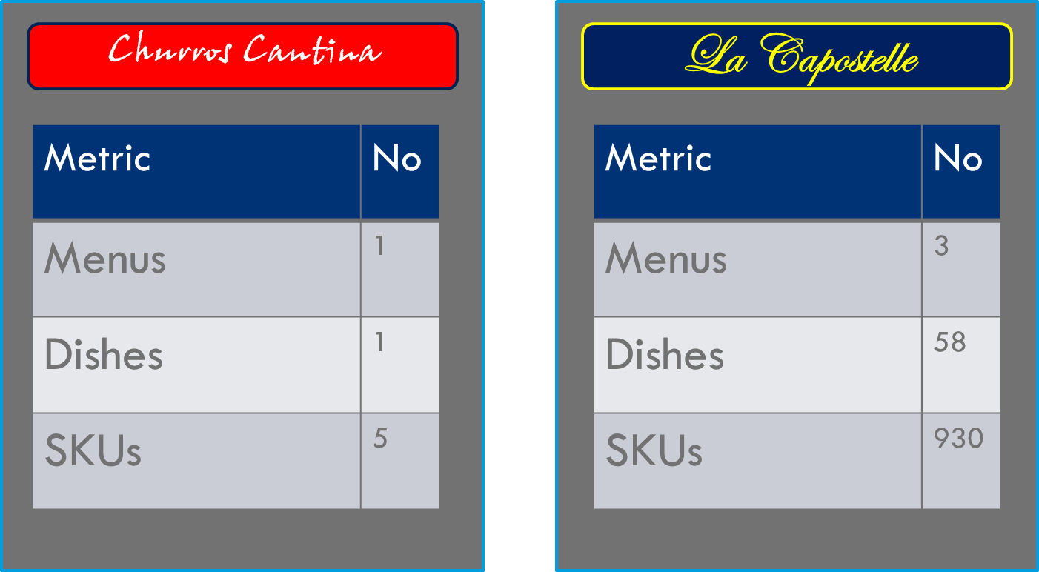
SKU impact
Notes:
Here’s a simple example of how two fictitious restaurants demonstrate that ingredient range has a direct impact on the increased probability of waste. The first one is called ‘Churros Cantina’ and only sells one product type – Churros with Chocolate Sauce. The second is a smart Italian diner called ‘La Capostelle’ and sells a multitude of menu options across three different menus. The result is that the ‘Churros Cantina’s one dish results in a very low number of SKUs; 5. ‘La Capostelle’ on the other hand has so much variety that it has 58 dishes resulting in 930 SKUs.
This is in no way intended to suggest that the La Capostelle business model is flawed, rather it demonstrates how a relatively modest increase in dishes can have an enormous influence on the number of ingredients used. This in turn means more storage, more mise en place, and almost certainly more waste. So the important thing to note is that you can improve your menu planning within your existing business model rather it forcing you to change it.

Slide 18
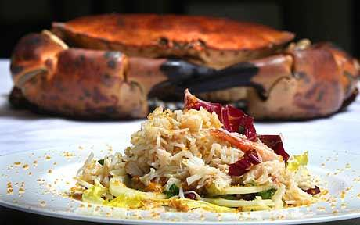
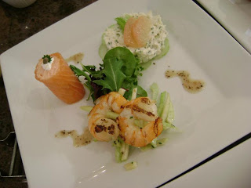
Recipe impact
1 dish
8 ingredients
4 cooking processes
20 mins. chef time
1 dish
23 ingredients
10 cooking processes
55 mins. chef time
Notes:
Following on from the overall menu options, menu planning also has an impact on specific dishes. In two different hotel restaurants, both were offering crab as a menu option. One was a simple salad which had 8 ingredients, 4 cooking processes and took up chef time for 20 minutes. The other was a trio of crab which required 23 ingredients, 10 different cooking processes and took up 55 minutes of chef time.
Reviewing all parts of the menu, including how each dish is constructed and prepared is vital to maximising the best from your menu.
Interestingly, the crab salad tasted the best, and was lower price and higher margin too.

Slide 19
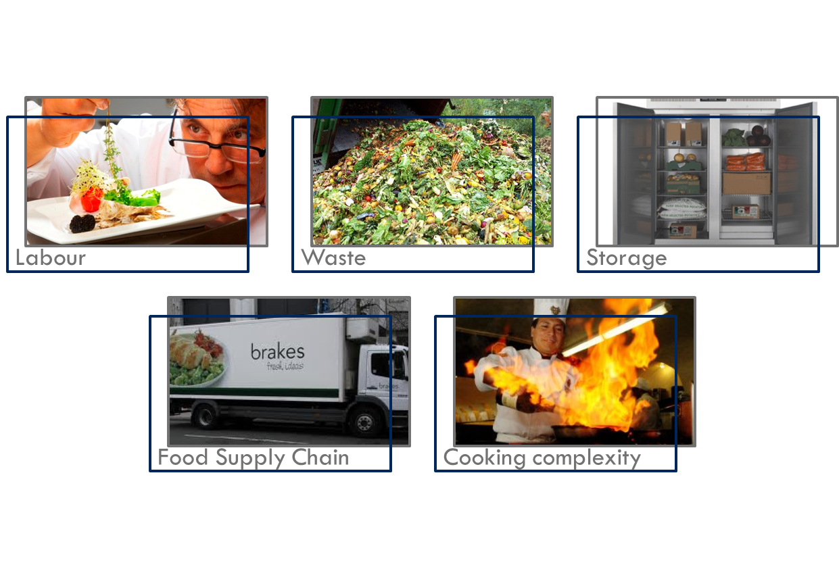
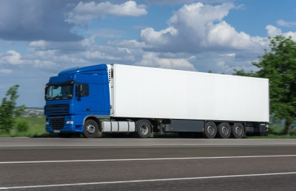
More SKUs has a wide impact
Notes:
So having more ingredients has a substantial impact on food waste. Here’s a simple summary of how:
Every new ingredient you put on a menu has to be cooked or prepared in some way – this may put more pressure on labour cost as well.
Every new ingredient has a proportion of it that may be wasted, which could push up the amount of food wasted.
Every new ingredient requires storage – if it’s chilled or frozen it uses energy to store it too.
Every new ingredient means another box on your supply truck, which creates more complexity upstream in your supply chain.
Every new ingredient adds complexity to your cooking.
It is worth noting that changes to existing dishes are essential to most hospitality and food service outlets as tweaks reflect seasonality and retain customer interest.

Slide 20
An exemplar
Notes:
This business is a great example of how good menu planning can keep food waste down and positively impact profits as well. It’s a Vietnamese fast casual chain called PHO. At Pho they pay a great deal of attention to keeping the number of ingredients down by using many within multiple dishes. By great imaginative design they give the diner loads of choice but keep their ingredient list to one of lowest in their sector. They also look very carefully at what gets made versus what gets bought in, so that they maximise their labour efficiency, whilst keeping food waste to an absolute minimum. Go take a look.

Slide 21
Another exemplar
Notes:
Here’s another example. Tampopo are a successful operation in the North of England who specialise in pan-Asian cooking. They have several branches which are all on the same menu. When they came to move into London they knew that they had to create a different concept (East Street) and menu to meet the needs of the London market. They managed to do this using the same ingredient list as their Tampopo restaurants. The result was that they were able to plug in their existing supply chain – reducing complexity again.

Slide 22
Model analysis metrics
Notes:
The best way to improve the performance of your business by reducing waste through menu planning is to model the results on an ongoing basis. Here are some ways in which this can be done

Slide 23
Dynamic menu modelling
Gather data on customer needs
Gather data on food waste
Create/review recipes and menus
Determine / measure ingredients/
SKU’s
Measure outputs - analyse data
Notes:
One way is to use ‘Dynamic Menu Modelling’.
Start by assembling any information that you have on customer need – this includes historical sales mix on types of dishes, and may also include feedback from customer surveys, or focus groups.
Compile data on the amount of food waste – analysing spoilage, preparation and kitchen waste as well as plate waste from customers.
Using the information in step 1 and step 2 compile your menus, develop your recipes, determine the range of ingredients that you will use, and start serving your customers.
Start measuring the outputs – customer sales mix, gross profit, and essentially the levels of food waste generated. This can be done on quite short time periods – a month, or even a week is all that is required.
Once complete, you have a starting point from which to measure progress. Now start the process again using the knowledge you have gained, and try changing the range of dishes or the recipes in order to reduce the number of ingredients – then start the process again and measure the outcomes. By reviewing customer feedback, sales mix, gross profit and food waste levels, you will within a few iterations make significant gains through this method. For example, a company recently reduced food waste by 29%, improved gross profit by 1.3%, and improved guest feedback scores at the same time, by using Dynamic Menu Modelling.
WRAP has lots of support available to help you measure food waste: www.wrap.org.uk/waste_measurement

Slide 24
Metrics model
 | Range | SKUs | Covers | Revenue | Gross profit | Spoilage | Prep waste | Consumer returns | Stock Value | Stock Turn
 | # | # | # per week | £ per week | £ per week | Kilo per week | Kilo per week | Kilo per week | £ | Cost of Sales/Stock value
Starters
Main courses
Desserts
Others
Total
www.wrap.org.uk/waste_measurement
Notes:
To start the planning review, it is good to document a whole menu on a grid like this one, documenting everything from the number of dishes and SKUs for a course right through to the spoilage and customer returns. This gives an in depth view of a whole menu.
Once this task has been completed, you can amend the number of dishes, or review the composition of the ingredients, or change the cooking process, then monitor it for a week and then compare the data against the original figures. This will help really refine your menus.

Slide 25
Example KPIs for dynamic menu modelling
 | Range |  | Covers per menu item | Revenues per menu item | Gross profit per menu item | Spoilage per menu item | Prep waste per menu item | Consumer returns per menu item
 | # |  | # per week | £ per week | £ per week | Kilo per week | Kilo per week | Kilo per week
Total
 | SKUs |  | Covers per SKU | Revenues per SKU | Gross profit per SKU | Spoilage per SKU | Prep waste per SKU | Consumer returns per SKU
 | # |  | # per week | £ per week | £ per week | Kilo per week | Kilo per week | Kilo per week
Total
Notes:
Once you have the base data assembled you can also develop Key Performance Indicators (KPIs) by combining any of the data points that you collect. By focusing particularly on the number of dishes (range) and the number of ingredients you can watch as you gradually refine your menu to higher levels of performance.
The information should be collected on a basis that is appropriate for your company; this may be on a daily or weekly basis. The information should be shared with staff to get them motivated and ensure they are fully involved in tackling food waste.

Slide 26
Notes:
Another way of ensuring an efficient menu planning process is to ensure that it is a team based activity, with everyone that can make a difference fully involved. This example shows a high level view of the menu planning process used by a hotel chain. There are six different people involved in menu planning, each with an important role. The Food & Beverage Director sets some high level goals for the new menu – covering sales and profit targets, spend per head, and customer satisfaction. The Marketing Manager inputs customer information from client feedback forms and focus groups. Food & Beverage control overlay this with historical menu sales mix. Once the Food & Beverage Director refines the menu’s goals based upon the additional inputs the brief hits the Exec Chef’s desk to create a draft of the menu. This is discussed with the Purchasing Manager to ensure that the right ingredients are selected, and that they are available at best cost. The first draft is then reviewed by the full team before being piloted/tested live with clients. At this stage the Restaurant Manager becomes involved to input service requirements, and Food & Beverage Control finalise the menu’s costings. At this point every member of the team is involved, all contributing their own value to the process. The menu is then implemented and reviewed – perhaps using Dynamic Menu Modelling. The detail of the menu holds the key to success on profitability, customer satisfaction, and food waste in any food operation, and a team based plan such as the one above ensures that the best possible results are obtained.
In particular staff involvement and full engagement will ensure strategic planning is implemented as staff will understand the importance of effectively managing food waste and the implications their actions have. Again mention staff involvement and motivation – getting people behind this so that they understand the importance/implications of effectively managing this is key to delivering change – please add a sentence on this

Slide 27
Allergens and Menu Planning
In December 2014 the new EU Food Information for Consumers Regulation 1169/2011 (EU FIC) came into force. Food businesses are now required to provide allergy information on food sold unpackaged, in for example catering outlets, deli counters, bakeries and sandwich bars.
Essentially, the regulations require caterers to be able to provide information to their diners on each of a list of 14 allergenic ingredients. This information is “dish-based” – as a customer needs to be able to find out from the caterer if any (and which) of the 14 are present in any of the menu dishes.
Visit food.gov.uk for more information.

Slide 28
What does this mean for chefs?
Dishes need recipes
Ingredients need assessing for allergens
Recipes, ingredients and allergens need recording
In particular, composite or
part prepared ingredients require
special attention.

Slide 29
Grouping information into lists
One way to address EU FIC is by using one or more of the lists suggested opposite.
Creating a list of Ingredients allows you to base endless recipes with those ingredients included. If you record the recipes you can track each dish back to inform the diner of the allergen information required.
Recipe lists takes this one step further. By creating a standard list of recipes you can record easily which dishes contain which allergen.
Taken to its ultimate, compiling a list of menus simplifies the process further.
Ingredients
Lists of ingredients
Each ingredient with its own record of source and allergens
Recipes
Lists of Recipes
Each recipe with its own record of allergens
Menus
Lists of Menus
Menus with each dish having recipes
Ingredient lists within Recipes
Each recipe with its own record of allergens

Slide 30
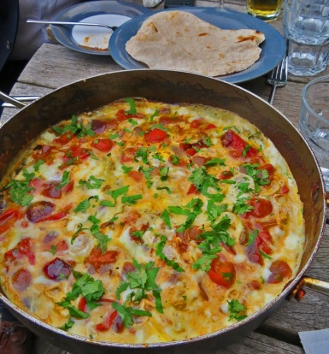
Grouping information to reduce Food Waste
Going through the process of creating a group of information into lists (be that Ingredient, Recipe or Menu) gives you the opportunity to examine the range of ingredients that you are using. As a rule the more ingredients that you buy, the more food waste is created. The reasons are simple:
The more dishes you put on the menu, the more ingredients that you have to buy
The more ingredients you buy the more stock you have to hold
The more stock you hold the more storage waste that happens

Slide 31
Top tips
So, when you are reviewing your ingredient lists, here are some simple tips to keep your ingredient list under control:
Focus on menu items that are popular with your customers
Use common recipes but with small variations for interest
Keep recipes simple, focus on ingredient quality and cooking
Develop dishes that use some ingredients from other recipes
Keep the range of pack sizes that you buy to a minimum
Buy ingredients with the longest shelf life

Slide 32
Thank you
Find out more
visit www.wrap.org.uk/hospitality
You Tube channel
hafs@wrap.org.uk
Notes:
In summary, the creation of highly effective menus is not only a critical process in the avoidance of food waste, but an essential part of creating happy customers, and good margins in every catering organisation.

