Slide 1


Food Packaging & Procurement
Claire Guerin
Sector Manager – Sustainable Procurement
claire.guerin@zerowastescotland.org.uk
zerowastescotland.org.uk
@zerowastescot
Notes:
Zero Waste Scotland Title Slide – image version

Slide 2
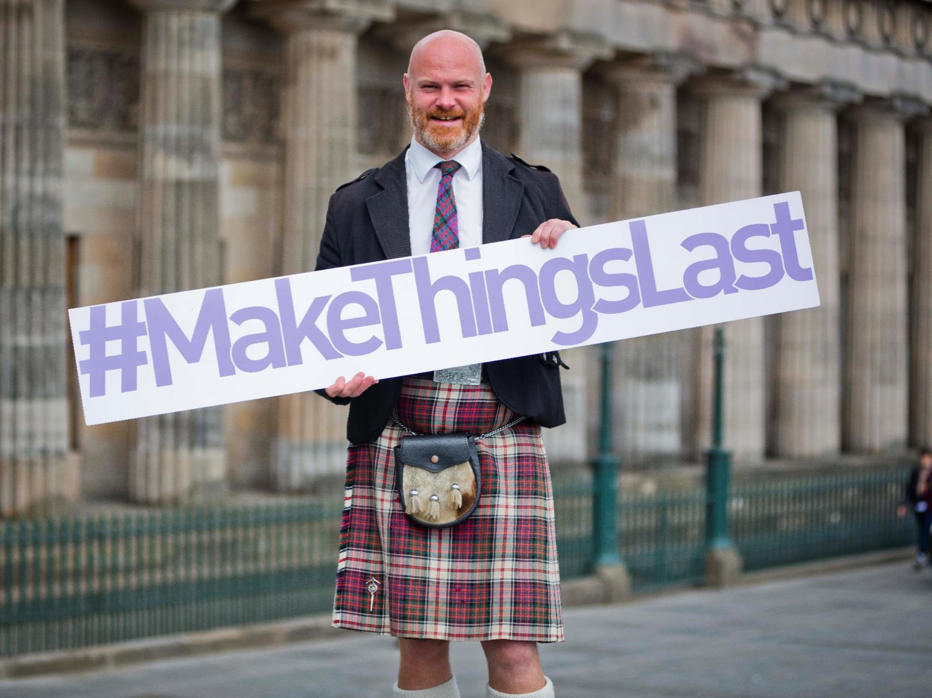
Notes:
Scotland is a leading nation on the circular economy – in which products and materials are kept in high-value use for as possible via closed loop systems, and goods and services are designed to ensure longevity. Single-use items are representative of our current, throwaway society.
Our national circular economy strategy – Making Things Last
The Scottish Government has placed the circular economy at the core of Scotland’s Economic Strategy and Manufacturing Action Plan, and its Making Things Last strategy highlights priority areas with the greatest opportunity to deliver economic, environmental and social benefits. This at a time when many countries are only just beginning to think about the circular economy, or are not working towards it yet at all.
Our progressive policy approach is matched by major investment to 'make things happen'.
Evidence suggests that adopting the circular economy could be worth up to £1.5bn to Scotland’s economy and save around 11 million tonnes of greenhouse gases per year by 2050.

Slide 3
About Zero Waste Scotland
We exist to create a society where resources are valued and nothing is wasted.
Our goal is to help Scotland realise the economic, environmental and social benefits of making best use of the world’s limited natural resources.
Notes:
Zero Waste Scotland exists to create a society where resources are valued and nothing is wasted. Our goal is to help Scotland realise the economic, environmental and social benefits of making best use of the world’s limited natural resources.
Intro to ZWS slide – who we are and what we do.
We are Scotland’s circular economy expert organisation.
We exist to create a society where resources are valued and nothing is wasted.
Our goal is to help Scotland realise the economic, environmental and social benefits of making best use of the world’s limited natural resources.
We’re funded to support delivery of the Scottish Government’s circular economy strategy, Making Things Last. We receive additional funding to support the EU’s 2020 growth strategy.
What is our role in relation to plastics?
The campaigns to ban or reduce single-use plastics tie closely in to our work around waste prevention, litter prevention and recycling, and specifically to our work on DRS. Our European-funded Circular Economy Investment Fund and business services is also supporting the development of new business models, which might design out waste, and is investing in new technologies to collect and reprocess plastics
Zero Waste Scotland is a founding member of the New Plastics Economy, an initiative led by the Ellen MacArthur Foundation aiming to accelerate a circular economy for plastics. We are also in discussion with WRAP about their Plastics Commitment, which is due to be launched in spring 2018.

Slide 4

We help buyers
Research
  Create & Refine Guidance
Practical support
  Mentoring
  Online Resources
European Engagement
  Knowledge exchange
Notes:
Optional – audience are procurers so would be interested in this – but as our current mentoring offering is narrowed to focus on change leader projects only might be best to leave this out for now and see if anyone gets in contact post conference that wants to work on a specific project that has potentially good CE outcomes.
We provide mentoring support to public sector procurement professionals, helping them to identify and capitalise on circular procurement opportunities such as leasing, repair and re-use, remanufacture within relevant procurements. The programme is underpinned by previous research that identified priority areas of focus (e.g. textiles, electronics, furniture, catering, construction, medical devices) and the creation of a commodity guidance document “Procuring for Reuse, Repair & Remanufacture”, containing suggested clause wording and considerations to implement at each stage of the procurement process. To date procurements supported have a total value of £1.2 billion. Those with the greatest potential to embed circular economy outcomes are being followed up at regular intervals to capture outcomes.
Recently joined SPP Next, the European Union platform for sustainable procurement policy. This will keep Zero Waste Scotland at the forefront of good practice across Europe and also allow us to showcase the best examples from Scotland with European partners.

Slide 5

Food Packaging & Procurement
Overview
Background and context
  scale of the issue
Government action
The role of people
The role of procurement
Project examples

Slide 6


Plastic bottles
1 billion
plastic bottles on the Scottish market each year (over 2 billion drinks containers of all materials)¹
20 million
of these plastic bottles are littered in Scotland each year
120,000 tonnes of plastic packaging waste is produced from households in Scotland each year²
800,000 tonnes of UK plastic packaging waste per year equates to around 65,000 tonnes of plastic packaging in Scotland
15,000 tonnes of plastic bottles in residual waste could be worth between £375,000 and £1.95m if recycled instead
1. Eunomia for Zero Waste Scotland 2015, scaled from 2012 UK data 2. This is a per capita calculation for Scotland, based on a figure of 1.5m for UK households
Notes:
Zero Waste Scotland body text slide.

Slide 7
Disposable cups
- wake up and smell the coffee
Scotland generates
2 million disposable coffee cups a year
Disposable coffee cups are difficult to recycle due to their material composition
Avoiding the need for disposable cups through re-use is the best way to reduce their environmental impacts
Notes:
Zero Waste Scotland body text slide.

Slide 8




But plastics do have a place….
Medical
Applications
Car
Manufacturing
Food
Preservation
Household Appliances
The debate should be about how we minimise them, while we work with all parties to improve infrastructure and product design to ensure the things we need for everyday life can be used for longer
Notes:
We do not necessarily support full ban on single-use plastics. We recognise that in many circumstances, single-use plastics fulfil an essential function, such as extending the shelf life of food waste. Instead we are working with key stakeholders, primarily manufactures and retailers, but also consumers, to minimise the use of single-use plastics across the board, and increase the range of alternatives, including recyclable or re-usable options. We will support the Scottish Government in having these conversations and informing the work of the Expert Panel so that we take the most appropriate action to tackle the impact single-use items has on our environment.

Slide 9
Scottish Government banning of single use cotton buds
UK Government announce plans for Deposit Return and plastic straws ban
Target date for UK Govt. 25 year plan to eradicate all avoidable plastic waste
EU strategy target date, all plastic packaging on the market should be 100% recyclable. Scotland has matched this commitment
Scottish Government Programme of Work, Deposit Return Scheme & Expert Panel on plastics announced
Parliamentary debate on “Stemming the Plastic Tide
2017
2018
2018
2018
2030
2042
Notes:
In the Programme for Government 2017, the government announced the intention for form an Expert Panel on Environmental Charges and Other Measures. This panel will give advice to the government on taking action for a range of materials, ranging from tyres to as well as how we take action on reducing the number of single-use items we waste in Scotland.
A debate on ‘Stemming the Plastic Tide: Action to Tackle the Impact of Single-use Plastics on Land and in our Seas’ was held in Parliament on 7th February 2018. This demonstrated cross-party support for action on reducing the impact of plastics on our environment.
In 2018, the Scottish Government announced the ban on the sale of plastics microbeads, which are commonly found in cosmetic products.
The Scottish Government has recently announced its intention to ban single-use plastic stemmed cotton buds, and also to match the EU commitment to remove non-recyclable plastic packaging from the market by 2030.
The EU launched its plastics strategy, which contains the commitment that all plastic packaging on the market should be 100% recyclable, by 2030.
The UK Government pledged to eradicate all ‘avoidable’ plastic waste by 2042, urging supermarkets to introduce plastic-free aisles, and seeking evidence for a possible charge on single-use plastic containers such as takeaway boxes.

Slide 10
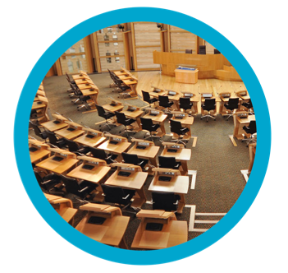

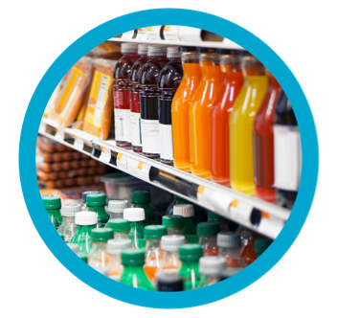

Everyone has a role to play in plastics
Governments
Policy and regulation
Manufacturers
Make things
that last
Suppliers/retailers
Select recyclable product options
Consumers
Make the right choice
Notes:
Governments – discussed in previous slides
What can suppliers/ retailers and manufacturers do?
Zero Waste Scotland would like to see retailers and manufacturers ensure that:
They are considering the design of packaging to look for alternatives that support reuse or a reduced impact on the environment.
They are using items made from recycled content, helping build the demand for recycled products here in the UK.
They are making their packaging fully recyclable, which might mean using a more limited range of plastics types and avoiding composite or laminated packaging.
They are taking steps to reduce the ‘leakage’ of plastics during their operations, such as loading vehicles. Initiatives like Operation Clean Sweep are encouraging businesses to take action to improve this.
They are adding their collective weight to campaigns and communications initiatives.
There have been a slew of recent announcements from retailers making changes to minimise their environmental impact. For example:
Wagamama and Costa recently pledged to end their use of plastic straws.
McDonalds committed to make all of its packaging from renewable or recycled sources.
Iceland has become the first major supermarket to pledge to go plastic-free on own-brand products.
In 2015/16 Sainsbury’s redesigned its two-pint milk bottles to be 14.6% lighter. Based on current sales, the supermarket says it should save 580 tonnes of plastic per year.
What can councils and resource management companies do?
Zero Waste Scotland would like to see collectors and reprocessors ensure that:
They are signed up to and are implementing the necessary changes that support the Household Recycling Charter, or a collection system that is similar (for businesses).
They adhere to or adopt quality standards to ensure that the value of plastics collected for recycling are as high as they can be.
They continue to invest in technology and infrastructure to support the collection and reprocessing of plastics.
They are taking steps to reduce litter and bad management of waste, which is often the cause of plastics ‘leaking’ into the land and marine environment.
Consumers – next slide with actions..

Slide 11

How can procurement
play a role?
DESIGN & DEMAND
Influence design, for re-use and recyclability
Stimulate demand for recyclable options
Notes:
Where plastics are used, these should be practicably recyclable. Practicably recyclable means collections and reprocessing infrastructure is technically and economically feasible with examples in the UK or abroad.
PET bottles (except opaque), HDPE bottles and non-black PP bottles
PP and HDPE pots, tubs and trays
Influence the design stage where possible to consider reuse of packaging as well as recyclability.
Composite materials (i.e. where more than one plastic is bonded to other materials) are currently difficult to recycle.
We need to stimulate demand for recycled content – this will support the economic case for recycling. Procurement could support the ‘pull’ factor and build the economic case for improving current recycling rates by specifying high % recycled content in packaging

Slide 12

Food for thought
Plastic packaging can extend the life of a product.
Important for procurement to consider 3 key R’s.
1. REMOVE
2. RENEWABLE
3. RECYCLABILITY
Notes:
1. REMOVE: Option to specify removing packaging?
2. RENEWABLE: Is there a renewable alternative?
3. RECYCLABILITY: Would an alternative support recyclability?
Additional notes
Plastic packaging often serves a useful purpose to sustain or extend the life of a product, most notably food.
If choosing alternatives, consider:
is there any option to remove packaging for this product?
Is the alternative made from renewable materials (e.g. wood/paper/plant)?
Will making it from alternative material support the achievement of ‘recyclability’ (e.g. It could be added to paper recycling collections) or reuse?

Slide 13

Composting,
biodegradable
packaging
Notes:
My notes on this subject:
When properly disposed of via composting, biodegradable packaging can provide a more sustainable single-use packaging option. The unfortunate reality however, is that this rarely occurs. Most biodegradable packaging ends up in residual waste stream and ultimately, in landfill where is breaks down to produce methane gas, a powerful greenhouse gas 25times more potent that carbon dioxide.
https://www.marinelitterthefacts.com/faq states that ‘Sometimes it is suggested that biodegradable or compostable materials could be a solution to plastic in the ocean. With the current materials available, these require specific circumstances, such as very high temperatures, specific anaerobic conditions or UV light exposure, which will not occur in the oceans (or in landfill, for that matter). The UN also cautioned that using these materials may actually increase littering as consumers would assume that because these materials would breakdown overtime it was acceptable to litter them. If compostable or biodegradable materials are used, it's also important that they don't enter the recycling stream as this can have detrimental effects, rendering the recyclate unusable.’
The EU published recent guidance on the impact of the use of oxy-degradable plastic – http://ec.europa.eu/environment/circular-economy/pdf/oxo-plastics.pdf

Slide 14



Cutting down on disposable
coffee cups…
Initial findings from two pilot projects indicate that charging for disposable cups is having a positive impact on the uptake of re-useable ones.
Talk to us if you’re interested in exploring options around this.
Notes:
3 participants in the study – only 1(St Andrews) uni/college – need more.
Zero Waste Scotland (ZWS) is seeking before and after data from organisations which have implemented, plan to implement, or would like to implement a disposable coffee cup (DCC) charge on their estates. ZWS will use this data to evaluate the behavioural impact of DCC charges on reusable cup (RC) usage rates in order to support public discourse and public policy discussion.
In September 2017, First Minister Nicola Sturgeon announced the Scottish Government would explore the potential for a disposable cup charge in Scotland. Packaging charges can be a more effective means of changing behaviour and increasing packaging reuse rates. Scotland’s 5p carrier bag charge for example, reduced single-use carrier bag consumption in Scotland by 80% within its first year. A recent UK field study found that when combined with other measures, a DCC charge could increase reusable cup rates by up to 12.5%, with an individual contribution of 3.5%.
ZWS is unable to provide financial support to POs, but will provide in-kind contributions (advice, analysis and project communications materials). Costs to POs should be minor and limited to time altering the EPOS system. Costs may be offset by waste management and procurement savings. Run the trial for 5 weeks.

Slide 15
NHSS Plastic Cups
  Procurement Strategy for Catering Disposables (2016)
  LCA: Commodity Advice
  Market research
  Pre-procurement trials (CE Investment Fund )– reusable & disposable options
  Inform framework retender – new requirements
    Fully recyclable reusable & disposable specification
    Collection requirements
    Charging/incentives
Notes:
ZWS advised on Procurement Strategy for the Catering Disposables Framework in 2016 prior to retender. A high-level life-cycle assessment of single use catering cups was undertaken by ZWS using procurement data and demonstrated that a re-usable cup, used multiple times, had the lowest impact. The analysis, along with market engagement & further research led to pre-procurement trials being developed & supported through the ZWS Circular Economy Investment Fund. The trial results will inform Procurement Strategy on developing an appropriate specification to enable procurement of single polymer cups that can be either collected in a closed loop recycling system (single use patient environment), or can be reused multiple times in areas with low infection control risk.
How did it happen? The NHS Commodity Manager wanted to do something innovative & different.

Slide 16
Innovation – World Class Plastic Sorting Infrastructure: Project Beacon
Mechanical Recycling
All plastic
Unrecoverable
Chemical Recycling
Notes:
Complete plastics recycling, new technologies and innovative integrative approach.
A global first, being piloted in Scotland.
Over 90 per cent of all received plastics will be recycled to new value-added uses.

Slide 17

Measures we can all take:
REDUCE
Say no to straws Shop smart
Keep your cup Drink tap water
A bag is for life
Metal cutlery only
RE-USE
Re-usable alternatives
e.g. Re-useable straws
RECYCLE
At home, work and out & about – take it home if you have to
Notes:
Refer to ‘Core Lines’ Plastics narrative document for measures for consumers.

Slide 18
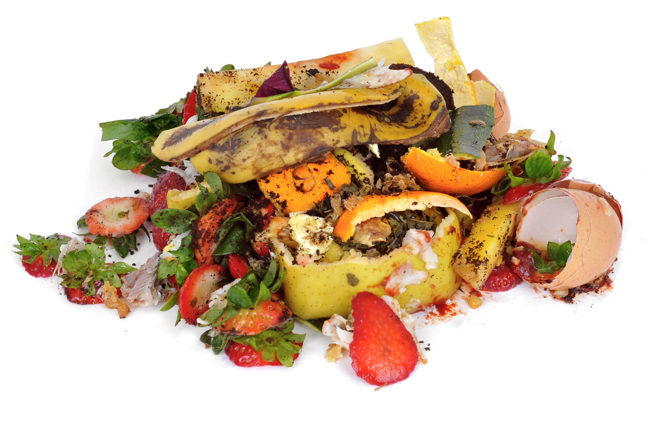

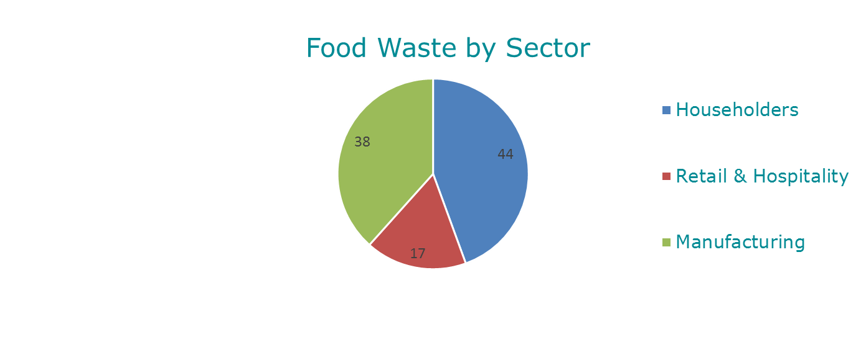
One third of food is wasted
In Scotland alone we’re wasting around 1.35 million tonnes of food and drink every year.
Notes:
56% of food waste generated by retail and manufacturing sectors is avoidable
75% of food waste generated by hospitality and food sector is avoidable
Household (solid and liquid waste) – 600,000 tonnes (44%)
Commercial and Industrial (solid waste only) – 740,000 tonnes (55%)
Of which…
Food and drink manufacturing – 510,000 tonnes (38%)
Other – 235,000 tonnes (17%)

Slide 19
Waste Prevention Implementation Fund
Result in evidenced implemented waste material, cost and carbon savings;
Be able to demonstrate that the project would not be viable without receiving the implementation funding;
Operate within the food, drink and construction sectors, however waste prevention initiatives in other sectors may be supported;
Demonstrate added value and impact and focus on the physical implementation of a proven waste prevention measure or measures, rather than identification of/or a feasibility study;
Have a payback period of up to 10 years or in the case of equipment purchase, within the lifespan of the equipment.
Who can apply? To be eligible, your organisation must be:
A small or medium sized enterprise according to the European Commission definition which means your enterprise will have fewer than 250 employees and a turnover below €50m;
An SME based in Scotland and it must be this location that benefits from the fund.

Slide 20
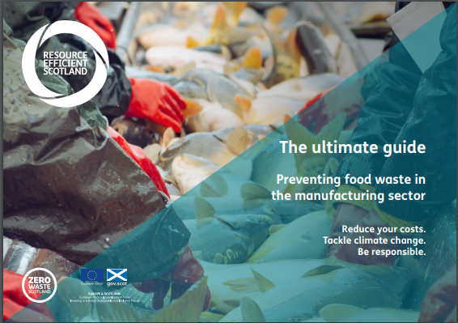
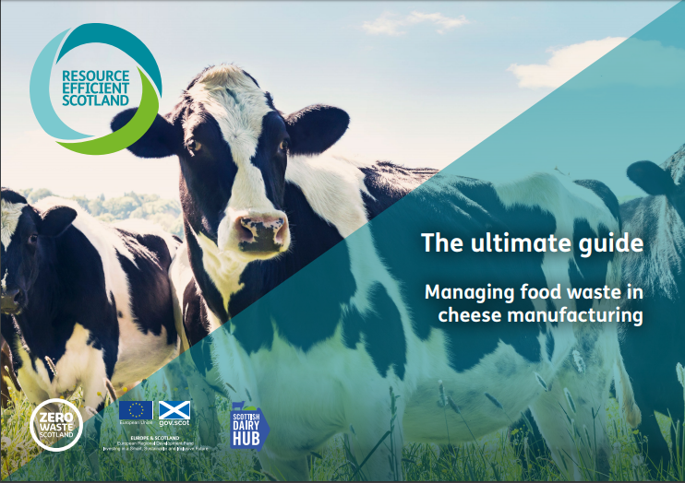
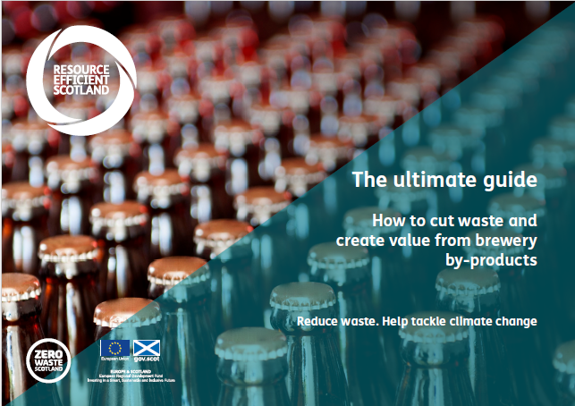
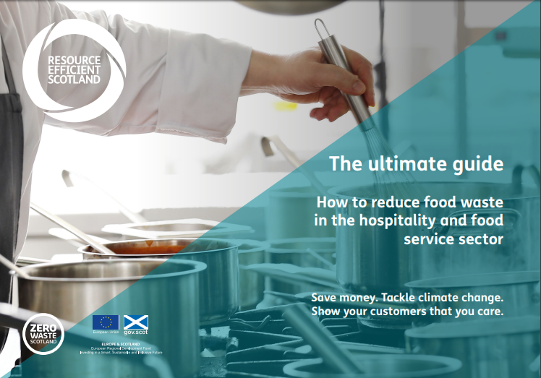
Guidance Documents

Slide 21

Good to Go
Encouraging customers to take home uneaten leftovers.
Visit Good to Go for a free doggy bag starter kit (300 boxes, stickers & bags).

Slide 22

Love Food Hate Waste employee workshops
Fun and interactive training workshops to help your employees understand how best to reduce waste, reuse and recycle at home
Reduce waste at work as they become more attuned to sustainable behaviour at home
A session takes between 1 to 2 hours for a minimum of 10 employees taking part

